Slide 1
Sports Injuries

Slide 2
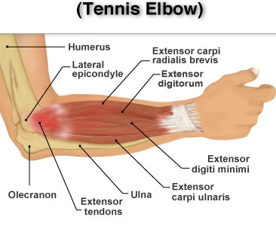
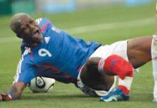
Types of injury
Acute
(fractures, dislocations, strains, sprains)
Chronic
(achilles tendonitis, stress fracture,‘tennis elbow’)

Slide 3
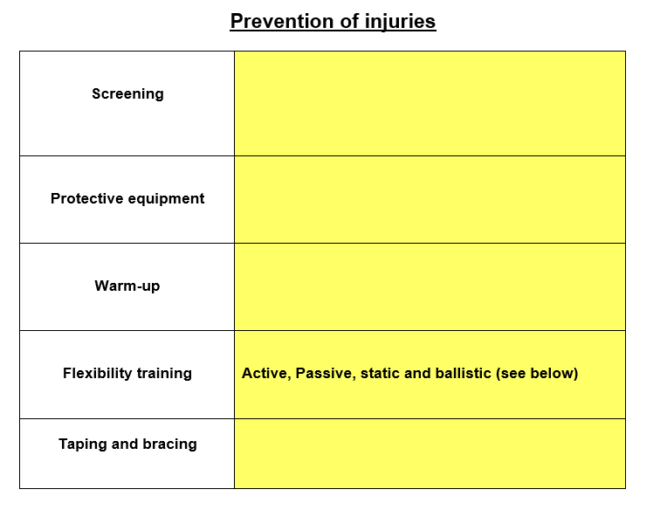
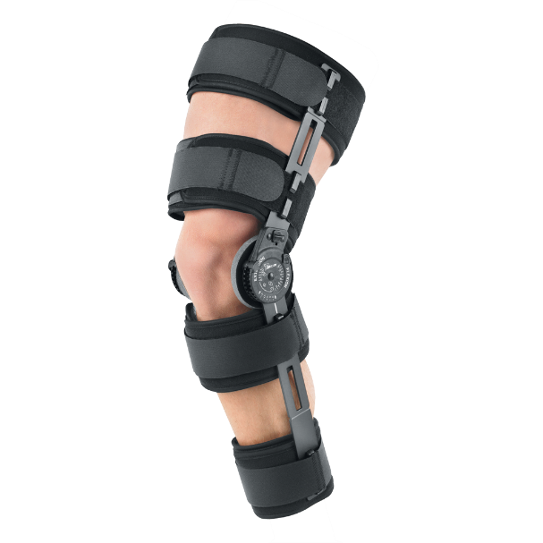
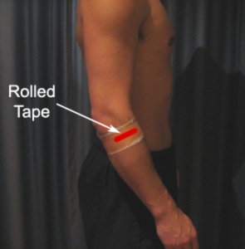
Testing/assessing muscle imbalances, core strength, range of joint movement, and postural alignment. If problems are detected then the appropriate training programme is used to correct the problem and reduce the injury risk.
E.g. shin pads, skull caps, post protectors, batting helmets, etc.
(pulse raiser and stretches)
Increases elasticity of muscles, improves blood flow, and improves psychological readiness and responses
Increase joint range of motion and reduces resistance to movement
Taping can help with support and stability e.g. taping
for tennis elbow. Bracing is more substantial and prevents
further injury after an operation

Slide 4
Physiological Adaptations to Flexibility Training
Prevention of injuries
Adaptations result in:
Increased joint range of movement (ROM) prevents over-stretch injuries e.g. hamstring tears
Decreased resistance to joint movement.
Changes to skeletal muscle
Increased resting length of the muscles
Changes to connective tissue.
Increased resting length of the tendons and ligaments.

Slide 5
Step 1
13
Ex Phys
Here, the individual performs a passive stretch with the help of a partner and extends the leg until tension is felt.
This stretch is detected by the muscle spindles. If the muscle is being stretched too far then a stretch reflex should occur.

Slide 6
Step 2
13
Ex Phys
The individual then isometrically contracts the muscle for at least 10 seconds (by pushing their leg against their partner).
Golgi tendon organs are also sensitive to tension developed in a muscle and during an isometric contraction send an inhibitory signal which overrides the excitory signal from the muscle spindle and inhibits the stretch reflex.

Slide 7
Step 3
13
Ex Phys
There is further relaxation of the target muscle as a result and it can be stretched further (increased ROM).

Slide 8
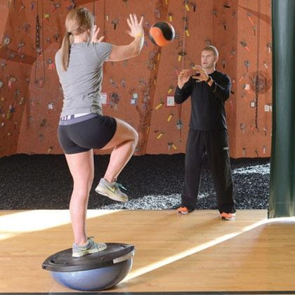
How/why do we train it? = using balance exercises to restore lost proprioception after a joint injury e.g. ankle sprain
What is Proprioception? subconscious process using a system of receptor nerves (proprioceptors) located in the muscle, tendons and joints to provide information about the body’s position.

Slide 9
Strength training for rehabilitation
https://www.youtube.com/watch?v=OsRKIEWLjr8

Slide 10
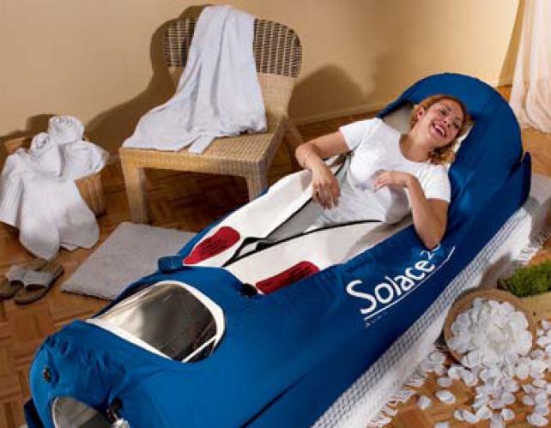
Hyperbaric chambers
How does it work?
The chamber is pressurised
This increases the amount of O2 that can be breathed in
Haemoglobin is fully saturated with O2
More oxygen can be diffused to injured area
Effects?
Reduces swelling
Formation of new blood cells
Increases white cell activity at injured site
http://www.youtube.com/watch?v=j5TpSj3_Ggg

Slide 11
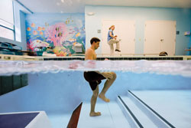
Hydrotherapy
How does it work?
Takes place in warm water to aid circulation
Squats, lunges, walking and running in water
Buoyancy of water supports body weight
Reduces load and impact on joints
Effects?
Exercising against the resistance allows for gradual strengthening of the injured area.
Allows more movement than is permitted on land
Improves blood circulation, relieves pain and relaxes muscles.

Slide 12
Ice baths
How does it work?
After high intensity/ impact work
Done for 5 – 10 minutes -usually broken up into ‘hot and cold’ sessions (2 mins ‘hot’ followed by 1 min in cold bath)
Cold water causes the blood vessels to constrict and this drains the blood out of the legs
On leaving the bath, muscles fill up with new oxygenated blood helping the cells function better
Effects?
Aids in removal (‘flushing out’) of lactic acid from muscles
Reducing soreness (DOMS)
Can be unpleasant at the time
http://www.youtube.com/watch?v=-VIi0deVWGo

Slide 13
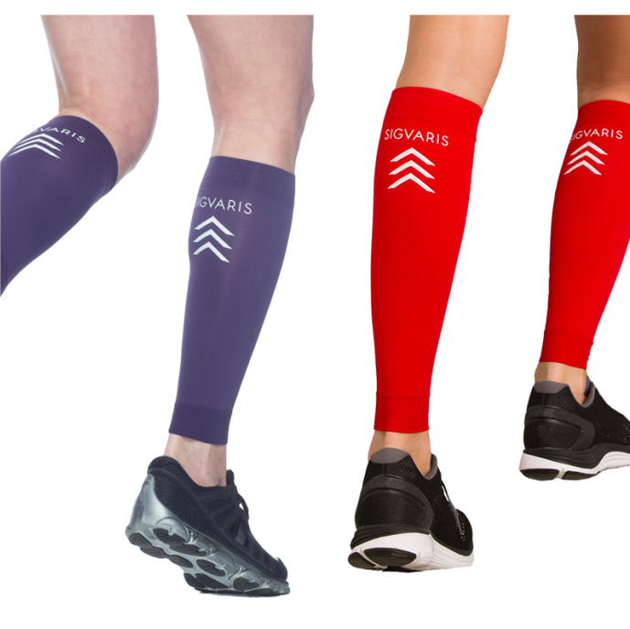
Compression garments
How does it work?
Medical grade compression garments worn
Apply external pressure to squeeze muscles and blood vessels during exercise
Effects?
Improve blood circulation – assist venous blood flow
Assists blood lactate removal
Reduce DOMS

Slide 14
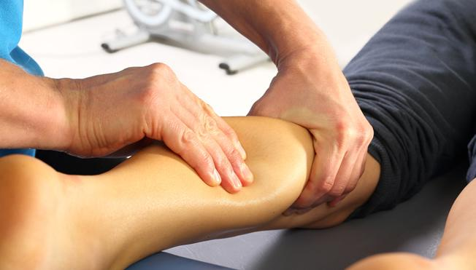
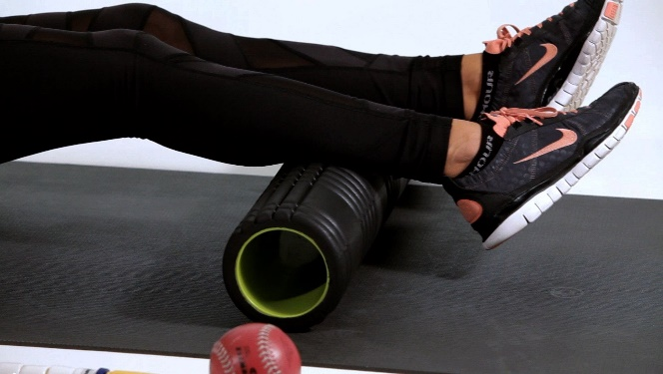
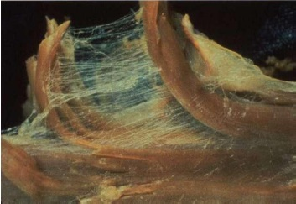
Massage & Foam Rolling
Release tension & tightness in the muscle (myofascial release) so improves joint mobility
Speed up removal of waste products like lactic acid
Breaks down scar tissue caused by tissue damage
Increased blood flow speeds up delivery of nutrients for repair of tissues
Fascia connecting individual muscle fibres.

Slide 15
DOMS (Delayed Onset of Muscle Soreness)
Occurs due to the structural damage to muscle fibres and connective tissue surrounding the fibres.
Occurs 24-48 hours following excessive eccentric contraction when muscle fibres are put under a lot of strain.
This type of muscular contraction is performed mostly during weight training and plyometrics.
A thorough warm-up and cool-down can help to avoid / reduce DOMS.
DOMS can also be reduced by minimising eccentric muscle contractions early in the session and ensure training intensity is increased gradually.
Ice baths and massage can also be used.

Slide 16
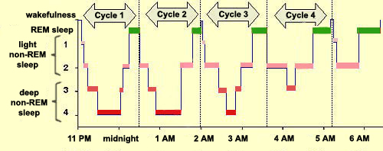
Importance of Sleep for Recovery
During sleep, rebuilding of damage to muscles occurs
Most of the re-building occurs in during deep sleep
The deepest part of sleep is the third stage of non-REM sleep
The deepest part of sleep is the third stage of non-REM sleep where brain waves are at their slowest and blood flows from the brain to the muscles to restore.
If sleep is too short then time for muscle repair is limited.

Slide 17
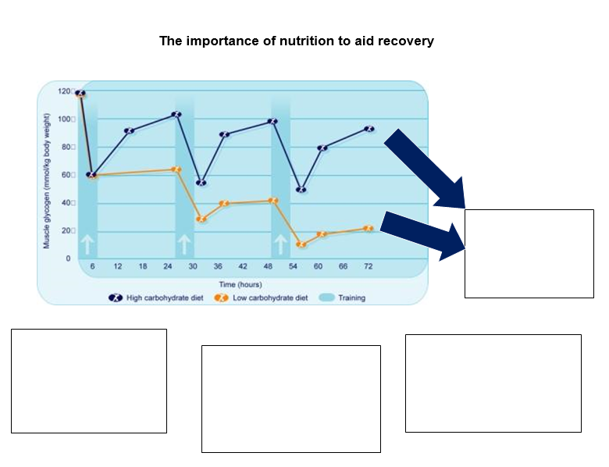
Muscle glycogen stores are depleted during training and need to be replenished after
Eating glycogen in the first 20-minutes after exercise enhances performance the next day
Liquid can be absorbed much more quickly that solids and also helps to rehydrate.
Consume 4:1 ratio of carbohydrate to protein (e.g. Sardines on toast or chocolate milk) as protein helps with re-synthesis of glycogen

Slide 18
Re-cap quiz
Hyperbaric chambers increase the pressure of O2 at the injury site. Why does this benefit the rehabilitation of the injured area? [2]
Reduces swelling at site
Raises activity of white cells
Define and give an example of a chronic sports injury [2]
long-term/over-training/over-use/repetitive strain injury
E.g. tennis elbow/ stress fracture/or equiv
How are ice baths beneficial to a Rugby player’s recovery from playing? [3]
Constriction of veins/blood vessels/muscle pump
Recover faster/faster removal of waste products e.g. lactic acid
Reduction of DOMS/reduces inflammation/swelling/pain
Allows them to train more frequently
How can a performer be rehabilitated from a soft tissue injury such as a muscle strain? [4]
Short term:
R – rest
I – Ice
C – Compression / comfort
E – Elevation
Long term:
Massage
Strength training/ conditioning
Flexibility training/ stretching/ PNF
Cryotherapy
Proprioceptive training

