Slide 1
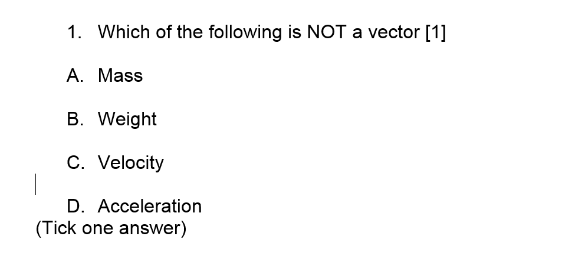

Slide 2
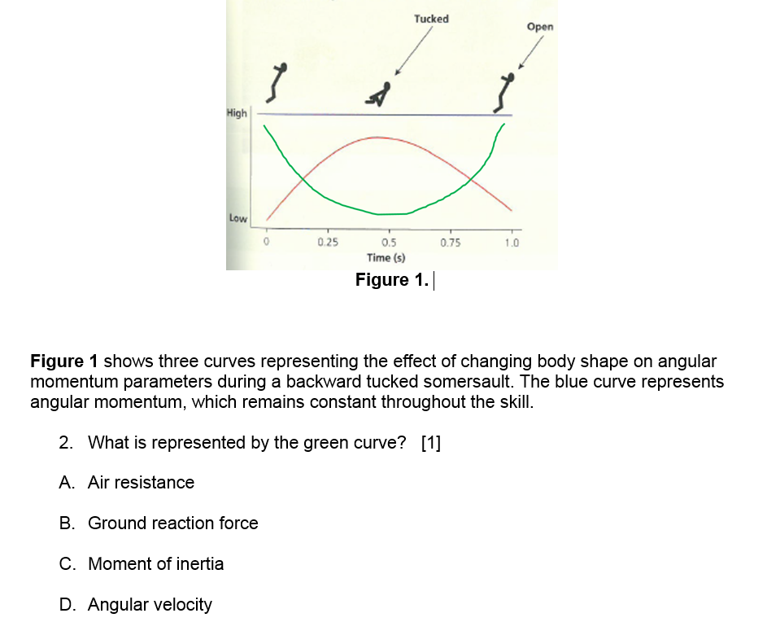
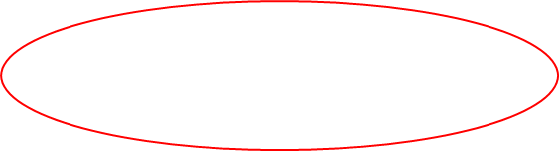

Slide 3
3 marks from:
Drag reduction | How the swimmer achieves it
Streamlining/ reduce shape drag [1] | Straight arms/ thinner or narrower arm action/ compression panels in swim suit to squeeze body in/ by wearing a tight swimming cap to keep hair against head/ or equiv [1]
Reduce surface drag/ reduce friction [1] | Shave hairs off arms and legs/Wear swim suit with smooth material/Wear swim cap/ or equiv [1]

Slide 4
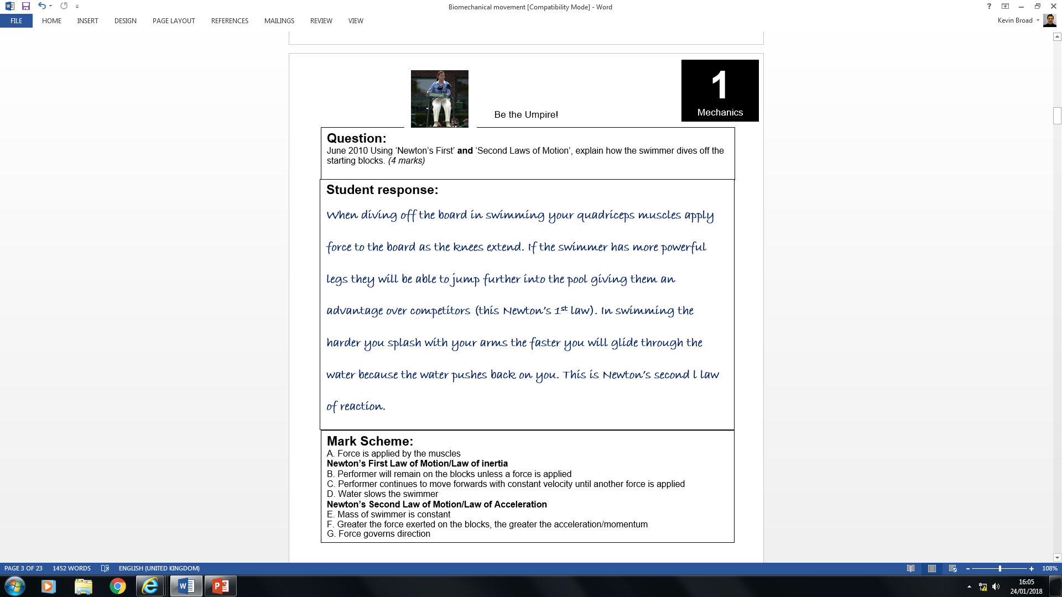

Slide 5
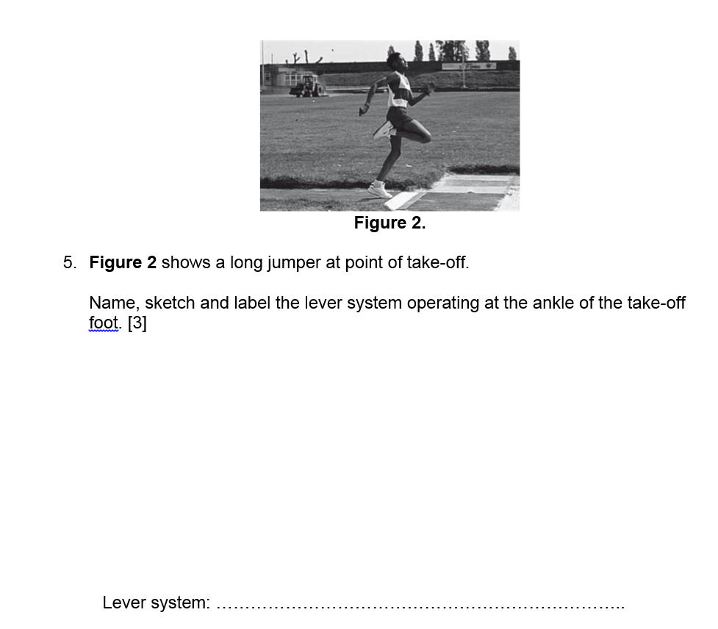
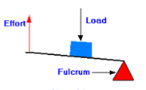
Effort, Load and Fulcrum in the right order [1]
Effort and load arrows in the right direction [1]
2nd Class [1]

Slide 6
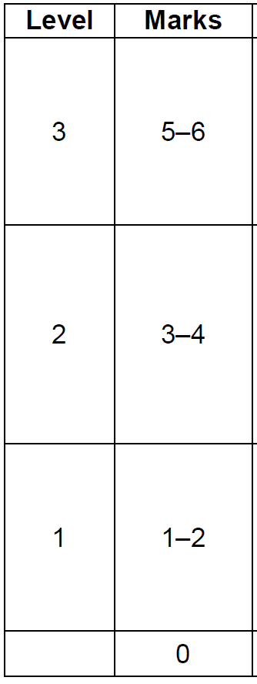
Discus is another athletic event. Explain how altering the angle of attack will affect fluid dynamics and the distance travelled by a discus. [6]
AO1
Fluid dynamic forces – affect gases and liquids
Lift = a force which makes an object travel perpendicular to the direction of motion
Drag = a force which acts in opposition to motion e.g. air resistance
AO2
With a high angle of attack
= the discus will not travel as far/stall
Less lift production and more drag
With optimal angle of attack = The discus will travel further
Due to maximal lift production
With a low angle of attack
=The discus will not travel as far
Less lift production
AO3
• As a result, air begins to flow less smoothly/quickly over the top of the discus (1).
• Meaning that air flow over the top of the discus becomes more and more separated (1).
Shape drag/air resistance
• As a result, air begins to flow more quickly over the top of the discus (1).
• Meaning that a pressure difference is created between the upper side and under side/ lower pressure above discus (1).
Bernoulli principle
Optimal angle = 25 – 40 degrees
Little/no lift created because no pressure gradient between upper and lower surfaces
Velocity/acceleration of air above is equal to/similar to air molecules below discus
Drag/air resistance is low

Slide 7
Explain how the gymnast can alter speed of rotation during flight [8]
AO1 – 2 marks
Rotation = angular motion/movement of a body around a fixed point or axis
Rotation is caused by force applied outside the body’s centre of mass e.g. piking at the hips at take-off
This is also known as a torque force or moment
Speed of rotation = angular velocity or rate of change of angular displacement (rad/s)
AO2 – 3 marks
AO3 – 3 marks
Analysis
Tucking body results in reduced moment of inertia
Extending body increases moment of inertia
Change in moment of inertia leads to a change of angular velocity/speed/spin of rotation/ angular moment;
D. Angular momentum remains constant (during rotation)
D. This is Newton’s 1st law (momentum remains constant unless an external torque force is applied)
E. Angular momentum = moment of inertia x angular velocity
F. Angular velocity = speed of rotation
G. Moment of inertia = reluctance of the body to move
H. Moment of inertia related to the spread/distribution of mass around axis
Changing the shape of the gymnast’s body causes a change in speed of rotation
Gymnast can increase speed of rotation by tucking body/bringing arms towards rotational axis
Gymnast slows down rotation by extending body/opening out/or equivalent
Accept other relevant explanations/ analysis

