Slide 1
1
Biomechanics
Biomechanics

Slide 2

Newton’s First Law
Law of Inertia

Slide 3
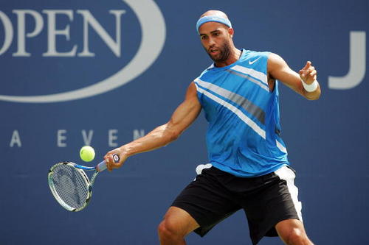
Newton’s Second Law
Law of Acceleration

Slide 4
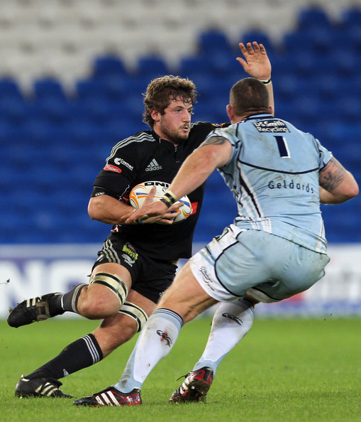
Newton’s Third Law
Law of Reaction

Slide 5
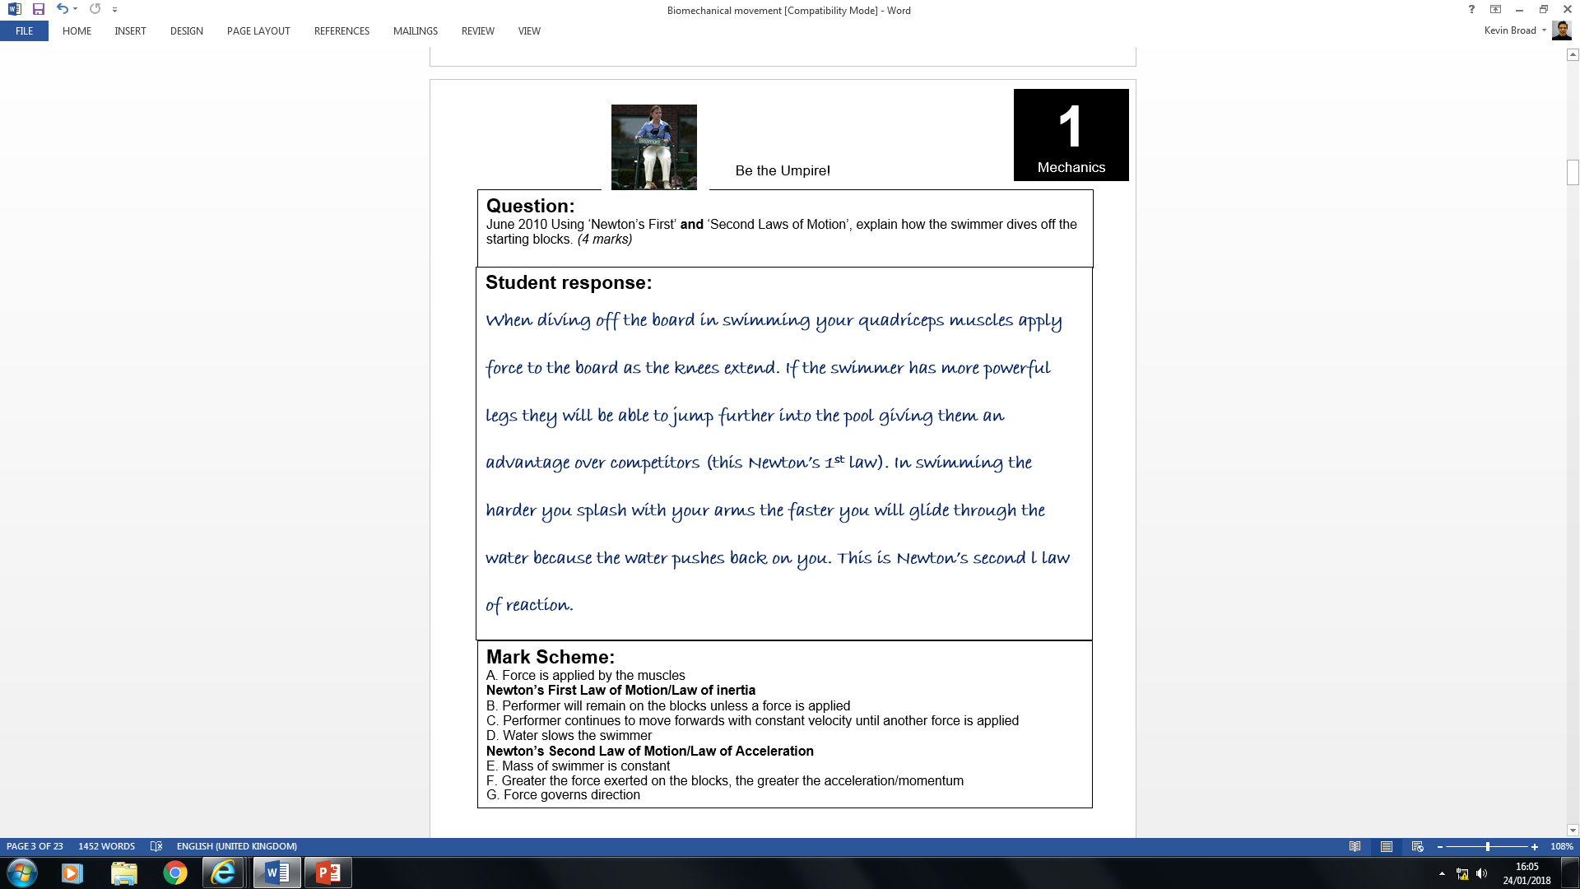

A
No mark - (2nd law not 1st law)
No mark - not relevant to dive off blocks
1

Slide 6
Force
Force = a push or a pull. Forces can cause a resting body to move or a moving body to stop, slow down, speed up or change direction.
Factors affecting forces:
Size of force
Direct force application
Eccentric force application

Slide 7

Explain how the application of force to a ball affects the type of motion produced.
Linear
u l a
g r
n
a
COM
COM
Application of force
(Racket)
Application of force
Racket
D_ _ E_T FORCE
E_C_NT_I_ FORCE

Slide 8
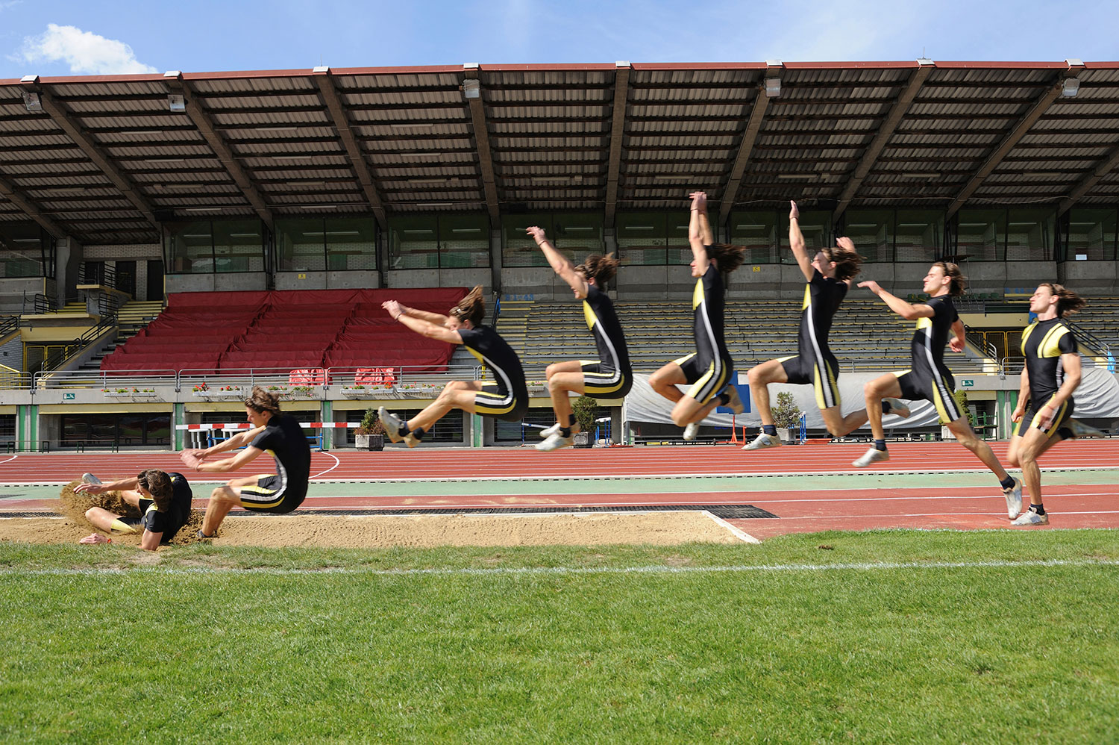
Centre of mass = the point around which the mass of a body is equally distributed.

Slide 9
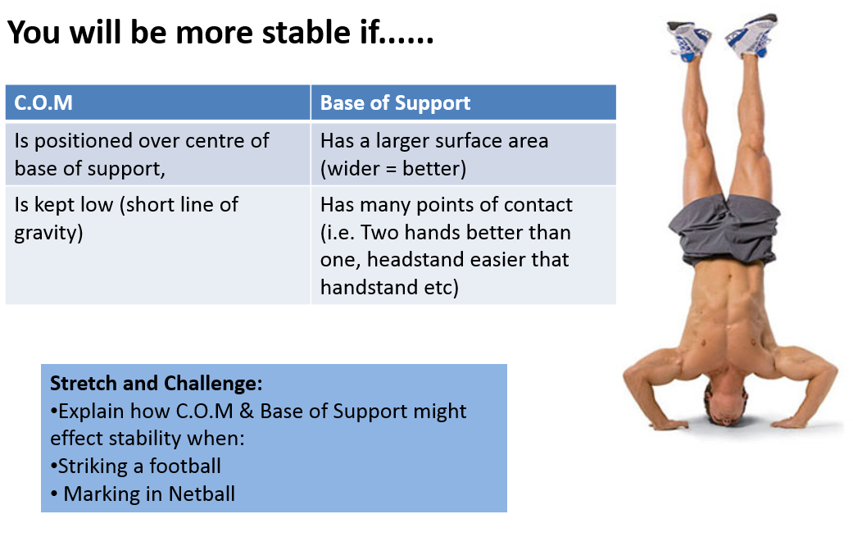
Centre of mass & Stability

Slide 10
Mass
VECTORS – SIZE + DIRECTION
SCALARS – SIZE ONLY
Weight
= The force on a given mass due to gravity
= The physical amount of matter in a body
Measured in Newtons
Measured in kilograms
Your mass can be measured indirectly by your weight
W = mg, where g = 9.81 m/s² is acceleration due to gravity

Slide 11
Distance
VECTORS – SIZE + DIRECTION
SCALARS – SIZE ONLY
Displacement
= The distance between the start and finish points of a motion path
= The physical length of the path a body follows
Measured in metres
Measured in metres

Slide 12
Speed
VECTORS – SIZE + DIRECTION
SCALARS – SIZE ONLY
Velocity
= the rate of change of position with reference to direction.
= the rate of change of position.
Measured in metres per second
Measured in metres per second
Calculated as: displacement (m)
time taken (s)
Calculated as: distance covered (m)
time taken (s)

Slide 13
Inertia
SCALARS – SIZE ONLY
= the resistance an object has to a change in its state of motion. The bigger the mass the larger the inertia of the body or object.
Therefore mass can be considered to be the measure of inertia.

Slide 14
VECTORS – SIZE + DIRECTION
Acceleration
= the rate of increase in velocity.
Acceleration occurs when velocity increases.
-1
acceleration: change in velocity (ms )
time taken (s)

Slide 15
VECTORS – SIZE + DIRECTION
Deceleration
= the rate of decrease in velocity.
Deceleration occurs when velocity decreases.
-1
deceleration: change in velocity (ms )
time taken (s)

Slide 16
VECTORS – SIZE + DIRECTION
Momentum
= the product of the mass and velocity of an object.
Momentum is measured in kg.m/s.
-1
Momentum = Mass (kg) x velocity (ms )

Slide 17
Vector diagrams
https://www.youtube.com/watch?v=h7UVXzgU0vU

Slide 18
Re-cap quiz
Identify 3 vectors [3]
Give a definition for each [3]
Identify 3 scalars [3]
Give a definition for each [3]

Slide 19
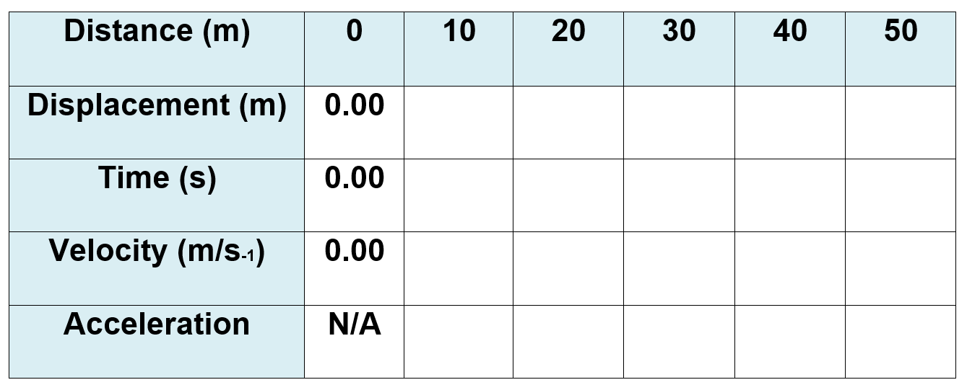
50m Sprint practical
10
10
10
10
10
1.8
2.9
4.2
5.6
6.6
10/1.8 =
5.6 m/s
10/1.1 =
9.0 m/s
10/1.3 =
7.6 m/s
10/1.4 =
7.1 m/s
10/1.0 =
10 m/s
5.6 – 0.00 / 1.8 =
3.1 m/s
9.0 - 5.6 / 1.1=
3.0 m/s
7.6 - 9.0 / 1.3=
-1.0 m/s
7.1 - 7.6 / 1.4=
-0.4 m/s
10 - 7.1 / 1.0=
2.9 m/s
Final velocity – initial velocity
time

Slide 20
Impulse
The product of the average magnitude of a force acting on a body and the time for which that force acts.
Impulse (Newton seconds/ Ns) = Force x time
We generate a large force when jumping for a rebound in basketball
We can increase the time for which force is applied e.g. three to four turns used in hammer throw as opposed to a single swing.

Slide 21
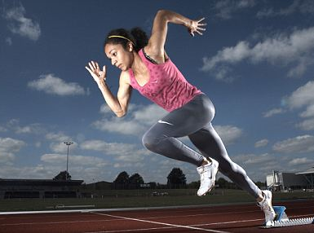
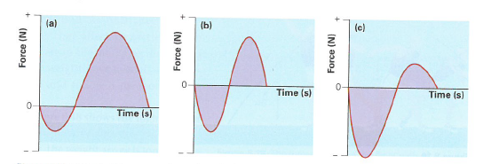
Impulse in sprinting
Net impulse = combination of positive and negative impulses.
The net impulse is positive so that the sprinter can accelerate.
The positive impulses (upward and forward) are more forceful and last longer than the negative impulses.

Slide 22
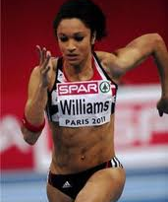
Impulse in sprinting
Net impulse = combination of positive and negative impulses.
The net impulse is zero meaning that there is no acceleration or deceleration and the sprinter is moving at a constant velocity.
The positive and negative impulses are equal – they are the same force and last for the same amount of time.

Slide 23
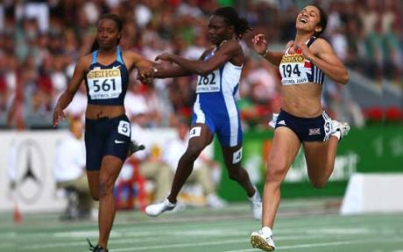
Impulse in sprinting
Net impulse = combination of positive and negative impulses.
The net impulse is negative meaning the sprinter will decelerate.
The negative impulses (downwards) are more forceful and last longer than the positive impulses.
See 17.35 – 21.30 in the following clip:
https://www.youtube.com/watch?v=rqMkOA7WZr8

Slide 24
Re-cap quiz
Explain Newton’s 3 Laws [3]
Use an example to show how each law can be used to improve performance in sport [3]
Define the term angular motion and use an example to explain its use in sport. [3]
What is meant by moment of inertia? How and why
would a gymnast reduce their body’s moment of
inertia? [3]

Slide 25
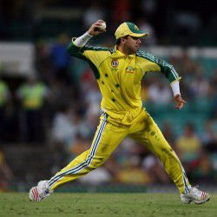
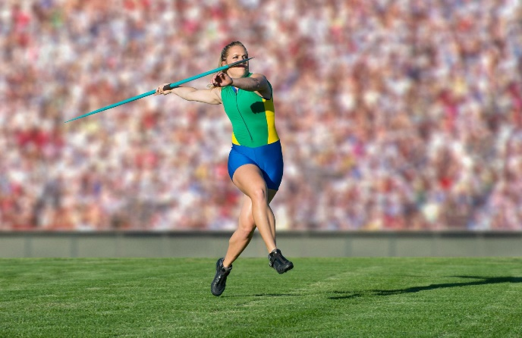
Factors affecting parabolic flight
Angle of release | Height of release | Velocity of release
Optimum angle of release is dependent upon release height and landing height.
If release height and landing height are equal then the optimum angle of release is 45 degrees.
If the release height is greater than the landing height the optimum angle of release is less than 45 degrees.
The greater the height of release the greater the horizontal distance.
The greater the release velocity of the projectile the greater the horizontal distance it can travel.

Slide 26
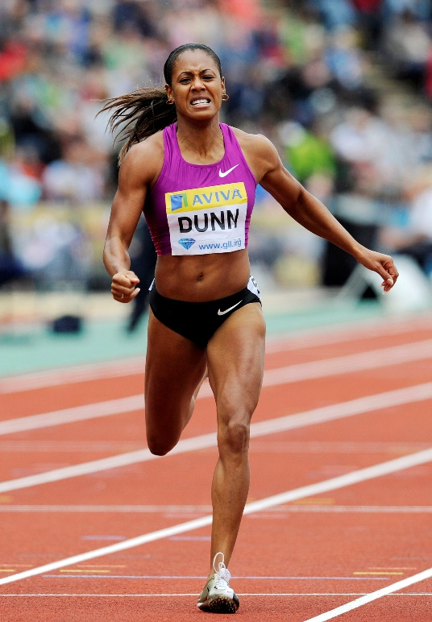
Revision – Newton’s
Laws of motion
4
Biomechanics
Mark Scheme:
A. Force is applied by the muscles
Newton’s First Law of Motion/Law of inertia
B. Sprinter continues to move forwards with constant velocity until another force is applied
Newton’s Second Law of Motion/Law of Acceleration
C. Mass of performer is constant
D. Greater the muscular force exerted, the greater the acceleration/momentum
E. Force governs direction
Newton’s third law of motion / Law of Reaction
F. Ground pushes in opposition/reaction to muscular force applied/ Ground reaction force

Slide 27
Angular motion
4
Biomechanics
= Movement around a fixed point or axis.
Moments of force or Torque
Torque (often called the moment) can be described as a rotational force.
Torque = force (N) x perpendicular distance from
(Newton the fulcrum (metres)
metres)

Slide 28
4
Biomechanics
 | Linear motion (Straight line) | Angular motion (in a circle around a fixed point or axis)
Newton’s 1st law
Newton’s 2nd law
Newton’s 3rd law
A body will continue in its state of rest or uniform velocity unless acted upon by an external force
A rotating body will continue to turn about its axis of rotation with consistent angular momentum unless an external rotational force (torque) is exerted upon it.
The acceleration of an object is directly proportional to the force applied and takes place in the direction in which the force is applied.
The rate of change of angular momentum of a body is proportional to the force (torque) causing it and the change that takes place occurs in the direction in which the force (torque) acts.
Every action has an equal and opposite reaction
When a torque force is applied by one body to another, the second body will exert an equal and opposite force (torque) on the other body.

Slide 29
VECTORS – SIZE + DIRECTION
SCALARS – SIZE ONLY
Angular displacement
= The change in angle between the start and finish point of a rotation
Measured in radians
1 radian = 57.3 degrees

Slide 30
VECTORS – SIZE + DIRECTION
SCALARS – SIZE ONLY
Angular velocity
= The rate of change of angular displacement
Measured in radians per second
Angular velocity = Angular displacement(rad)
(rad/s) time taken (s)

Slide 31
VECTORS – SIZE + DIRECTION
SCALARS – SIZE ONLY
Angular acceleration
= The rate of change of angular velocity
2
Measured in radians per second
Angular acceleration = change in angular velocity
(rad/s ) time taken (s)
2

Slide 32
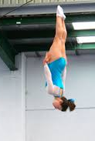
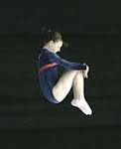
Moment of inertia
= Resistance of a body to angular motion (rotation)
The moment of inertia will be smaller….
The smaller the mass of the body
The closer the mass is from the axis of rotation
So flexing the arms and legs reduces the moment of inertia.
This will make rotation easier
The moment of inertia will be higher….
The greater the mass of the body
The further the mass is from the axis of rotation
So straightening the arms and legs increases the moment of inertia.
This will make rotation harder.

Slide 33
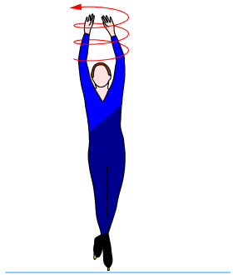
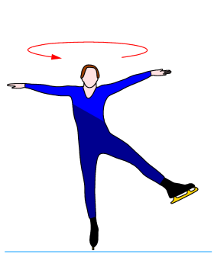
Angular momentum
= moment of inertia x angular velocity.
It is a conserved quantity i.e. it stays the same unless an external torque acts
At start of spin arms and legs are stretched out.
Skater brings arms and legs back in line with body.
This increases their distance from the axis of rotation.
The distance of these body parts to the axis of rotation decreases.
Results in a large moment of inertia (so spin is slower)
This reduces the moment of inertia so that angular momentum can increase (spin faster).

Slide 34
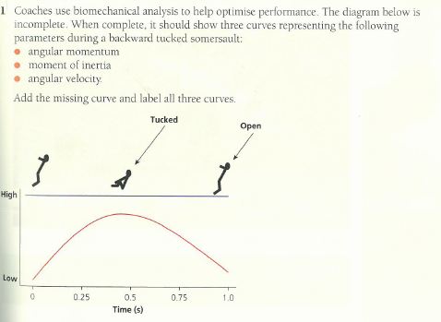
Angular momentum
Moment of inertia
Angular velocity

Slide 35
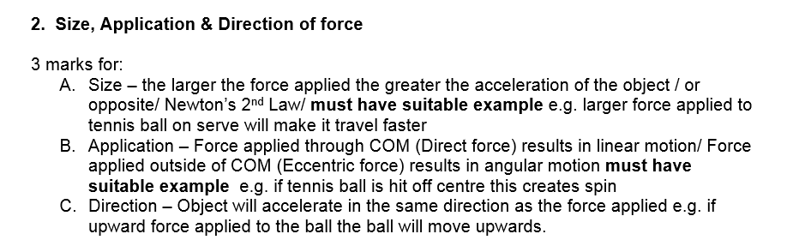

Slide 36
Timed essay: Explain how the gymnast can alter speed of rotation during flight [8]
AO1 – 2 marks
Rotation = angular motion/movement of a body around a fixed point or axis
Rotation is caused by force applied outside the body’s centre of mass e.g. piking at the hips at take-off
This is also known as a torque force or moment
Speed of rotation = angular velocity or rate of change of angular displacement (rad/s)
AO2 – 3 marks
AO3 – 3 marks
Analysis
Tucking body results in reduced moment of inertia
Extending body increases moment of inertia
Change in moment of inertia leads to a change of angular velocity/speed/spin of rotation/ angular moment;
D. Angular momentum remains constant (during rotation)
D. This is Newton’s 1st law (momentum remains constant unless an external torque force is applied)
E. Angular momentum = moment of inertia x angular velocity
F. Angular velocity = speed of rotation
G. Moment of inertia = reluctance of the body to move
H. Moment of inertia related to the spread/distribution of mass around axis
Changing the shape of the gymnast’s body causes a change in speed of rotation
Gymnast can increase speed of rotation by tucking body/bringing arms towards rotational axis
Gymnast slows down rotation by extending body/opening out/or equivalent
Accept other relevant explanations/ analysis

Slide 37
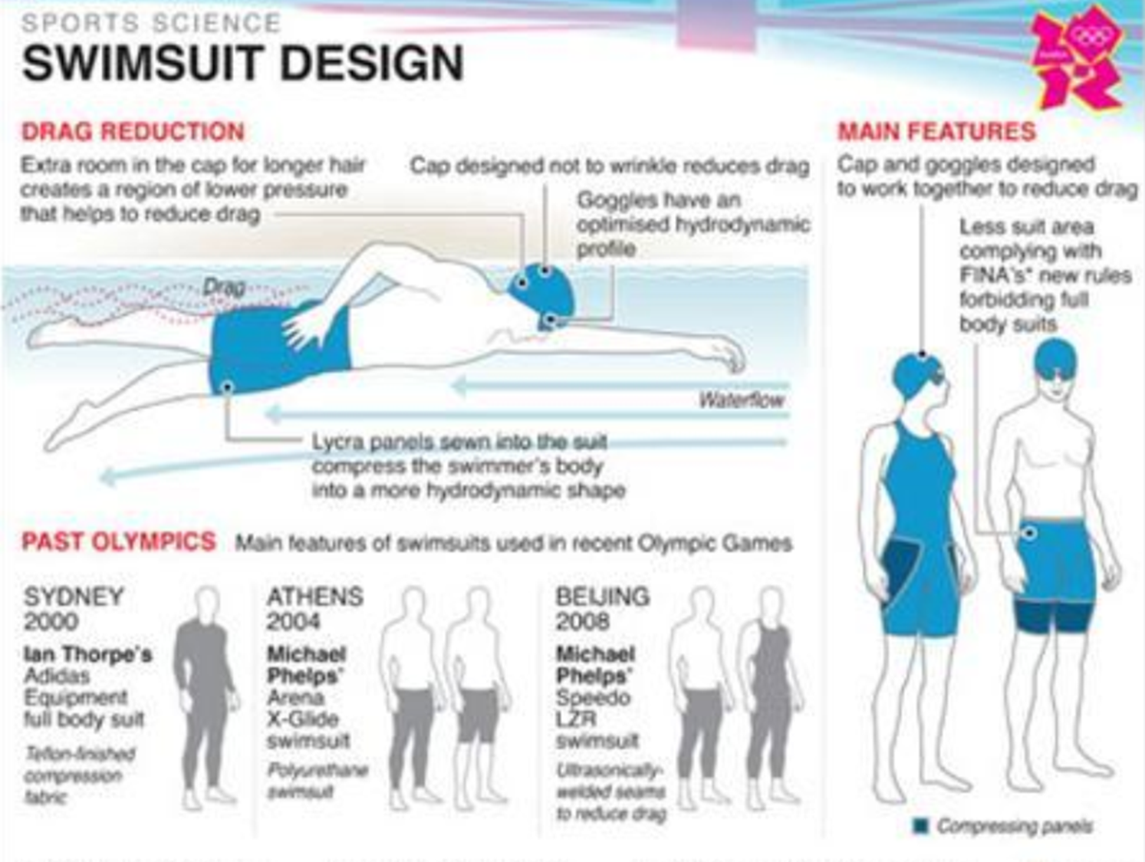
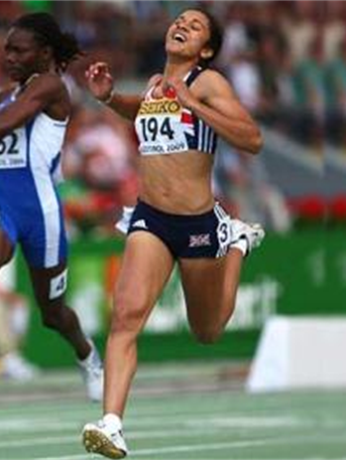
Fluid Mechanics
5
Biomechanics
Dynamic fluid force = a force which affects the flow of fluids or gases
Drag force =
A force which acts in apposition to motion e.g. Air resistance
Surface drag -
Caused by friction between the surface of an object and the fluid environment
Form drag -
The impact of the shape of the object on the fluid environment
Reduce surface drag by shaving body hair or wearing specialised smooth clothing
Reduce form drag by streamlining movements to create the thinnest and straightest form

Slide 38
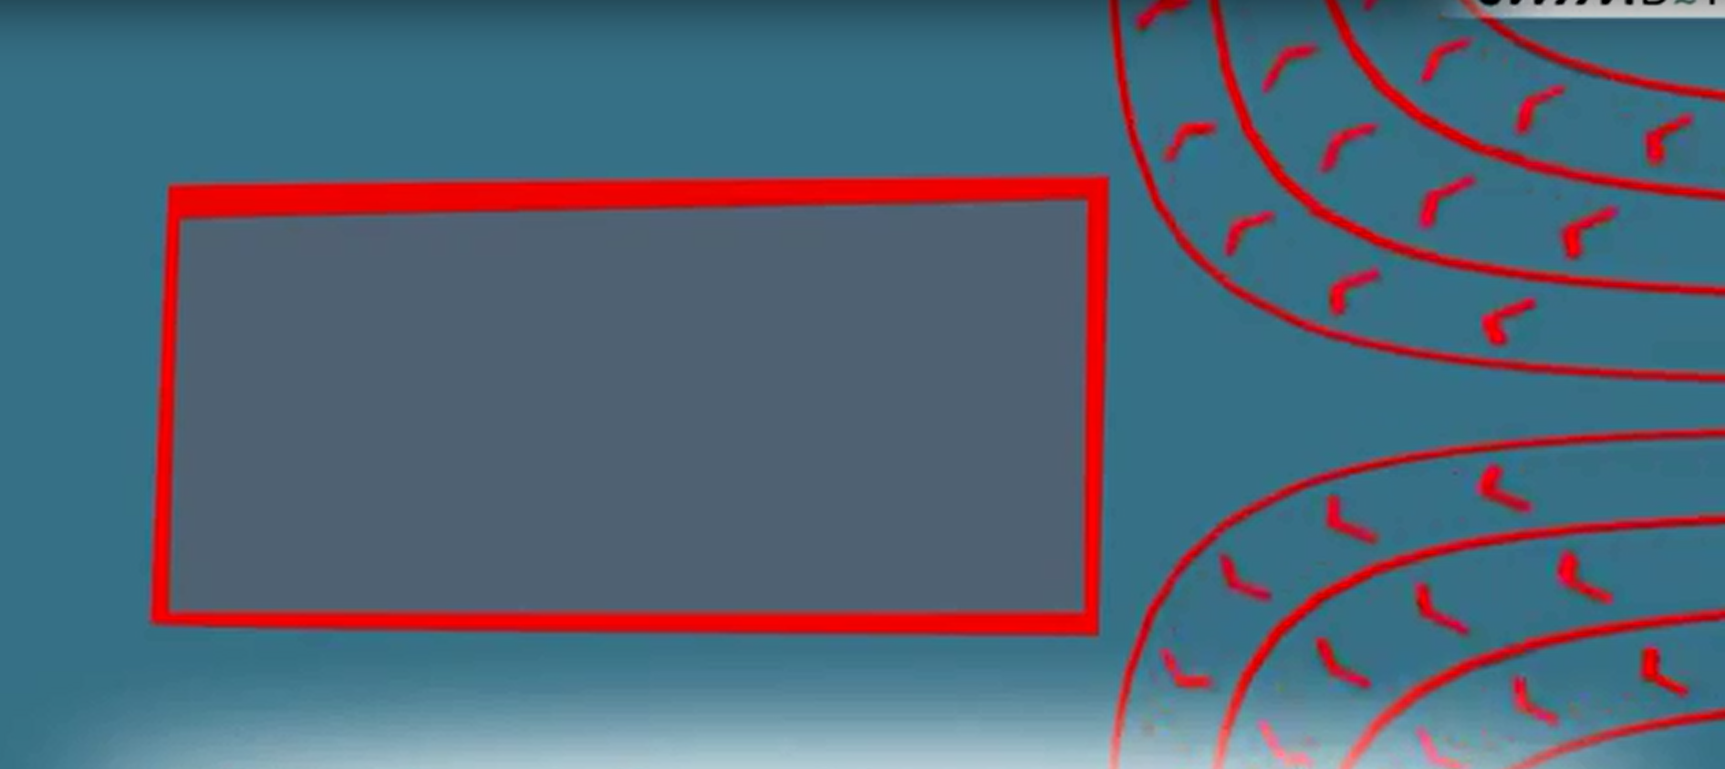
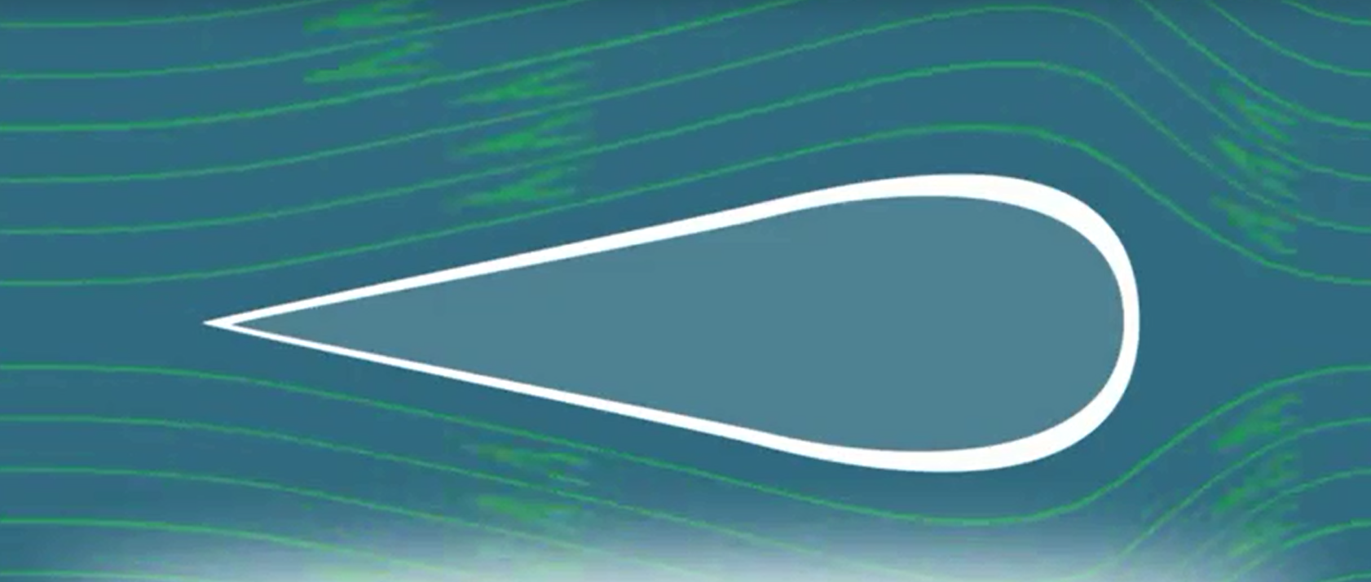
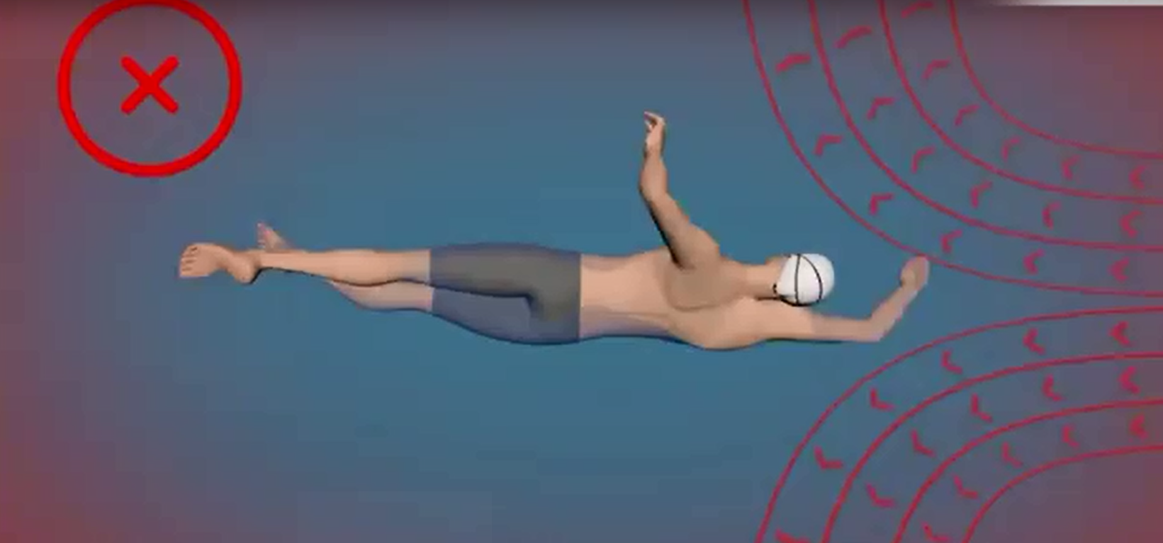
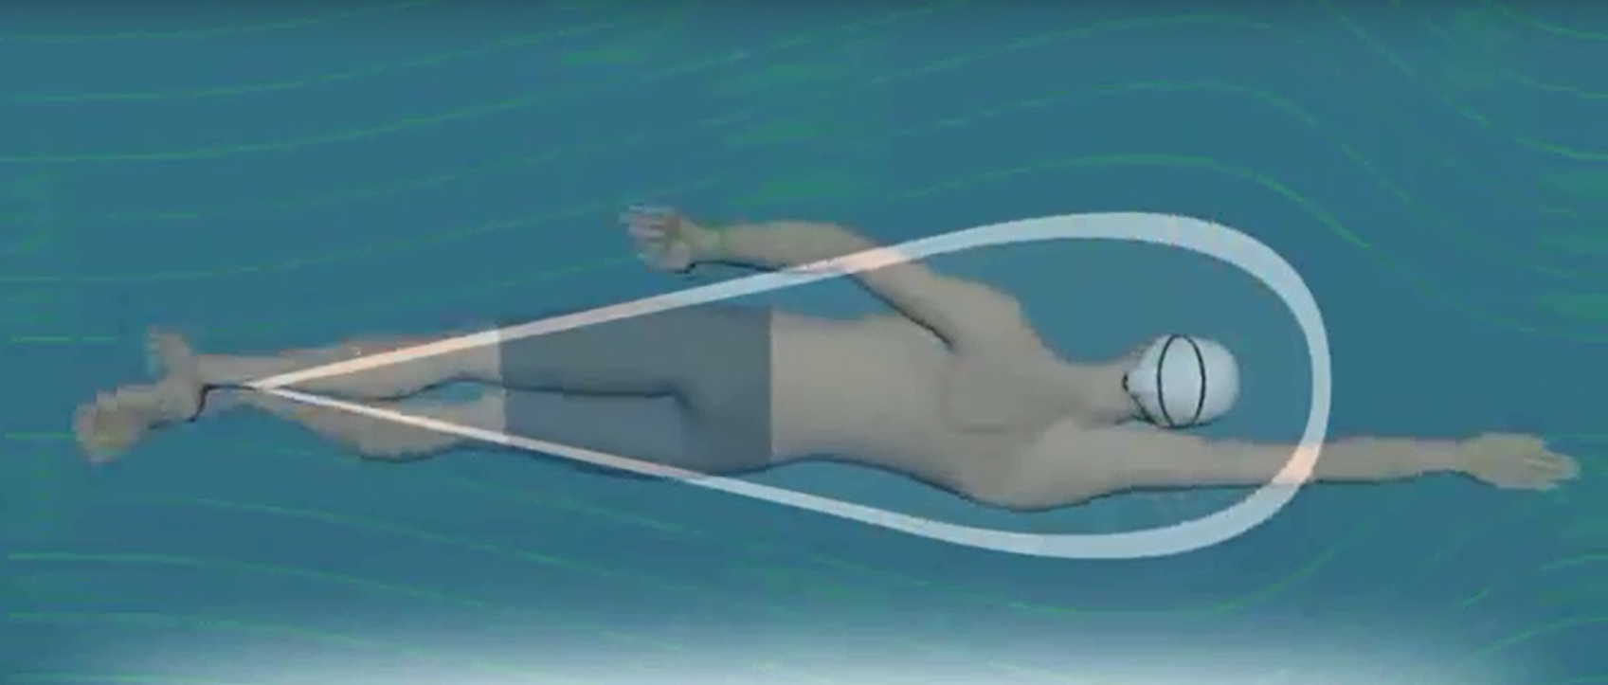
Thinner straighter body/ arm action
This is known as ‘streamlining’
Leads to reduced drag/force acting in opposition to the movement
This is shape drag/ form drag

Slide 39
Fluid Mechanics
5
Biomechanics
Dynamic fluid force = a force which affects the flow of fluids or gases
Drag force =
A force which acts in opposition to motion
Lift = a fluid force that causes
a body to move perpendicular
to the direction of travel
Form drag -
The impact of the shape of the object on the fluid environment
Reduce form drag by streamlining movements to create the thinnest and straightest form
Can be upward
e.g. Discus
Can be downward
e.g. cycling, speed skating, motor sport
Surface drag -
Caused by friction between the surface of an object and the fluid environment
Reduce surface drag by shaving body hair or wearing specialised smooth clothing
Lift occurs due to the Bernoulli principle which states:
Where air molecules exert less pressure the faster they travel and more pressure when they travel slower.
https://www.youtube.com/watch?v=9j22mIq9f-c
https://www.youtube.com/watch?v=sIrJOrTAJjg

Slide 40
Upward Lift of a Discus

Slide 41
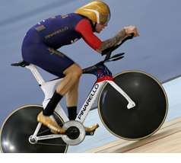
Timed essay: With reference to fluid dynamics, explain why Bradley Wiggins leans forward over the handle bars when cycling [8]
AO1 – 2 marks
Fluid dynamics affects gases or fluids/water
Drag = A force which acts in opposition to motion
Lift = a fluid force that causes
a body to move perpendicular
to the direction of travel
AO2 – 3 marks
AO3 – 3 marks
Analysis
Leaning forward/head down over the handle bars changes the shape of the cyclist’s body moving through the air/fluid
Resulting in a thinner/smaller shape moving through the air
This reduces shape drag (also known as ‘form drag’)
Leaning forward /head down over the handle bars reduces distance that air travels over the top of the body.
Greater velocity of air travelling under the cyclist/ Lesser velocity of air above cyclist
Results in lower air pressure below the cyclist / greater air pressure above the cyclist
Creates downward lift force
Drag
The cyclist experiences less (air) resistance to movement
Therefore travels faster/higher velocity than an upright position
‘Streamlining’ effect
The larger the shape results in greater drag
Lift
E. This is the Bernoulli principle (greater velocity of air = reduced air pressure)
G. This is an ‘inverted aerofoil’
H. Downward lift force results in greater force applied to track
Leading to greater Ground Reaction Force (GRF)/ Friction force
J. Therefore the cyclist accelerates/ velocity increases
J. This is Newton’s 2nd Law – greater external force = greater acceleration
K. Newtons 3rd law – every action has equal and opposite reaction (Lift force acts down, ground reaction force (GRF) acts upward
Accept other relevant explanations/ analysis

Slide 42
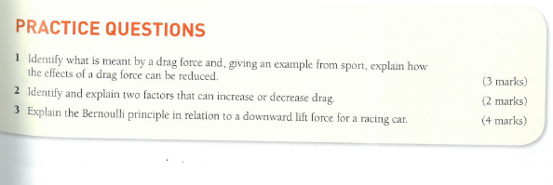

Slide 43
15-marker practice:
Figure 1
Figure 1 shows an elite cyclist in competition.
Evaluate the impact of fluid dynamic forces and sports technology on the elite cyclist [15]

Slide 44
Evaluate the impact of fluid dynamic forces and sports technology on the elite cyclist [15]
AO1 – 4 marks
Drag = A force which acts in opposition to motion
Lift = a fluid force that causes
a body to move perpendicular
to the direction of travel
Sports Technology:
Facilities, Equipment, Analytical tools (GPS, motion tracking, Metabolic Cart, Video analysis) , Clothing, Materials, Surfaces, vibration, electro-stimulation, Drugs & testing, supplements,
rehabilitation
AO2 – 5 marks
Application
AO3 – 6 marks
Evaluation/Analysis
Form drag acts on the shape/size of the cyclist’s body as it moves through the air.
Surface drag results from friction of the air particles travelling against the bike/cyclist
Cyclist creates downward lift by leaning forward over handle bars
Inverted aerofoil
lower air pressure below the cyclist / greater air pressure above the cyclist/ Bernoulli Principle
Clothing – Lightweight, smooth clothing material for cyclists, reduce surface drag by lowering friction
Equipment – cycling helmets aerodynamic shape =results in greater speed of air over top of cyclist, Greater downward lift
Materials – lightweight carbon bike frames require less muscular force, thinner shape of frames = less drag, greater acceleration,
Data analysis – GPS tracking, more immediacy & quality of feedback on performance
A. Drag negatively impacts on cycling performance
B. ‘Air resistance’
C. Decreases the velocity of cyclist/ slower race times
D. Downward lift positively impacts on cycling performance
E. More force exerted into ground/ track
F. Leading to greater Ground Reaction Force (GRF)/ Friction force/Newton’s 3rd law – opposition
G. Therefore the cyclist accelerates/ velocity increases/faster race times
H. This is Newton’s 2nd Law – greater external force = greater acceleration
+ enhanced quality of performance, race times, medals
+ more spectator interest e.g. records broken
+ Financial rewards, prize money,
+ Success leads to raised profile, celebrity
Expensive
Unfair advantage
Sport should be about ‘natural’ talent
More success brings more pressure, intrusion into private life
Technology can malfunction/data lost/unreliable/ invalid
Accept other relevant explanations/ analysis

