Slide 1
Unit 14 Section 2:
Lifestyle Assessment
Questionnaire & consultation

Slide 2
Targeted learning aims
Learning outcome 2
Be able to assess the lifestyle of a selected individual.

Slide 3
Introduction
To provide advice on lifestyle improvement and plan a related activity programme you must be able to assess the lifestyle of an individual
Using a questionnaire can assess the five lifestyle factors.

Slide 4
What is lifestyle?
Lifestyle Factors
Physical activity
Alcohol
Smoking
Diet
Stress levels

Slide 5
Why assess?
Collect information of clients strengths and areas of improvement
Helps to establish realistic goals
Helps to avoid injury
Testing initial fitness levels is a useful benchmark against which progress can be measured with continued testing providing motivating feedback.

Slide 6
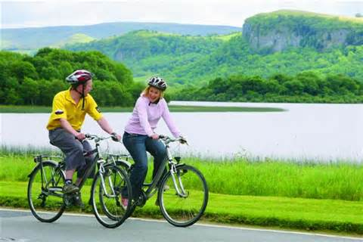
Levels of physical activity
How much do they do at present? Historical?
What kind of exercise?
Effort level?
Duration per week?
Strength activities?
http://2.bp.blogspot.com/-6_V47QJXIIY/T7lNk9Nf6_I/AAAAAAAAAYI/tfA5DpYHBzg/s1600/Cycling+.jpg

Slide 7
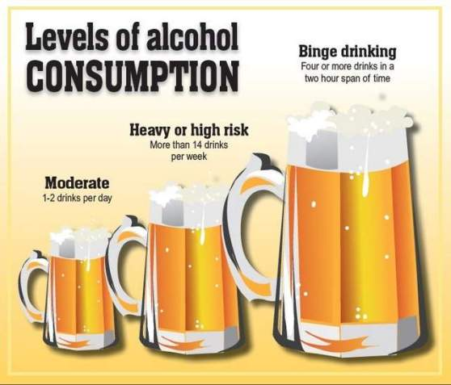
Alcohol consumption
Volume (units) per day / per week?
Frequency of consumption (how many days a week?)
http://www.blogs.va.gov/VAntage/wp-content/uploads/2013/06/Levels-of-alcohol-consumption-Photo-1-2.jpg

Slide 8
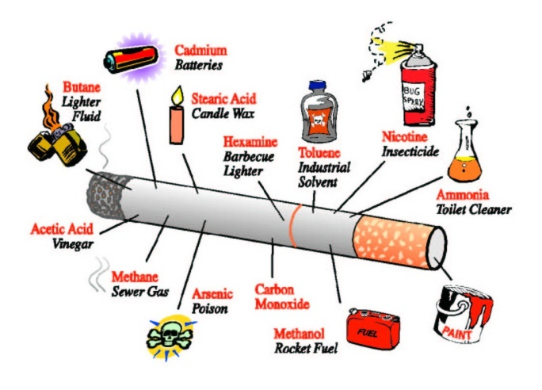
Smoking
Type of smoking? (cigarettes, cigars, pipe)
Duration of smoking? (number of years)
Volume? (amount per day)
If previous smoker find out previous habits.
http://www.altbehave.com/wp-content/uploads/2010/10/smokingcessation.jpg

Slide 9
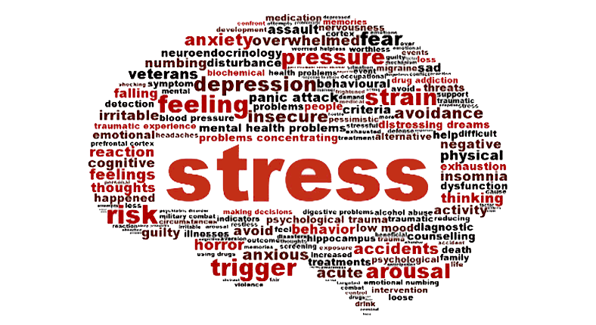
Stress levels
Major life events and recent changes in personal situation (e.g. marriage, divorce, bereavement, loss of job etc)
Recent health status
Eating habits
Sleep patterns
http://users2.unimi.it/fens_stress/images/Sl_StressBrain.png

Slide 10
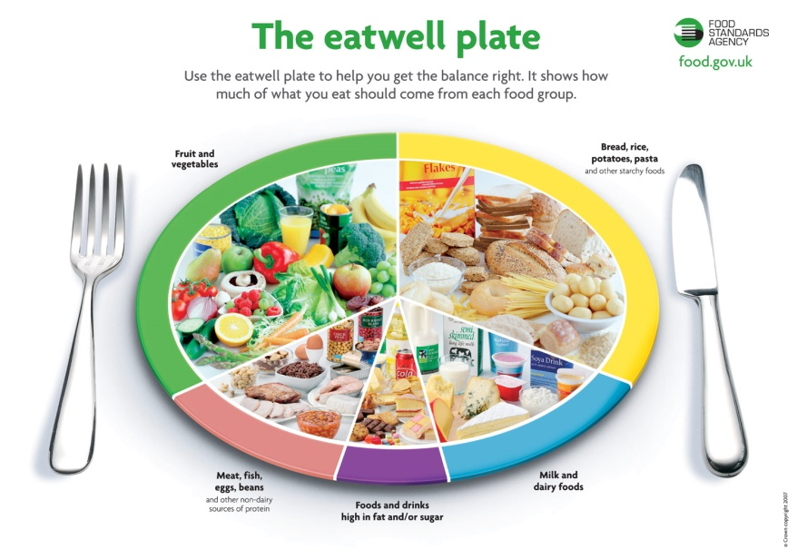
Diet
Balanced? (50% Carbohydrates, 30% fats, 20% proteins, Vitamins and minerals (5-9 a day fruit and veg), Low added sugar, Low saturated fat)
24 diet recall?
3 meals per day?
2-2.5 litres of water per day?
Preparation of food?
Types of meals?
Size of meals?
http://www.fussyfoodie.co.uk/foodie/wp-content/uploads/eatwellplate.jpg

Slide 11
Coronary Heart Disease Risk Factors
  Leading cause of death in industrialised countries
  Classified into two types:
    Angina and heart attacks (myocardial infarction)
Occur due to narrowing of arteries carrying blood to heart, usually due to fatty substances.
Angina – a severe pain in the chest brought on by exertion such as exercise and relieved by rest and medication.
Heart Attack – due to an obstruction of a coronary artery either as fatty substances or a blood clot.

Slide 12
Lifestyle factors that increase the risk of CHD
A diet high in saturated fats
Diet high in table salt
Obesity
Smoking
Excess alcohol consumption
Older age
Male gender
High blood pressure
Type 2 diabetes
If a person has a high risk of CHD, they should be referred to a GP before they start training

Slide 13
What to include?
Personal details – name, address, date of birth, gender, tel no, email,
Fitness goals – what? How long?
Physical activity level - Current fitness level/training status and history
Diet – what kinds of food? Special diet? Supplements?
Other Lifestyle factors – alcohol, smoking, stress,
Past and current medical history – diabetes, high cholesterol, high blood pressure, asthma, heart problems, chest pains, epilepsy, osteoporosis, previous/current injuries/operations, pregnancy
Family medical history (parents and grandparents)
Measure body composition
Current medication
Other Comments
Signed/Date

Slide 14
Data Protection Act
Under the Data Protection Act, clients have the right to have inaccurate data corrected, destroyed, blocked or erased. They may seek compensation for any damage or distress caused by you by such inaccuracy. Inaccurate data means information that is incorrect or misleading about any matter of fact.
The Act also governs the way in which you may use the personal information given to you, and clients have the right to require you to stop, or not to begin, using their personal information for direct marketing purposes.

Slide 15
Client consultation
Builds relationship between tester and client. May take up to an hour and should include:
  Record of personal details e.g. name, contact number, GP’s name
  Identifying and setting client’s goals
  Lifestyle evaluation
  Health evaluation
  Listing medications taken
  Obtaining informed consent
  Health-related tests
  Setting your aims as tester

Slide 16
Client consultation
Questioning Further
  some clients may need further questioning to gather further info
  You may need clarification of some details
  Health-based / Fitness- based Test results might have alerted you to other issues
  Quiet environment with no distractions
  Do not baffle with science or technical jargon
Listening
  You should be able to identify any issues that are not obvious at first just by listening

Slide 17
Client consultation
Non-verbal communication
  93% of all communication is non-verbal
  Based on body language
Client confidentiality
  Anyone involved in health screening and fitness testing has a duty of confidentiality regarding clients
  Personal information should be kept in a secure place
  You should not pass on any personal information to anyone else without that person’s permission

Slide 18
Case study
Ben, 53
Smoker 7 a day and since 18.
Engineer (desk job), 45 hours a week, no high stress level
Drinks 2 pints a day most days maybe not on Sunday.
Takeaways twice a week, likes cakes but tries to be healthy by eating fruit and no fried food. If I work late I tend to have microwave meals.
Moderate swimming 20 minutes twice a week and sometimes 5 a side footie for 1 hour on a Monday.
Identify and describe Ben’s strengths and areas of improvement.
Also explain each one saying why they are strengths and areas of improvement. To be able to explain, compare physical activity levels with national guidelines, compare alcohol consumption with national guidelines, assess stress levels, assess smoking habits and assess the diet of the individual against guidelines
Write model answers to show your interpretation of Ben’s lifestyle assessment.

