Slide 1
Lifestyle Recommendations

Slide 2
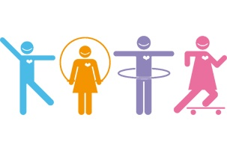
Ways to increase physical activity levels
Thought is usually more unpleasant than the actual doing.
If exercise has never been done before and for those in poor shape, immediate results should not be expected as it takes time and consistency.
Those already doing exercise will find it easier to increase their exercise levels.
http://tse3.mm.bing.net/th?id=OIP.M66451ec19c0fa98d1fcb3cedb26e3ae0o0&pid=15.1

Slide 3
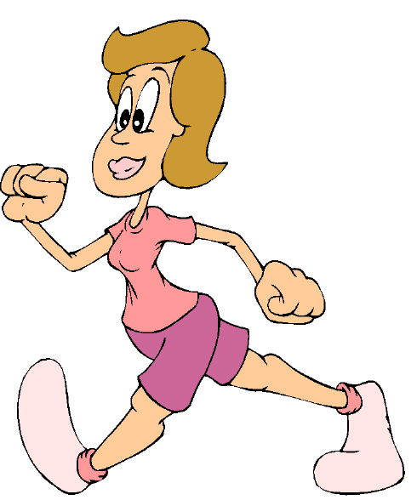
Walking
Target of 10,000 steps per day(about 5 miles) is recommended to achieve health benefits.
A sedentary person averages 2,000-3,000 per day.
Pedometer can be used as motivational tool to achieve goal and assess progress (Influx of fitness trackers)
Sensible approach would be to increase average daily steps by 500 each week until 10,000 target is reached.
Encourage people to get off the bus a stop earlier and walk further to work.
http://kristiholl.net/writers-blog/wp-content/uploads/2013/05/woman-walking.jpg

Slide 4
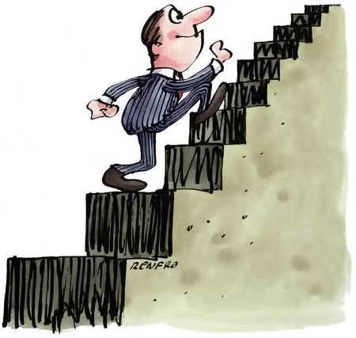
Stair climbing
Encouraging use of stairs in the workplace instead of the lift or escalator (this is moderate intensity activity and easier to do than more vigorous exercise programmes)
Energy cost of climbing stairs is approximately 8-10 kcals per minute so can help with weight control.
Also helps with bone strength, leg power and cardiovascular fitness.
http://www.examiner.com/images/blog/replicate/EXID31867/images/climbing_stairs.jpg

Slide 5
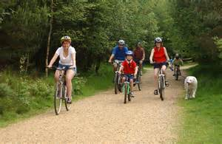
Cycling
Daily it can lead to significant health benefits.
Most fitness levels can participate, although anyone with heart disease should consult a doctor prior to cycling.
Cycling offers a healthy leisure transport alternative to car journeys as 70% of all car trips are less than 5 miles.
http://tse1.mm.bing.net/th?id=OIP.M810e77a5781e0230532db1ae7573f092o0&pid=15.1

Slide 6
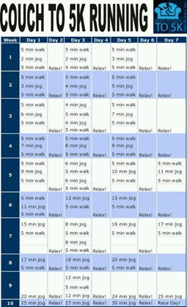
Couch to 5k
Couch to 5K is a running plan for absolute beginners. It was developed by a new runner, Josh Clark, who wanted to help his fifty-something mum get off the couch and start running, too.
The plan involves 3 runs a week, with a day of rest inbetween, and a different schedule for each of the 9 weeks.
How does Couch to 5K work?
Probably the biggest challenge a new runner faces is not knowing how or where to start.
Often when trying to get into exercise, we can overdo it, feel defeated and give up when we're just getting started.
Couch to 5K works because it starts with a mix of running and walking to gradually build up your fitness and stamina.
Week 1 involves running for just a minute at a time, creating realistic expectations and making the challenge feel achievable right from the start.
https://www.pinterest.com/explore/couch-to-5k/

Slide 7
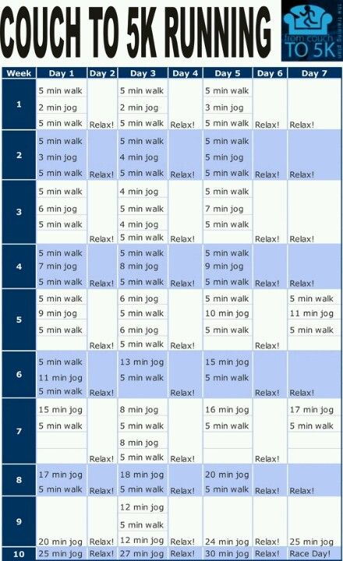
Couch to 5k
Who is Couch to 5K for?
Couch to 5K is for everyone. Whether you've never run before or if you just want to get more active, Couch to 5K is a free and easy way of getting fitter and healthier.
If you have any health concerns about beginning an exercise regime like Couch to 5K, make an appointment to see your GP and discuss it with them first.

Slide 8
Couch to 5k
What are the benefits?
There are plenty of benefits from getting into running. For starters, it's an easy way of improving your physical health.
Running requires little equipment, but a good pair of running shoes that suit your foot type may help improve comfort.
Running regularly will improve the health of your heart and lungs. It can also help you lose weight, especially if combined with a healthy diet.
There's evidence it may help increase bone density in some people, which can help protect against bone diseases like osteoporosis.
There are also mental benefits of running. Taking on the challenge of Couch to 5K can help boost your confidence and self-belief, as you prove to yourself that you can set yourself a target and achieve a goal.
Running regularly can also be a great stress reliever and has even been shown to combat depression.
https://www.pinterest.com/explore/couch-to-5k/

Slide 9
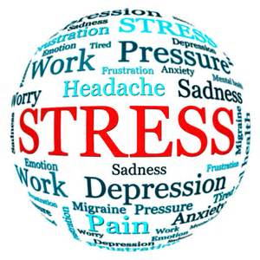
Advice on stress management
To control stress there are generally 2 approaches taken:
  Try to reduce overall amount of stress
  Develop coping or stress management techniques
  http://livingwellsalina.com/wp-content/uploads/2014/05/stress_ball.jpg

Slide 10
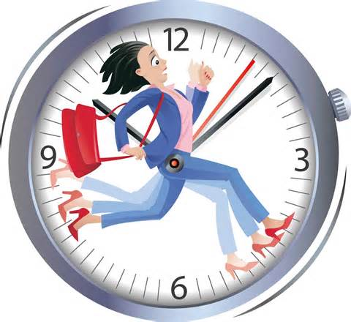
Reducing overall stress
Factors that promote stress (stressors) should be identified and , if possible, eliminated or reduced.
Careful time management and prioritisation of workload and commitments may help an individual manage their stress better.
http://businessamongmoms.com/wp-content/uploads/2014/09/time-management-1.jpg

Slide 11
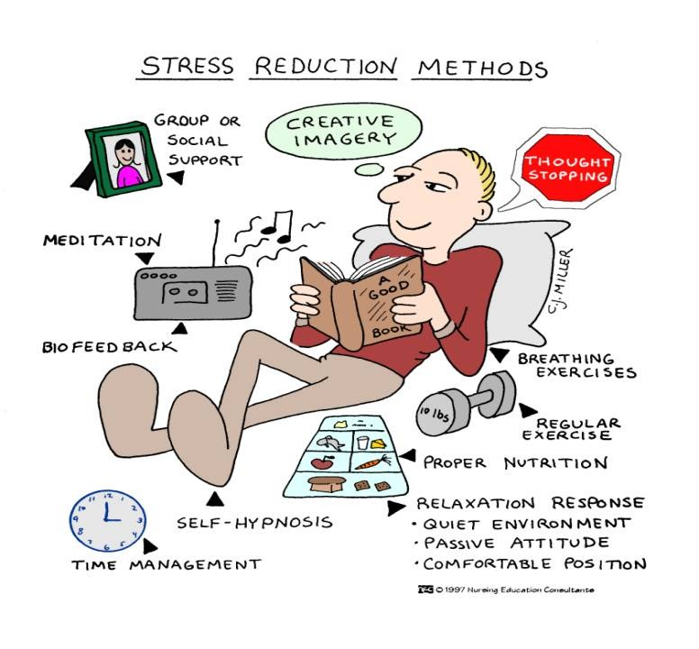
Developing coping/stress management techniques
It is not possible to eliminate all stresses in daily life
Having techniques or taking part in activities that reduce levels of stress will have a positive impact on health and well-being.
http://www.oddduckblog.com/wp-content/uploads/2011/10/stress-reducing-methods.jpg

Slide 12

Developing coping/stress management techniques
Assertiveness
  the ability to express your feelings and rights while respecting those of others.
  It is a skill that has to be learned
  Once mastered it can help deal with conflict situations that may cause stress.
Goal setting
  Properly set goals can be motivating and rewarding
  Achieving set goals can build on self-confidence and reduce stress.
  http://www.chrissiewebber.co.uk/wp-content/uploads/2015/04/Goal-Setting.jpg

Slide 13
Developing coping/stress management techniques
Time management
  Critical element
  About achieving tasks in good time using goal setting, task planning and minimising time spent on unproductive activities.
  Physical activity
  Has a positive effect on anxiety, depression, self-esteem and mood
  Produces an outlet for frustration and releases endorphins, ‘feel good’, hormones that lift mood and provide a distraction from the stressor.

Slide 14
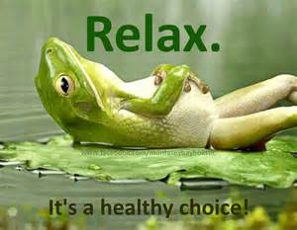
Developing coping/stress management techniques
Positive self-talk
  Inner dialogue you have with yourself
  Influences your emotional life and reflects how you respond to your thoughts, feelings and actions which can be positive or negative
  Positive self-talk involves taking an optimistic view of life and your situation
  In daily life there are constant challenges, difficulties and deadlines and being able to take a positive view of them and having constructive ways od dealing with them helps manage and reduce stress.
Relaxation and breathing exercises
  Focusing on breathing exercises is a simple way of trying to control or reduce stress.
  It involves controlled inhalation and exhalation
  It is best undertaken when you are comfortable and quiet
  http://montereybayholistic.files.wordpress.com/2013/02/relax-for-health.jpg

Slide 15
Developing coping/stress management techniques
Cognitive Behavioural Therapy (CBT)
  Cognitive behavioural therapy (CBT) is a talking therapy that can help you manage your problems by changing the way you think and behave.
  CBT cannot remove your problems, but it can help you deal with them in a more positive way. It is based on the concept that your thoughts, feelings, physical sensations and actions are interconnected, and that negative thoughts and feelings can trap you in a vicious cycle.
  CBT aims to help you crack this cycle by breaking down overwhelming problems into smaller parts and showing you how to change these negative patterns to improve the way you feel.
  Unlike some other talking treatments, CBT deals with your current problems, rather than focusing on issues from your past. It looks for practical ways to improve your state of mind on a daily basis.

Slide 16
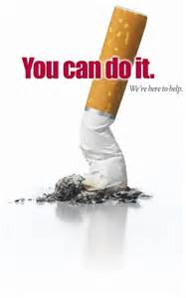
Advice on smoking cessation
Smoker must want to stop for any strategy to work
acupuncture, NHS smoking helpline, NHS stop-smoking services, nicotine replacement therapy
http://www.thegreenrooms.net/wp-content/uploads/2014/10/Smoking-cessation2.jpg

Slide 17
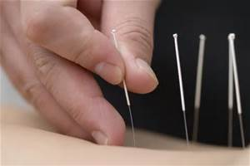
Acupuncture
A traditional Chinese therapy where fine needles are inserted at certain sites in the body for therapeutic or preventative purposes.
It is based on scientific evidence that shows the treatment can stimulate nerves under the skin and in muscle tissue.
This results in the body producing pain-relieving substances, such as endorphins.
Traditional acupuncture is based on the belief that an energy, or "life force", flows through the body in channels called meridians. This life force is known as Qi (pronounced "chee").
Practitioners who adhere to traditional beliefs about acupuncture believe that when Qi does not flow freely through the body, this can cause illness. They also believe acupuncture can restore the flow of Qi, and so restore health.
http://tse1.mm.bing.net/th?&id=OIP.M46af8a930608b1c60468a6a723712f11H0&w=300&h=200&c=0&pid=1.9&rs=0&p=0

Slide 18
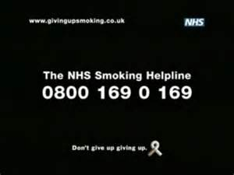
NHS Smoking Helpline
Launched in 2000 as part of government initiative to encourage 1.5 million people in UK to give up smoking by 2010.
Offers information, advice and support
http://files.coloribus.com/files/adsarchive/part_24/242355/coi-jak-600-38295.jpg

Slide 19
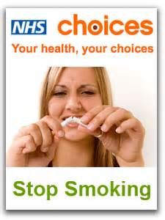
NHS stop smoking services
Group and one-to-one counselling
Information on nicotine replacement therapy
http://www.pressreleasepoint.com/files/images/uid24862/stop-smoking-promo2_0.png

Slide 20
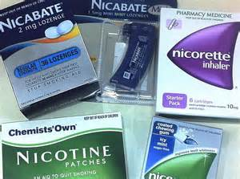
Nicotine replacement therapy
Gums
Patches
Lozenges
Sprays
http://1.bp.blogspot.com/-87L1GYHwD3w/T7mdSE54c-I/AAAAAAAAAFI/UhC4fo0Yunw/s1600/nicotine+products.JPG
Available on prescription and suitable for most smokers
Those who are pregnant or taking regular medication should consult doctor first
Unlike cigarettes they do not contain harmful cancer-causing harmful chemicals.

Slide 21
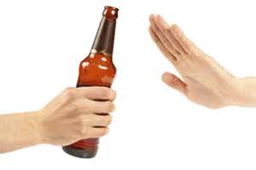
Advice on reducing alcohol consumption
When alcohol consumption becomes so excessive and frequent that it has a severe and negative impact on health it is termed ‘alcoholism’.
Alcoholics exhibit intense cravings for alcohol and become physically dependent on it.
However, recovery is possible if the user is strongly motivated to stop drinking.
http://fattyliverforlife.com/wp-content/uploads/2015/03/Reduce-Alcohol-Consumption.jpg

Slide 22
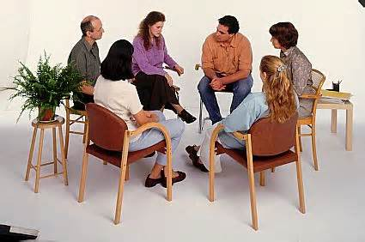
Individual or group counselling
Provided by specially trained therapists
It may involve family members also
Involves exploring and developing awareness of triggers for alcohol consumption and the breaking of habitual behaviours are key areas of focus.
Relapse is often high for alcohol abusers and preventing this is key in counselling and therapy.
http://psychclasses2.wikispaces.com/file/view/group-therapy.jpg/222890164/group-therapy.jpg

Slide 23
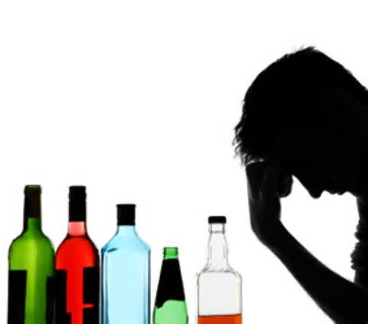
Detoxification/withdrawal
Treatment for alcohol abuse often begins with detoxification and withdrawal.
Necessary when consumption has continued over a long period of time.
Can be an uncomfortable process with unpleasant withdrawal symptoms.
Withdrawal symptoms can be fatal so detoxification is usually undertaken under supervision within an alcohol treatment facility.
http://wedorecover.com/images/Alcohol-Detox-1.jpg

Slide 24
Self-help groups
Successful treatment depends on recognition of a problem by the sufferer
Alcoholics Anonymous (AA) help many sufferers through a step-by-step programme of recovery.

Slide 25

Alternative therapies
Some people seek alternative therapies but there are mixed views over their value within the medical fraternity.
Acupuncture – traditional Chinese therapy which may help to lessen withdrawal symptoms by increasing body’s production of mood enhancing endorphins.
Hypnosis – is an altered state of consciousness which may help to lessen withdrawal symptoms
http://howtohypnotizesomeone.ecoffeeonline.com/wp-content/uploads/2012/06/hypnosis.jpg

Slide 26
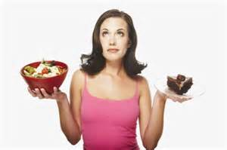
Advice on dietary changes
Timing of food intake/Number of meals/Size of meals
  This is key to food habits
  Food habits develop over time and are resistant to change
  They are subconscious and acquired at a young age
  Where food is available 24 hours a day, intake can be at any time
  However, most of us do not eat continually but stick to reasonably defined meal times – 3 meals a day approach in the West
  If lifestyle changes more snacking will occur
  http://curcovia.com/wp-content/uploads/2012/05/dietary-Changes-Menopause-470-wplok.jpg

Slide 27
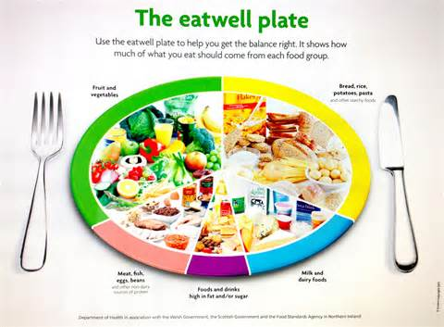
Advice on dietary changes
Government has set dietary intake goals.
Diet should be balanced across the five main food groups.
Advised to eat wholegrain starchy carbohydrate food and fruits and vegetables
Eat less fatty and sugary foods.
http://mathewbose.com/nutrition/wp-content/uploads/2013/02/photo-15.jpg

Slide 28
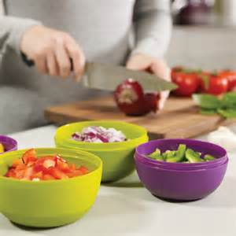
Advice on dietary changes
Food preparation
  Most foods require some preparation before consumption
  It depends on the cooking skills, facilities and time available
  Awareness of this when suggesting strategies for improving diet need to be realistic and achievable goals.
  http://www.holycool.net/wp-content/uploads/2013/06/Joseph-Joseph-Prep-Store-Food-Preparation-Bowls1.jpeg

Slide 29
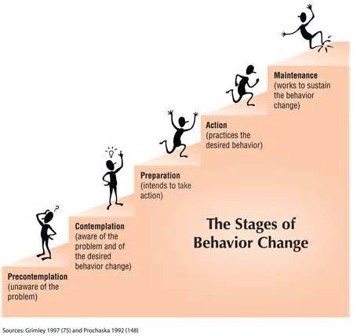
Behaviour changes
Behaviour modification has its basis in psychological principles of learning theory and is used to change or modify a person’s behaviour.
Can be used to eliminate unhealthy lifestyle behaviours.
Most common approach is to use Stages of Change Model (Prochaska, Diclemente and Norcross, 1992)
http://www.pactnow.ca/images/4stages.jpg

Slide 30
Stages of Change Model
Change occurs through the following stages:
Pre-contemplation – not considering change in the near future. People in this stage fail to notice or have any concerns about a particular behaviour (e.g. overeating)
Contemplation – Becoming aware a change may be desirable (e.g. can’t fit into clothes so need to lose weight)
Preparation – Begin to set targets and goals to improve behaviour
Action – Start to implement the plan – obstacles should be expected and strategies to overcome them may need to be considered
Maintenance – Able to acknowledge that setbacks will come, but you remind yourself of your goals and positive benefits of the change to cope with relapses.
Termination – achieved when you have overcome all temptation towards your previous behaviour.

Slide 31
Simple steps to behaviour modification
Identify the problem and understand the need to change
Understand the influences on the problem
Establish short-, medium- and long-term goals for tackling the change and record them
Develop a strategy to facilitate change and understand the resources or skills required for success
Implement the strategy and record and monitor progress
Evaluate progress and consider strategies to maintain change in behaviour if successfully achieved

Slide 32
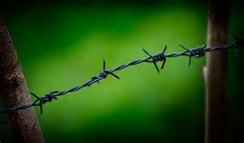
Common barriers to change
Lack of knowledge about the benefits of the behaviour change
Lack of self-efficacy(or confidence) in making the behaviour change
Setting unrealistic goals for behaviour change
Lack of commitment to making the change
Lack of control over your environment to make the change
Lack of support from others to make the change
Falling at the first hurdle (relapse)
https://realbalancewellness.files.wordpress.com/2011/01/barbedwire.jpg

Slide 33
Cognitive & behavioural strategies
These are approaches to behavioural change based on concepts and principles derived from psychological models of human behaviour.
Includes a broad range of approaches from structured individual psychotherapy to self-help.
In CBT, the client and therapist work together to identify and attempt to understand the client’s problem behaviour
A key element is to help the client understand the relationship between thoughts, feelings and behaviour.
The client and therapist then attempt to establish a shared understanding of the problem
This leads to personalised goals and strategies for tackling the problem that are monitored and evaluated over time
During the process the client learns to develop psychological and/or practical skills for problem solving or management.
The overall aim is for the client to attribute improvements in their behaviour to their own efforts and not those of the therapist.

Slide 34

Possible approaches to change
Individual advice and leaflets
Individual counselling and support
Group counselling and support
Campaigns and displays
Community-based activities
http://advantureconsulting.com/wp-content/uploads/2013/05/Approaches-to-Change-1-275x183.jpg

Slide 35
Case Study

Slide 36
Positives & negatives of strategies and their impact on health.

Slide 37
American College of Sports Medicine www.acsm.org
British Nutrition Foundation www.nutrition.org.uk
Department of Health www.doh.gov.uk
Food Standards Agency www.eatwell.gov.uk
Human Kinetics www.humankinetics.com
The World Health Organisation www.who.int
Top End Sports www.topendsports.com

