Slide 1
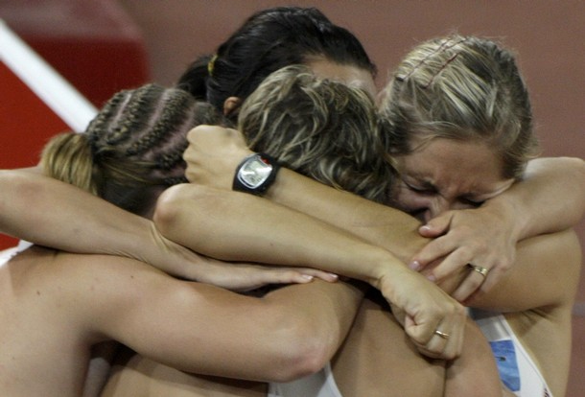
Psychology and Sport Performance
Group Dynamics 3: Cohesion

Slide 2
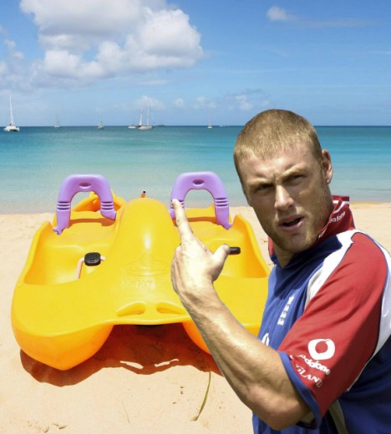
Definitions
Social Cohesion
This relates to how well the team members enjoy each other’s company.
E.g. Socialising away from sport – Andrew Flintoff drunk on a pedalo in Caribbean
Task Cohesion
This refers to how well a team work together to achieve shared objectives.
E.g. Winning a tournament, league promotion
Players don’t have to get on well to do this but normally respect each other as players e.g. Chicago Bull’s in 1990s

Slide 3
Creating an Effective Team Climate
What can the coach do?
What can players do?
Communicate effectively
Ensure everybody knows their role
Keep changes to a minimum
Encourage a group identity
Set both group and individual goals
Get to know the athletes
Be responsible for their own activities
Resolve conflict quickly
Try hard – give 100%
Get to know each other
Help each other
Task
In pairs Discuss how to create an effective team climate
List 3 objectives as a coach?
List 3 objectives as a player?
List objectives on a flipchart sheet

Slide 4
Factors Affecting Cohesion
Carron’s Conceptual Model of Cohesion (Carron, 1982)
Environmental Factors
Team members that live closer to each other tend to be more cohesive...
Personal Factors
If players are motivated to achieve group aims – have similar backgrounds – similar attitudes and opinions – similar commitment levels then satisfaction will be higher and the group is likely to be more cohesive.
Environmental Factors
Personal factors
Leadership Factors
Team factors
Cohesion
Individual Outcomes
Group Outcomes

Slide 5
Carron’s Model
Environmental Factors
Personal factors
Leadership Factors
Team factors
Cohesion
Individual Outcomes
Group Outcomes
Leadership Factors
Leadership style, communication style and behaviour and compatibility of the coach’s and athletes personalities all affect cohesion.
Team Factors
If a team can stay together for a long period of time, experience highs and lows and be involved in the decision-making process, the group is more likely to be productive and cohesive.

Slide 6
Relationship between cohesion and performance
This brings us back to how interactive the sports are.
Highly interactive sports like football and volleyball require direct interaction and coordination so cohesion especially task cohesion is important.
Coactive sports require little, if any, direct interaction or coordination.
Therefore, cohesion has a greater influence on performance in interactive sports than it does on coactive sports like golf or archery.

