Slide 1
Circular Motion
3.4.1 Circular Motion

Slide 2
Aims
Quick circles recap
Angular Speed
Centripetal Acceleration
Centripetal Force
Applications of Circular Motion

Slide 3
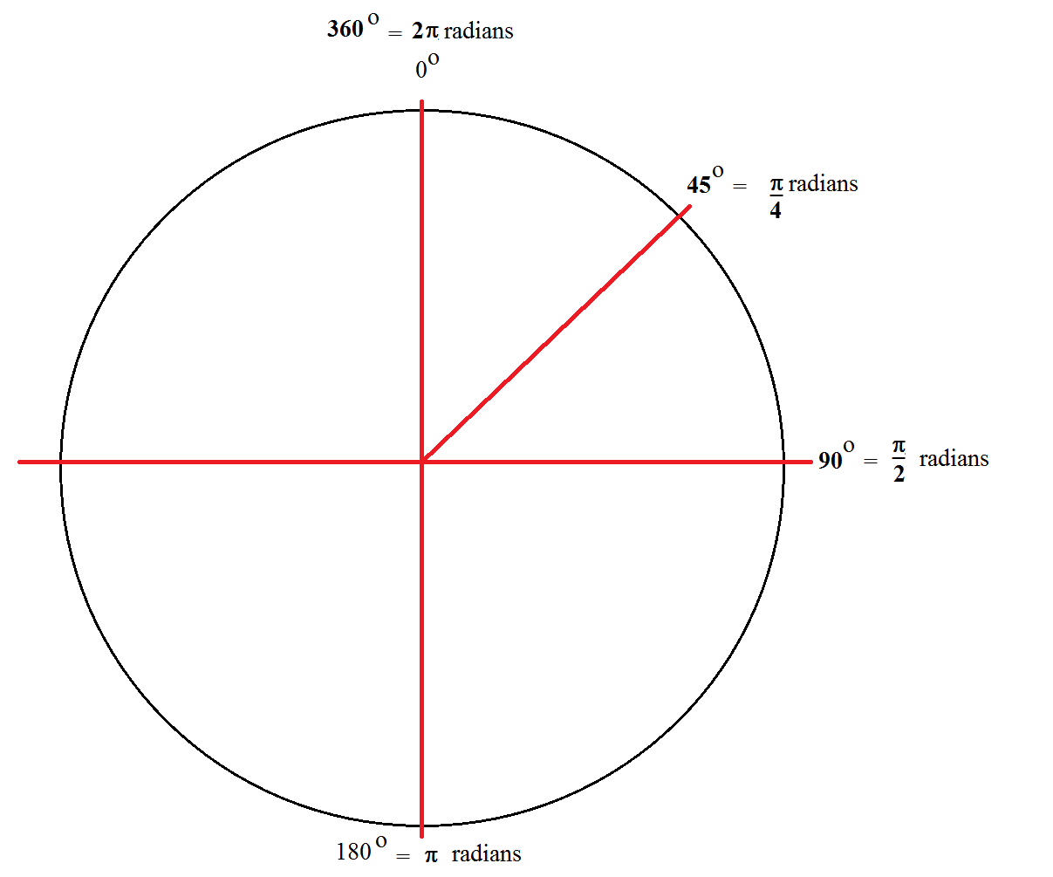
Recap
Circumference of a circle is $c=2πr$
The point from the centre to the perimeter is the radius
$radians=degrees×\frac{π}{180}$
$degrees=radians×\frac{180}{π}$

Slide 4
Frequency
Frequency is basically how frequent something happens
In terms of circular motion, frequency is determined how many cycles per unit time
E.g. You mark a point on a wheel, let it spin and count how many times it goes round
The frequency of rotation is $f=\frac{1}{T}$

Slide 5
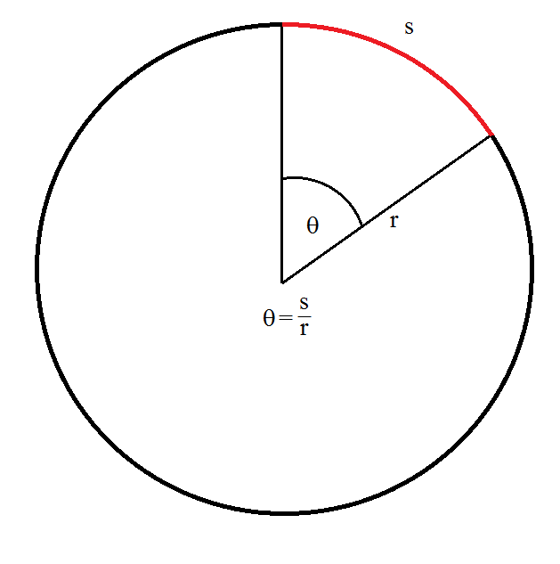
Circular Motion Basics
Motion in a straight line is an easy enough concept to deal with, however if we constrain the motion to one physical point, we produce circular motion

Slide 6
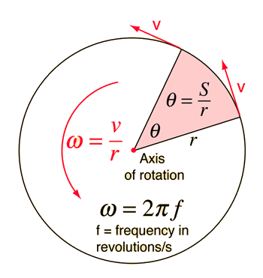
Circular Motion Basics
But what about the previous case of marking the point on the wheel? What if we want something more than just watching go around?!
Using some of our knowledge and the fundamental equation of $speed=\frac{distance}{time}$, we can find the rotational speed of the point
Unit of angular speed ω is rad s⁻¹

Slide 7
Angular Displacement
The angular displacement is given by:
$θ=\frac{arc length}{radius}=\frac{s}{r}$
Proving the 2π radians – an object travels in one complete circle from one position right back to the original position, in doing so it has travelled the circumference of the circle
$θ=\frac{s}{r}=\frac{2πr}{r}=2π$
Angular displacement in terms of rotations in a certain time frame is:
$θ=\frac{2πt}{T}=2πft$

Slide 8
Question
A cyclist travels at a speed of 12 ms⁻¹ on a bicycle which has wheels of 0.40 m radius. Calculate:
a) the frequency of rotation of each wheel
b) the angular speed of each wheel
c) the angle the wheel turns through in 0.10 s in radians and degrees

Slide 9
Question
A cyclist travels at a speed of 12 ms⁻¹ on a bicycle which has wheels of 0.40 m radius. Calculate:
a) the frequency of rotation of each wheel
b) the angular speed of each wheel
c) the angle the wheel turns through in 0.10 s in radians and degrees
a) Circumference of wheel = 2πr = 2π x 0.40 = 2.5 m
Time (period) for 1 rotation = $T=\frac{circumference}{speed}=\frac{2.5}{12}=0.21 s$
$∴frequency=\frac{1}{T}=\frac{1}{0.21}=4.8 Hz$
b) $ω=\frac{2π}{T}=\frac{2π}{0.21}=30 rad s^{−1}$
c) $θ=\frac{2πt}{T}=\frac{2π×0.10}{0.21}=3.0 rad$ or $3.0×\frac{180}{π}=172^{0}$

Slide 10
Question
During their physics field trip to the amusement park, Tyler and Maria took a rider on the Whirligig. The Whirligig ride consists of long swings which spin in a circle at relatively high speeds. As part of their lab, Tyler and Maria estimate that the riders travel through a circle with a radius of 6.5 m and make one turn every 5.8 seconds. Determine the speed of the riders on the Whirligig.
$v=\frac{2πr}{T}=\frac{2.π.6.5}{5.8}=7.04 ms^{−1}$

Slide 11
Question
The tallest Ferris wheel in the world is located in Singapore. Standing 42 stories high and holding as many as 780 passengers, the Ferris wheel has a diameter of 150 meters and takes approximately 30 minutes to make a full circle. Determine the speed of riders (in m/s and mi/hr) on the Singapore Flyer. (GIVEN: 1.00 m/s= 2.24 mi/hr)
$v=\frac{2πr}{T}=\frac{πd}{T}=\frac{π.150m}{1800s}=0.26 ms^{−1} and 0.2618×2.24=0.58 mph$

Slide 12
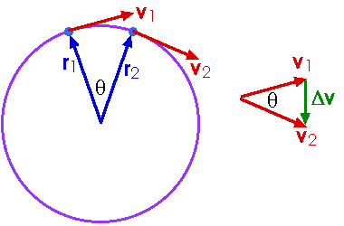
Centripetal Acceleration
We have already seen the concept of velocity in straight line motion
However, velocity being a vector quantity acts differently in circular motion

Slide 13
Centripetal Acceleration
Because the path of velocity is constantly changing, the resultant velocity (as seen on previous slide) always points ‘down’ from the motion or to be more precise….towards the centre of the circle
Due to the very nature of acceleration being a change in velocity, we see that centripetal acceleration will act in the same direction as the change in tangential velocity
Centripetal Acceleration $a=\frac{v^{2}}{r}=ω^{2}r$

Slide 14
Centripetal Force
We have a change in velocity resulting in an acceleration
We have an acceleration acting towards the centre of the circle
Because we have an acceleration acting….
We must have a force acting….
In the same direction (Newton’s 1st and 2nd laws)
Therefore centripetal force is given by:
$F=ma$ $a=\frac{v^{2}}{r}=ω^{2}r$ $∴F=\frac{mv^{2}}{r}={mω}^{2}r$

Slide 15
Satellites, Gravity and Centripetal Acceleration

Slide 16
Question
Calculate the centripetal force and acceleration of a 3.0 Kg mass tied in a rope and swung in a circle of radius 0.75 m, which is moving in a velocity of 4.0 m/s?
$F=\frac{mv^{2}}{r}=\frac{3×4^{2}}{0.75}=64 N$
$a=\frac{v^{2}}{r}=\frac{4^{2}}{0.75}=21.33 ms^{−1}$

Slide 17
Question
A car of mass 1000 Kg moves in a circular path of radius 50 m. The constant speed of car is given by 12 m/s. Determine the centripetal force of the car?
$F=\frac{mv^{2}}{r}=\frac{1000×{12}^{2}}{50}=2880 N$

Slide 18
Question
A car is moving with a constant velocity around a circular path. If the radius of the circular path is 48.2 m and the centripetal acceleration is 8.05 m/s² , what is the tangential speed of the car?
$a=\frac{v^{2}}{r}$
$∴v=\sqrt{a×r}=\sqrt{8.05×48.2}=19.7 ms^{−1}$

Slide 19
Conversion Factors

Slide 20
Hard Question
You are designing and aeroplane propeller that is to turn at 2400 rpm. The forward airspeed of the plane is to be 75.0 ms⁻¹, and the speed of the tips of the propeller through the air must not exceed 270 ms⁻¹ (this is approx. 80% the speed of sound in air and would produce less noise).
(a) what is the maximum possible propeller radius?
(b) with this radius, what is the acceleration of the propeller tip?

Slide 21
Hard Question
(a) $ω=2400 rpm=2400×\frac{2π}{60}=251 rad s^{−1}$
From figure (a) we find that $v_{tan}=rω$ and relying upon finding the hypotenuse from Pythagoras in figure (b):
$v_{tip}^{2}=v_{plane}^{2}+v_{tan}^{2}=v_{plane}^{2}+r^{2}ω^{2}$
$∴r=\sqrt{\frac{v_{tip}^{2}−v_{plane}^{2}}{ω^{2}}}=\sqrt{\frac{{270}^{2}−{75}^{2}}{{251}^{2}}=1.03 m}$
(b) $a=ω^{2}r={251}^{2}×1.03=6.5×10^{4} ms^{−2}$

Slide 22
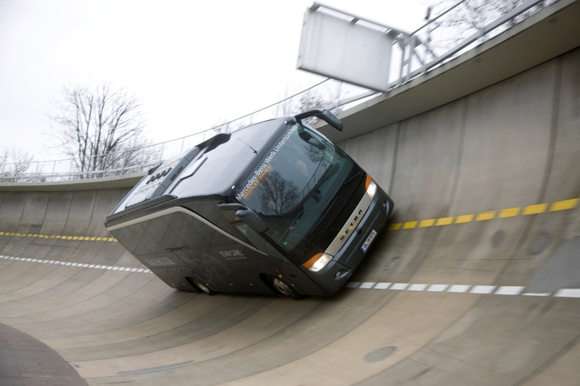
Banking (Without money!)
If a car is on a level (unbanked) surface, the forces acting on the car are its weight, mg, pulling the car downward, and the normal force, N, due to the road, which pushes the car upward
Both of these forces act in the vertical direction and have no horizontal component. If there is no friction, there is no force that can supply the centripetal force required to make the car move in a circular path - there is no way that the car can turn

Slide 23
Banking (Without money!)
On the other hand, if the car is on a banked turn, the normal force (which is always perpendicular to the road's surface) is no longer vertical
The normal force now has a horizontal component, and this component can act as the centripetal force on the car!
The car will have to move with just the right speed so that it needs a centripetal force equal to this available force, but it could be done
Given just the right speed, a car could safely negotiate a banked curve even if the road is covered with perfectly smooth ice!

Slide 24
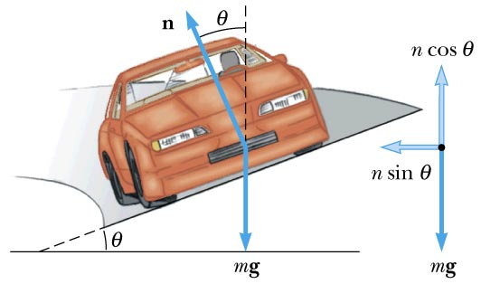
Banked Turns
$n_{1}+n_{2}=n$
Vertical component $n\cos{θ}$
Horizontal component $n\sin{θ}=\frac{mv^{2}}{r}$ because it acts in a
Because vertical balances weight:
$n=\cos{θ=mg}$
$∴\tan{θ=\frac{n\sin{θ}}{n\cos{θ}}}=\frac{mv^{2}}{mgr}=\frac{v^{2}}{gr}$

Slide 25
Question
If the banking angle is not to exceed 5º, what is the maximum speed for zero sideways friction when the bank has a radius of 360 m?
$v=\sqrt{gr\tan{θ}}=\sqrt{9.81×360×\tan{5}}=18 ms^{−1}$

Slide 26
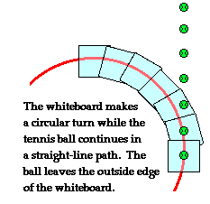
Newton First Law
“Every object continues in its state of rest, or of motion in a straight line at constant speed, unless it is compelled to change by forces exerted on it."

Slide 27
Slow wheel
When the “mud” hits the wheel
Mud sticks to wheel
Adhesion accelerates mud towards the centre of wheel
Circular “motion”

Slide 28
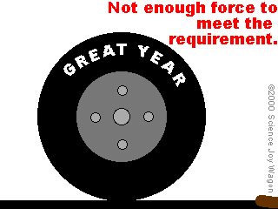
Faster wheel
Mud hits wheel
Mud sticks to wheel
Adhesion not great enough to accelerate Mud
Thus projectile “motion”

Slide 29
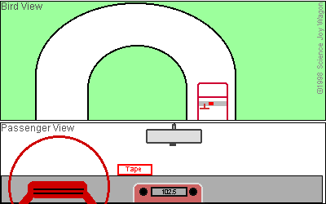
So what about Centrifugal force?
Its all about perception

Slide 30
Centrifugal Force
An object traveling in a circle behaves as if it is experiencing an outward force.
This force, known as the centrifugal force, depends on the mass of the object, the speed of rotation, and the distance from the centre.
The more massive the object, the greater the force; the greater the speed of the object, the greater the force; and the greater the distance from the centre, the greater the force.

Slide 31
Centrifugal Force
It is important to note that the centrifugal force does not actually exist.
We feel it, because we are in a non-inertial coordinate system.
(A non-inertial reference frame is a frame of reference that is undergoing acceleration with respect to an inertial frame. An accelerometer at rest in a non-inertial frame will in general detect a non-zero acceleration)
Nevertheless, it appears quite real to the object being rotated.
This is because the object believes that it is in a non-accelerating situation, when in fact it is not.

Slide 32
Centrifugal Force
For instance, a child on a merry-go-round is not experiencing any real force outward, but he/she must exert a force to keep from flying off the merry-go-round.
Because the centrifugal force appears so real, it is often very useful to use as if it were real.
The more massive the object, the greater the force.

Slide 33
Centrifugal Force
We know that this is true because an adult will have a harder time staying on a merry-go-round than a child will.
The greater the speed of rotation, the greater the outward force.
We know that this is true because a merry-go-round is harder to stay on, the faster it rotates.
If you move further out on the merry-go-round, you will have to exert a greater force to stay on. In order to stay on a circular path, we must exert a force towards the centre called centripetal (or "centre-seeking") force.

Slide 34
Chavs and Circular Motion Do Not Mix!
https://www.youtube.com/watch?v=Ct1QuKLJl-g

Slide 35
Centrifugal Force
Consider a rope with a ball on the end.
You can swirl the ball around in a circle over your head while holding onto the rope.
The ball experiences the so-called centrifugal force, and it is the rope that provides the force to keep in moving in the circle.

Slide 36
Centripetal Force Vs. Centrifugal Force
https://www.youtube.com/watch?v=zHpAifN_2Sw

Slide 37
Vertical Circles
Top
We are going to consider 4 points
horizontal
horizontal
Bottom
Assume a constant angular velocity ➔ Constant centripetal force

Slide 38
Centripetal Force
Horizontally:
The weight is perpendicular to tension
Only tension provides the centripetal force
Top
Tension AND Weight in the same direction
The resultant provides the centripetal force
Bottom
Tension and Weight in the opposite direction
The resultant provides the centripetal force

Slide 39
At The Top
Resultant force = T+mg
= Centripetal force
Quick Calculation
A 100g ball moving in a circle needing a centripetal force = 2N
What is the Tension in the string?
1N
T+mg

Slide 40
At The Bottom
Resultant force = T-mg
= Centripetal force
Quick Calculation
A 100g ball moving in a circle needing a centripetal force = 2N
What is the Tension in the string?
3N
T
mg

Slide 41
Horizontal
Centripetal force = Tension = 2N
If the body moves with a radius 1m
What speed is it moving?
What angular velocity?
What is the minimum speed to keep it in a circle?

Slide 42
Weightlessness
Why do feel weightless?
Why do I feel I have weight?
What do we call it when the only force is a bodies weight?
Free Fall

Slide 43
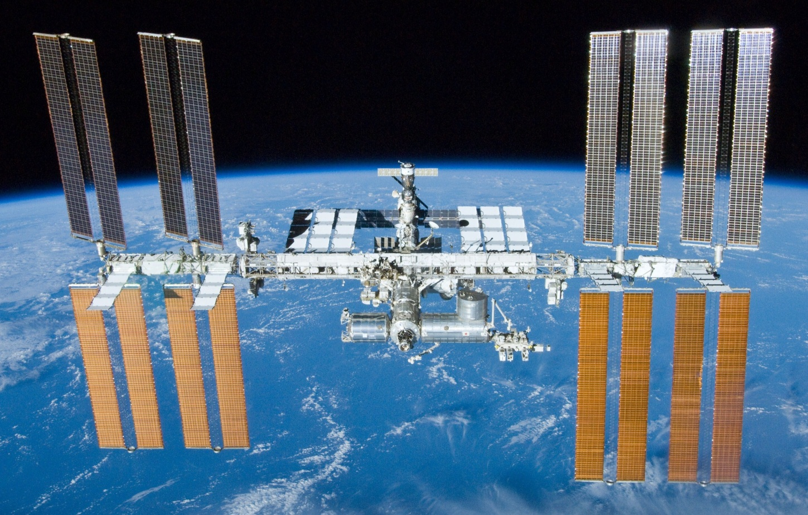
ISS and Free Fall
The ISS is in constant free-fall
When a body is in constant free-fall
the only force it feels is the force of
Gravity
The ISS astronauts are within the ISS frame of reference, so they are falling at the same rate – once again due to gravity
They do not fall into the Earth due to the Earth being curved and the ISS’s forward velocity

Slide 44
ISS and Free Fall
https://www.youtube.com/watch?v=iQOHRKKNNLQ

