Slide 1
Circular Motion
3.4.1 Circular Motion

Slide 2
Aims
Quick circles recap
Angular Speed
Centripetal Acceleration
Centripetal Force
Applications of Circular Motion

Slide 3
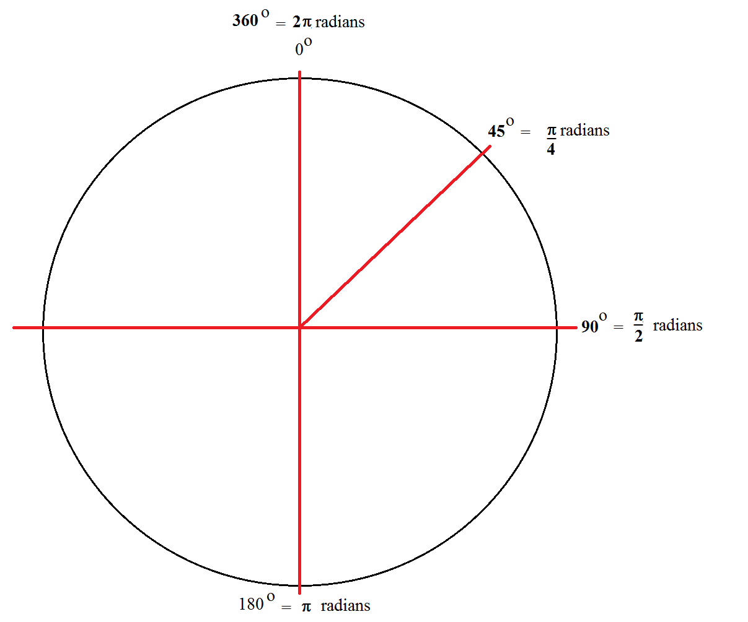
Recap
Circumference of a circle is $c=2πr$
The point from the centre to the perimeter is the radius
$radians=degrees×\frac{π}{180}$
$degrees=radians×\frac{180}{π}$

Slide 4
Frequency
Frequency is basically how frequent something happens
In terms of circular motion, frequency is determined how many cycles per unit time
E.g. You mark a point on a wheel, let it spin and count how many times it goes round
The frequency of rotation is $f=\frac{1}{T}$

Slide 5
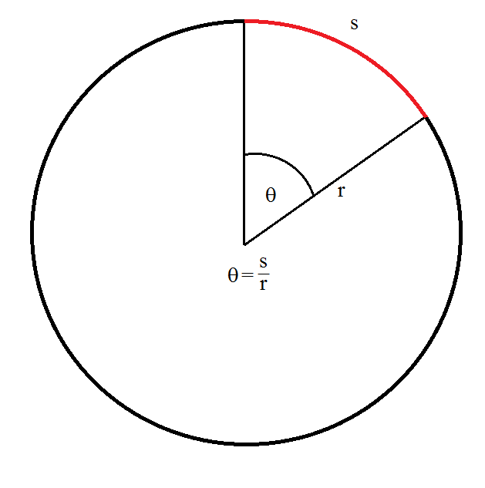
Circular Motion Basics
Motion in a straight line is an easy enough concept to deal with, however if we constrain the motion to one physical point, we produce circular motion

Slide 6
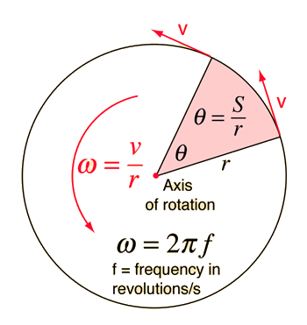
Circular Motion Basics
But what about the previous case of marking the point on the wheel? What if we want something more than just watching go around?!
Using some of our knowledge and the fundamental equation of $speed=\frac{distance}{time}$, we can find the rotational speed of the point
Unit of angular speed ω is rad s⁻¹

Slide 7
Angular Displacement
The angular displacement is given by:
$θ=\frac{arc length}{radius}=\frac{s}{r}$
Proving the 2π radians – an object travels in one complete circle from one position right back to the original position, in doing so it has travelled the circumference of the circle
$θ=\frac{s}{r}=\frac{2πr}{r}=2π$
Angular displacement in terms of rotations in a certain time frame is:
$θ=\frac{2πt}{T}=2πft$

Slide 8
Question
A cyclist travels at a speed of 12 ms⁻¹ on a bicycle which has wheels of 0.40 m radius. Calculate:
a) the frequency of rotation of each wheel
b) the angular speed of each wheel
c) the angle the wheel turns through in 0.10 s in radians and degrees

Slide 9
Question
A cyclist travels at a speed of 12 ms⁻¹ on a bicycle which has wheels of 0.40 m radius. Calculate:
a) the frequency of rotation of each wheel
b) the angular speed of each wheel
c) the angle the wheel turns through in 0.10 s in radians and degrees
a) Circumference of wheel = 2πr = 2π x 0.40 = 2.5 m
Time (period) for 1 rotation = $T=\frac{circumference}{speed}=\frac{2.5}{12}=0.21 s$
$∴frequency=\frac{1}{T}=\frac{1}{0.21}=4.8 Hz$
b) $ω=\frac{2π}{T}=\frac{2π}{0.21}=30 rad s^{−1}$
c) $θ=\frac{2πt}{T}=\frac{2π×0.10}{0.21}=3.0 rad$ or $3.0×\frac{180}{π}=172^{0}$

Slide 10
Question
During their physics field trip to the amusement park, Tyler and Maria took a rider on the Whirligig. The Whirligig ride consists of long swings which spin in a circle at relatively high speeds. As part of their lab, Tyler and Maria estimate that the riders travel through a circle with a radius of 6.5 m and make one turn every 5.8 seconds. Determine the speed of the riders on the Whirligig.
$v=\frac{2πr}{T}=\frac{2.π.6.5}{5.8}=7.04 ms^{−1}$

Slide 11
Question
The tallest Ferris wheel in the world is located in Singapore. Standing 42 stories high and holding as many as 780 passengers, the Ferris wheel has a diameter of 150 meters and takes approximately 30 minutes to make a full circle. Determine the speed of riders (in m/s and mi/hr) on the Singapore Flyer. (GIVEN: 1.00 m/s= 2.24 mi/hr)
$v=\frac{2πr}{T}=\frac{πd}{T}=\frac{π.150m}{1800s}=0.26 ms^{−1} and 0.2618×2.24=0.58 mph$

Slide 12
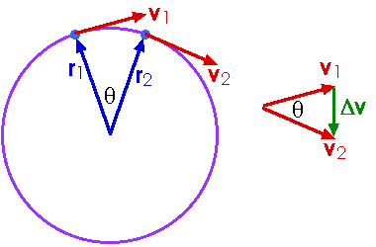
Centripetal Acceleration
We have already seen the concept of velocity in straight line motion
However, velocity being a vector quantity acts differently in circular motion

Slide 13
Centripetal Acceleration
Because the path of velocity is constantly changing, the resultant velocity (as seen on previous slide) always points ‘down’ from the motion or to be more precise….towards the centre of the circle
Due to the very nature of acceleration being a change in velocity, we see that centripetal acceleration will act in the same direction as the change in tangential velocity
Centripetal Acceleration $a=\frac{v^{2}}{r}=ω^{2}r$

Slide 14
Centripetal Force
We have a change in velocity resulting in an acceleration
We have an acceleration acting towards the centre of the circle
Because we have an acceleration acting….
We must have a force acting….
In the same direction (Newton’s 1st and 2nd laws)
Therefore centripetal force is given by:
$F=ma$ $a=\frac{v^{2}}{r}=ω^{2}r$ $∴F=\frac{mv^{2}}{r}={mω}^{2}r$

Slide 15
Satellites, Gravity and Centripetal Acceleration

Slide 16
Question
Calculate the centripetal force and acceleration of a 3.0 Kg mass tied in a rope and swung in a circle of radius 0.75 m, which is moving in a velocity of 4.0 m/s?
$F=\frac{mv^{2}}{r}=\frac{3×4^{2}}{0.75}=64 N$
$a=\frac{v^{2}}{r}=\frac{4^{2}}{0.75}=21.33 ms^{−1}$

Slide 17
Question
A car of mass 1000 Kg moves in a circular path of radius 50 m. The constant speed of car is given by 12 m/s. Determine the centripetal force of the car?
$F=\frac{mv^{2}}{r}=\frac{1000×{12}^{2}}{50}=2880 N$

Slide 18
Question
A car is moving with a constant velocity around a circular path. If the radius of the circular path is 48.2 m and the centripetal acceleration is 8.05 m/s² , what is the tangential speed of the car?
$a=\frac{v^{2}}{r}$
$∴v=\sqrt{a×r}=\sqrt{8.05×48.2}=19.7 ms^{−1}$

Slide 19
Conversion Factors

Slide 20
Hard Question
You are designing and aeroplane propeller that is to turn at 2400 rpm. The forward airspeed of the plane is to be 75.0 ms⁻¹, and the speed of the tips of the propeller through the air must not exceed 270 ms⁻¹ (this is approx. 80% the speed of sound in air and would produce less noise).
(a) what is the maximum possible propeller radius?
(b) with this radius, what is the acceleration of the propeller tip?

Slide 21
Hard Question
(a) $ω=2400 rpm=2400×\frac{2π}{60}=251 rad s^{−1}$
From figure (a) we find that $v_{tan}=rω$ and relying upon finding the hypotenuse from Pythagoras in figure (b):
$v_{tip}^{2}=v_{plane}^{2}+v_{tan}^{2}=v_{plane}^{2}+r^{2}ω^{2}$
$∴r=\sqrt{\frac{v_{tip}^{2}−v_{plane}^{2}}{ω^{2}}}=\sqrt{\frac{{270}^{2}−{75}^{2}}{{251}^{2}}=1.03 m}$
(b) $a=ω^{2}r={251}^{2}×1.03=6.5×10^{4} ms^{−2}$

