Slide 1
Circular Motion
Objective
Be able to find angular displacement and angular speed.
Be able to calculate centripetal force.

Slide 2
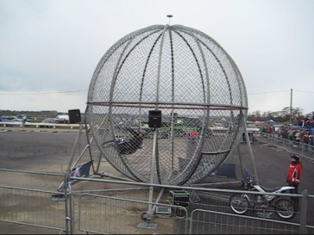
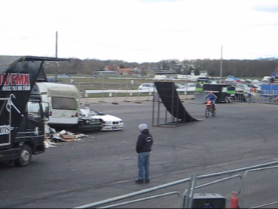
Circular Motion
Examples of motion in a circle:
satellites; CDs; roller coasters; car round a bend;
engine parts.
Circular motion
BMX wall ride
Wall of death

Slide 3

Angular Displacement
Consider a bike wheel which is rotating.
In order to do useful calculations, we need to talk about angular displacement and angular velocity.
θ = angular displacement (rad)
= angular velocity (rad s⁻¹)
If the wheel takes T seconds to rotate once, it will turn through an angle of 2π / T radians each second.
The frequency of rotation will be given by f = 1/T
The angular displacement in a certain amount of time, t, is given by:
θ = 2πt / T OR θ = 2πft

Slide 4
Angular Velocity
Circumference = 2πr
Time for one rotation = distance travelled / velocity
= 2πr / v OR 2π / ω
In other words:
2πr / v = 2π / ω
v = r ω
From the previous slide,
θ = 2πft
We also know that ω = θ / t
∴ ω = 2πf

Slide 5
Worked example
A cyclist travels at a speed of 12 ms⁻¹ on a bike which has wheels of radius 40cm. Calculate:
a the frequency of rotation of each wheel;
b the angular speed of each wheel;
c the angle the wheel turn through in 0.10s in:
i radians ii degrees
Using standard notation:
v = 12ms⁻¹
r = 0.4m
a circumference = 2 x π x 0.4
= 2.5m
T = circumference / speed = 2.5 / 12
= 0.21s
f = 1 / T = 1 / 0.21
= 4.8Hz
b ω = 2πf
= 30rads⁻¹
c i θ = ωt = 30 x 0.1
3.0rad
i θ = 3.0 x 360 / 2π
= 172⁰
A few questions
P23 qu 1-4

Slide 6
Centripetal Force
If you pick any point on this bike wheel, it will rotate with a constant speed, but its direction will be constantly changing.
This means its velocity is changing.
It is always accelerating.
This is called centripetal acceleration.
Centripetal acceleration is given by:
a = v² / r
= ω² r
And, since it’s accelerating, there must be a force. This is called centripetal force.
By applying N2, we get:
F = mv² / r
= mrω²
Centripetal force is not a TYPE of force, but a DESCRIPTION of the force. The centripetal force is the force which causes the acceleration towards the centre. It can come from all sorts of places – gravity, tension in a string, etc.

Slide 7
Worked example
A stone of mass 0.5kg is swung round in a horizontal circle (on a frictionless surface) of radius 0.75m with a steady speed of.
Calculate:
a the centripetal acceleration of the stone;
b the centripetal force acting on the stone.
Using standard notation:
m= 0.5kg
r= 0.75m
v= 4ms⁻¹
a) a = v²/r
= 4² / 0.75
= 21.4 m s⁻²
  F = ma
= 0.5 x 21.4
= 10.7 N
Notice that this is a linear acceleration and not an angular acceleration. The angular velocity of the stone is constant and so there is no angular acceleration.
Here’re the usual questions:
P25 – qu 1-4

Slide 8
Applications of Circular Motion - Cars
Objective
Explain what forces are experienced when cars travel over hills and round bends.

Slide 9
It might be an idea to copy the next few slides. They’re examples of how you need to think through certain types of problem.
Add whatever notes you need to ensure that it makes sense to you.
The key thing for each type of problem is to figure out where the centripetal force comes from.

Slide 10
Cars going over bumps / hills / bridges
S
The car is supported by a force, S.
When v=0, S = mg.
As v increases, the car has a greater tendency to continue in a straight line. This is because S decreases.
v
mg
The centripetal force is the resultant of S and mg:
F = mg - S
And we know that F = mv² / r
∴ mg – S = mv² / r
As v increases, a greater centripetal force is required to keep it moving in a circle. This happens by S decreasing.
F_{max} occurs when S = 0
The fastest speed the car can travel over the hill will be given by:
mg = mv_{max}² / r OR v_{max} = √gr

Slide 11
Cars going round bends
The centripetal force is provided by the friction of the tyres on the road.
v
The car has a certain top speed, v_{max} before it begins to slip on the road because the friction is not enough to provide the centripetal force.
Friction
Friction_{max} = m v_{max}² / r
In questions on this sort of thing, you’ll be given details of the friction.

Slide 12
Banked tracks
R
This is supposed to be a car coming towards us. It’s travelling round a bend and the track is banked at an angle, θ.
Centripetal
force
θ
mg
IF there’s no friction on the tyres, the centripetal force is provided by the horizontal component of R.
F = R sinθ (which is also equal to mv² / r)
mg is balanced by the vertical component of R, so:
mg = R cosθ
R sinθ
mv²
=
OR tanθ = v² / gr
R cosθ
rmg

Slide 13
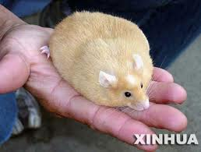
Worked example
My hamster has a mass of 2kg (he’s a big lad). He has a top speed of 15ms⁻¹. Is he able to run over a hill of radius 20m at top speed without taking off? (g = 9.8ms⁻²).
Say the hamster is supported by a force, S.
The centripetal force is the resultant of S and mg:
F = mg – S
F_{max} will occur when S = 0
F_{max} = mg
BUT centripetal force is also given by F = mv² / r
The fastest the animal can travel over the hill will be given by:
mg = mv_{max}² / r
v_{max} = √gr
= 14ms⁻¹
No, he can’t run over the hill at top speed.
Some questions
P27 – Qu 1-4

Slide 14
Applications of Circular Motion – Fairground Rides
Objective
Explain what forces are experienced on a variety of fairground rides.

Slide 15
Big dippers
When you go down a dip, you’re forced down into your seat.
S represents the support force of the track on the car.
S
The centripetal force is the resultant of S and mg, and is also equal to mv² / r:
F = S – mg = mv² / r
∴ S = mg + mv² / r
v
mg
Since we experience mg in normal circumstances anyway, the extra force pushing downwards is mv² / r

Slide 16
Very long swings
L
Maximum speed is calculated by equating GPE at the top and KE at the bottom:
v² = 2gh
S
At the lowest point, centripetal force is provided by the resultant of S and mg:
S – mg = mv² / L
BUT v² = 2gh
S – mg = 2mgh / L
OR S = mg + 2mgh / L
mg
Since we experience mg in normal circumstances anyway, the extra force experienced is 2mgh / L

Slide 17
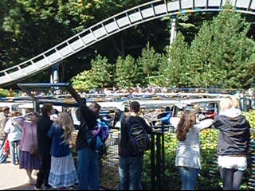
Big wheel thingy
On this big wheel thingy, the riders are being squished against the inside of the circumference.
R is the reaction force from the wheel.
Person at top
R + mg
At the maximum height, the centripetal Force is provided by R + mg and is equal to mv² / r
R = mv² / r - mg
A bit of practice
p29
At a certain speed, v₀ (so that v₀² = gr), R = 0.
∴ There is no reaction force on the person.
You must have a minimum speed of v₀ to stop people falling out.
Exam questions p30 qu2, 4, 5b, c i, 6a, b ii, 7a, b, 8b

Slide 18
Every measurement has a degree of uncertainty. The number of reliably known digits in a number is called the number of significant figures.
For example the radius of the earth is 695 000 000 m. This number is not exact but has been “rounded off” to the nearest million metres. We say the number has three significant figures. The zeros at the end of this number are “not significant”.
In some numbers zeros are significant. For example in a measurement stated as 605mm the zero is significant. The rules for determining the number of significant figures are as follows:
• all non-zero digits are significant
• zeros between non-zero digits are significant
• zeros at the end of a decimal are significant
• all other zeros are not significant.
Using these rules 65.00 has four significant figures but each of the numbers 65, 6500, and 0.0065 has only two significant figures.
When answering a question, the accuracy of your response should be the same as the least accurate figure given in the question.

Slide 19
Exam questions p30 qu2, 4, 5b, c i, 6a, b ii, 7a, b, 8b

