Slide 1
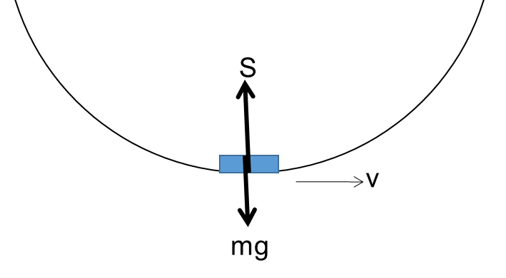
CW | Applications of centripetal Acceleration | 09/06/2016
For each case below state, describe and explain what the centripetal force is
S
v
mg
From my learning today I will be able to:
Key: | Identify and describe Centripetal Acceleration and force for each case (C)
Boost: | Explain what forces are experienced when cars travel over hills and round bends. (B)
Aspire: | Calculate Centripetal Acceleration and force for each case (A)
Objective

Slide 2
Cars going over bumps / hills / bridges
The car is supported by a force, S.
When v=0, S = mg.
As v increases, will happen? Why will this happen?
S
v
mg

Slide 3
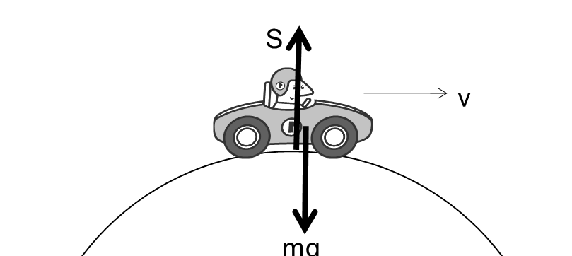
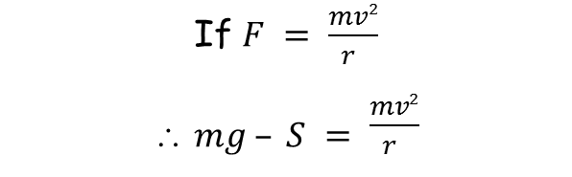

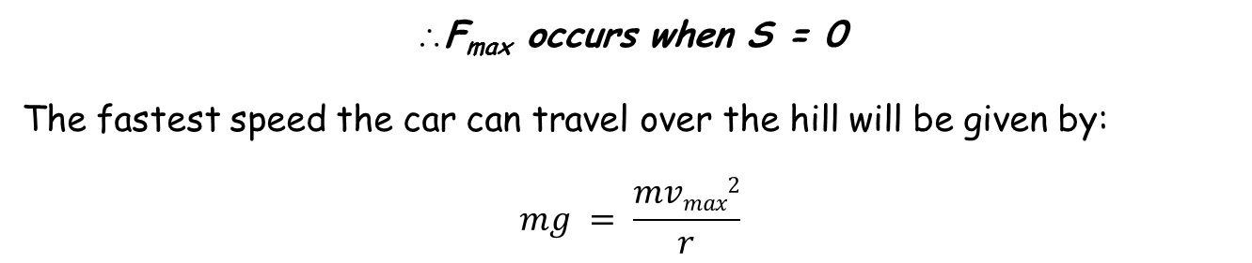
The centripetal force is the resultant of S and mg:
$$F = mg − S$$
If $F = \frac{mv2}{r }$
∴ $mg – S = \frac{mv2}{r }$
As v increases the car is more likely to leave the road. This means the resultant force decreases to 0. Ie - S decreases.
F_{max} occurs when S = 0
The fastest speed the car can travel over the hill will be given by:
$$mg = \frac{mvmax2}{r}$$

Slide 4
Cars going round bends
What is the centripetal force provided by?
The car has a certain top speed, v_{max} before it begins to slip on the road.
Why does this happen?
v
Friction
Friction_{max} = m v_{max}² / r
In questions on this sort of thing, you’ll be given details of the friction.

Slide 5
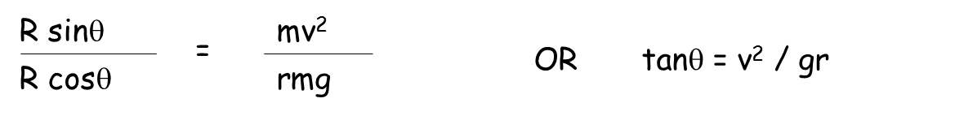
Banked tracks
This is supposed to be a car coming towards us.
It’s travelling round a bend and the track is banked at an angle, θ.
R
Centripetal
force
θ
mg
IF there’s no friction on the tyres, the centripetal force is provided by the horizontal component of R.
F = R sinθ (which is also equal to mv² / r)
mg is balanced by the vertical component of R, so:
mg = R cosθ

Slide 6
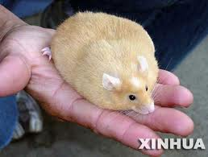
My hamster has a mass of 2kg (he’s a big lad). He has a top speed of 15ms⁻¹. Is he able to run over a hill of radius 20m at top speed without taking off? (g = 9.8ms⁻²).
Say the hamster is supported by a force, S.
The centripetal force is the resultant of S and mg:
F = mg – S
F_{max} will occur when S = 0
F_{max} = mg
BUT centripetal force is also given by F = mv² / r
The fastest the animal can travel over the hill will be given by:
mg = mv_{max}² / r
v_{max} = √gr
= 14ms⁻¹
No, he can’t run over the hill at top speed.
Some questions
P27 – Qu 1-4

Slide 7
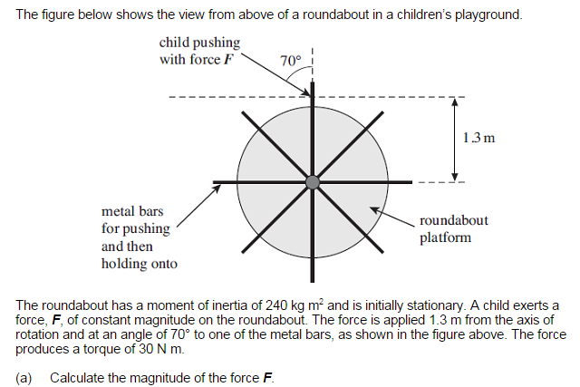
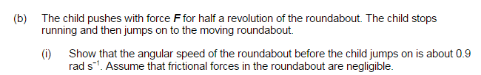

Slide 8
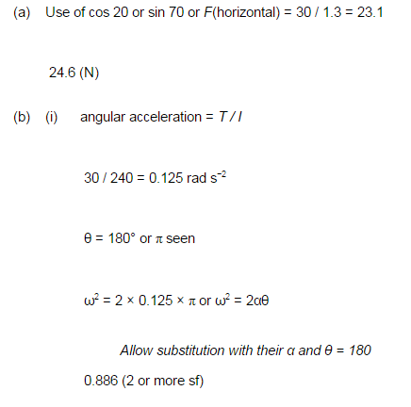

Slide 9
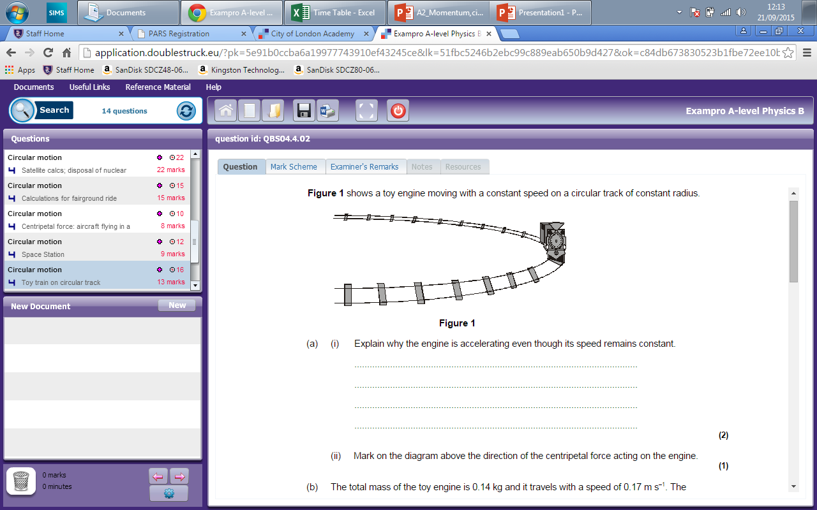

Slide 10
