Slide 1
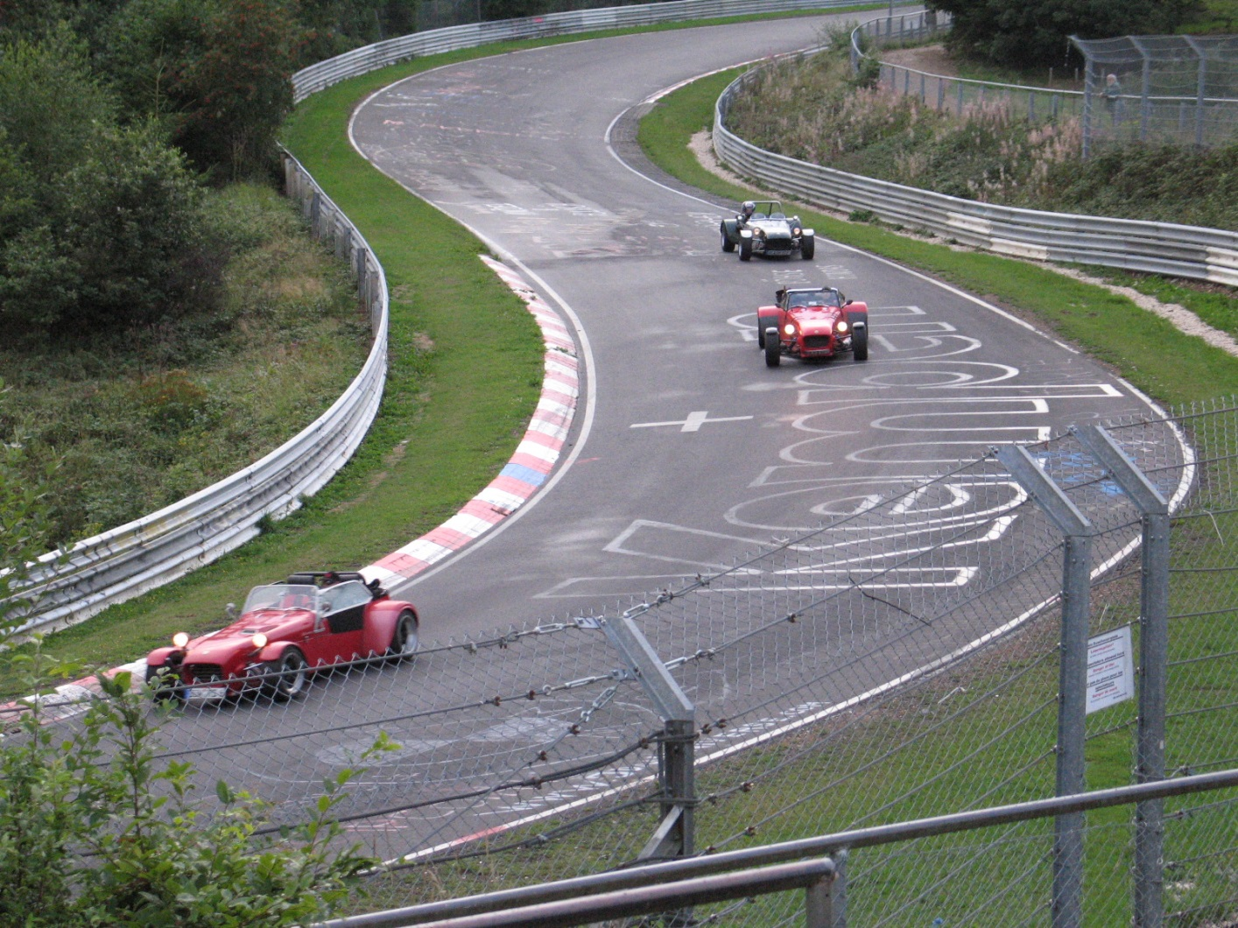
On the road
What forces are acting on these cars?
Notice that the track is banked…

Slide 2
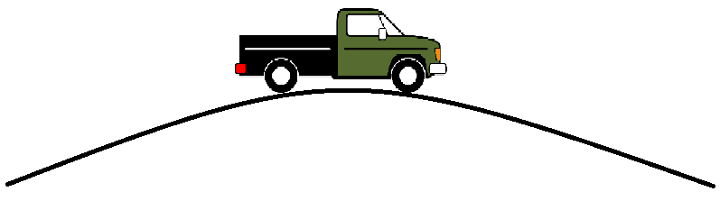
Over the hill?
We can calculate the centripetal force from an object rounding a hill top, as well as comparing it to the support force from the ground and gravity:
S is the support force from the ground

Slide 3
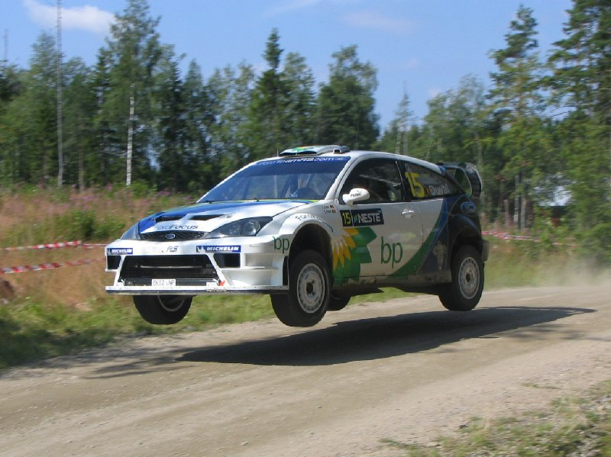
If a car goes too fast then the support force will become zero as the car appears to become weightless.
Any faster and the car will jump the hill!

Slide 4
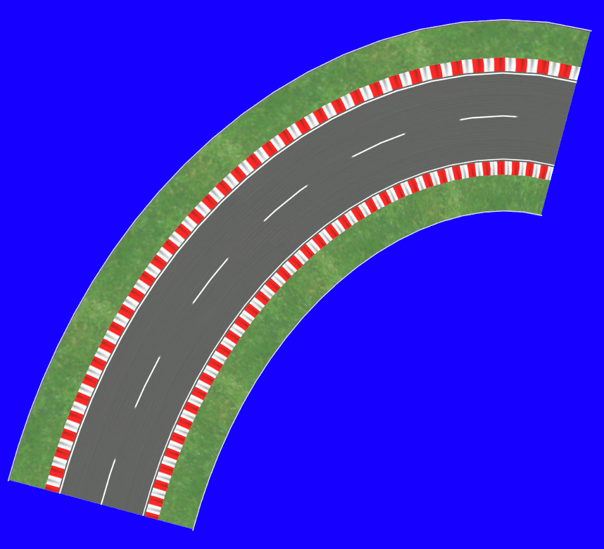
Cornering
The exact same principle can be used on a corner or roundabout, except here the force is Friction (not weight)
(Where the force of friction is a limiting force which is proportional to the mass of the vehicle)

Slide 5
Links to friction
There is a constant called the coefficient of friction μ between surfaces – this depends on the surfaces themselves.
Substitution into the formula from the previous slide and simplifying gives a formula for the maximum velocity around a bend without slipping:

Slide 6
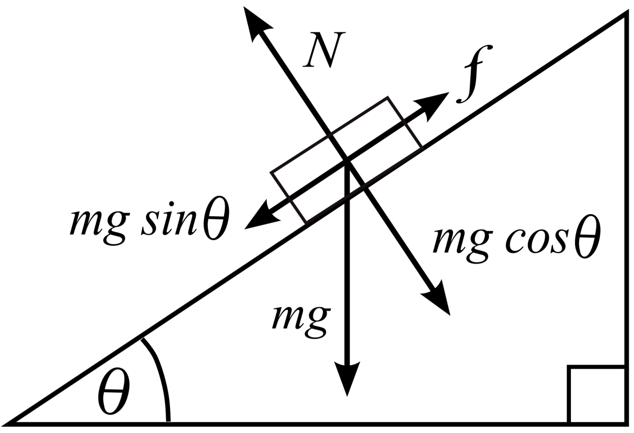
Banked curves
Resolving the vectors for an object on a slope gives the force along the slope toward the centre. At a certain speed the centripetal force will equal this and hence no friction is needed to corner!

Slide 7
Summary
Centripetal force can be equated to weight if an object goes over a circular rise (Most hilltops can be modelled as part of a circle) and the maximum velocity can be calculated
During cornering then friction is equated to centripetal force to find the limiting velocities until slipping
Banked surfaces on corners can be created so that at a certain velocity no friction is required to make the object follow a circular motion.

