Slide 1
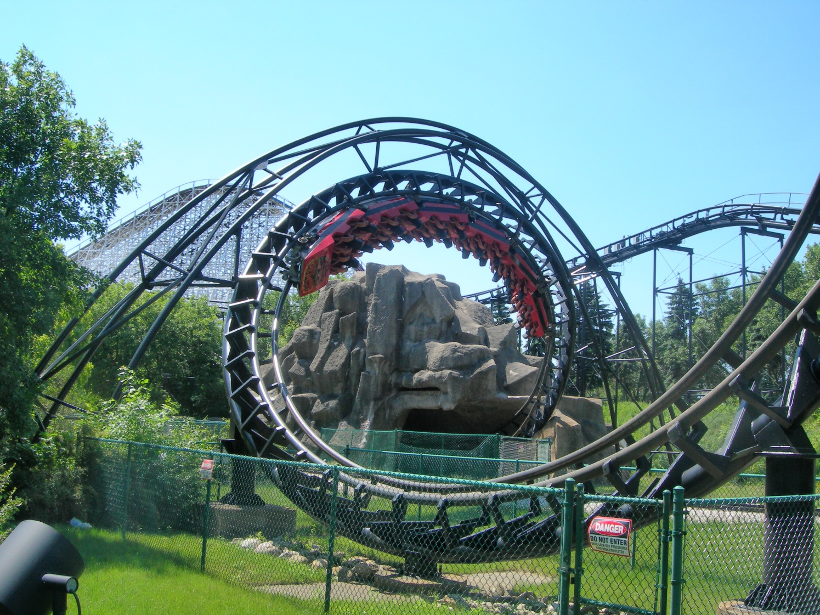
At the Fairground
What forces act on the people in this carriage during the ride?

Slide 2
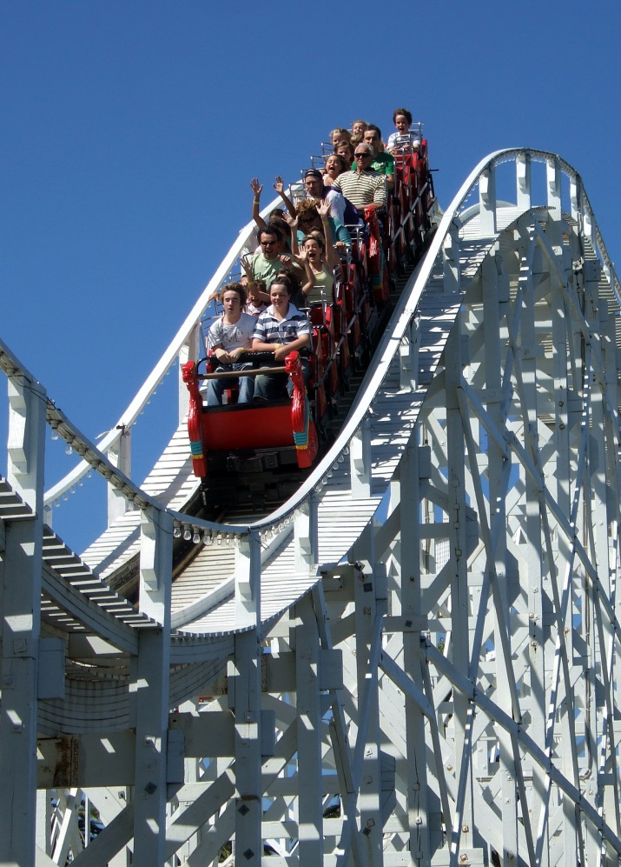
The BIG Dipper
A cart is moving with a velocity v through a dip. This can be modelled as a section of a circle. The centripetal force is acting upwards and this is balanced by a combination of weight and support force.
Therefore the force “felt” by the passengers is:

Slide 3
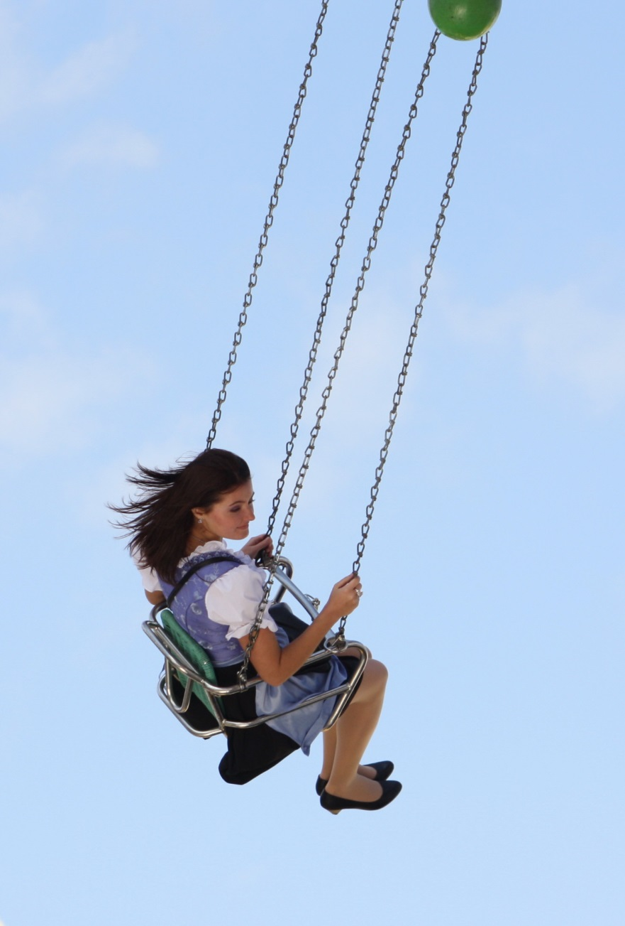
The very long swing
A person on a long swing turns gravitational potential energy into kinetic energy:
This final formula gives the support force due to motion. The overall tension in the chains of the swing are:
If the swing is length L then we also have:
Rearranging and cancelling gives:
Substituting in v² gives the support force:

Slide 4
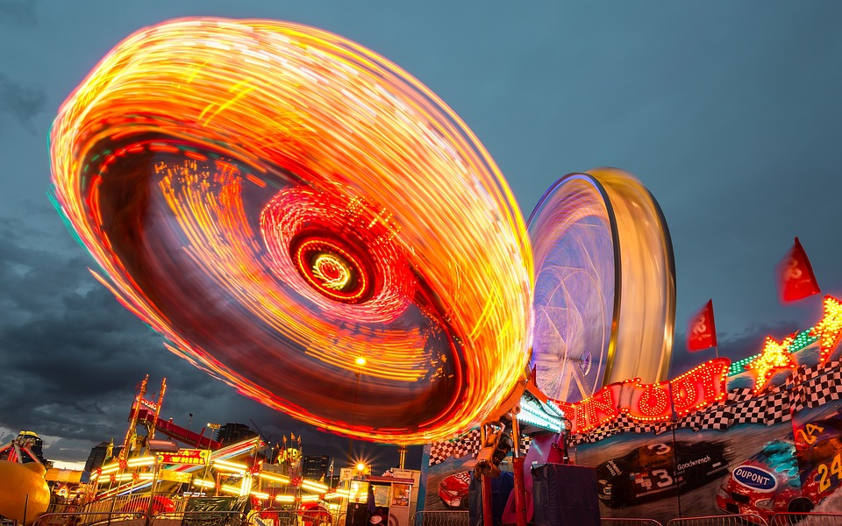
Gravity Wheel
A vertical wheel with a person on the inside can rotate fast enough so that the centripetal force is the same as or greater than their weight, so the person does not fall away from the wall at the top.
At the correct speed the reaction force is zero so they feel weightless at the top:

Slide 5
Summary
All fairground rides are designed with forces in mind. You can often use circular mechanics to work out the forces involved
The people in the rides will feel the overall force which is usually the support or reaction force plus gravity
When creating your formulae you must consider if gravity and the reaction forces are operating in the same direction or not
Centripetal force is what causes the circular motion so is therefore the sum of the other forces, not a separate force – Often students misunderstand this!

