Slide 1
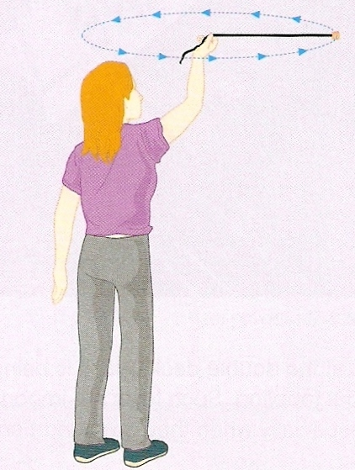
Calculate the centripetal tension force in a string used to whirl a mass of 200g around a horizontal circle of radius 70cm at 4.0ms⁻¹.
ΣF = m v² / r
= (0.200kg) x (4.0ms⁻¹)² / (0.70m)
tension = 4.6 N

Slide 2
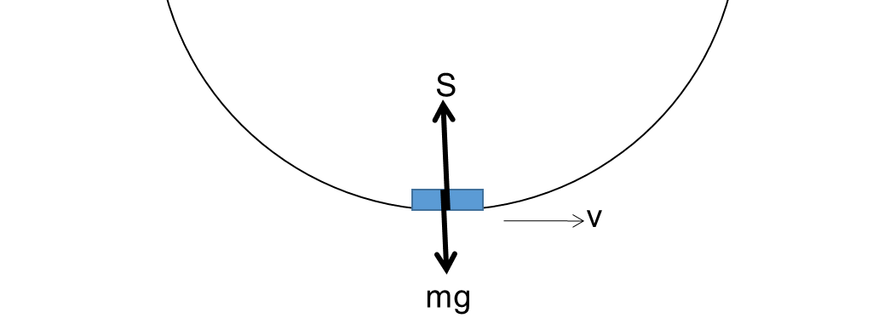
Big dippers
When you go down a dip, you’re forced down into your seat.
S represents the support force of the track on the car.
The centripetal force is the resultant of S and mg, and is also equal to mv² / r:
F = S – mg = mv² / r
∴ S = mg + mv² / r
Since we experience mg in normal circumstances anyway, the extra force pushing downwards is mv² / r

Slide 3
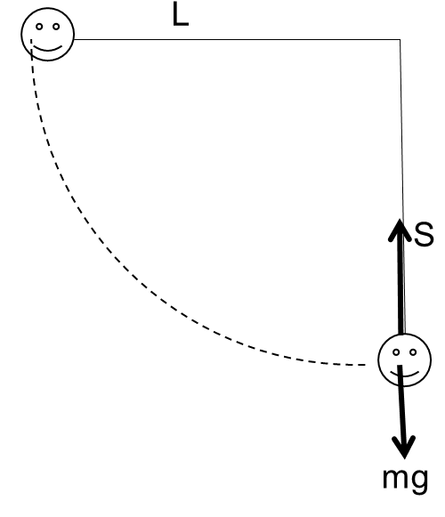
Very long swings
Maximum speed is calculated by equating GPE at the top and KE at the bottom:
v² = 2gh
At the lowest point, centripetal force is provided by the resultant of S and mg:
S – mg = mv² / L
BUT v² = 2gh
S – mg = 2mgh / L
OR S = mg + 2mgh / L
Since we experience mg in normal circumstances anyway, the extra force experienced is 2mgh / L

Slide 4

Big wheel thingy
On this big wheel thingy, the riders are being squished against the inside of the circumference.
R is the reaction force from the wheel.
Person at top
At the maximum height, the centripetal Force is provided by R + mg and is equal to mv² / r
R = mv² / r - mg
R + mg
A bit of practice
p29
At a certain speed, v₀ (so that v₀² = gr), R = 0.
∴ There is no reaction force on the person.
You must have a minimum speed of v₀ to stop people falling out.
Exam questions p30 qu2, 4, 5b, c i, 6a, b ii, 7a, b, 8b

Slide 5
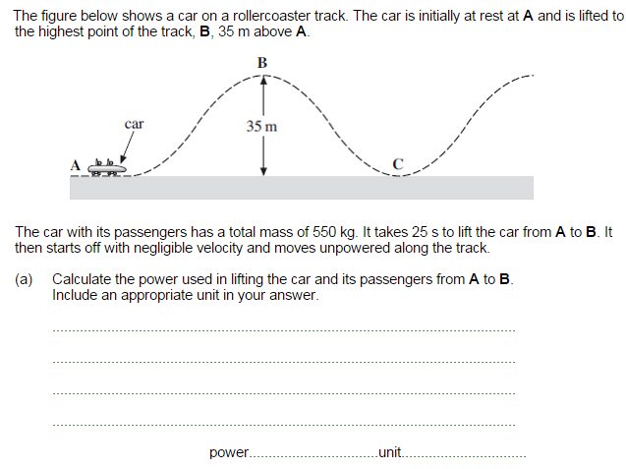

Slide 6
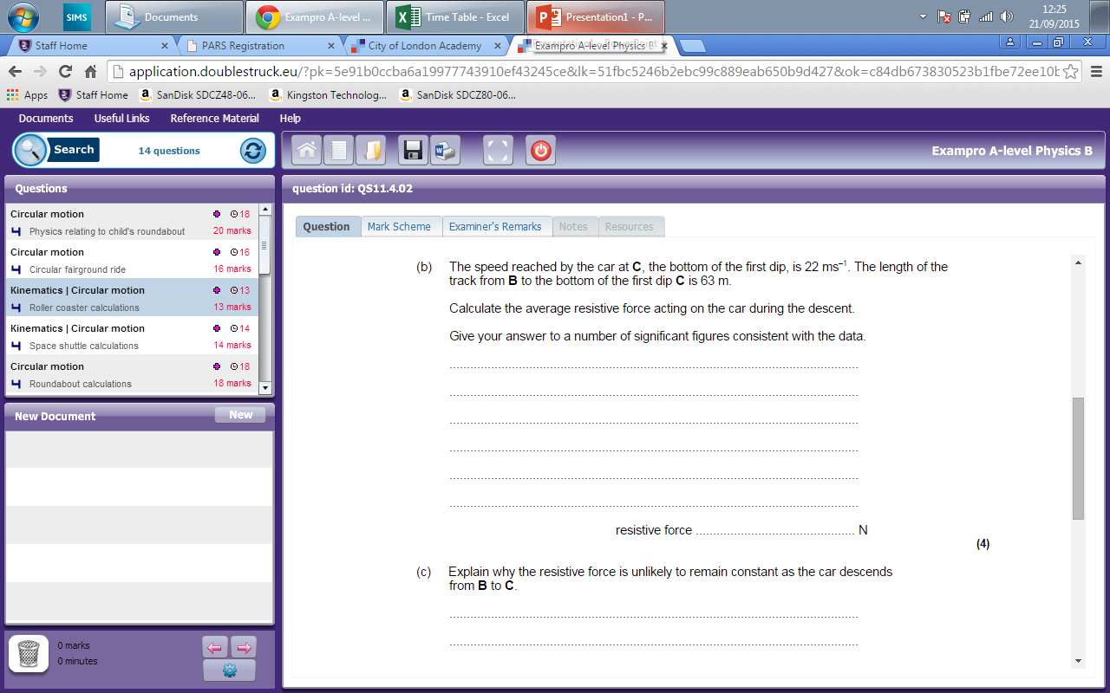
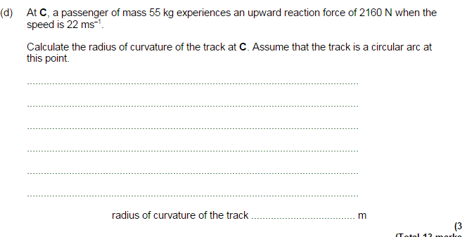

Slide 7
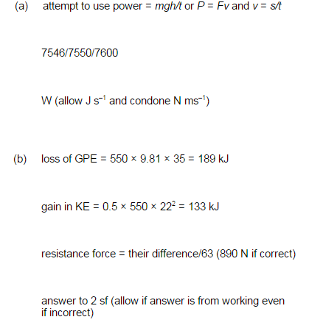
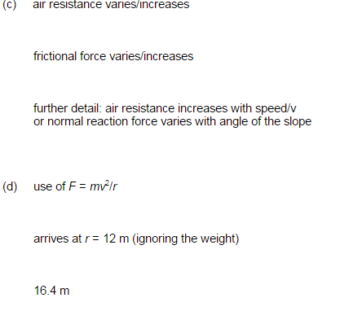

Slide 8
Every measurement has a degree of uncertainty. The number of reliably known digits in a number is called the number of significant figures.
For example the radius of the earth is 695 000 000 m. This number is not exact but has been “rounded off” to the nearest million metres. We say the number has three significant figures. The zeros at the end of this number are “not significant”.
In some numbers zeros are significant. For example in a measurement stated as 605mm the zero is significant. The rules for determining the number of significant figures are as follows:
• all non-zero digits are significant
• zeros between non-zero digits are significant
• zeros at the end of a decimal are significant
• all other zeros are not significant.
Using these rules 65.00 has four significant figures but each of the numbers 65, 6500, and 0.0065 has only two significant figures.
When answering a question, the accuracy of your response should be the same as the least accurate figure given in the question.

