Slide 1
Simple Harmonic Motion II
Displacement | Velocity | Acceleration
+ A | 0 | - (2π f )² A
0 | ± 2π f A | 0
- A | 0 | + (2π f )² A
A ?
B ?
C ?
D?
E ?
E ?
From my learning today I will be able to:
Key: | Describe the principles of simple harmonic motion C
Boost: | Calculate phase difference and acceleration for simple harmonic systems- B
Aspire: | Derive expressions from circular motion– A/A*

Slide 2
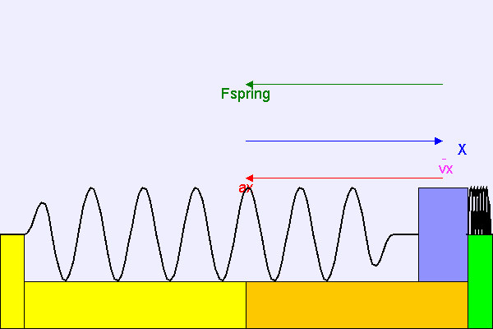
Variation of x, v and a with time
The acceleration, ax depends on the resultant force, Fspring on the mass.
Note that the acceleration ax is always in the opposite direction to the displacement, X.
Notes:
2

Slide 3
SHM time graphs
+ A
x
x
v
a
time
v
T/4 T/2 3T/4 T 5T/4 3T/2
a
- A
x = A cos (2π f t)
v = - 2π f A sin (2π f t)
v_{max} = ± 2π f A
a = - (2π f )² A cos (2π f t)
a_{max} = ± (2π f )² A
Note: The velocity curve is the gradient of the displacement curve
and the acceleration curve is the gradient of the velocity curve.
Notes:
3

Slide 4
Variation of x, v and a with time
The acceleration, ax depends on the resultant force, Fspring on the mass.
Note that the acceleration ax is always in the opposite direction to the displacement, X.
Notes:
4

Slide 5
Question
A body oscillating with SHM has a period of 4.0ms and amplitude of 30μm. Calculate (a) its maximum speed and (b) its speed when its displacement is 15μm.
f = 1 / T
= 1 / 4.0ms
= 1 / 0.004s
= 250Hz
(a) v = ± 2πf √(A² − x ²)
maximum speed occurs when x = 0
v_{max} = ± 2πf √(A²) = ± 2πf A
= ± 2π x 250 x 30μm
= ± 2π x 250 x 0.000 030m
maximum speed = 0.0471 ms⁻¹
(b) v = ± 2πf √(A² − x ²)
= ± 2π x 250 x √((0.000 030m)²
− (0.000 015m)²)
= ± 500π x √((0.000 030m)²
− (0.000 015m)²)
= ± 500π x √((9 x 10 ⁻¹⁰)
− (2.25 x 10 ⁻¹⁰))
= ± 500π x √(6.75 x 10 ⁻¹⁰)
= ± 500π x 2.598 x 10 ⁻⁵
speed = 0.0408 ms⁻¹
Notes:
5

Slide 6



Slide 7


Slide 8



Slide 9
Variation of x, v and a with time
The acceleration, ax depends on the resultant force, Fspring on the mass.
Note that the acceleration ax is always in the opposite direction to the displacement, X.
Notes:
9

Slide 10

The spring-mass system
If a mass, m is hung from a spring of spring constant, k and set into oscillation the time period, T of the oscillations is given by:
T = 2π√(m / k)
Mass on spring - Fendt
AS Reminder: Spring Constant, k:
This is the force in newtons required to cause a change of length of one metre.
k = F / ΔL
unit of k = Nm⁻¹
Notes:
10

Slide 11
Question
A spring extends by 6.0 cm when a mass of 4.0 kg is hung from it near the Earth’s surface (g = 9.8ms⁻²). If the mass is set into vertical oscillation state or calculate the period (a) near the Earth’s surface and (b) on the surface of the Moon where g = 1.7 ms⁻².
The spring constant, k is given by:
k = F / ΔL
= (4.0 x 9.8) / 0.060m
= 653.3 Nm⁻¹
(a) T = 2π√(m / k)
= 2π √(4.0 / 653.3)
= 2π √(0.006122)
time period = 0.49s
(b) g does not appear in the time period equation of the spring.
Therefore the period on the Moon is the same = 0.49s
Notes:
11

Slide 12

The simple pendulum
A simple pendulum consists of:
a point mass
undergoing small oscillations (less than 10°)
suspended from a fixed support
by a massless, inextendable thread of length, L
within a gravitational field of strength, g
The time period, T is given by:
T = 2π√(L / g)
  Simple Pendulum - Fendt
Notes:
12

Slide 13
Question
Calculate: (a) the period of a pendulum of length 20cm on the Earth’s surface (g = 9.81ms⁻²) and (b) the pendulum length required to give a period of 1.00s on the surface of the Moon where g = 1.67ms⁻².
(a) T = 2π√(L / g)
= 2π √(0.20m / 9.81ms⁻²)
= 2π √(0.204)
time period = 0.90s
(b) T = 2π√(L / g)
becomes: T² = 4π² (L / g)
becomes: L = T²g / 4π²
= ((1.00)² x 1.67) / 4π²
length = 0.0423m (3.23cm)
Notes:
13

