Slide 1
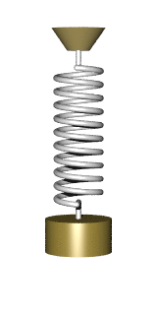
CW | SHM and Time periods | 13/11/2018
Think about a spring and mass system moving with SHM.
What do you think affects the period of oscillation?
From my learning today I will be able to:
Key: | Describe the experiment to find g (C)
Boost: | Calculate the time period of a mass on a spring and a simple pendulum (B)
Aspire: | Suggest an experimental method to find the gravitational field strength (A)

Slide 2
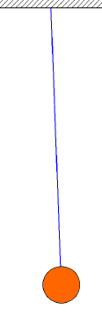
What about a Pendulum?

Slide 3
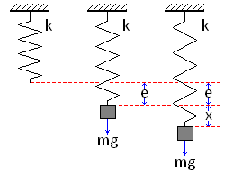
For a spring displaced from its equilibrium position (after the mass has already displaced it) the following equation gives the restoring force acting upon the spring.
What is this restoring force?
Connect what we’ve learnt in the previous lessons.

Slide 4
Derivation of Time period for a mass spring system

Slide 5
Question
A spring extends by 6.0 cm when a mass of 4.0 kg is hung from it near the Earth’s surface (g = 9.8ms⁻²). If the mass is set into vertical oscillation state or calculate the period (a) near the Earth’s surface and (b) on the surface of the Moon where g = 1.7 ms⁻².
The spring constant, k is given by:
k = F / ΔL
= (4.0 x 9.8) / 0.060m
= 653.3 Nm⁻¹
(a) T = 2π√(m / k)
= 2π √(4.0 / 653.3)
= 2π √(0.006122)
time period = 0.49s
(b) g does not appear in the time period equation of the spring.
Therefore the period on the Moon is the same = 0.49s
Notes:
5

Slide 7
The simple pendulum
A simple pendulum consists of:
a point mass
undergoing small oscillations (less than 10°)
suspended from a fixed support
by a massless, inextendable thread of length, L
within a gravitational field of strength, g
The time period, T is given by:
T = 2π√(L / g)
  Simple Pendulum - Fendt
Notes:
7

Slide 8
Question
Calculate: (a) the period of a pendulum of length 20cm on the Earth’s surface (g = 9.81ms⁻²) and (b) the pendulum length required to give a period of 1.00s on the surface of the Moon where g = 1.67ms⁻².
(a) T = 2π√(L / g)
= 2π √(0.20m / 9.81ms⁻²)
= 2π √(0.204)
time period = 0.90s
(b) T = 2π√(L / g)
becomes: T² = 4π² (L / g)
becomes: L = T²g / 4π²
= ((1.00)² x 1.67) / 4π²
length = 0.0423m (3.23cm)
Notes:
8

Slide 9


Slide 16
