Slide 1
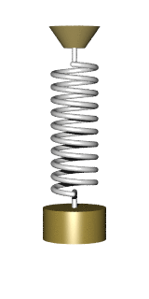
CW | Damped Systems and Resonance | 27/11/2018
Think about a spring and mass system moving with SHM.
Explain what’s incorrect about its motion for real world applications?
From my learning today I will be able to:
Key: | Describe how energy is lost in a Simple harmonic system and what Resonance is (C)
Boost: | Explain the difference between free and forced vibrations and the circumstances required for resonance to occur (B)
Aspire: | Suggest practical engineering applications for Dampening and resonance (A/A*)

Slide 2
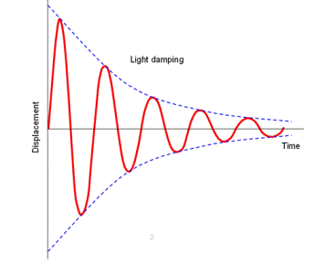
Explain what’s happening to the energy in this system?
Connect this graph to a real example from what we’ve learnt about so far

Slide 3
Oscillations die away due to dissipative forces. When this happens, the system is said to be damped.

Slide 4
As the pendulums amplitude reaches 0, what happens the frequency of oscillation?

Slide 6
Explain what causes the difference between the red and green line on the graph.
Critical damping brings the body back to the equilibrium point very quickly with out oscillation.
Over damping also prevent oscillation but makes the body take a longer time to reach equilibrium

Slide 7
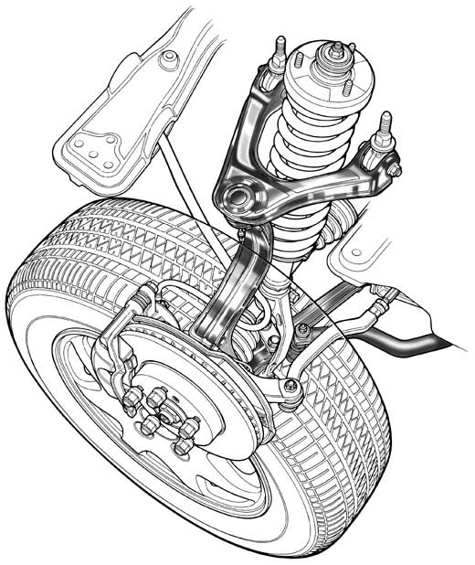
A car suspension system includes a spring and damper. The damper provides almost critical damping.
Explain what this is and how it occurs. Suggest why this type of damping is useful for a car (6 marks)
To answer this question:
1-2 | The information conveyed by the answer is poorly organised and may not be relevant or coherent. There is little correct use of specialist vocabulary. The form and style of writing may be only partly appropriate
3-4 | The information conveyed by the answer may be less well organised and not fully coherent. There is less use of specialist vocabulary, or specialist vocabulary may be used incorrectly. The form and style of writing is less appropriate.
5-6 | The information conveyed by the answer is clearly organised, logical and coherent, using appropriate specialist vocabulary correctly. The form and style of writing is appropriate to answer the question.

Slide 8
Natural frequency - frequency at which objects vibrate when no force is applied.
Periodic force - regular pushes at the right times to make it swing higher.
When a periodic force is applied, a system undergoes forced oscillation.

Slide 9
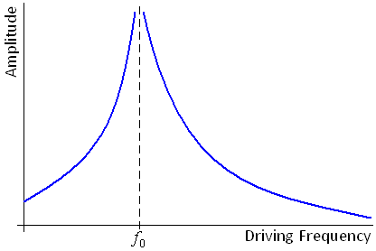

Slide 10
Phase Difference between driver and driven
When the driving force begins to oscillate the driven object the phase difference is 0.
When resonance is achieved the phase difference between them is π.
When the driving frequency increases beyond the natural frequency the phase difference increases to π/2.

Slide 11
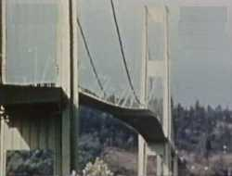
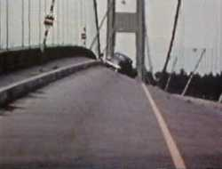
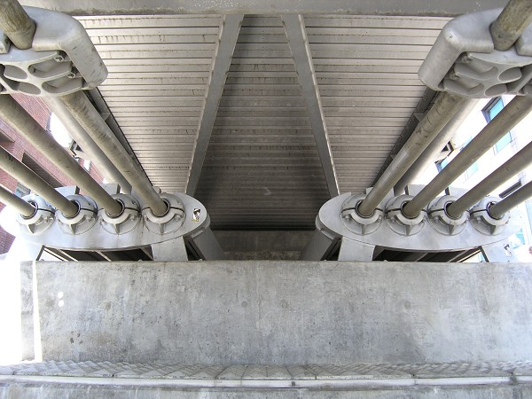
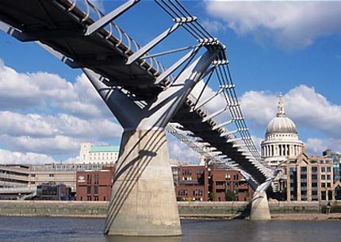
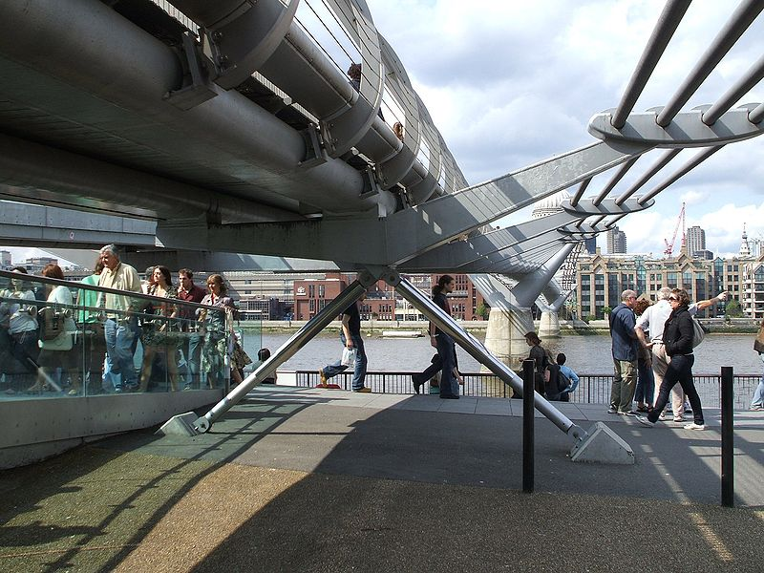
In 1940, a periodic force due to a 40 mph wind set up resonance in a bridge across Tacoma Narrows in the US.
Tacoma Narrows Bridge
In 2000, the Millennium Bridge swayed when people walked across it. It was later fitted with dampers to overcome the problem.

Slide 12
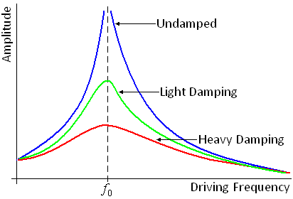
Damping reduces the size of the oscillations at resonance. There is still a maximum amplitude reached but it is much lower than when the system is undamped.
We say that damping reduces the sharpness of resonance. This becomes clearer if we look at the graph on the left.
It shows the amplitude of oscillation against frequency for different levels of damping.

Slide 14
A U-tube manometer is half-filled with water. The liquid levels are displaced so that one side is higher than the other. The water is then left free to oscillate from side to side. The tube has a cross section area of 1cm² and the initial displacement is 0.1 m from the rest position, which is 0.5 m above the middle of the bottom of the tube. The total length of tube filled with water is 1.1 m. g = 10 N kg^{–1}
Using the relationship: pressure = density x g x depth, calculate the pressure at the bottom of the tube due to each of the unbalanced columns of water and hence the resultant force acting. g = 10 m s^{–2}
How will the force vary as the levels move towards their rest positions?
Show that the restoring force is proportional to the displacement and hence that the resultant motion is simple harmonic.
Explain why the period remains constant as the oscillations die away due to friction.
How will the motion differ if mercury is used instead of water, with a density 13.6 times greater?

Slide 15
Archimedes’ principle states that the upthrust acting on a body immersed partly or wholly in a fluid is equal to the weight of fluid displaced. A cylindrical fishing float is 15 cm long, with an average cross section of 3 cm². It is made of polystyrene and has negligible mass. A lead weight of 30 g is attached to the bottom of the float using a thin nylon monofilament line. g = 10 N kg^{–1}
Assuming the weight and line to be of negligible volume, calculate how far the float will sink into the water?
A fish pulls on the baited hook further down the line and pulls the float down a further 3 cm before letting go. Calculate the resultant force on the float as the fish lets go.
Show that the restoring force is proportional to the distance that the float is pulled below its rest level.
If the float is lifted slightly by the angler and dropped, show that the force is again proportional to the distance above the rest position.

Slide 16
1.
Resultant force
2. Force is proportional to displacement.
3.
i.e. F is proportional to x.
4. The term equivalent to the ‘spring constant’ and the mass remain the same so the frequency is unchanged.
5. The restoring force will be greater due to the larger pressure difference, caused by the greater density and hence proportionately greater effective spring constant. The mass to be moved will also be greater in proportion to the density. As a result the two effectively cancel and the time period is unchanged, if we consider the motion to be pure SHM.
6. The up thrust must support 30 g, so the up thrust is 0.3 N.
The float sinks until 0.3 N of water is displaced. Length of float submerged = h.
7. Additional volume displaced = 0.03 m  3  10–4 m2 = 9  10–6 m3
up thrust = Vg = 9  10–6 m3  1000 kg m–3  10 N kg–1 = 0.09 N
8. F = density  area  g  additional length submerged, therefore the force is proportional t o the additional length submerged.
9. Lifting the float involves the same calculation, with the decrease in up thrust being calculated, which is then the resultant force downwards.

