Slide 1
Induction
K – describe what happens to the moving conductor in the B-field
B – apply Fleming’s right hand rule
A – explain how a current is induced to flow in the wire

Slide 2
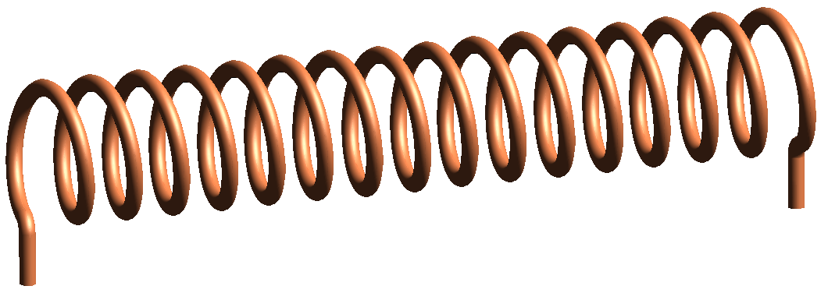
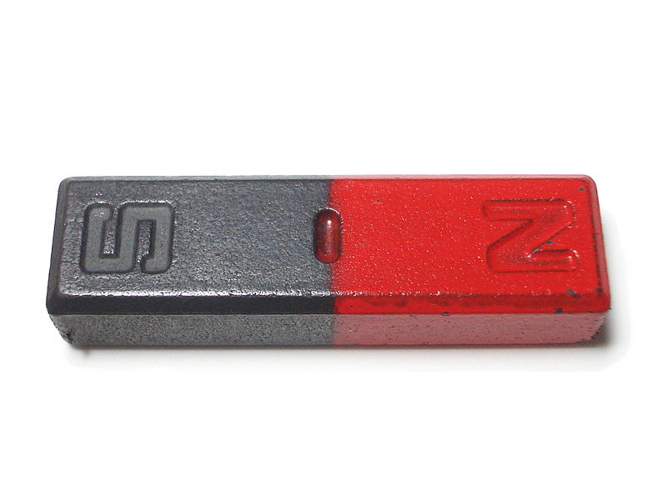
Generating electricity
What three things do you need to generate electricity?
Movement

Slide 3
When a moving charge moves it produces a magnetic field.
Similarly when a conductor moves in a magnetic field it causes a current to flow in the conductor. This is called induction. This can also happen if you have a conductor with a magnetic field moving across it.
The condition for induction is that the conductor must cut across the lines of flux.

Slide 4
Electromagnetic Induction
Electromagnetic Induction means that an emf (electromagnetic flux) is created when a wire is passed through a magnetic field. If the wire is part of a complete circuit then the emf will create a current flow in the wire.
How can the emf be increased?
Move the wire faster
Use a coil of wire
Use a stronger magnet
Note: No emf is created if the wire is parallel to the magnetic field lines as no magnetic lines will be broken as it moves.

Slide 5
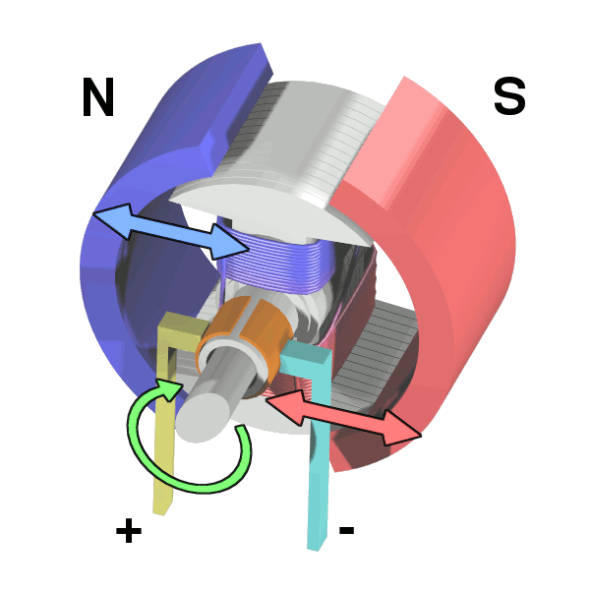
Using a motor in reverse
If a motor is forced to move and it is connected in a circuit then a current will be produced in the circuit.

Slide 6
Using a dynamo
A dynamo contains a magnet that spins within a coil of wire. This induces an emf in the coil which in turn can produce a current.

Slide 7
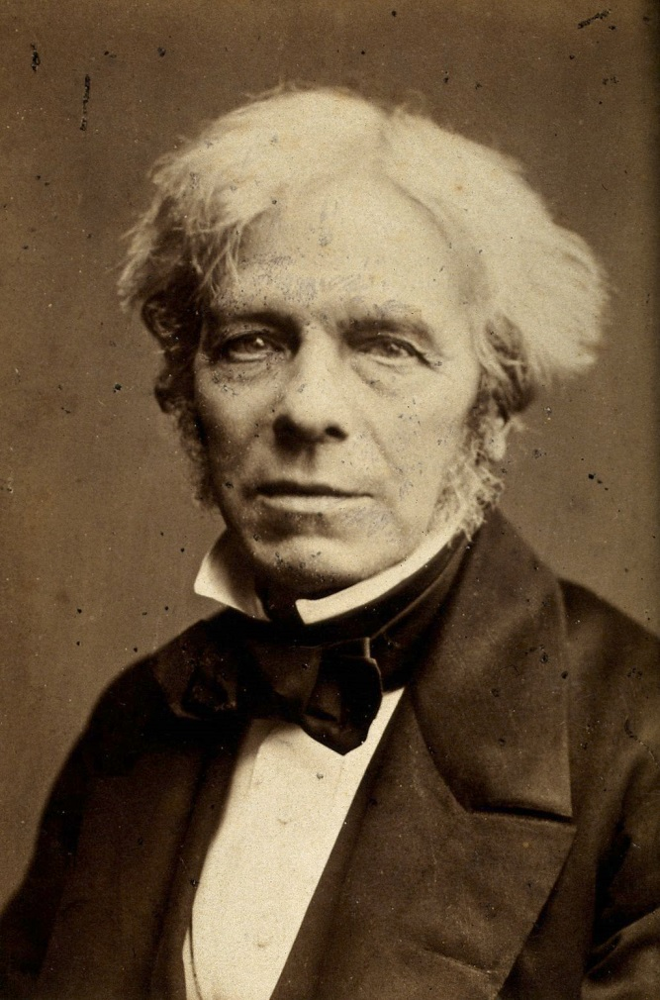
Michael Faraday
Credited with discovering electromagnetic induction, his famous quote when asked what electricity is for, he replied:
“What use is a new baby”
and
“Why sir, there is the probability that you will soon be able to tax it”
1791 - 1867

Slide 8
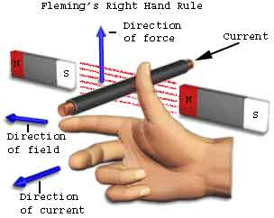
The direction of the current can be determined using Fleming’s right hand rule.

Slide 9
Task
Explain what happens to this conductor as it is moved across this magnetic field.

Slide 10
Answers
current moves upwards
Conductor cuts across lines of flux
Potential difference induced at the ends of the conductor
Current flows
Electrons move down

Slide 11
Summary
If a wire is moved in a magnetic field then an emf is created in the wire
If connected to a circuit this emf created a current that carries energy to the components
In a motor the coil moves inside fixed magnets; in a dynamo the magnet moves inside a fixed coil
The following will increase the current:
Coiling the wire
Moving the wire faster
Using a stronger magnet
Flemming’s right-hand rule is used to work out current flow direction

