Slide 1
Gravitational Potential

Slide 2
Aims

Slide 3
Gravitational potential
Gravitational potential energy is given as the energy of a body due to its position in a gravitational field
Consider a rocket blasting off the surface of the Earth
As the rocket rises, it does work against the ‘trap’ of the gravitational field surrounding the Earth
Therefore as it rises, the potential energy of the rocket increases – if the rocket was to come back down, it would ‘lose’ this gpe

Slide 4
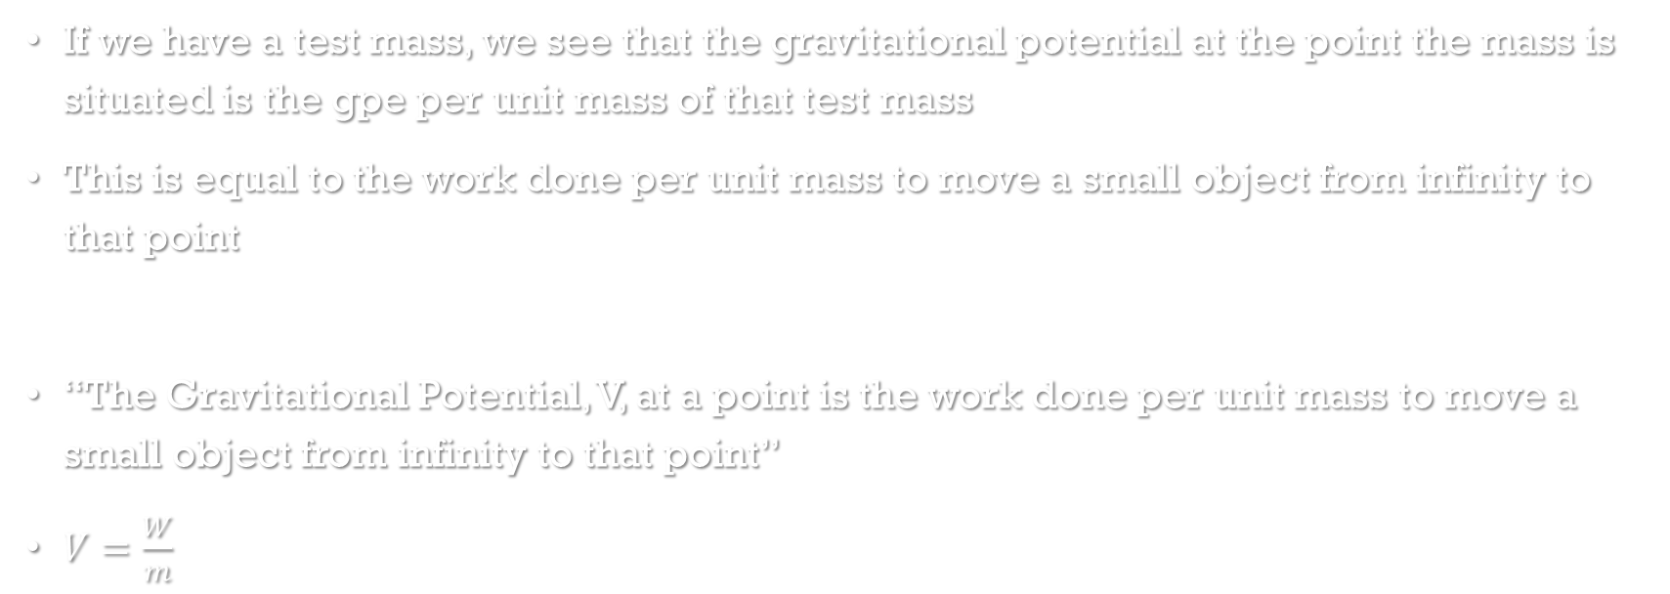
Gravitational Potential
If we have a test mass, we see that the gravitational potential at the point the mass is situated is the gpe per unit mass of that test mass
This is equal to the work done per unit mass to move a small object from infinity to that point
“The Gravitational Potential, V, at a point is the work done per unit mass to move a small object from infinity to that point”
$V=\frac{W}{m}$

Slide 5
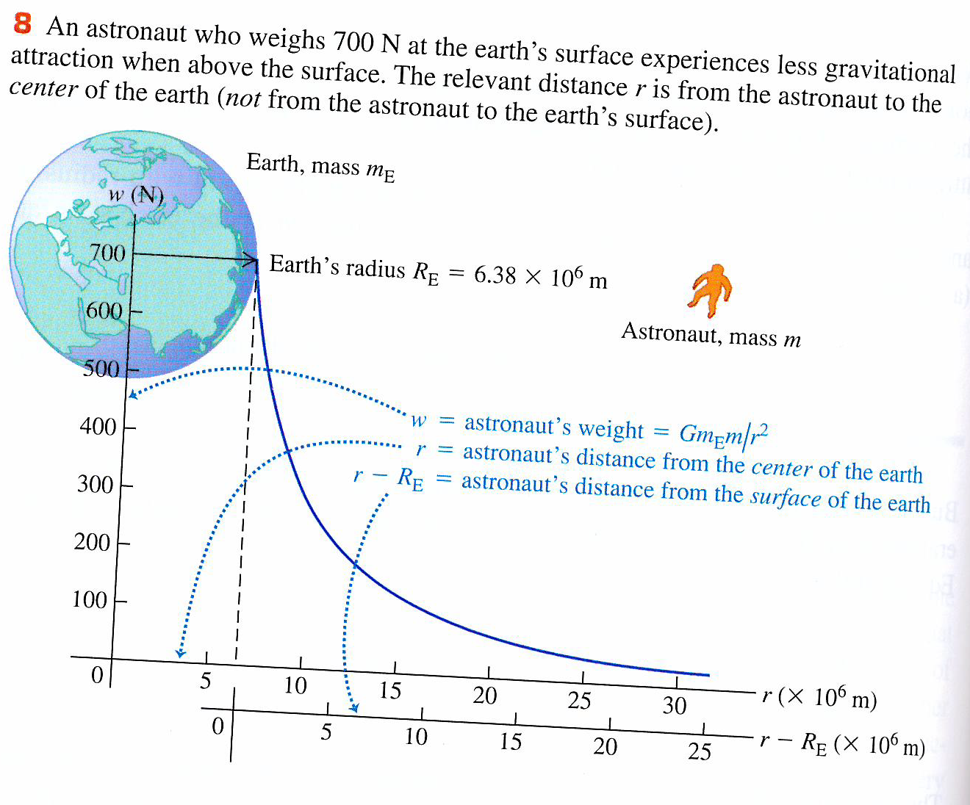
Gravitational potential
Add figure 8 page 454

Slide 6
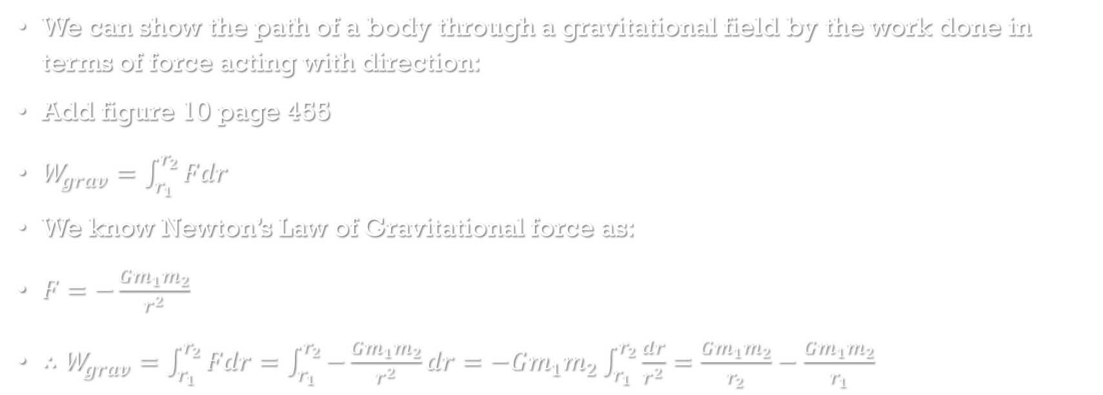
Mathematical gravitational potential
We can show the path of a body through a gravitational field by the work done in terms of force acting with direction:
Add figure 10 page 455
$W_{grav}=\int_{r_{1}}^{r_{2}}{Fdr}$
We know Newton’s Law of Gravitational force as:
$F=−\frac{Gm_{1}m_{2}}{r^{2}}$
$∴W_{grav}=\int_{r_{1}}^{r_{2}}{Fdr}=\int_{r_{1}}^{r_{2}}{−\frac{Gm_{1}m_{2}}{r^{2}}dr}=−Gm_{1}m_{2}\int_{r_{1}}^{r_{2}}{\frac{dr}{r^{2}}}=\frac{Gm_{1}m_{2}}{r_{2}}−\frac{Gm_{1}m_{2}}{r_{1}}$

Slide 7

Mathematical gravitational potential
So if we only consider one point in a gravitational field:
Gravitational Potential Energy can be given as:
$E_{p}=−\frac{Gm_{1}m_{2}}{r}$

Slide 8
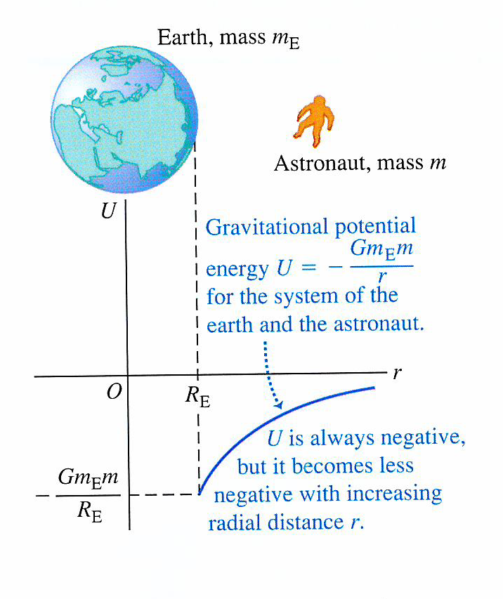
Mathematical gravitational potential
Add figure 11 page 456

Slide 9
Question
A robotic lander with an Earth weight of 3430 N is sent to Mars, which has a radius of 3.40 x10⁶ m and a mass of 6.42 x10²³ kg. Find the weight of the lander on the Martian surface and the acceleration there due to gravity.

Slide 10

Answer
$w=mg$
$m=\frac{w}{g}=\frac{3430}{9.81}=350 kg$
$F=\frac{Gm_{1}m_{2}}{r^{2}}=\frac{6.67×10^{−11}×6.42×{10}^{23}×350}{{\left(3.40×{10}^{6}\right)}^{2}}=1.30×{10}^{3} N$
$g_{M}=\frac{F}{m}=\frac{1.30×{10}^{3}}{350}=3.7 ms^{−2}$

Slide 11
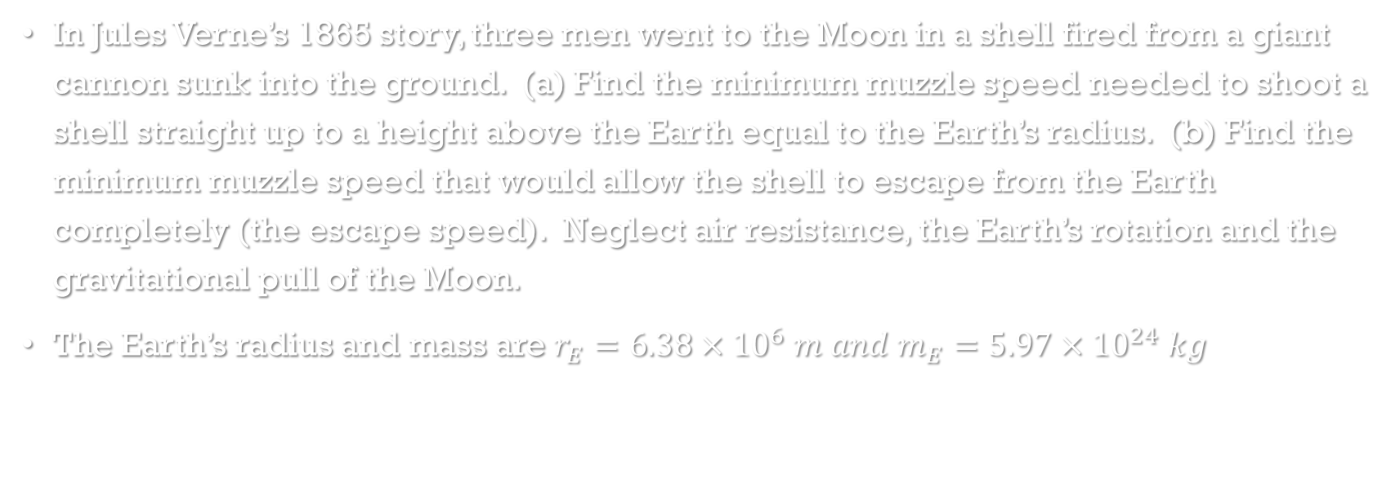
Question
In Jules Verne’s 1865 story, three men went to the Moon in a shell fired from a giant cannon sunk into the ground. (a) Find the minimum muzzle speed needed to shoot a shell straight up to a height above the Earth equal to the Earth’s radius. (b) Find the minimum muzzle speed that would allow the shell to escape from the Earth completely (the escape speed). Neglect air resistance, the Earth’s rotation and the gravitational pull of the Moon.
The Earth’s radius and mass are $r_{E}=6.38×{10}^{6} m and m_{E}=5.97×{10}^{24} kg$

Slide 12
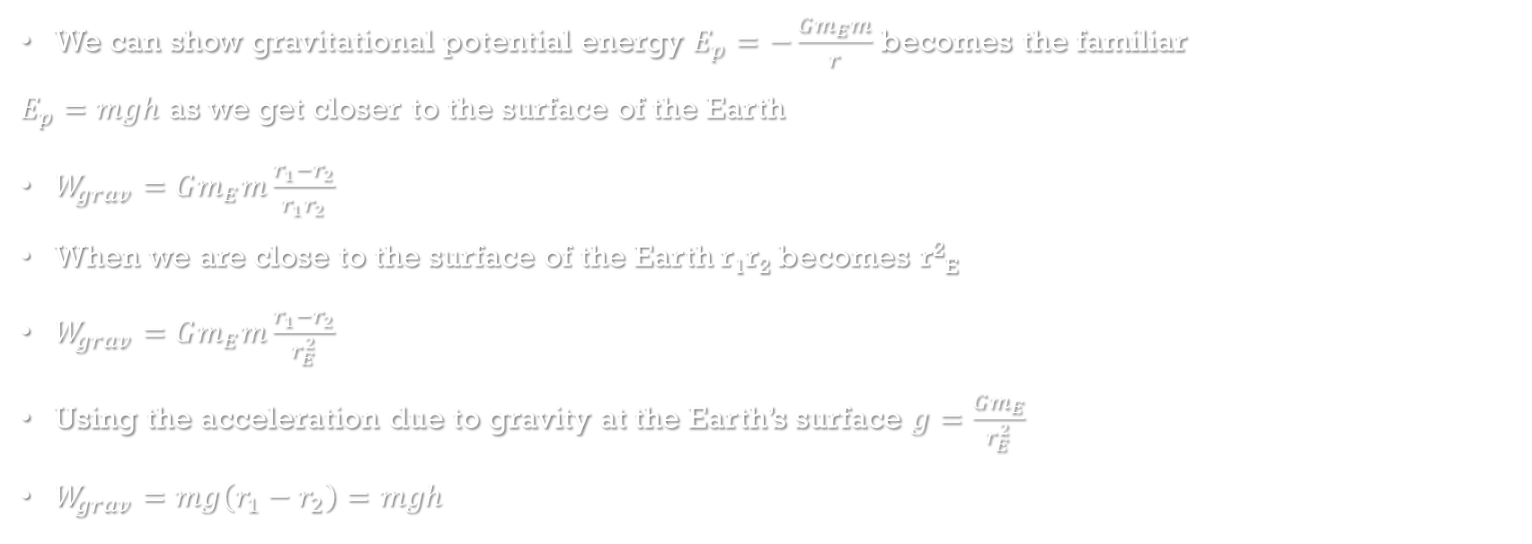
Gravitational potential and work proof
We can show gravitational potential energy $E_{p}=−\frac{Gm_{E}m}{r}$ becomes the familiar
$E_{p}=mgh$ as we get closer to the surface of the Earth
$W_{grav}=Gm_{E}m\frac{r_{1}−r_{2}}{r_{1}r_{2}}$
When we are close to the surface of the Earth r₁r₂ becomes r²_{E}
$W_{grav}=Gm_{E}m\frac{r_{1}−r_{2}}{r_{E}^{2}}$
Using the acceleration due to gravity at the Earth’s surface $g=\frac{Gm_{E}}{r_{E}^{2}}$
$W_{grav}=mg\left(r_{1}−r_{2}\right)=mgh$

Slide 13
Questions
Complete the summary questions on page 58

