Slide 1
CW | Satellite Motion | 31/10/2018
From my learning today I will be able to:
Key: | Identify Conditions for Satellite Motion (C)
Boost: | Explain what happens if speed is increased (B)
Aspire: | Explain Types of sattelites(A)

Slide 2
Throwing a ball

Slide 3
Throwing it faster

Slide 4
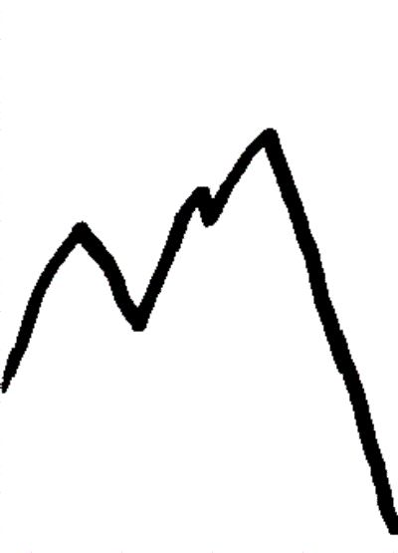
Big mountain, big gun, very fast

Slide 5
https://www.youtube.com/watch?v=51mxBkwwSB8

Slide 6
Explain the benefits and drawbacks of a geosynchronous orbital satellite
(6 marks)
Use the marking Performa and your phone to answer the question
To answer this question:
1-2 | The information conveyed by the answer is poorly organised and may not be relevant or coherent. There is little correct use of specialist vocabulary. The form and style of writing may be only partly appropriate
3-4 | The information conveyed by the answer may be less well organised and not fully coherent. There is less use of specialist vocabulary, or specialist vocabulary may be used incorrectly. The form and style of writing is less appropriate.
5-6 | The information conveyed by the answer is clearly organised, logical and coherent, using appropriate specialist vocabulary correctly. The form and style of writing is appropriate to answer the question.

Slide 7
Let’s say we have a planet orbiting a star.
It remains in orbit due to centripetal force = mv²/r
From Newton’s law, we know that gravitational force = Gm₁m₂/r²
Equating these expressions, we have: GMm/r² = mv²/r
(M = mass of star and m = mass of planet.)
But v is distance travelled in one orbit (2πr) divided by period: v = 2πr/T
Plugging this into the previous equation, and cancelling m on both sides gives:
GM/r² = 4π²r/T²
Rearranging again gives: T² = (4π²/GM) r³
This shows that the further away a planet is, the longer its period of orbit (but in a non-linear way).
Although this law was originally discovered for the motion of planets, it works equally well for all satellite motion. We just need to think about what M is in the constant (4π²/GM).

Slide 8
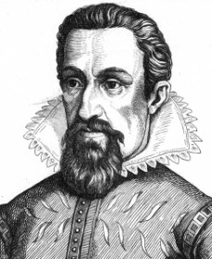
The three laws of planetary motion devised by Kepler are: 1. The orbit of every planet is an ellipse with the sun at a focus. 2. A line joining a planet and the sun sweeps out equal areas during equal intervals of time. 3. The square of the orbital period of a planet is directly proportional to the cube of the semi-major axis of its orbit.
Kepler’s work on planetary motion helped Isaac Newton later devise his own theory of universal gravitation.

Slide 9
Use Kepler’s third law, T² ∝ r³, to answer this question.
Two Earth satellites, A and B, orbit at radii of 7.0 × 10⁶ m and 2.8 × 10⁷ m respectively.
Which satellite has the longer period of orbit?
What is the ratio of orbital radii for the two satellites?
What, therefore, is the ratio of the cubes of the orbital radii?
What, therefore, is the ratio of the squares of the orbital periods?
Finally therefore, what is the ratio of the satellites’ orbital periods?
The radius of a geostationary orbit is 42 200 km. Use this fact together with the constancy of R³ / T² to estimate the height above the Earth’s surface of a satellite whose circular orbit is completed in 90 minutes. How many times a day would such a satellite orbit the Earth?
90 minutes is a typical orbital period for a military reconnaissance satellite, and 100 minutes for a civilian Earth observation satellite. Can you suggest a reason for this difference?

Slide 10
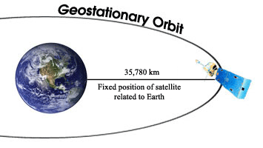
Geostationary satellites are predominantly used for communications.
Satellite TV companies use geostationary satellites to cover a constant area on the Earth’s surface – hence you point your satellite dish receiver in the direction of the geostationary satellite.
3 geostationary satellites placed into orbit 120 degrees apart above the equator would be able to cover the entire Earth (except for very near the poles).
Because geostationary satellites have to be launched so high (other satellites orbit as low as a few hundred km), the energy and costs required for launching a satellite into geostationary orbit are high.
Verify if this is a geostationary orbit

Slide 11
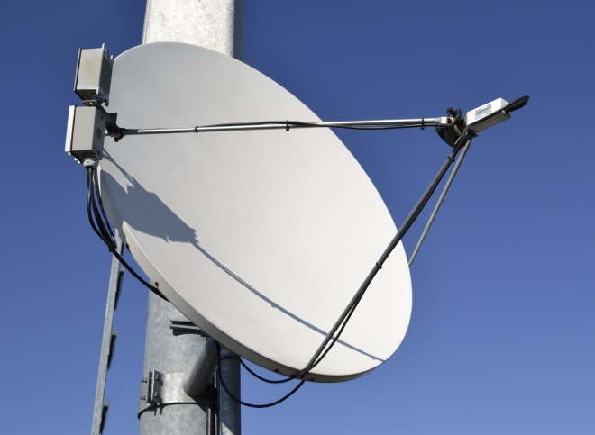
Geostationary orbits
A special orbit that is very useful is one that orbits above the equation on planet Earth and has a rotational period of exactly 24 hours.
This is useful because fixed receivers on Earth do not need to move to track these satellites because they appear to be stationary in the sky.
What altitude does a geostationary satellite need to be placed at?
36000 km
(If you got 42000km what did you forget?)

Slide 12
Satellites and Energy
A satellite has two energies, kinetic and potential:
By substituting this in for v and then rearranging we obtain:
Can this be simplified further?
Note that this is particularly useful as knowing the total energy enables the calculation of the either kinetic or potential energy if only one is known.
Recall that the satellite must be moving at velocity v so that Kepler’s third law is maintained, therefore:

Slide 13
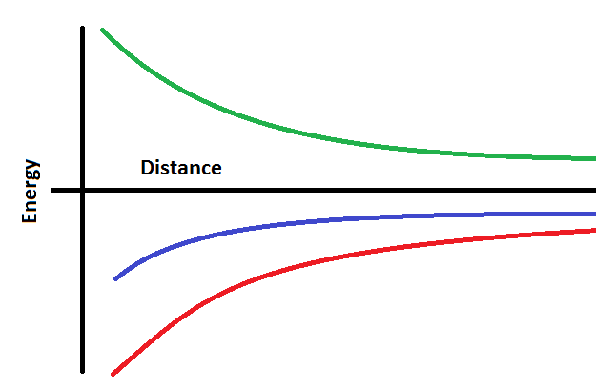
Graphing energy
Note that the total energy of a satellite varies with distance with a negative 1/r graph, as does the potential energy.
The kinetic energy is a positive 1/r graph
Kinetic
Total
Potential
Which line is which energy?

Slide 14
Summary
The height of a satellite is controlled by its orbital time and vice-versa
The height of a geostationary satellite is fixed as it has to maintain an orbital period of one day
The kinetic and potential energies of satellites can be calculated and the total energy is the sum of the two (Noting that potential energy is negative as)
The total energy of a satellite is always negative

