Slide 1
CW | Electric Field strength and field lines | 03/11/2015
From my learning today I will be able to:
Key: | Calculate Potential (C)
Boost: | Draw and interpret equipotential lines (B)
Aspire: | Suggest the amount of energy needed to escape fields (A/A*)

Slide 2
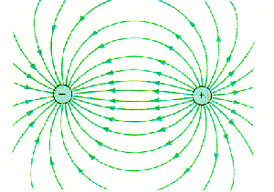
Electric Field Lines

Slide 3
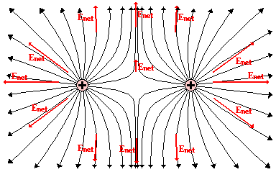
Electric Field Lines of two Positive Charges

Slide 4
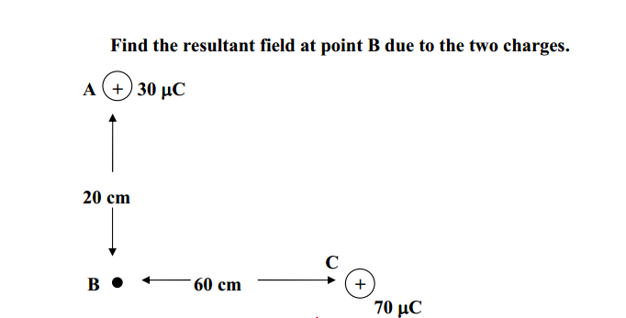
Recap Example
+

Slide 5
Electric Field strength is the Force per unit charge on a positive test charge placed at that point
E=F/D

Slide 6
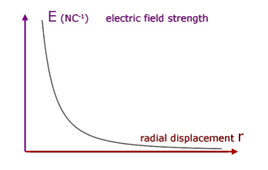
How Electric Field Strength varies with distance from the point…

Slide 8
Two oppositely charged plates produce a uniform electric field between them. The lines of force are equally spaced and parallel. When you move a charge around a uniform electric field the force on it remains constant. So the electric field strength is the same everywhere.
electric field strength = voltage / distance
The electric field strength between the plates depends on two factors: the voltage between the plates and the distance between them.
E = V / d

