Slide 1
Energy and Charge in Capacitors
Wednesday, 13 February 2019
K – state the definition of capacitance
B – describe how to measure the energy stored in a capacitor
A – calculate the energy and charge stored by a capacitor

Slide 2
A capacitor is a device for storing electrical charge.
Most capacitors consist of two parallel conductors (plates) separated by a thin insulator (air in the simplest case)
Uses of capacitors include: voltage regulation in power supplies, timing circuits, tuning circuits and in back-up power supplies.
capacitor symbol

Slide 3
Capacitors are designed to store charge
They are made from two parallel metal plates
When a p.d. is applied the electrons move from one plate to the other so the plates have an equal but opposite charge
The plates must be separated by an insulating material
One plate has a charge of +Q and one has a charge of -Q

Slide 4
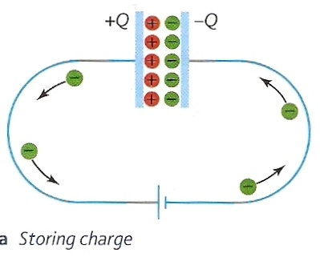

Slide 5
When you charge up a capacitor you can calculate the charge added (using Q=It) and measure the p.d.
Plotting this gives a straight line graph
This means that p.d. is proportional to charge
The capacitance C of a capacitor is defined as the charge stored per unit p.d.
C = $\frac{Q}{V}$

Slide 6
A capacitor of 500μF is charged by a power supply 4V through a 200Ω resistor. Calculate (a) the initial charging current and (b) the final charge stored on the capacitor.
(a) Initially the capacitor voltage is zero and all 4V of the power supply will be across the resistor.
I_{o} = V / R
= 4V / 200Ω
Initial current = 0.02 A = 20 mA
(b) At the end of the charging process, all 4V will be across the capacitor.
Q = CV
= 500μF x 4V
final charge = 2000 μC

Slide 7
Try page 95 Q3 and Q4

Slide 8
Dielectrics
Why does a statically charged balloon stick to an uncharged wall or window?

Slide 9
Capacitor design
What design makes the best capacitor?
Large area for the plates (A)
Parallel plates
Plates close together (small distance d)
Dielectric between the plates with a large dielectric constant (ε_{r})

Slide 10
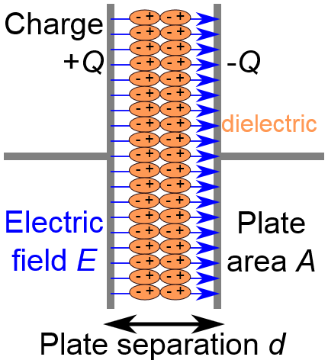
Increasing the capacitance of a capacitor
If you use an insulating material between the charged plates then a charge can be induced in this insulator when the plates become charged
This occurs due to movements in the molecules that make up the dielectric material
If the molecules are polar molecules then the effect is enhanced

Slide 11
Dielectric constant
The relative permittivity is also often referred to as the dielectric constant of a material
Note that charge for a given potential difference can also be used to calculate this value instead of capacitance as they are proportional to each other
Material | Dielectric constant
Paper | 3.7
Quartz | 4.3
Mica | 7
Strontium Titanate | 300

Slide 12
Polarisation and frequency
The dielectric works because the charge on the plates induces a polarising effect on the particles in the dielectric:
Orientation polarisation: Covalent molecules that do not share electrons equally are dipoles that align with the field
Ionic polarisation: Oppositely charged ions align with the field
Electronic polarisation: Electrons in an atom are displaced slightly and the atom then aligns with the field
When in an alternating field the three mechanisms work in different ways. They can only sustain the oscillations up to a certain frequency:
Orientation polarisation decreases first (10⁹ Hz)
Ionic polarisation decreases second (10¹² Hz)
Electronic polarisation decreases last (10¹⁵ Hz)

Slide 13
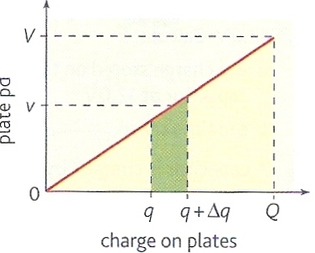
Energy stored by a capacitor

Slide 14
The work ΔW is represented by the green area on the graph.
The total work W done in charging the capacitor by charge Q to potential difference V is equal to the area under the curve.
= ½ x base x height
W = ½ QV
This is also the energy stored by the capacitor

Slide 15
Question
Calculate the energy stored when:
(a) a 10μF capacitor is charged by 12V
(b) 200μC is placed on a capacitor using 6V
(c) a 0.05μF capacitor receives 40 nC of charge.
(a) W = ½ CV ²
= ½ x (10 x 10 ^{– 6} ) x (12)²
= 7.2 x 10 ⁻ ⁴ J (720 μJ)
(b) W = ½ QV
= ½ x (200 x 10 ^{– 6} ) x (6)
= 6.0 x 10 ⁻ ⁴ J (600 μJ)
(c) W = ½ Q ² / C
= ½ x (40 x 10 ^{– 9}) ² / (5 x 10 ^{– 8})
= 1.6 x 10 ⁻ ⁸ J (16 nJ)

Slide 16
When a capacitor is charged, energy is stored on it because electrons are forced onto one of its plates and taken off the other one
Stored as electrical potential energy
Energy is released in a short amount of time with a large initial current
$$Energy stored in a capacitor, E=\frac{1}{2}QV$$
What other forms can this be written in?

Slide 17
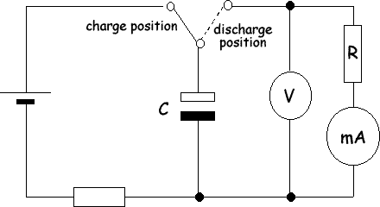
The capacitor is charged from the battery
The switch is moved and it is discharged through the resistor
The current and p.d. can be measured as it discharges
This can also be done with a datalogger

Slide 18
Try questions 1-4 on page 97

