Slide 1
Discharging Capacitors
Wednesday, 23 November 2016
K – describe the shape of a graph of current or charge in a discharging circuit
B – calculate charge and current after a certain time
A – explain the importance of the time constant, RC

Slide 2
When a capacitor discharges through a fixed resistor the discharge current decreases gradually to zero
The p.d. across the capacitor decreases as the charge stored decreases which explains the decreasing current
In theory, the charge on the plates never becomes zero
Exponential changes occur whenever the rate of change of a quantity is proportional to the quantity itself

Slide 3

From this we get the general equation:
$$X=X_{0 }e^{\frac{−t}{RC}}$$
X in this formula can represent current, charge or p.d.

Slide 4
Formulae for capacitor discharge
There are therefore standard formulae for the discharge of a capacitor as follows:

Slide 5
RC is called the time constant and has units of seconds
In one time constant the value of X will decrease to 0.37 of its original value (e⁻¹)

Slide 6
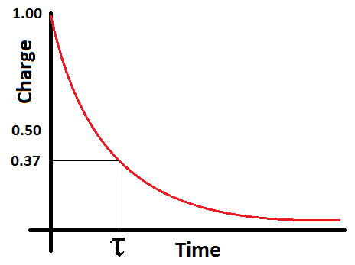
To find the time constant of an exponential decay curve you must plot a graph and find out how long it took for the initial charge (or current) to drop to 37% of this initial value.
Maths note:
e⁻¹ ≈ 0.37

Slide 7
If a capacitor is charging up then after t=RC it will have charged to 0.63 of its full charge

Slide 8
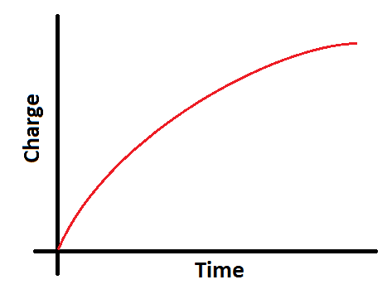
When you charge a capacitor the current flow is again an exponential decay with the same formula as with discharge
The potential difference across the plates and the charge on the plates is an inverted exponential decay curve

Slide 9
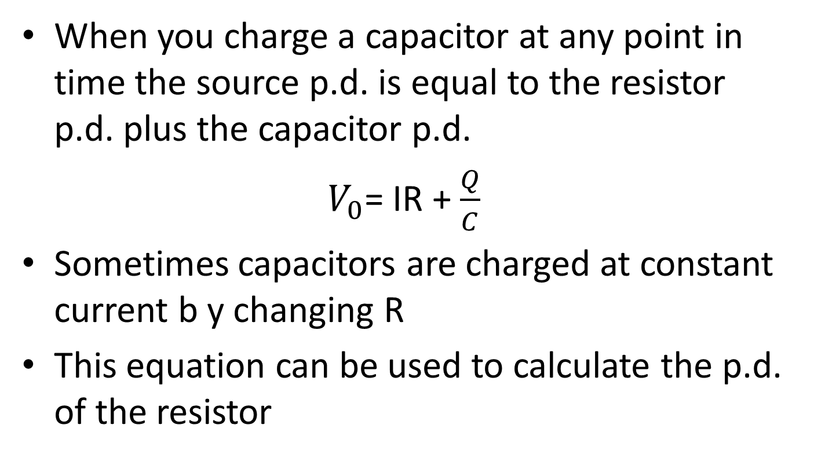
When you charge a capacitor at any point in time the source p.d. is equal to the resistor p.d. plus the capacitor p.d.
$V_{0}$= IR + $\frac{Q}{C}$
Sometimes capacitors are charged at constant current b y changing R
This equation can be used to calculate the p.d. of the resistor

Slide 10
P101 Q1-4
P102-104 Q2-5
P105 Q7-8

