Slide 1
Wednesday, 06 March 2019
Forces on a current carrying wire
What do you already know about magnets and magnetic fields?

Slide 2
K – state the factors affecting the force on a current carrying wire in a magnetic field
B – calculate the size of the force on the wire
A – explain the difference in force when the fields are parallel and perpendicular to each other

Slide 3
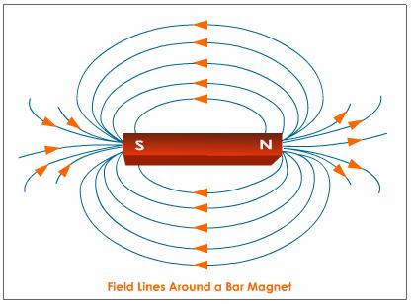
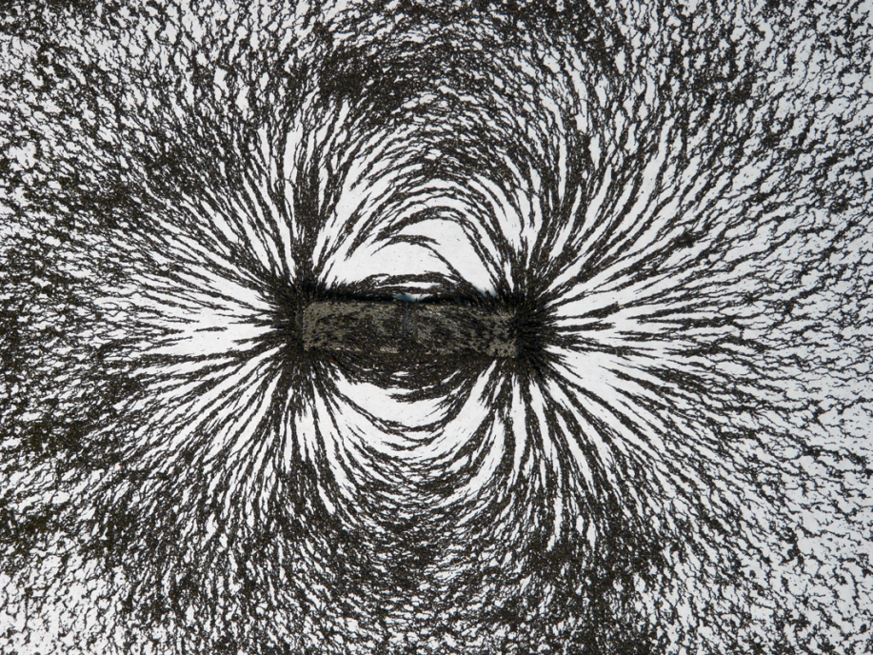
Definition : A magnetic field is a force field which surrounds either a magnet or a wire carrying an electric current and will act upon, without contact, another magnet or current carrying wire

Slide 4
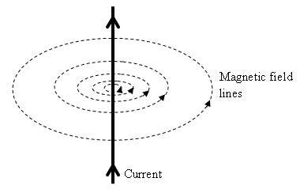
A current moving inside a wire creates a magnetic field around the wire
The field lines move in a circle around the wire
If the wire is inside another magnetic field the two may exert a force on each other

Slide 5
When will you get maximum force or no force at all?
If the wire and the magnetic field are at right angles to each other then the force is a maximum
If the wire and the field lines are in the same direction then the force is zero

Slide 6
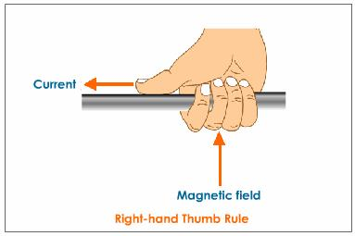
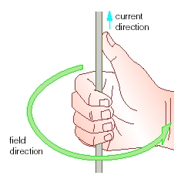
Wires carrying an electric current produce a magnetic field.
The “right-hand rule” can be used to establish the direction of this field. Note the current direction is the direction of “conventional current” positive to negative

Slide 7
The three factors that affect the magnitude of the force are:
The magnetic flux density – B
The current in the wire – I
The length of the wire inside the field – l
This gives is the formula F = BIl when the field and wire are at right angles

Slide 8
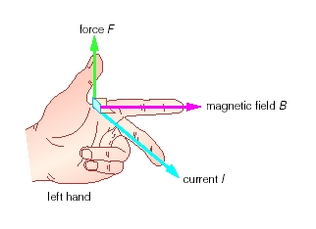
We can use Fleming’s left-hand rule to determine the direction the wire will move

Slide 9
Formula and units
If the current flow is at right angles to the magnetic field then then the following formula can be used:

Slide 10
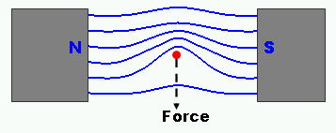

Slide 11
Magnetic Flux Density
For a given magnetic field, the Force on a current-carrying wire (when perpendicular to the field) is equal to:
$F=BIl$
Where $I$ is the current, $l$ is the length of the wire, and B is the Magnetic flux density, equal to the force per unit length per unit current.
Unit of Magnetic flux: NA⁻¹m⁻¹ but given the unit of Tesla (T) (therefore 1T = 1 NA⁻¹m⁻¹)

Slide 12
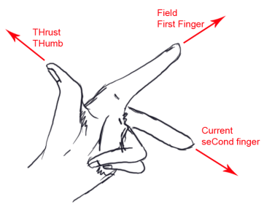
A straight horizontal wire of length 5m is in a uniform magnetic field which has a magnetic flux density of 120mT. The wire is perpendicular to the field lines which act due North. When the wire conducts a current of 14A from East to West calculate the magnitude and direction of the force on the wire.
$$F=BIL$$
F = 120 x 10⁻³ x 14 x 5
F = 8.4N
Vertically downwards
Field due North
Current East to West

Slide 13
Answers
Complete:
Force | Magnetic flux density | Current | Length
20 N | 0.3 T | 7 A | 9.52 m
3 N | 1 mT | 20 A | 150 m
500 N | 33 T | 200 mA | 75.8 m
67 N | 0.4 T | 2.5 A | 67 m
6 kN | 4 T | 60 A | 25 m

Slide 14
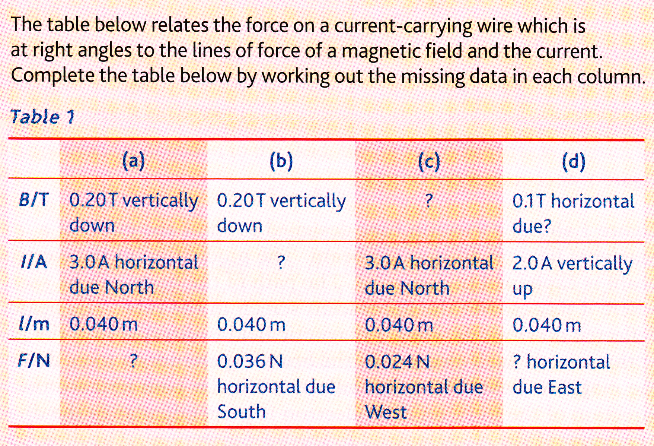
Problems
0.2T Vertically down
South
4.5A East to West
2.4 x 10⁻²N West
8.0 x 10⁻³N

Slide 15
06/03/2019
The Motor Effect
K – describe the construction of a DC motor
B – state the factors which increase the speed of the motor
A – explain how the DC motor works

Slide 16
Name 5 things that have an electric motor in.
In each device what does the motor do?

Slide 17
Looking from above :
F
w
F
Y
X
Y
α
F
X
F
Coil Parallel to field. Torque = $Fw$
Coil now at an angle α to the field. Torque = $Fwcosα$
But $F=BIln$
$$Torque=BIlnwcosα$$
$lw$ is the area $A$ of the coil giving $Torque=BIAncosα$
When the coil is parallel to field (α =0°, cos 0° = 1), the torque is BIAn. When the coil is perpendicular (α =90°, cos 90° = 0), the torque is zero.

Slide 19
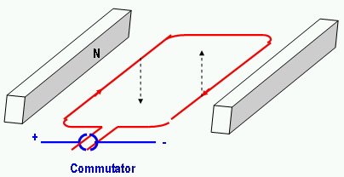

Slide 20
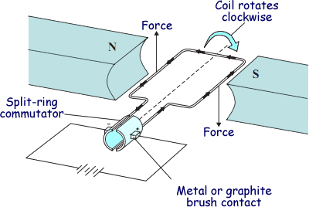
The current flows in different directions on each side of the coil
This means the force on each side is in the opposite direction
This creates a couple which turns the coil
Every half-turn the current flows again and there is another force to keep the coil turning

Slide 21
Write an explanation of how the DC Motor works. Include as much detail as you can.

Slide 22
Current flows around the coil when the brushes connect
This current produces a magnetic field around the wire
On opposite sides of the coil the current is in opposite directions
This means the force acting on each side is in opposite directions producing a couple
The couple produces a turning effect on the coil
Every half turn the current reconnects and a force acts to continue turning the coil
The motor can be speeded up by (name 2 of) increasing the current, adding more coils, increasing the magnetic field strength of the magnet or moving the magnet closer to the coils
1-2 = D, 3-4=C, 5=B, 6=A

