Slide 1
04/01/2017
The Motor Effect
K – describe the construction of a DC motor
B – state the factors which increase the speed of the motor
A – explain how the DC motor works

Slide 2
Name 5 things that have an electric motor in.
In each device what does the motor do?

Slide 3
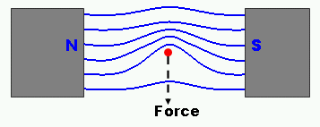

Slide 4
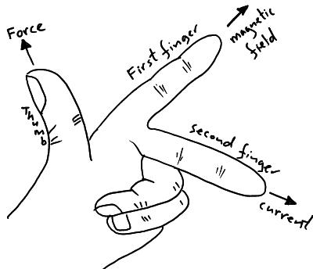

Slide 5


Slide 6
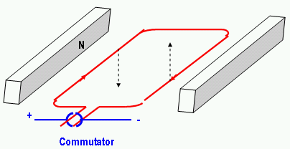

Slide 7
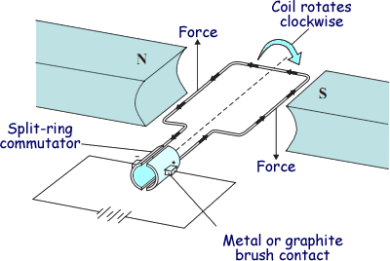
The current flows in different directions on each side of the coil
This means the force on each side is in the opposite direction
This creates a couple which turns the coil
Every half-turn the current flows again and there is another force to keep the coil turning

Slide 8
Write an explanation of how the DC Motor works. Include as much detail as you can.

Slide 9
Current flows around the coil when the brushes connect
This current produces a magnetic field around the wire
On opposite sides of the coil the current is in opposite directions
This means the force acting on each side is in opposite directions producing a couple
The couple produces a turning effect on the coil
Every half turn the current reconnects and a force acts to continue turning the coil
The motor can be speeded up by (name 2 of) increasing the current, adding more coils, increasing the magnetic field strength of the magnet or moving the magnet closer to the coils
1-2 = D, 3-4=C, 5=B, 6=A

Slide 10
Formula and units
If the current flow is at right angles to the magnetic field then then the following formula can be used:

Slide 11
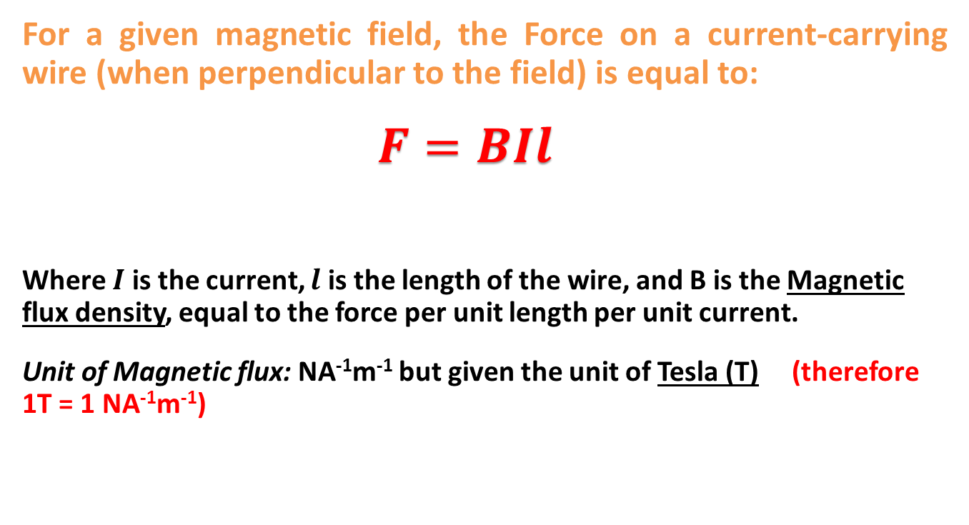
Magnetic Flux Density
    For a given magnetic field, the Force on a current-carrying wire (when perpendicular to the field) is equal to:
    $F=BIl$
    Where $I$ is the current, $l$ is the length of the wire, and B is the Magnetic flux density, equal to the force per unit length per unit current.
    Unit of Magnetic flux: NA⁻¹m⁻¹ but given the unit of Tesla (T) (therefore 1T = 1 NA⁻¹m⁻¹)

Slide 12
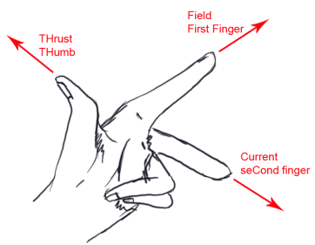
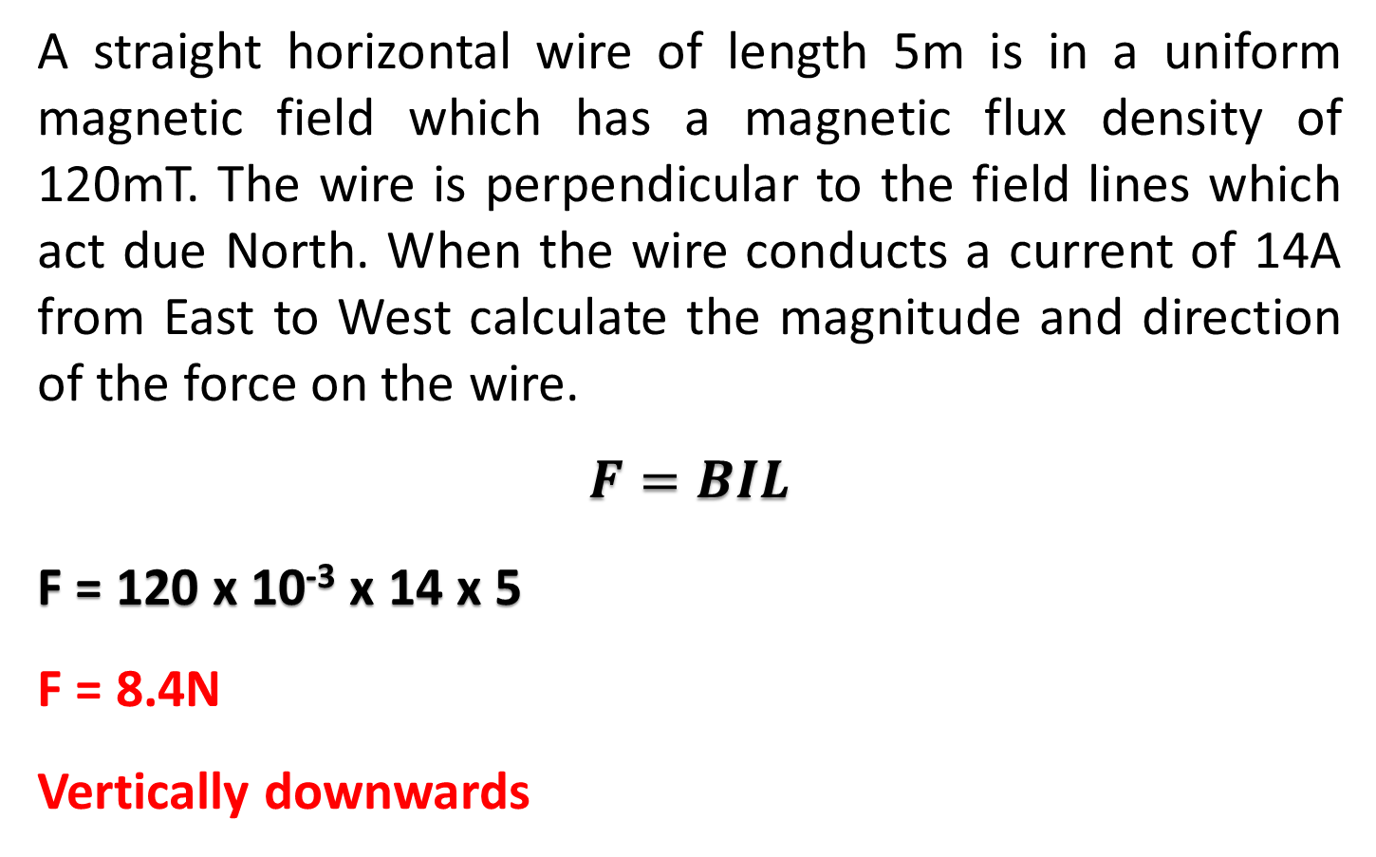
    A straight horizontal wire of length 5m is in a uniform magnetic field which has a magnetic flux density of 120mT. The wire is perpendicular to the field lines which act due North. When the wire conducts a current of 14A from East to West calculate the magnitude and direction of the force on the wire.
    $$F=BIL$$
    F = 120 x 10⁻³ x 14 x 5
    F = 8.4N
    Vertically downwards
Field due North
Current East to West

