Slide 1
Charged particles in a magnetic field
K – state the factors affecting the size of the force
B – calculate the force on the particle
A – explain the applications of this phenomena

Slide 2
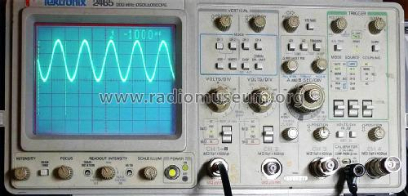
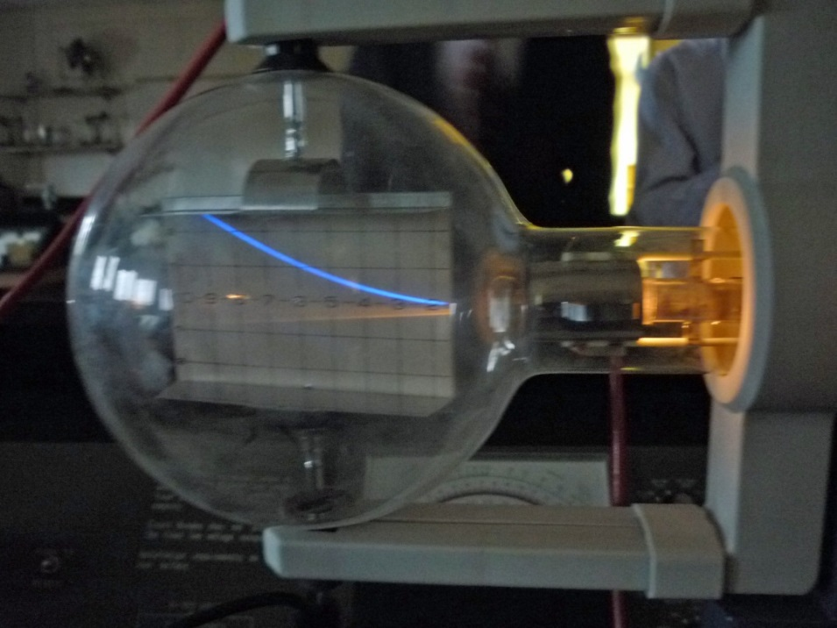
What links these pictures?

Slide 3
A moving charge is analogous to the current in a wire
When the charged particle moves through a field a force acts upon it
Fleming’s left hand rule will tell you the direction of the force
REMEMBER: current in the left hand rule is in the same way as conventional current

Slide 4
What factors will affect the force on the particle?

Slide 5
How do you calculate the force on the particle?

Slide 6
Answer the multiple choice questions on the worksheet.
Summary questions page 102
Complete these for homework

