Slide 1
Path of charged particles in a magnetic field
CSI INTRO
How do mass spectrometers work?

Slide 2
K - Describe the path of a charged particle in a magnetic field using Fleming’s left hand rule
B – Calculate the radius of curvature of a charged particle in a magnetic field
A – explain the applications of the circular paths of charged particles in magnetic fields

Slide 3
Magnetic fields are used to control beams of charged particles. The force acts at right angles to the direction of motion.
No work is done by the magnetic field on the particle. Its direction of motion is changed but not its speed. The kinetic energy is also unchanged.
The magnetic force causes centripetal acceleration which is perpendicular to the velocity.

Slide 4
PROVE IT:

Slide 5
An alpha particle enters a uniform magnetic field at right angles to the field of strength 0.03T at a velocity of 320m/s. What is its radius of curvature?

Slide 6
P115 Q1-4
P116-119 Q2-7

Slide 7
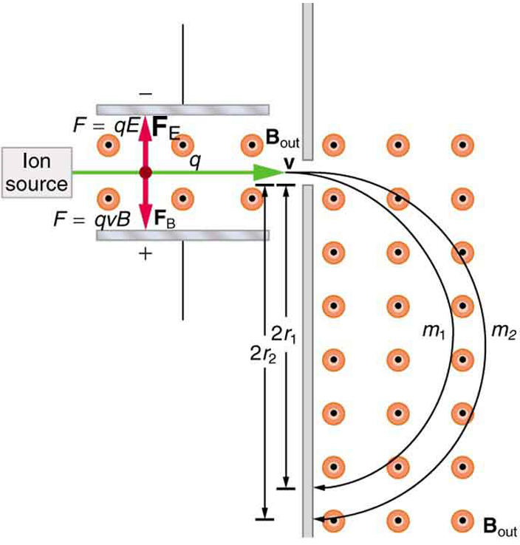
This is a diagram of the working inside a mass spectrometer. Explain using your knowledge of the path of a charged particle how it works.

Slide 8
        I feel confident about…
        I am unsure of…

