Slide 1
Lenz and Faraday
K – define the terms magnetic flux density and magnetic flux linkage
B – apply Faraday’s law to wires and coils
A – apply Lenz’s law to induction

Slide 2
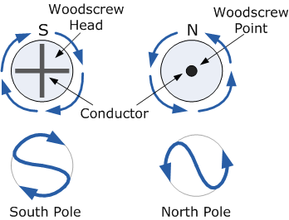
If you have current in a solenoid the magnetic field is analogous to a bar magnet. Which end will be the north or the south pole?

Slide 3
What will happen when a bar magnet is pushed into a coil connected to an ammeter?
The lines of flux cutting across the coils of wire induce a current in the solenoid
The current in the solenoid must produce a magnetic field
Why must the pole of the field in the solenoid oppose the pole of the incoming magnet?

Slide 4
Lenz’s law states that the direction of the induced current is always such as to oppose the change that causes the current
What conservation law is this?
What happens when the magnet leaves the solenoid?

Slide 5
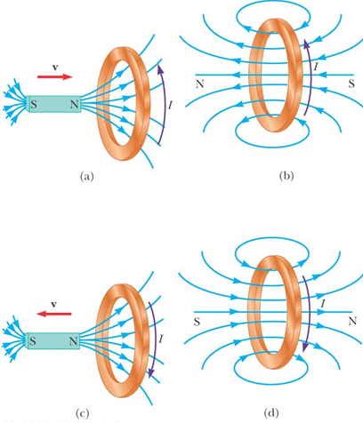

Slide 6
Definitions:
Magnetic flux density – B – Tesla, T
Area – A – m²
Magnetic flux – Φ – Weber, Wb
Φ = BA

Slide 7
Consider:

Slide 9
More about flux linkage
Flux linkage through a coil with N turns = N Φ = BAN
When the magnetic field is perpendicular to the coil face the flux linkage = N Φ = BAN
When the coil is turned through 180⁰ the flux linkage = -BAN
When the magnetic field is parallel to the coil then the flux linkage =0 as no field lines pass through the coil area
In general = N Φ = BANcosθ

Slide 10
Faraday’s law of electromagnetic induction states that the induced emf in a circuit is equal to the rate of change of flux linkage through the circuit
Induced emf ε = $−N\frac{∆∅}{∆t}$
The minus sign denotes that the induced emf acts in such a way to oppose the change that caused it.
Page 126 – Q1-4
Extension – page 133 Q1

