Slide 1
AC Generators
Outcomes
Describe the main features of an AC generator
Explain the shape of the voltage waveform
Explain two changes to the voltage waveform if the coil is turned faster

Slide 2
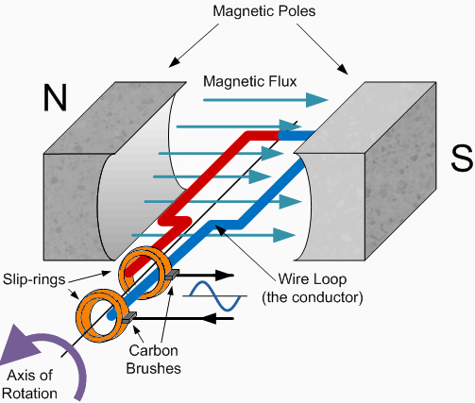
Outcomes * Describe the main features of an AC generator * Explain the shape of the voltage waveform * Explain two changes to the voltage waveform if the coil is turned faster
AC Generator
State the parts of an AC Generator?
Explain how the generators work?
Suggest why the current is AC?

Slide 3
Outcomes * Describe the main features of an AC generator * Explain the shape of the voltage waveform * Explain two changes to the voltage waveform if the coil is turned faster
Task
Explain the shape of the graph you have sketched. What would happen if the coil turned faster?
Extension
Explain these changes in the waveform by referring to Faraday’s law.

Slide 4
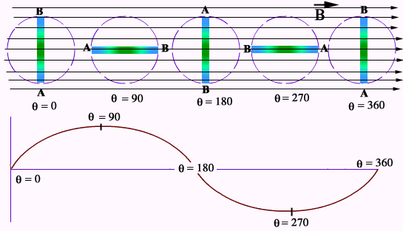
Outcomes * Describe the main features of an AC generator * Explain the shape of the voltage waveform * Explain two changes to the voltage waveform if the coil is turned faster

Slide 5
AC Generator
Flux linkage for N coils at angle θ is given as:
Spinning a coil of wire inside a constant magnetic field means that the angle that the wires cut the magnetic field lines changes over time.
This means that the flux linkage changes over time.
The frequency of the spinning magnet can be used to calculate the angle θ:

Slide 6
AC Generator
Flux linkage for N coils at time t (after angle θ was zero) is given as:
Any formula containing 2πf is often shortened to the following, called the angular frequency:

Slide 7
Emf
The gradient of a graph of flux linkage against time is the change in flux linkage per second so it is a way of calculating emf
ε₀ = Peak p.d.
f = Frequency

Slide 8
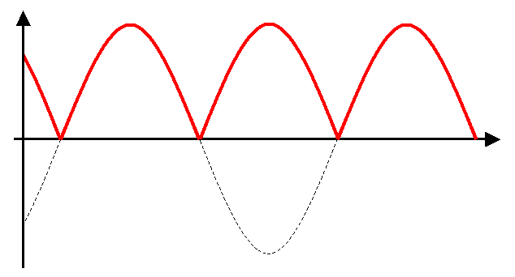
D.C. Generator
Using a split-ring commutator you can create a DC current from a spinning coil of wire
Although the current is always in the same direction, the spinning coil still creates a changing emf over time

Slide 9
Three phase alternator
A power station uses static coil windings outside of a spinning electromagnet. This creates 3 AC currents that are 120º out of phase to each other.
Transformers and sub-stations can supply these to businesses and homes 1/3 to each.

Slide 10
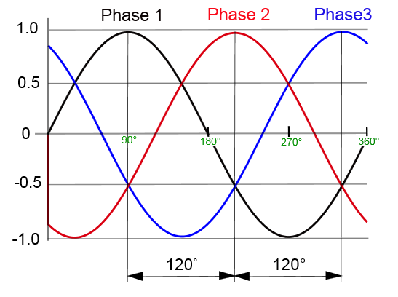
Current supplied from a 3 phase coil generator

Slide 11
Summary
Flux linkage for N coils at time t (after angle θ was zero) is given as:
The gradient of a graph of flux linkage against time is the change in flux linkage per second so it is a way of calculating emf:

Slide 12
AC current is a sine wave, as is the emf, over time
DC from a spinning coil is a wave but is always positive
UK mains electricity is created in three phases, only one phase is used by any one consumer.

Slide 13
Outcomes * Describe the main features of an AC generator * Explain the shape of the voltage waveform * Explain two changes to the voltage waveform if the coil is turned faster

