Slide 1
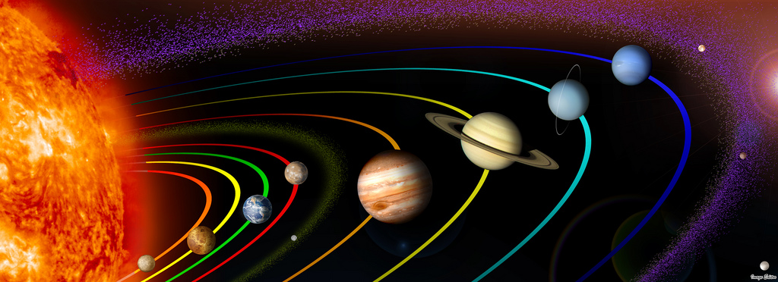
Newton’s Law of Gravitation
What data would you need to have to be able to understand and predict the motion of the planets?
The time period of each orbit T and the average orbital radius r

Slide 2
Analysing data
Look at the data below of the planets. Assuming that there is a relationship between the time period T and the orbital radius r can you use logs to plot a graph and find it?
Planet | Orbital Radius /10⁶ km | Orbital period /days
Mercury | 58 | 88
Venus | 108 | 225
Earth | 150 | 365
Mars | 228 | 687
Jupiter | 778 | 4400

Slide 3
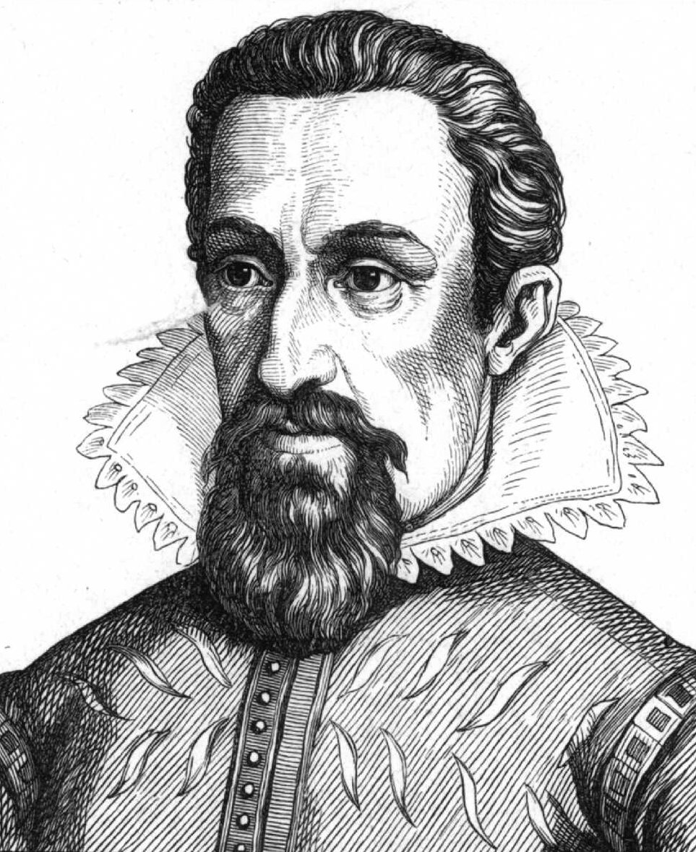
Johannes Kepler
Johannes Kepler (1571 – 1630) discovered several laws that can be used to understand and predict the motion of planets.

Slide 4
Isaac Newton
Isaac Newton invented a theory that there was a force of attraction that acted between the planets and the Sun. He then used this force to explain Kepler’s third law, assuming the masses can be modelled as point masses:
The force is always attractive
The force is proportional to the product of the masses of the planets
The force is inversely proportional to the square of their separations
How can the above three conditions be written as a single formula?

Slide 5
Newton’s constant
Rearranging the formula from the previous slide we can calculate the constant G
This constant is the same for all masses (all planets, stars and other masses) anywhere in the universe

Slide 6
Summary
Isaac Newton built on Kepler’s work to discover his own Law of Gravitation
The formula to calculate the force of attraction between two masses assumes the following:
    The masses can be considered point masses
    The force is always attractive
    The separation r between the masses is the distance between their centres (not their surfaces)

