Slide 1
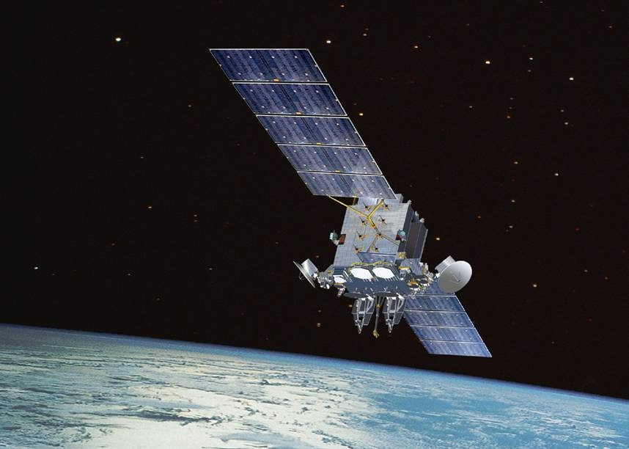
Satellite Motion
Why do satellites stay in space and not fall to Earth?

Slide 2
Centripetal force and Gravity
Recalling the two formulae for centripetal force and gravity and equating them you get:

Slide 3
Radial velocity
The radial velocity of the object is:
Can you rearrange this to prove Kepler’s third law?

Slide 4
Satellite Motion
Satellites are in perpetual freefall, they move around planet Earth at just the correct speed and at just the correct height so that their orbits are stable and satisfy the formula:
If you wanted a satellite to have a particular orbital time period T then what variable would you need to set to the correct value? The height!
If you wanted a satellite to have a particular orbital time period T then what variable would you need to set to the correct value?

Slide 5
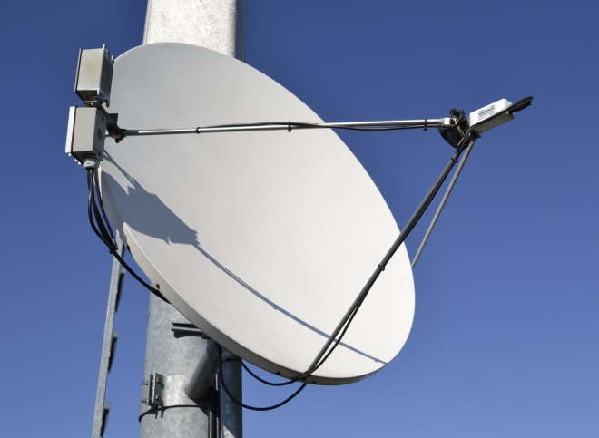
Geostationary orbits
A special orbit that is very useful is one that orbits above the equation on planet Earth and has a rotational period of exactly 24 hours.
This is useful because fixed receivers on Earth do not need to move to track these satellites because they appear to be stationary in the sky.
What altitude does a geostationary satellite need to be placed at?
36000 km
(If you got 42000km what did you forget?)

Slide 6
Satellites and Energy
A satellite has two energies, kinetic and potential:
By substituting this in for v and then rearranging we obtain:
Can this be simplified further?
Note that this is particularly useful as knowing the total energy enables the calculation of the either kinetic or potential energy if only one is known.
Recall that the satellite must be moving at velocity v so that Kepler’s third law is maintained, therefore:

Slide 7
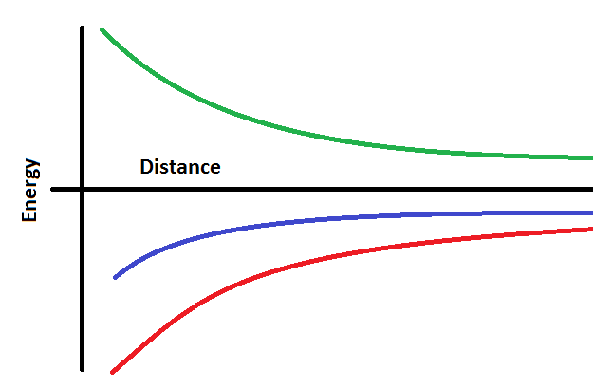
Graphing energy
Note that the total energy of a satellite varies with distance with a negative 1/r graph, as does the potential energy.
The kinetic energy is a positive 1/r graph
Kinetic
Total
Potential
Which line is which energy?

Slide 8
Summary
The height of a satellite is controlled by its orbital time and vice-versa
The height of a geostationary satellite is fixed as it has to maintain an orbital period of one day
The kinetic and potential energies of satellites can be calculated and the total energy is the sum of the two (Noting that potential energy is negative as)
The total energy of a satellite is always negative

