Slide 1
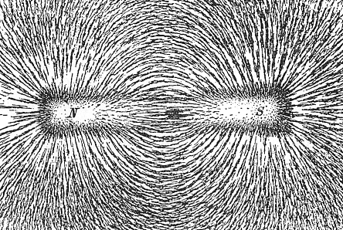
Field Patterns
What field patterns has you drawn while you have been at school?
You have drawn the field around a magnet

Slide 2
Static Electricity
Recall that electricity is the movement of charge; usually the flow of electrons
Conductors are materials in which electrons are free to move around
Insulators inhibit the movement of electrons, usually because they are held in place either within an atom or in the bonding between them
Static electricity occurs when:
Electrons are added or removed to an object
The object itself is either an insulator or it is insulated from its surrounding
A charge is therefore created on the object

Slide 3
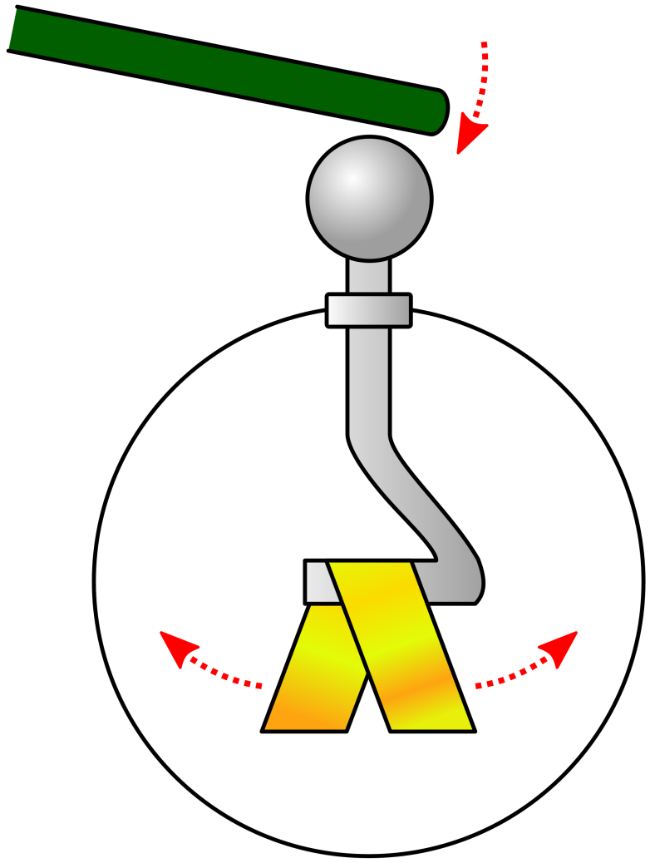
Gold Leaf Electroscope
You may have seen a Gold Leaf electroscope before when the photo-electric effect was demonstrated. Can you recall how it works and why?
Like charges repel so the gold leaf lifts up
When the top is touched or the charge removed the system becomes neutral and gravity pulls the leaf down

Slide 4
Shuttling ball experiment
If you suspend a ball (coated in conductive paint) between two high voltage plates it will shuttle between them
Why does it move in this manner?
Can the charge on the ball be calculated from the current flow?
The ball gains electrons at the negative plates and then is repelled from it. It moves to the positive plate and discharges before then swinging back to the negative plate
The charge is the current flow multiplied by the time period of the oscillation (Q=It)

Slide 5
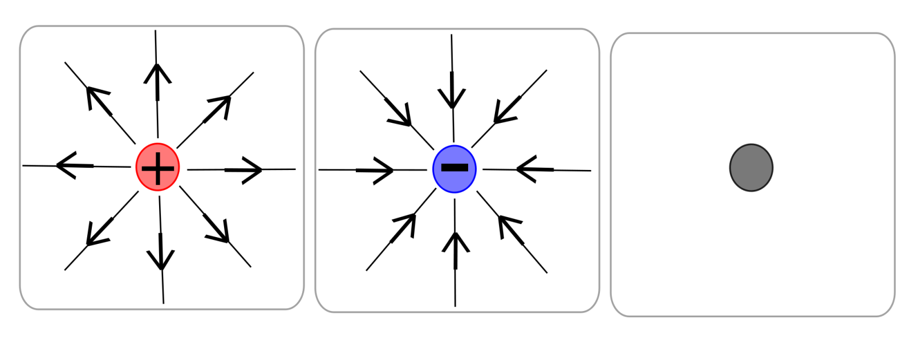
Field Lines
If a positively charged object is placed in an electric field then it will move away from the positive charge and towards the negative charge
The path along which it moves is a line of force or a field line
Positive Negative Neutral

Slide 6
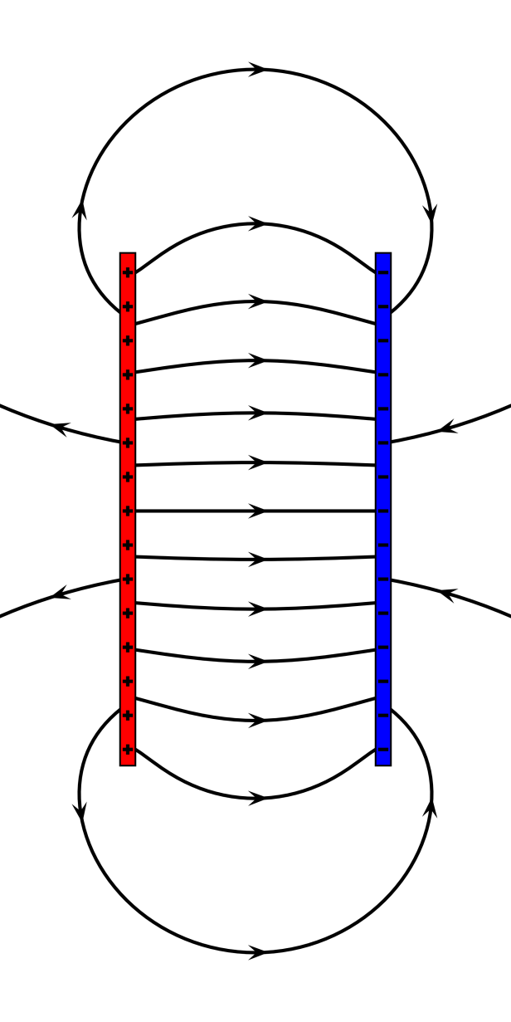
Field patterns
By placing test charges in fields you can draw the field lines at different points and build up a picture of the field pattern. There are three that you should be able to draw:
Electric plates that are parallel to each other:
Note that the field is almost uniform between the plates and can generally be considered as such for most calculations

Slide 7
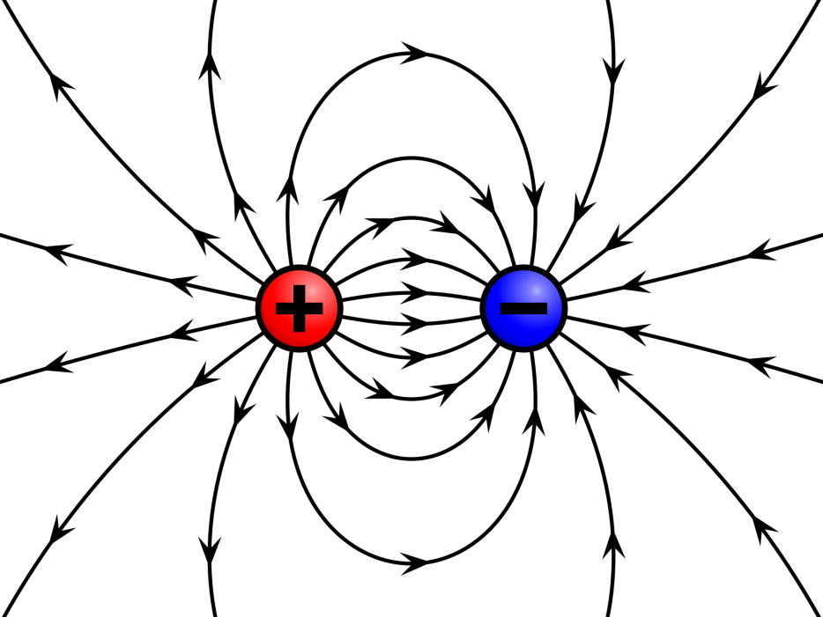
Two points charges create fields similar to those you have seen from magnets:
For point charges that are more distant the field lines between them begin to become more linear and uniform

Slide 8
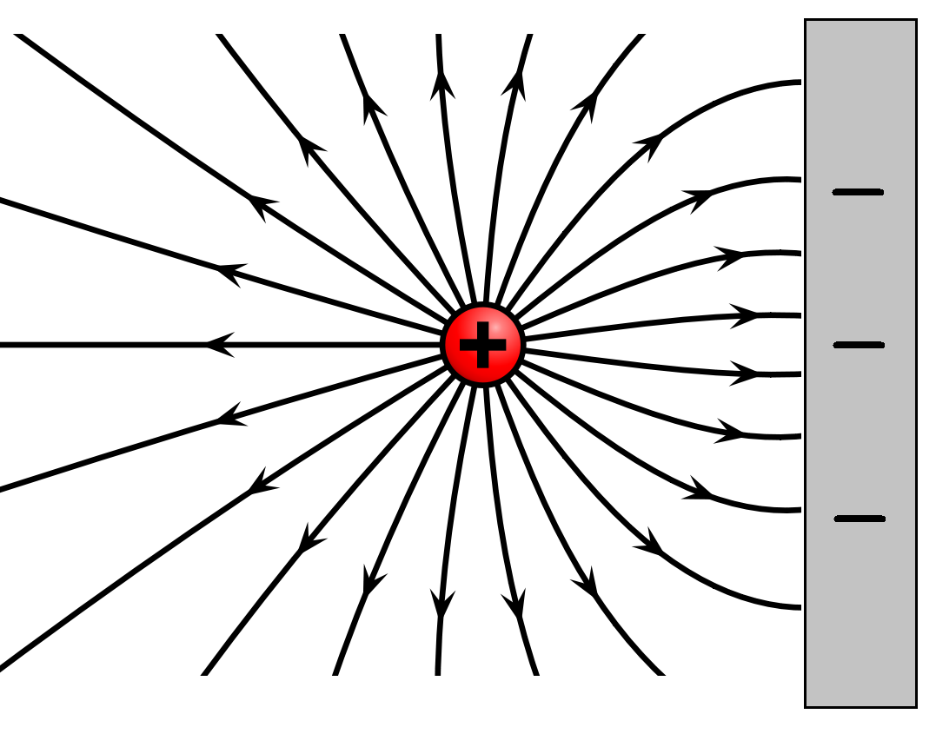
A point charge above a charges plate is a combination of the two you have already seen:

Slide 9
Summary
An electric current is a flow of charge, usually caused by free electrons moving in a conductor
Static electricity is when a charged object is insulated so that the charge cannot dissipate
An electric field exists around any charged particle or object
If a charged particle or object is placed in an electric field it will move along the field lines
The pattern of the field lines between parallel plates and /or point charges needs to be drawn and understood

