Slide 1
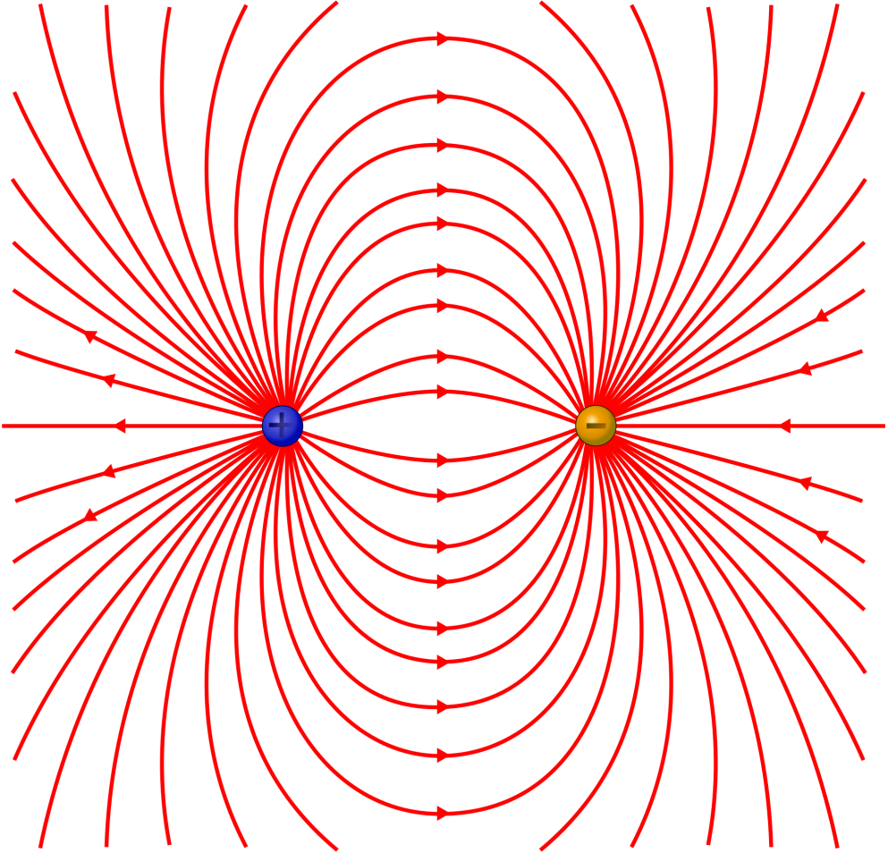
Electric Field Strength
How would you define the strength of an electric field? What would the units be?

Slide 2
Calculating Field Strength
Consider what happens if you place a test charge (a charge of negligible size and charge) within a field:
The charge moves along the field lines, caused by a force
What creates this force?
The greater the strength of the field E then the greater the force F
The greater the charge Q of the test charge then the greater the force F
The units are therefore NC⁻¹

Slide 3
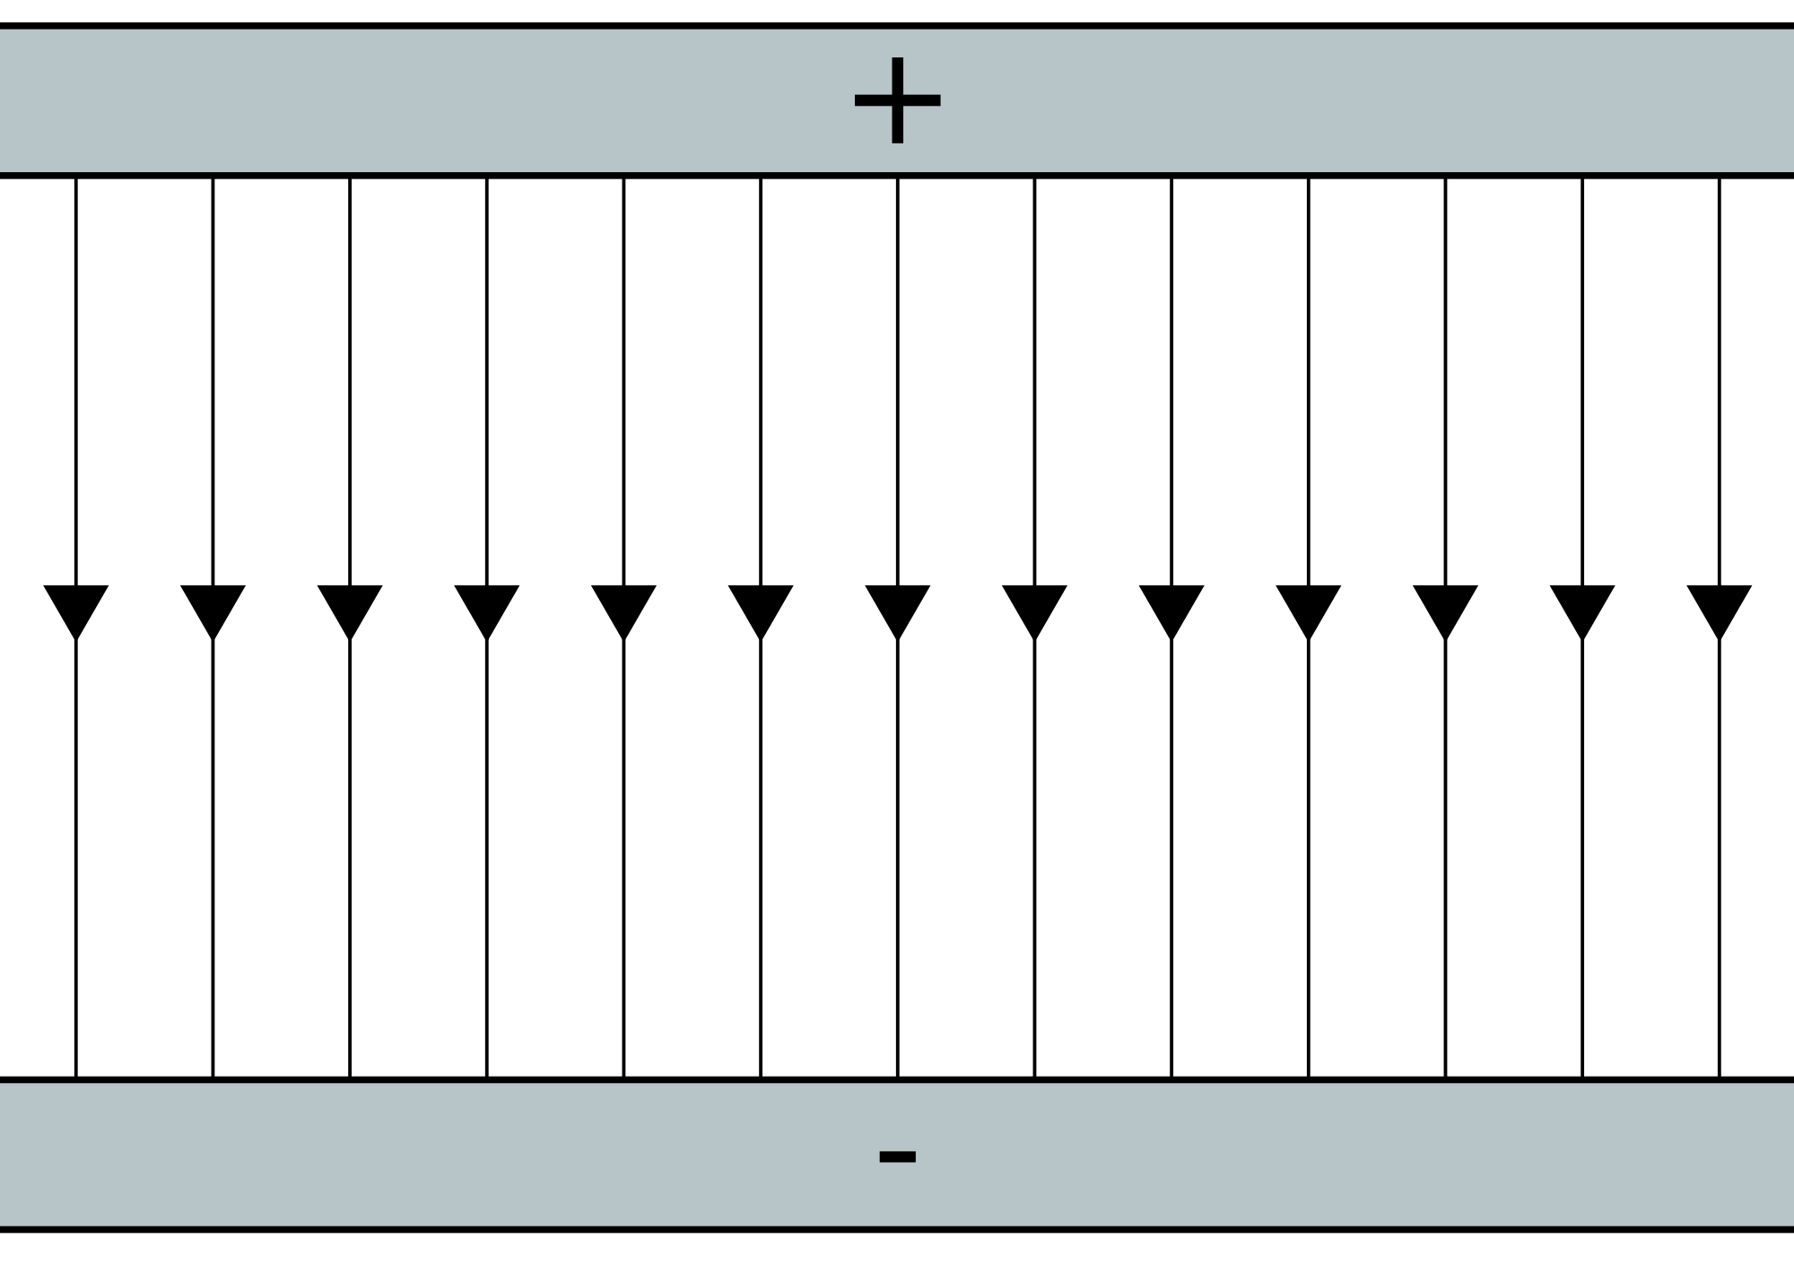
Parallel plates and electric fields
Can you recall what the field lines look like between two parallel plates?
Parallel
At right angles to the plates
Pointing from positive to negative

Slide 4
Parallel plates and electric fields
If you move a test charge between the plates then work must be done:
Can you recall the definition of Potential Difference?
Can you recall the definition of Potential Difference?
Work done per unit charge to move across a PD of V

Slide 5
Parallel plates and electric fields
Substitution and rearranging gives the field strength at any point between two plates, that are separated by a distance d

Slide 6
Permittivity of free space
The more concentrated the electric charge is on a surface then the greater the field strength will be above it
The greater the charge per surface are the greater the field strength
A constant of proportionality is required and is called epsilon nought or The Permittivity of free space

Slide 7
Summary
The electric field strength E is the force per unit charge on a test charge placed at that point in the field (NC⁻¹)
The formula for calculating the field strength between two parallel plates of separation d is:

