Slide 1

Capacitance
How can you store charge?

Slide 2
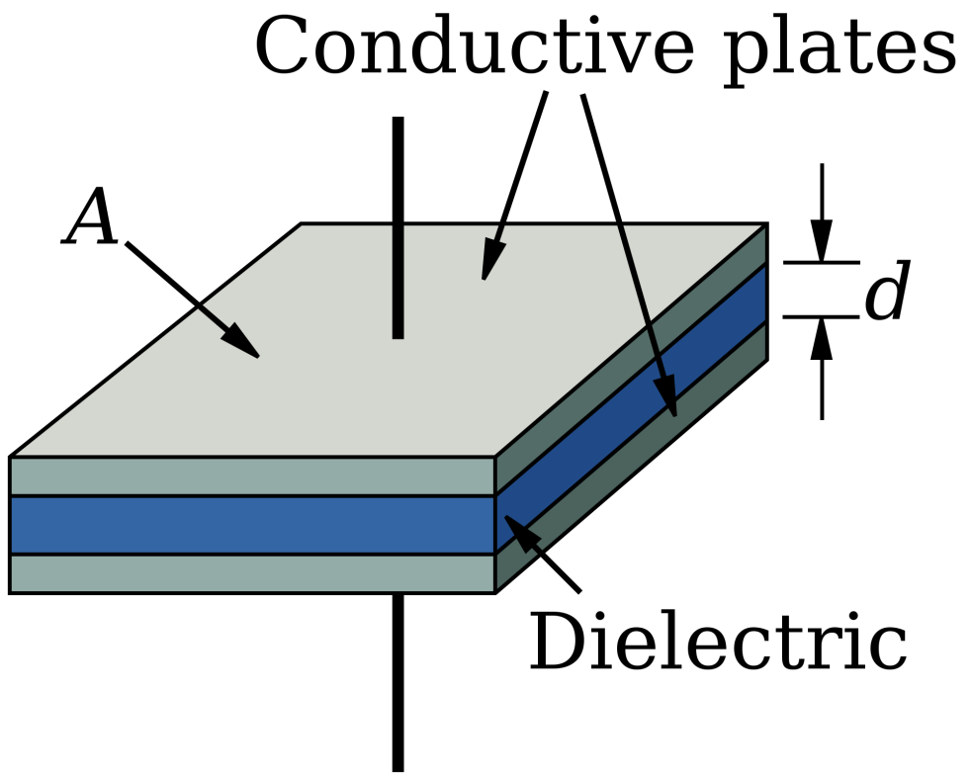
Storing charge
To store charge you need two plates that are next to each other and separated by a thick insulated sheet. You can then get two equal and opposite charges
The charge held on the capacitor is said to be Q meaning that +Q is on one and -Q is on the other one.

Slide 3
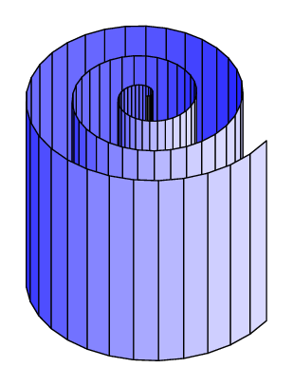
The ideal capacitor
What would be the ideal design parameters of a capacitor?
Infinitely large and perfectly flat plates
Plates as close as possible to each other however zero charge being able to flow between them
Clearly these conditions are not possible but a real capacitor attempts to emulate this design

Slide 4
Charging a Capacitor
If a Potential Difference is applied to a capacitor then it will charge the capacitor
A capacitor has a rating called its capacitance C using the units Farads (F)
Capacitance is defined as the charge stored per unit potential difference

Slide 5
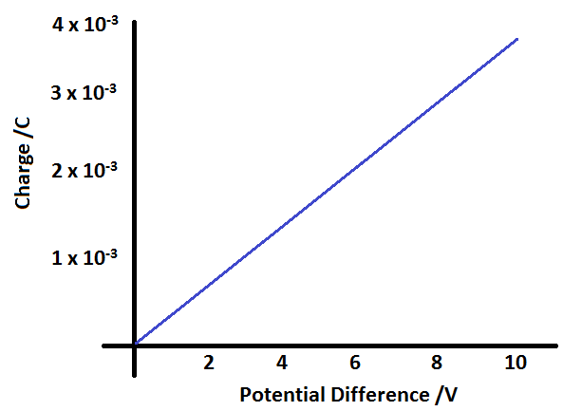
Investigating capacitance
The most accurate method for calculating capacitance is to apply a variety of P.D.'s across a capacitor and measure the current flow into it over time as it is connected.
Calculating the Charge allows a graph to be plotted of Charge against potential difference, the gradient of which is the capacitance.
What is the capacitance of this capacitor?

Slide 6
Maximum charge
As you increase the p.d. you increase the stored charge however there is a limit to how much can be held
When the charge gets big enough then the dielectric (the insulated layer) will break down and the charge will start to flow between the plates

Slide 7
Using capacitors
Smoothing out Voltages in sensitive circuits
Short term back-up supply voltages (Enough time for a PC to save)
Timing circuits (The charge / discharge rate of the capacitor can be used to time short time delays in circuits, e.g. interrupts in processing chips)
Pulsing circuits (Circuits that repeatedly turn on and off)
Tuning circuits (The discharge / charge rate of a capacitor has a natural oscillation that varying resistance in the circuit effects. By fine tuning this resistance you can calibrate an RC circuit to oscillate to a certain input frequency and tune a radio)
Filter circuits (To filter out unwanted frequencies from an input)

Slide 8
Summary
A capacitor is made of two plates separated by a dielectric layer
The charge stored on a capacitor is proportional to the p.d. applied
The capacitance of a capacitor is the charge per potential difference, the units are Farads
A Farad is a large unit of charge so mF or μF are often seen
Capacitors are used in almost all electronic devices

