Slide 1
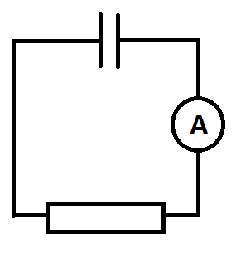
Charging and discharging a capacitor through a fixed resistor
If you were to monitor the current flow over time as a capacitor discharged, what would you expect to see?

Slide 2
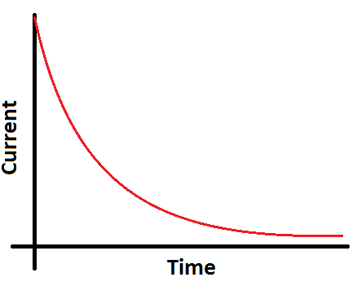
Discharge rate
When a capacitor is connected in a circuit with a switch and a resistor then it will discharge once the switch it closed. The rate at which it discharges is not linear because as it discharges the potential difference across the resistor drops, so the current drops.
What would a graph look like of current against time?

Slide 3
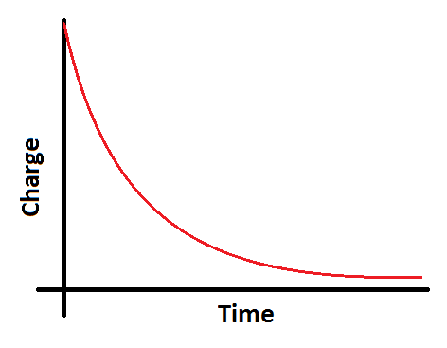
Charge over time
If the current flow is following an exponential decay curve, and this is a measure of the rate of flow of charge, then what would a graph look like that shows the charge on the plates over time as they discharge?
It would also be an exponential decay curve.

Slide 4
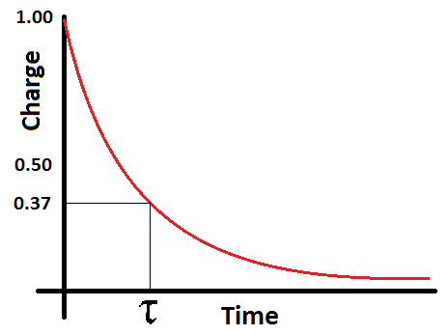
Time constant
To find the time constant of an exponential decay curve you must plot a graph and find out how long it took for the initial charge (or current) to drop to 37% of this initial value.
Maths note:
e⁻¹ ≈ 0.37

Slide 5
Analysis of the time constant
What is the general formula for an exponential decay curve?
How can this be turned into a straight line graph to find the time constant?
Because you are finding an unknown power then logarithms are required

Slide 6
Euler’s constant e
There is an irrational number e (≈2.718) that has a huge importance in exponential mathematics because the rate of change of the function e^{t} is also e^{t} which makes finding derivatives easy.

Slide 7
When you write a natural logarithm you should use the abbreviation ln:
The standard formula for exponential decay for any system is:
This means that the amount of something x after time t when you started with x₀ can be calculated given a constant λ which would be specific to the system examined.

Slide 8
Converting to linear graphs
Therefore by taking natural logs you get:
Because we are using natural logs the last term cancels out to one:
This is a straight line graph.

Slide 9
Applying logs to capacitor discharge
Plotting a graph of ln(Q) against time t will give s straight line of gradient –(1/τ)
Looking back at our formula for discharge we have:
Analysis of this time constant reveals that it is equal to the product of the resistance and the capacitance:
By taking logs we get:
AQA do not use the symbol τ however you will see it in most books

Slide 10
Formulae for capacitor discharge
There are therefore standard formulae for the discharge of a capacitor as follows:

Slide 11
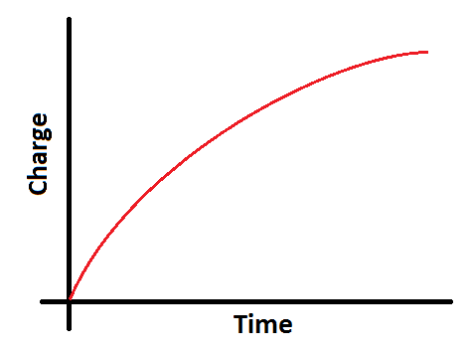
Charging a capacitor
When you charge a capacitor the current flow is again an exponential decay with the same formula as with discharge
The potential difference across the plates and the charge on the plates is an inverted exponential decay curve

Slide 12
Half life
You may notice a similarity to the exponential decay curve and the half life curve for radioactive decay that you have seen.
You can calculate the time it takes for the charge on a capacitor to halve with the following formula:
A simple rule for the time until the charge on a capacitor is approximately zero is 5RC

Slide 13
Summary
Discharge from a capacitor follows an exponential decay curve
Find the time it takes for a value (Q, I, V) to drop to 37% (e⁻¹) will give the time constant RC
Using logarithms to plot a linear graph will give a gradient of -1/RC
Charging a capacitor follows the same pattern except that the potential difference across the plates and the charge on the plates is getting larger over time so the correlation is an inverted exponential decay graph

