Slide 1
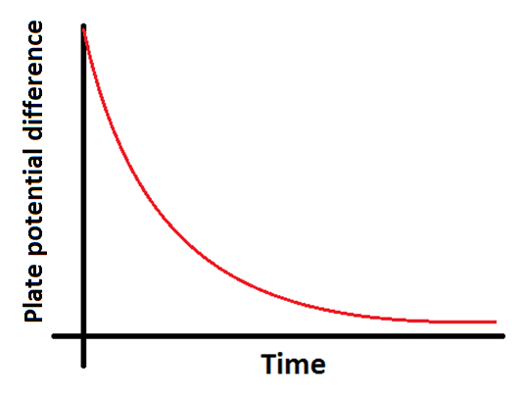
Investigation of the charge and discharge of capacitors

Slide 2
Remember, you need to measure the plate potential difference over time and create a linear graph of your results to find RC:

Slide 3
Opportunities for assessment
Your teacher will decide what level of independence you will have in this experiment:
You are given a complete step by step method to follow
You are given a limited choices of lengths/gauges of wire to use and a method to follow
You are given a brief method but have to determine the ranges and to use after doing a preliminary experiment
You plan and execute the experiment yourselves
It is important that during your A-Level course you can show evidence that you have performed a range of independence in performing experiments.

Slide 4
Writing up your experiment
You must write up this experiment fully showing a clear competence in the following skill areas:
Use appropriate digital instruments to record a range of measurements
Correctly construct circuits from circuit diagrams using a range of circuit components, including those where polarity is important
Design, construct and check circuits using DC power supplies, cells, and a range of circuit components
Use ICT such as computer modelling, or data logger with a variety of sensors to collect data, or use of software to process data

