Slide 1
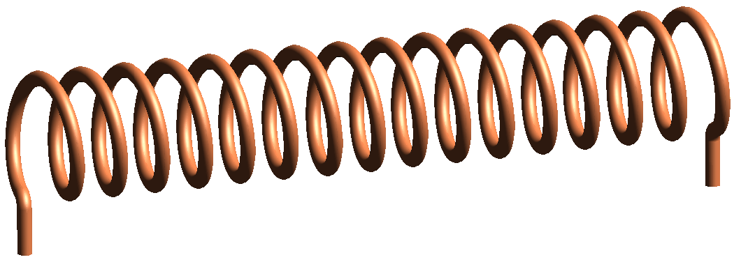
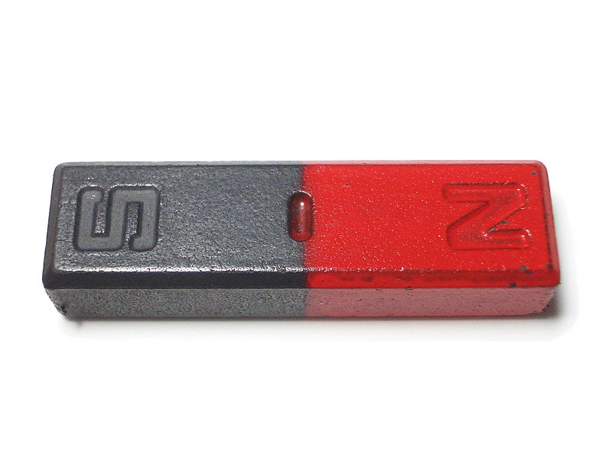
Generating electricity
What three things do you need to generate electricity?
Movement

Slide 2
Electromagnetic Induction
Electromagnetic Induction means that an emf (electromagnetic flux) is created when a wire is passed through a magnetic field. If the wire is part of a complete circuit then the emf will create a current flow in the wire.
How can the emf be increased?
Move the wire faster
Use a coil of wire
Use a stronger magnet
Note: No emf is created if the wire is parallel to the magnetic field lines as no magnetic lines will be broken as it moves.

Slide 3
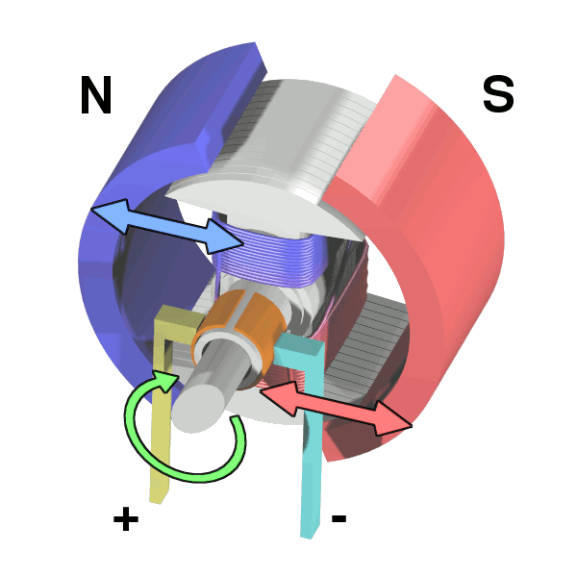
Using a motor in reverse
If a motor is forced to move and it is connected in a circuit then a current will be produced in the circuit.

Slide 4
Using a dynamo
A dynamo contains a magnet that spins within a coil of wire. This induces an emf in the coil which in turn can produce a current.

Slide 5
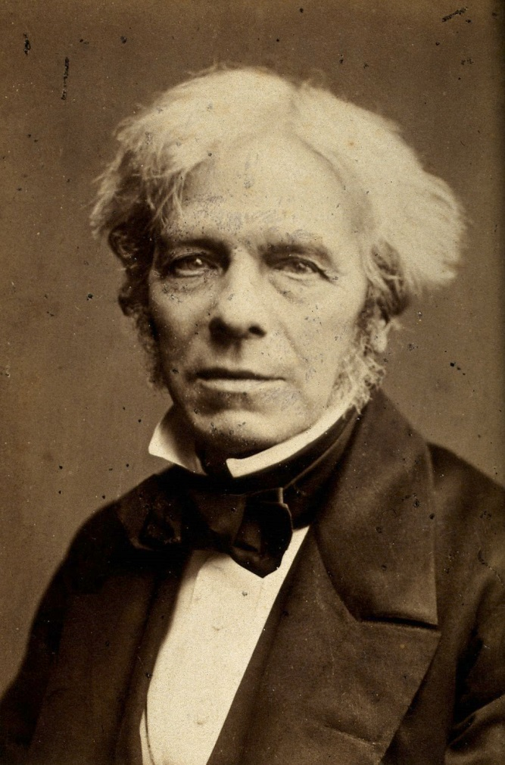
Michael Faraday
Credited with discovering electromagnetic induction, his famous quote when asked what electricity is for, he replied:
“What use is a new baby”
and
“Why sir, there is the probability that you will soon be able to tax it”
1791 - 1867

Slide 6
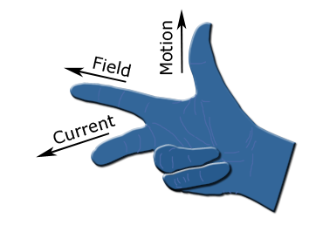
Fleming’s Right-hand Rule
Using your right hand you can work out the direction of current flow that is induced if a wire is move in a magnetic field

Slide 7
Summary
If a wire is moved in a magnetic field then an emf is created in the wire
If connected to a circuit this emf created a current that carries energy to the components
In a motor the coil moves inside fixed magnets; in a dynamo the magnet moves inside a fixed coil
The following will increase the current:
Coiling the wire
Moving the wire faster
Using a stronger magnet
Flemming’s right-hand rule is used to work out current flow direction

