Slide 1
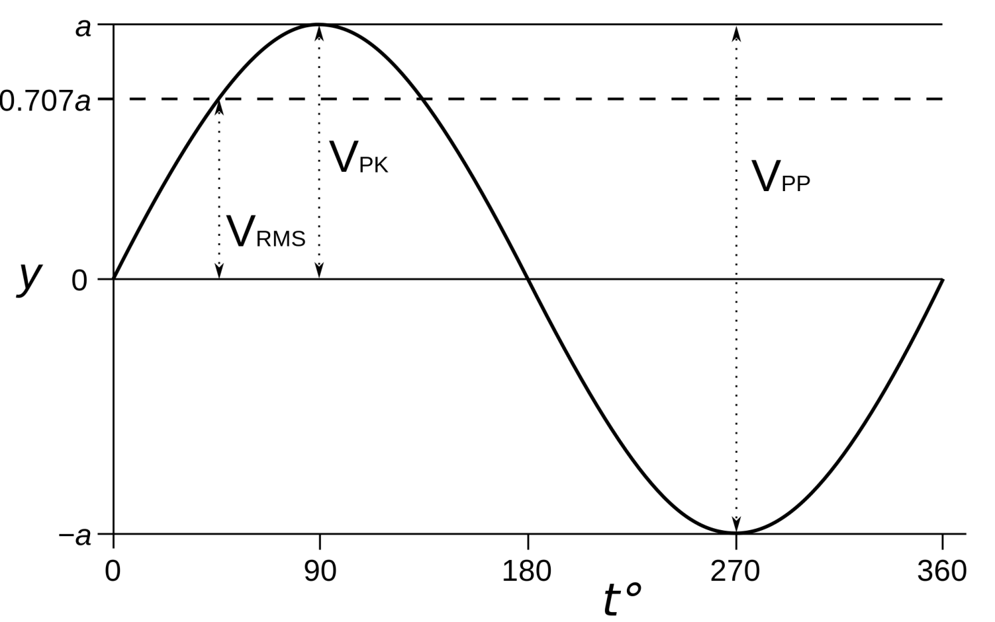
The alternating current generator
What is alternating? How can be display this in the lab?

Slide 2
AC Generator
Flux linkage for N coils at angle θ is given as:
Spinning a coil of wire inside a constant magnetic field means that the angle that the wires cut the magnetic field lines changes over time.
This means that the flux linkage changes over time.
The frequency of the spinning magnet can be used to calculate the angle θ:

Slide 3
AC Generator
Flux linkage for N coils at time t (after angle θ was zero) is given as:
Any formula containing 2πf is often shortened to the following, called the angular frequency:

Slide 4
Emf
The gradient of a graph of flux linkage against time is the change in flux linkage per second so it is a way of calculating emf
ε₀ = Peak p.d.
f = Frequency

Slide 5
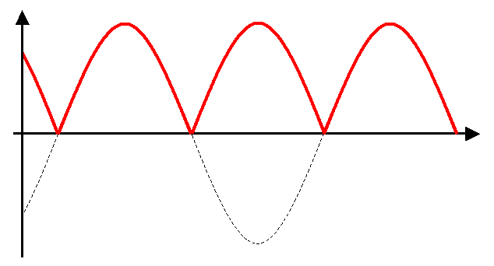
D.C. Generator
Using a split-ring commutator you can create a DC current from a spinning coil of wire
Although the current is always in the same direction, the spinning coil still creates a changing emf over time

Slide 6
Three phase alternator
A power station uses static coil windings outside of a spinning electromagnet. This creates 3 AC currents that are 120º out of phase to each other.
Transformers and sub-stations can supply these to businesses and homes 1/3 to each.

Slide 7
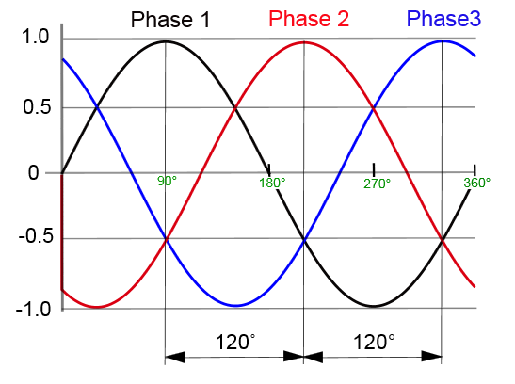
Current supplied from a 3 phase coil generator

Slide 8
Summary
Flux linkage for N coils at time t (after angle θ was zero) is given as:
The gradient of a graph of flux linkage against time is the change in flux linkage per second so it is a way of calculating emf:

Slide 9
AC current is a sine wave, as is the emf, over time
DC from a spinning coil is a wave but is always positive
UK mains electricity is created in three phases, only one phase is used by any one consumer.

