Slide 1
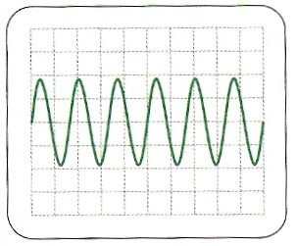
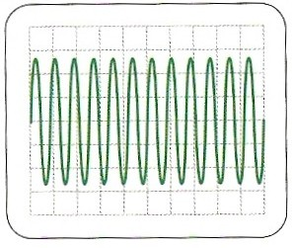
Measure the approximate period, frequency and peak-to-peak pd of the trace opposite if:
Time base = 5ms cm⁻¹
Y-gain = 5V cm⁻¹
period = 50ms / 6 ≈ 8.7ms
frequency ≈ 115 Hz
peak-to-peak pd ≈ 20V
Measure the approximate period, frequency and peak pd of the trace opposite if:
Time base = 2ms cm⁻¹
Y-gain = 0.5V cm⁻¹
period = 20ms / 12 ≈ 1.7ms
frequency ≈ 600 Hz
peak pd ≈ 1.3V

Slide 2
LO: To understand AC Current
Describe the main features of AC current and the equations. Use an Oscilloscope (C – AO1)
Use equations to calculate values such as RMS and explain what that is (B – AO2)
Apply understanding of AC in situations such as a generators and power stations (A/A* - AO3)

Slide 3
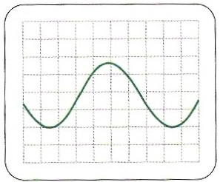
Question 3
The trace shows how a waveform of frequency 286 Hz and peak-to-peak pd 6.4V is displayed.
Suggest the settings of the time base and Y-gain amplifier.
The period of a wave of frequency 286Hz = 1/285 = 0.0035s = 3.5ms
One complete oscillation of the trace occupies 7cm.
Therefore time base setting is 3.5ms / 7cm
≈ 0.5 ms cm⁻¹
The peak-to-peak displacement of the trace is about 3.7 cm.
Therefore the Y-gain setting is 6.4V / 3.7cm
≈ 2V cm⁻¹

Slide 4
Further analysis
The amplitude of the wave should represent the input peak potential difference; how does this compare to the 2V you selected?
What effect does changing the vertical and horizontal dials have on the image on the screen?
Do the calculations still yield the same answers for time period and peak potential difference?

Slide 5
Root mean squared
To calculate an average value for a sinusoidal wave you find the root mean squared value, the formula being:
Applying this is UK mains that means that the RMS of the potential difference is:

Slide 6
Power of an AC supply
The power of an AC supply can be calculated in exactly the same way as a DC circuit except that the RMS of both the current and potential difference must be used (i.e. the RMS is the value of direct current that would have the same effect as the AC current)

Slide 7
Root mean square values
The root mean square (rms) value of an alternating current is equal to the value of direct current that would give the same heating effect as the alternating current in the same resistor.
if: I_{rms}² R = ½ I₀² R
then: I_{rms}² = ½ I₀²
and so:
I_{rms} = I₀ / √2
also with pds:
V_{rms} = V₀ / √2
and: P = I_{rms} V_{rms}

Slide 8
Question
Calculate the rms values of the UK and USA mains voltage supplies if the peak values, V₀ are 325V and 155V respectively.
V_{rms} = V₀ / √2
UK: = 325V / √2
V_{rms} = 230V
USA: = 155V / √2
V_{rms} = 110V

Slide 9
Answers:
Complete:
V₀ / V | I₀ / A | R / Ω | V_{rms} / V | I_{rms} / A | P / W
12 | 4
 |  | 50 | 230 | 4.6
155 |  |  |  | 5.5
 |  |  | 1.41 |  | 0.50
 | 0.30 | 20
3
8.49
2.83
24
325
6.5
1058
7.75
20
110
605
2
0.50
4
0.353
6
4.24
0.212
0.90

Slide 10
Summary
AC electricity alternates sinusoidally with a frequency of 50Hz and a peak potential difference of 325 Volts
An oscilloscope trace can be used to analyse a wave and measure the time period and peak potential difference
The root mean squared of both current and potential difference can be used to calculate the power rating (heating effect through a resistor) of an AC supply

