Slide 1
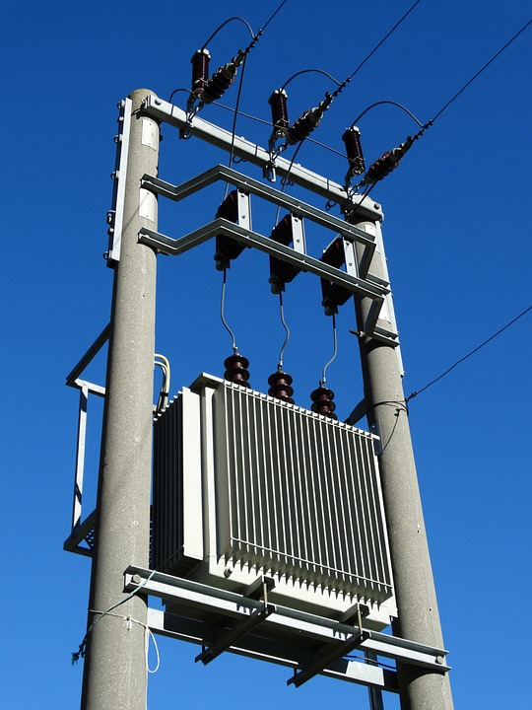
Transformers
What are the function and limitations of transformers?
Used to change the potential difference of a supply
Cannot change the frequency and only work with AC not DC

Slide 2
Transformer rules
All transformers consist of two coils of wire that are wrapped around an Iron core
Transformers only work with AC Potential Difference
As the P.D. oscillates it induces a changing magnetic field in the primary coil
This magnetic field also cuts the secondary coil so an emf is induced in the secondary coil

Slide 3
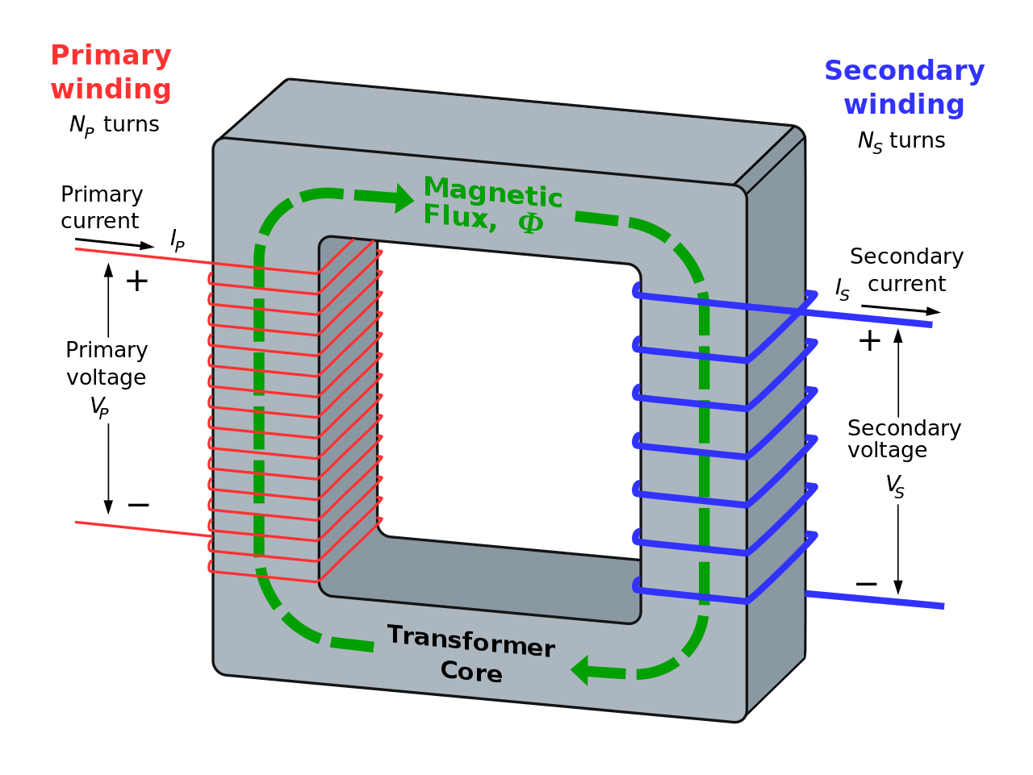

Slide 4
Transformer Mathematics
The induced emf in the primary coil opposes the P.D. applied to the primary coil V_{P}
Faraday’s Law states that the induced emf in the secondary coil is the same as the flux linkage in the secondary coil

Slide 5
Transformer Rule
Given that the P.D. in the primary coil is inducing the emf in the secondary coil then the ratio of them must be equal to the ratio of their Flux Linkages
Cancelling out the Magnetic Flux, the ratio of p.d. in the coils is equal to the ratio of the turns in each coil.
Note: This assumes no resistance in the wires / coils and that the magnetic fields overlap both of the coils.

Slide 7
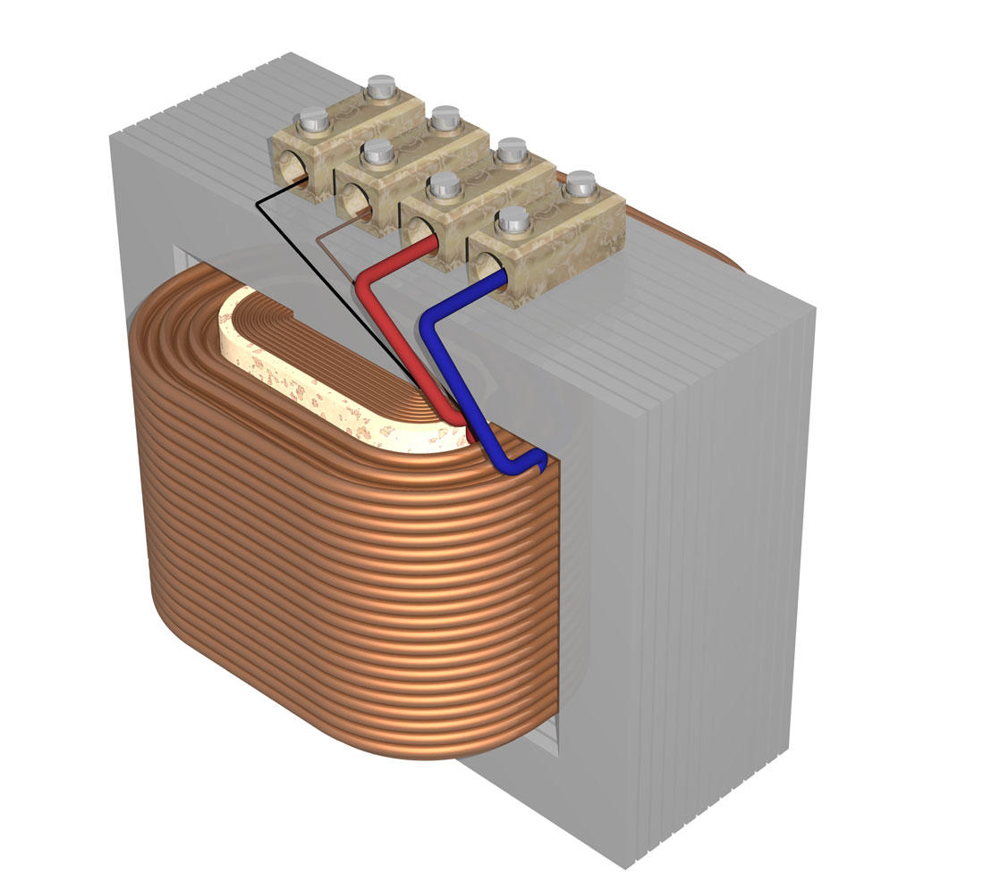
Transformer design
The coils have to share the same magnetic field. This is achieved by winding them around the same Iron core. A laminated iron core helps to “channel” the magnetic field more efficiently and reduce loss through heat

Slide 8
Efficiency of a Transformer
Transformers are almost 100% efficient if they are designed with:
Low resistance windings to reduce heat loss
A laminated core to reduce eddy currents in the Iron, which also cause heat loss

Slide 9
Calculating efficiency
When there is no current being drawn from the secondary coil (circuit is disconnected) the back emf in the primary coil acts against the p.d. in primary coil so there is very little current in the primary coil.
This explains why a phone charger that is left plugged into the mains with nothing attached to it charge draws very little current – important exam style question!
The efficiency is often given as a percentage. The use of superconductors would give even more efficient transformers however a superconductor that works at sufficiently high temperatures are yet to be discovered.
When there is no current being drawn from the secondary coil (circuit is disconnected) the back emf in the primary coil acts against the p.d. in primary coil so there is very little current in the primary coil.

Slide 10
National Grid
The transmission of electricity along the National Grid is much more efficient at high p.d. due to there being less current flowing (why does this reduce heating loss?)
A step-up transformer creates a high p.d.in the cables (as much as 400kV)
A step-down transformer then reduces the p.d to 230V (325V peak AC) for the domestic electricity supply

Slide 11
Summary
A transformer can change the p.d. of an AC supply, both up and down
The transformer formula links the current, p.d. and number of turns on the coils:
The efficiency of the transformer is increased by using low resistance wires and a laminated iron core
The National Grid uses transformers to reduce heating in overhead cables by increasing the p.d. and lowering the current

