Slide 1
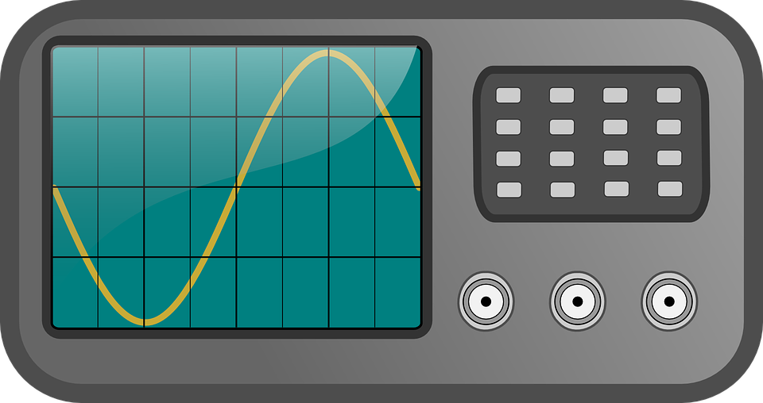
Investigation, using a search coil and oscilloscope, the effect on the magnetic flux linkage of varying the angle between a search coil and magnetic field direction

Slide 2
Magnetic Flux linkage
If you use a coil of N turns then the flux linkage is given by:
In general if the angle between the magnetic field and the face of the coil is θ the you have:

Slide 3
Opportunities for assessment
Your teacher will decide what level of independence you will have in this experiment:
You are given a complete step by step method to follow
You are given a limited choices of lengths/gauges of wire to use and a method to follow
You are given a brief method but have to determine the ranges and to use after doing a preliminary experiment
You plan and execute the experiment yourselves
It is important that during your A-Level course you can show evidence that you have performed a range of independence in performing experiments.

Slide 4
Writing up your experiment
You must write up this experiment fully showing a clear competence in the following skill areas:
Use appropriate analogue instruments to record a range of measurements
Use appropriate digital instruments to record a range of measurements
Correctly construct circuits from circuit diagrams using a range of circuit components
Use an oscilloscope including volt/division and timescale

