Slide 1
Satellite Motion and Planetary Orbits
Gravitation

Slide 2
Aims
G fields recap
Equipotential Lines recap

Slide 3
g Gravitational Field Strength
g = F / m
where m is a mass feeling the gravity force of a much larger mass M
Newton’s law in this situation can now be written:
F = - G M m
r²
Substituting F from the 2nd equation into the 1st: g = - G M m
r² m
g = - G M
r²

Slide 4
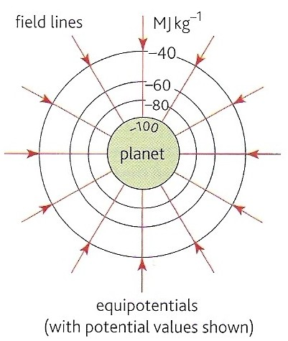
Gravitational Potential
These are surfaces that join up points of equal potential.
No work is done by gravitational force when a mass is moved along an equipotential surface.
Equipotentials are always perpendicular to field lines.
Examples include: contour lines on maps, sea level, the floor of a room, the bench top surface.

Slide 5
Work done through gravitational potentials
When a mass, m is moved through a gravitational potential difference of ΔV the work done ΔW is given by:
ΔW = m x ΔV

Slide 6
Question
Calculate the minimum work required to lift an astronaut of mass 80kg from the Earth’s surface to the height of the ISS (300 km).
Earth radius, r = 6400 km
Earth mass, M = 6.0 x 10 ²⁴ kg
G = 6.672 x 10 ⁻¹¹ N m ² kg ⁻ ²

Slide 7
Answer
V = - G M / r
V at Earth surface: r = 6.4 x 10 ⁶ m
= - (6.672 x 10 ⁻¹¹) x (6.0 x 10 ²⁴ ) / 6.4 x 10 ⁶
= - 6.26 x 10 ⁷ Jkg ⁻¹
V at ISS: r = 6.7 x 10 ⁶ m
= - 5.97 x 10 ⁷ Jkg ⁻¹
ΔV = (6.26 – 5.97) x 10 ⁷ Jkg ⁻¹ = 2.9 x 10 ⁶ Jkg ⁻¹
ΔW = m x ΔV
= 80 kg x 2.9 x 10 ⁶ Jkg ⁻¹
Work = 2.32 x 10 ⁸ J = 232 MJ

Slide 8
Question
(a) What work would be needed to remove the astronaut completely from the Earth’s gravitational field?
(b) If this work came from a conversion of initial kinetic energy (the astronaut is projected from the Earth’s surface), what would be the astronaut’s initial speed?

Slide 9
Answer
(a) ΔV = (6.26 – 0) x 10 ⁷ Jkg⁻¹ = 6.26 x 10 ⁷ Jkg⁻¹
ΔW = m x ΔV
= 80 kg x 6.26 x 10 ⁷ Jkg⁻¹
Work = 5.01 x 10 ⁹ J = 5 010 MJ
(b) ½ m v ² = ΔW = 5.01 x 10 ⁹ J
v² = (2 x 5.01 x 10 ⁹ J) / 80 kg
v² = (10.02 x 10 ⁹ J) / 80 kg
v² = 1.25 x 10 ⁸
speed, v = 1.12 x 10⁴ ms⁻¹ (11 kms⁻¹)
This is called the escape speed.

Slide 10
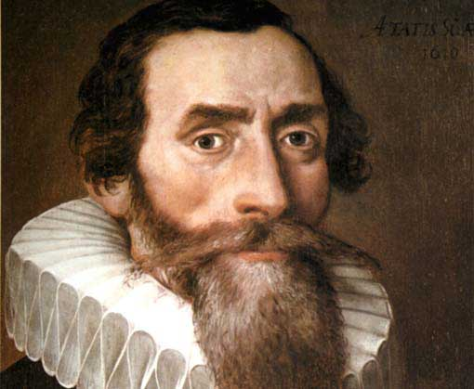
Kepler’s Three Laws
The orbit of a planet is an ellipse with the Sun at one of the two foci.
A line segment joining a planet and the Sun sweeps out equal areas during equal intervals of time.
The square of the orbital period of a planet is proportional to the cube of the semi-major axis of its orbit.

Slide 12
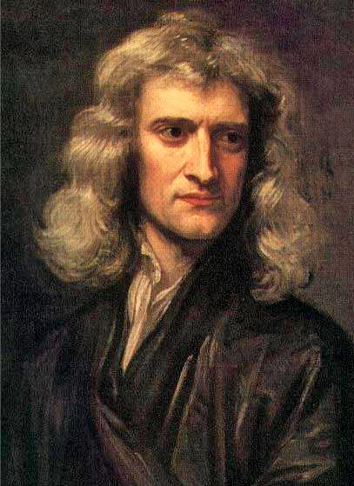
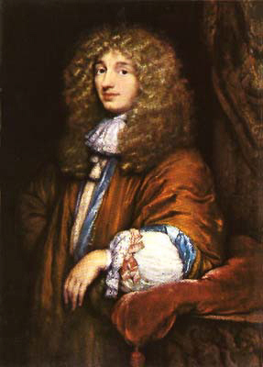
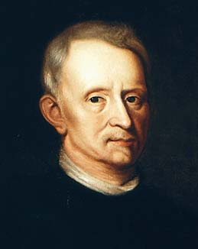
Newton Vs Hooke and Huygens
Vs

Slide 13
Geostationary Orbit
Satellites which are sent up to orbit the Earth can be polar trajectory satellites used to examine the Earth – mapping etc. or geostationary orbit when the satellite must remain in exactly the same position 24 hours a day
A specific height above the Earth’s surface is required to achieve geostationary orbit
At the specific geostationary height, the satellite will orbit the Earth at exactly 24 hours period

Slide 14
Question
Using Kepler’s 3rd law, calculate the distance of geostationary orbit
Mass of the Earth = 6.0 x10²⁴ kg
Radius of the Earth = 6400 km

Slide 15
Answer
$r^{3}=\frac{GMT^{2}}{4π^{2}}$
Period T = 24 h = 24 x 3600 s = 86 400 s
$r=\sqrt[3]{\frac{GMT^{2}}{4π^{2}}}=\sqrt[3]{\frac{6.67×{10}^{−11}×6.0×{10}^{24}×86 400^{2}}{4π^{2}}}=4.2×{10}^{7}m$
$∴r=4.2×10^{7}=42 000 km$
$42 000 −6400 km=36 000 km$

