Slide 1
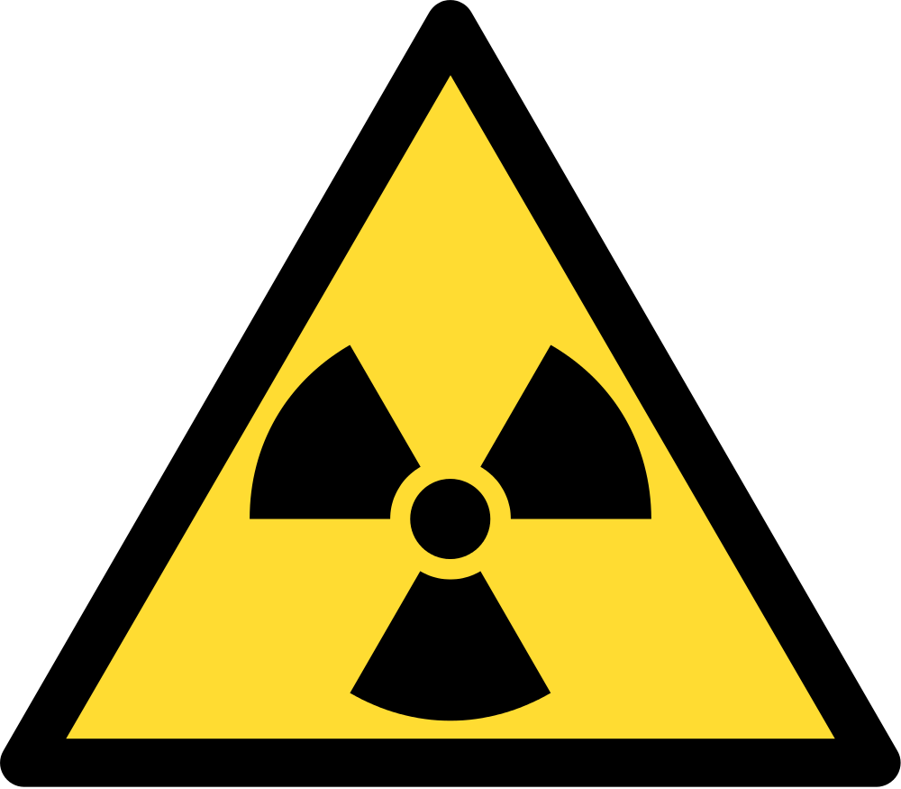
Dangers of Radioactivity
Radiation

Slide 2
Aims
Chance and Risk
Chernobyl
Units for Radioactivity
Acute Radiation Sickness

Slide 3

Chance and Risk
Radiation consists of several types of subatomic particles, principally gamma rays, neutrons, electrons, and alpha particles, that shoot through space at very high speeds
They can easily penetrate deep inside the human body, damaging some of the biological cells of which the body is composed. This damage can cause a fatal cancer to develop, or if it occurs in reproductive cells, it can cause genetic defects in later generations of offspring.
When explained in this way, the dangers of radiation seem to be very grave, and for a person to be struck by a particle of radiation appears to be an extremely serious event. So it would also seem from the following description in what has perhaps been the most influential book from the opponents of nuclear energy

Slide 4

Still Risky?
But before we start to panic, it should be pointed out that every person in the world is struck by about 15,000 of these particles of radiation every second of his or her life, and this is true for every person who has ever lived and for every person who ever will live.
Calculate the approximate yearly frequency of radioactive ‘interactions’ we have.
500 billion per year
In addition, our technology has introduced new sources of radiation like medical X-rays — a typical X-ray bombards us with over a trillion particles of radiation.

Slide 5
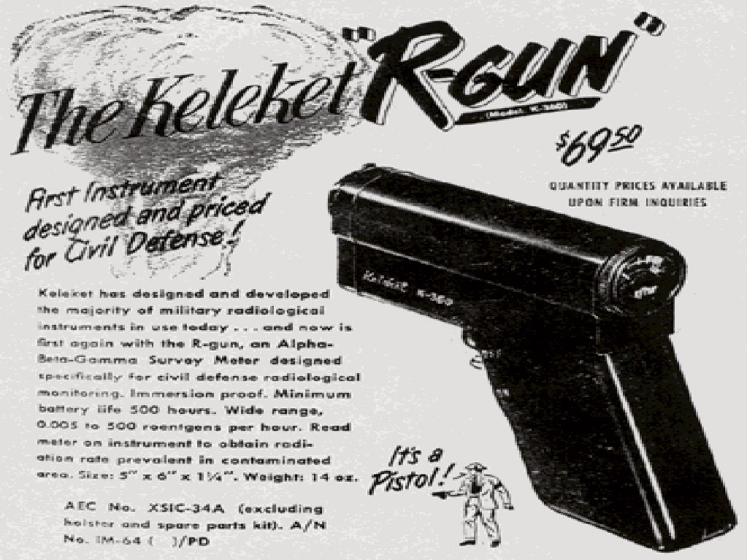
So with all this radiation?!....
With all of this radiation exposure, how come we're not all dying of cancer?
The answer to that question is not that it takes a very large number of these particles to cause a cancer.
As far as we know, every single one of them has that potential; "no level of radiation is perfectly safe."
What saves us, rather, is that the probability for one of these particles to cause cancer is very low.

Slide 6
Chernobyl
http://www.dailymotion.com/video/x33dpr_eine-chronik-schwerwiegender-tage

Slide 7
What units are used for measuring radioactivity?
Radioactivity or the strength of radioactive source is measured in units of becquerel (Bq). 1 Bq = 1 event of radiation emission per second. One becquerel is an extremely small amount of radioactivity.
An old and still popular unit of measuring radioactivity is the curie (Ci). 1 Ci = 37 GBq = 37000 MBq. One curie is a large amount of radioactivity.
The gray (Gy) is a derived unit of ionising radiation dose in (SI). It is used as a measure of absorbed dose. It is defined as the absorption of one joule of radiation energy per one kilogram of matter.
The sievert (Sv) is a derived unit of ionising radiation dose in (SI). It is a measure of the health effect of low levels of ionising radiation on the human body.
The equivalent cgs unit, the rad (equivalent to 0.01 Gy) – not used in most cases

Slide 8
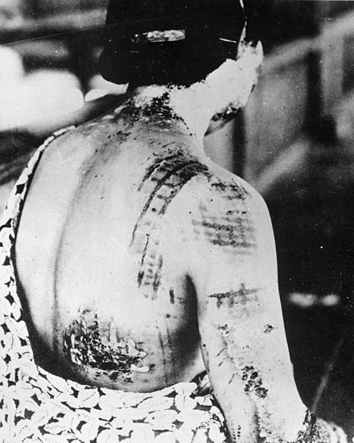
Acute Radiation Sickness
Classically acute radiation syndrome is divided into three main presentations: hematopoietic, gastrointestinal and neurological/vascular. These symptoms may or may not be preceded by a prodrome.
The speed of onset of symptoms is related to radiation exposure, with greater doses resulting in a shorter delay in symptom onset.
Each syndrome requires that the tissue showing the syndrome itself be exposed.
The hematopoietic syndrome requires exposure of the areas of bone marrow actively forming blood elements (i.e., the pelvis and sternum in adults).
The neurovascular symptoms require exposure of the brain.
The gastrointestinal syndrome is not seen if the stomach and intestines are not exposed to radiation.

Slide 9
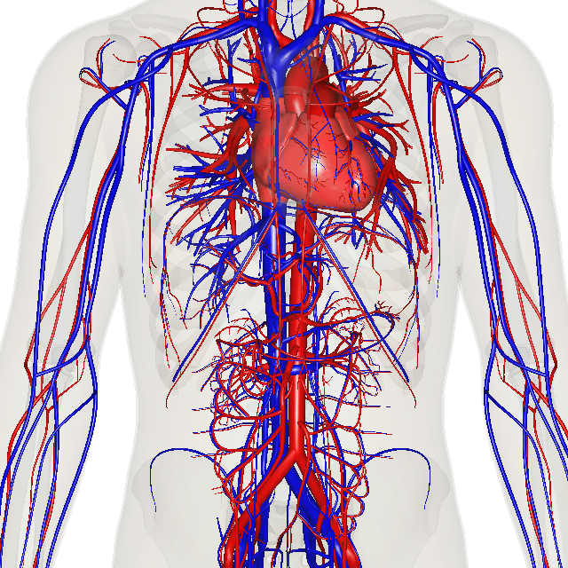
Acute Radiation Sickness
Hematopoietic
This syndrome is marked by a drop in the number of blood cells, called aplastic anaemia.
This may result in infections due to a low amount of white blood cells, bleeding due to a lack of platelets, and anaemia due to few red blood cells in the circulation.
These changes can be detected by blood tests after receiving a whole-body acute dose as low as 0.25 Gy, though they might never be felt by the patient if the dose is below 1 Gy. Conventional trauma and burns resulting from a bomb blast are complicated by the poor wound healing caused by hematopoietic syndrome, increasing mortality.

Slide 10
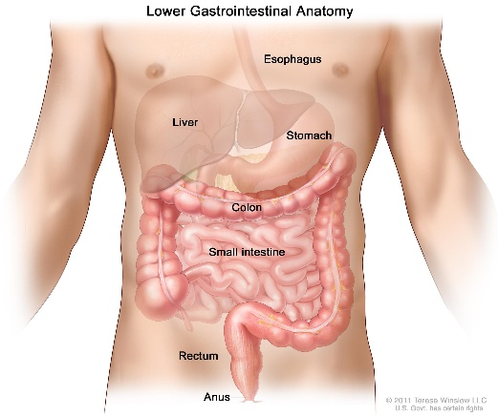
Acute Radiation Sickness
Gastrointestinal
This syndrome often follows absorbed doses of 6–30 Gy (600–3000 rad)
The signs and symptoms of this form of radiation injury include nausea, vomiting, loss of appetite, and abdominal pain. Vomiting in this time-frame is a marker for whole body exposures that are in the fatal range above 4 Gy. Without exotic treatment such as bone marrow transplant, death with this dose is common. The death is generally more due to infection than gastrointestinal dysfunction.

Slide 11
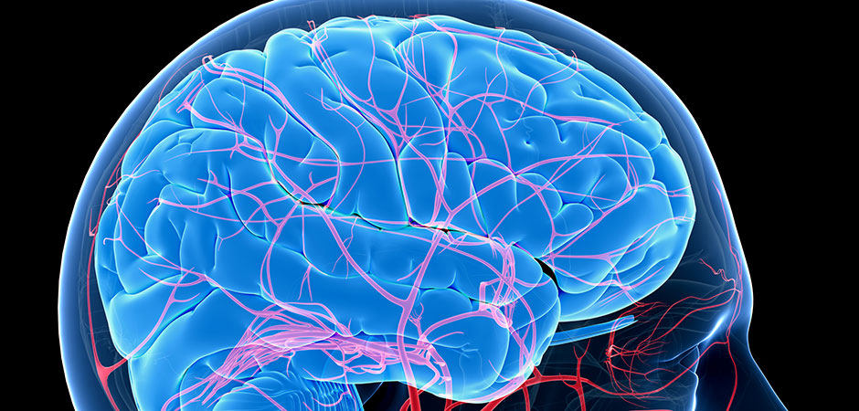
Acute Radiation Sickness
Neurovascular
This syndrome typically occurs at absorbed doses greater than 30 Gy (3000 rad), though it may occur at 10 Gy (1000 rad).
It presents with neurological symptoms such as dizziness, headache, or decreased level of consciousness, occurring within minutes to a few hours, and with an absence of vomiting. It is invariably fatal.

Slide 12
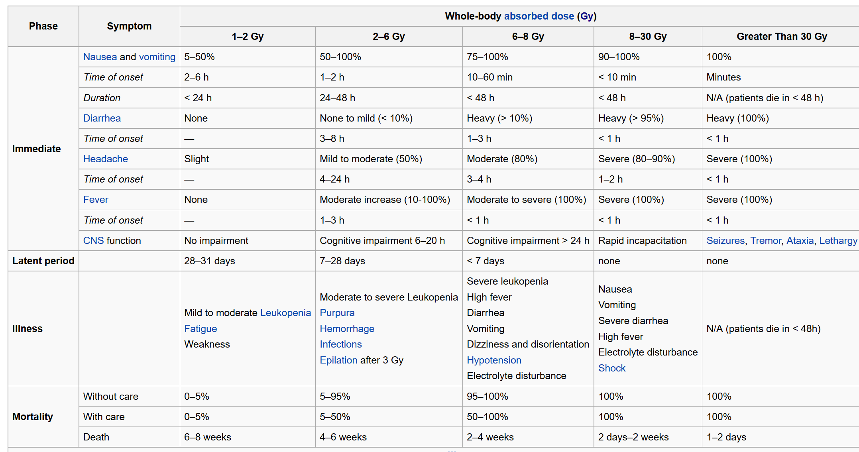
Acute Radiation Sickness

Slide 13
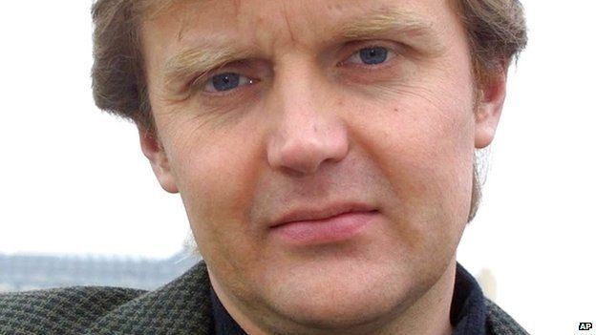
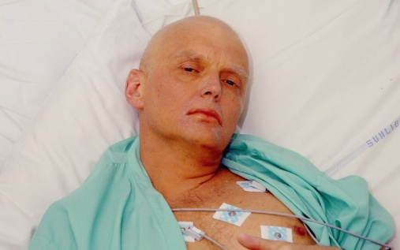
Quick Research Topic
Alexander Litvinenko
Defected KGB agent who was murdered by a few possible suspects
Write a quick 5 min presentation to determine who, when, why and symptoms of his radiation sickness and death
Do not cut and paste from the internet
Try to make different presentations
No more than 3 in a group

