Slide 1

The properties of α, β and γ radiation
What do you know about the three forms of ionising radiation and how could these be measured in the lab?

Slide 2
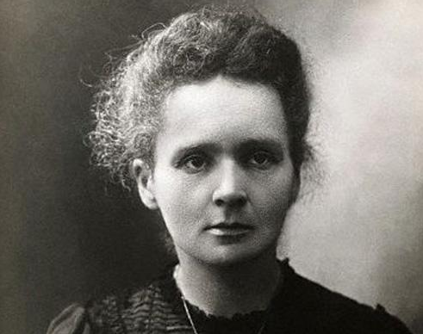
Marie Curie
Famous for her work with radioactive materials.
She showed how they could be separated and identified.
Marie Curie (1867 - 1934)

Slide 3
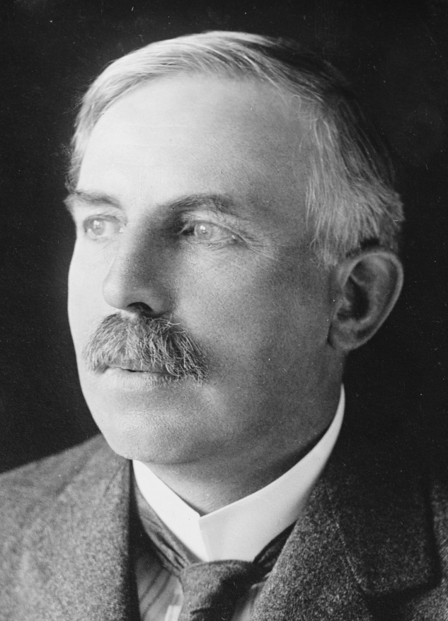
Ernest Rutherford
As well as creating the nuclear model of the atom, Rutherford also made several discoveries about radiation including:
It can ionise air which makes air conduct electricity
There were two types of radiation which he called Alpha (α) and Beta (β)
Gamma radiation was discovered a year later (γ) – by Paul Villard
Ernest Rutherford
(1871 - 1937)
Built upon the ideas of Thomson

Slide 4
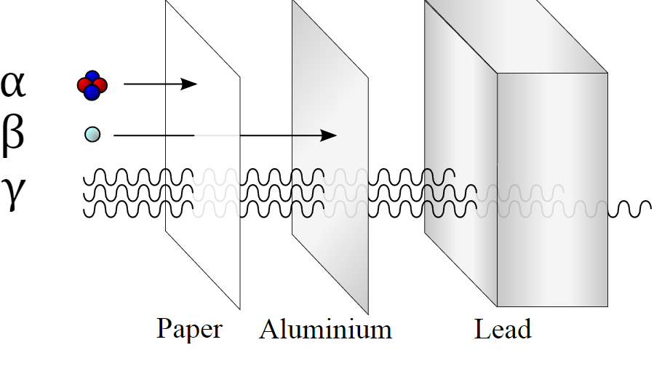
Absorption of radiation
(Penetrating power)
Alpha particles are large and cannot travel far in air. They ionise the particles in the air by knocking electrons off them making the air conductive.
Beta is less ionising than alpha radiation and gamma is less ionising again mainly due to them having no charge
Ionisation of gases is used in the Geiger tube to create a small charge and hence enable the detection of radiation

Slide 5
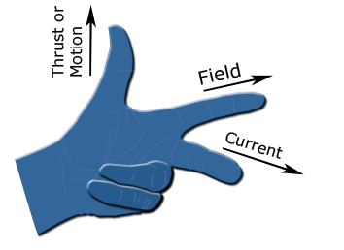
Moving charges in a magnetic field
If a charged particle moved within a magnetic field then it feels a force, the motor force.
The direction of this force can be worked out using Fleming’s left-hand rule

Slide 6
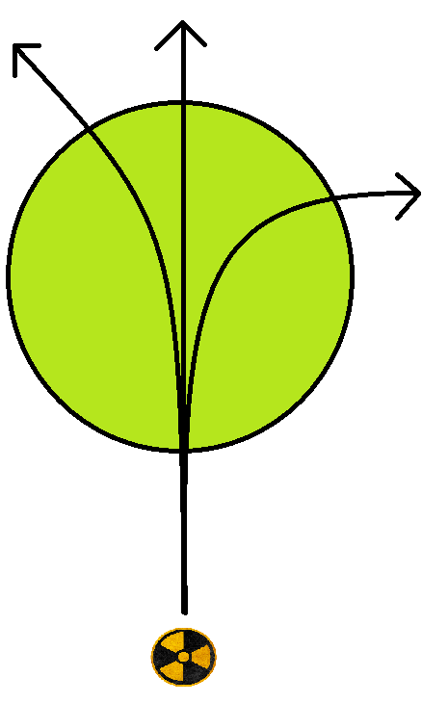
Using magnetism to separate radiation
A charged particle will feel a force on it if it moves in a magnetic field. The direction of this movement follows Flemming’s left-hand rule
Can you work out (given that Alpha is positive) which way the magnetic field is operating?
Why is the Gamma not deflected at all?
Why is Beta deflected more than Alpha?
α
γ
β

Slide 7
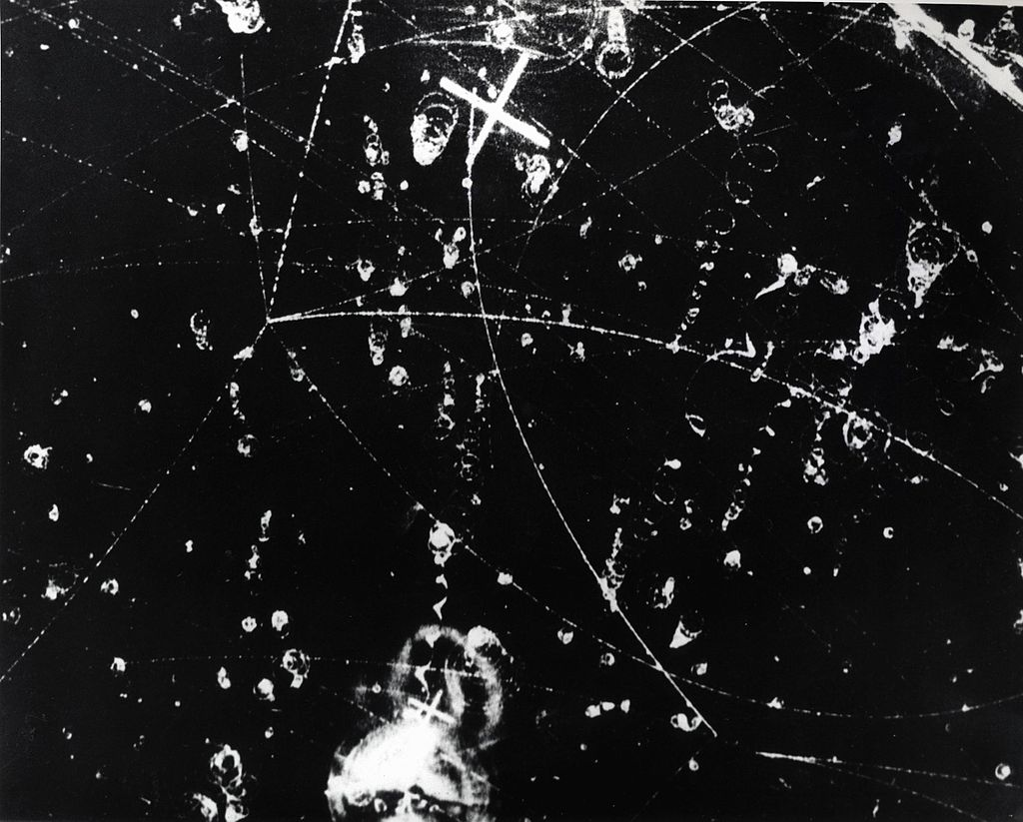
Cloud Chamber Experiments
Recall that charged particles moving in large, uniform magnetic fields, will move in curves and circles based on the masses and velocities.
When charged particles move through super-saturated gases then tracks condense out. Photographs of these can be analysed to work out what the charged particles are.

Slide 8
Deflection in an Electric Field
α
γ
Alpha and beta are charged particles so they deflect in an electric field (opposites attract and like charges repel)
Gamma has no charge so it does not deflect
β
-
+

Slide 9
Summary
There are three forms of radiation: Alpha, beta and gamma
These can be separated using different absorbing layers, magnetic fields and electric fields
The charges on the particles determine which way they deflect in a magnetic and electric field
Cloud chambers are used to analyse particles to determine their mass/charge ratio

