Slide 1
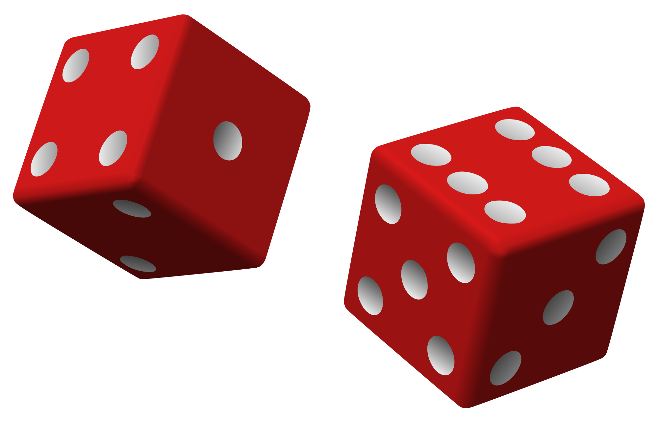
Radioactive Decay
How can we mathematically model a random process?

Slide 2
Radioactive Decay
Remember that radioactive decay is a random process which cannot be predicted or determined for a single atom.
The rate of decay is controlled by the amount of nuclei present so over time the activity decreased exponentially
This means that in a set time period the activity will halve, and then halve again and again…

Slide 3
Half Life
The half life of a certain isotope is the time that it would take for the mass of the isotope to decrease to half the mass of the initial mass.
You can therefore calculate the mass m of an isotope remaining from an initial sample m₀ using:

Slide 4
Avogadro Constant
Recall from GCSE Chemistry that for an isotope of mass A:
Its molar mass M is its mass number A in grams
One mole of the element contains N_{A} atoms which is the Avogadro constant
mass m of the element contains:

Slide 5
Activity
The activity A of a sample is how many disintegrations occur per second and these are measured in Becquerel (Bq)
Activity is proportional to the number of radioactive isotopes present which in turn decay exponentially over time.
Therefore activity decays exponentially over time

Slide 6
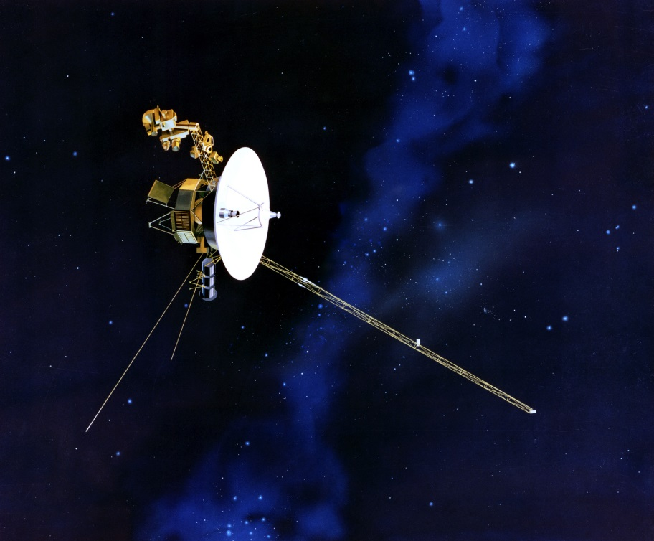
Activity and Power
Recall that the nucleus of an isotope becomes more stable when it decays, therefore the energy E must be released and be carried away by the particle
Long distance space probes require a nuclear power cell however if the activity is high to give high power then the source will not last very long.
Voyager has a power output of about 285W!
The power output is the product of the activity in Bq and the energy per emission in Joules which gives Watts
This can be thought of as the energy transferred from the radioactive source per second

Slide 7
Summary
Although radioactive decay is a random process it can be modelled statistically with large samples
The half life is the time it takes for half of the sample to decay, or the time it takes for the activity to halve
This therefore follows an exponential decay curve
The total power output (rate of energy output) from a radioactive source is therefore:
When choosing a source for use the activity must not be too high, with a short half-life or the source will not last too long. Likewise a very long half-life will create low overall activity and a low power output

