Slide 1
The theory of radioactive decay
Radioactive decay is not predictable
Is this due to a lack of knowledge of the nucleus?
No, this is a quantum mechanical process and is truly unpredictable and this is not due to a lack of scientific knowledge

Slide 2
Mathematics of decay
Recall that the activity is the rate of decay of an isotope. This is related to how many parent atoms N are present.
The lambda is a decay constant and describes the instability of the isotope. A formula where the rate of decay of a variable is a function of itself creates an exponential decay.

Slide 3
Exponential decay over time
If you consider a quantity x that is getting exponentially less over time t then the formula is:

Slide 4
Solving differentiation for exponential formulae
Consider the following:
Applying the rules of differentiation to this formula:
This therefore represents a special case formula x where:

Slide 5
Exponential number (Euler’s number)
From the previous formula we can see that there is a constant that represents:

Slide 6
Deriving the formula for exponential change
Combing the following three formulae:

Slide 7
Activity of a sample
From our knowledge of exponential decay mathematics we can write out a formula for the activity A of a sample after time t if the initial activity was A₀:

Slide 8
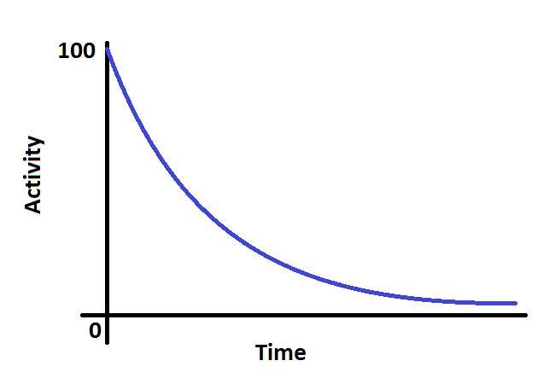
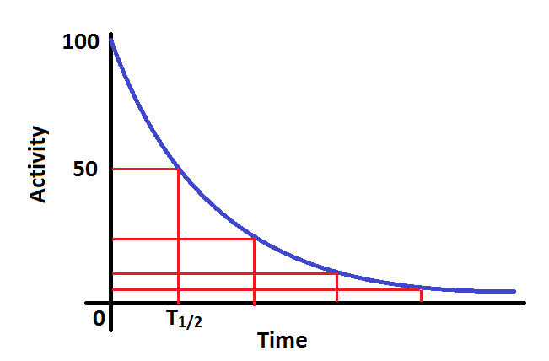
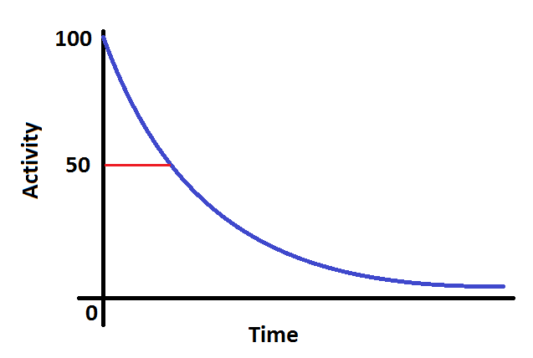
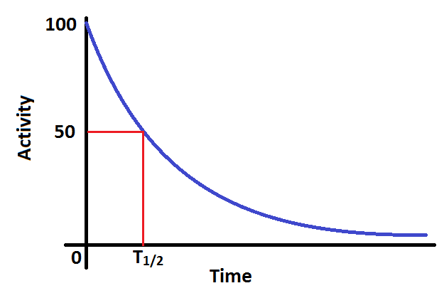
Half-life from graphs
Given a graph over time of either activity, count rate or number of parent isotopes you can quickly find the half-life:
To reduce uncertainty you can repeat this for ¼ etc. and take an average
Step 1: Read off from the y-axis the half-way point from the initial amount
Step 2: Read across and down to the x-axis and find the half-life time

Slide 9
Half Life
This is the time taken for x to halve in magnitude during exponential decay:
Substituting into the exponential formula we get:
Applying natural logs:

Slide 10
Decay constant
The decay constant is therefore a measure of the instability of the isotope, i.e. the bigger the half-life the smaller the decay constant.
The decay constant is the probability of an individual nucleus decaying per second.

Slide 11
Summary
Although radioactive decay is an unpredictable event mathematics can model the decay of a large number of atoms
The general formula for exponential decay can be used for activity, count rate or number of atoms as a function of time:
The half-life of an isotope is the time taken for half of the sample to decay, or for the activity to halve
The decay constant is a measure of instability and is linked to the half-life time by:

