Slide 1
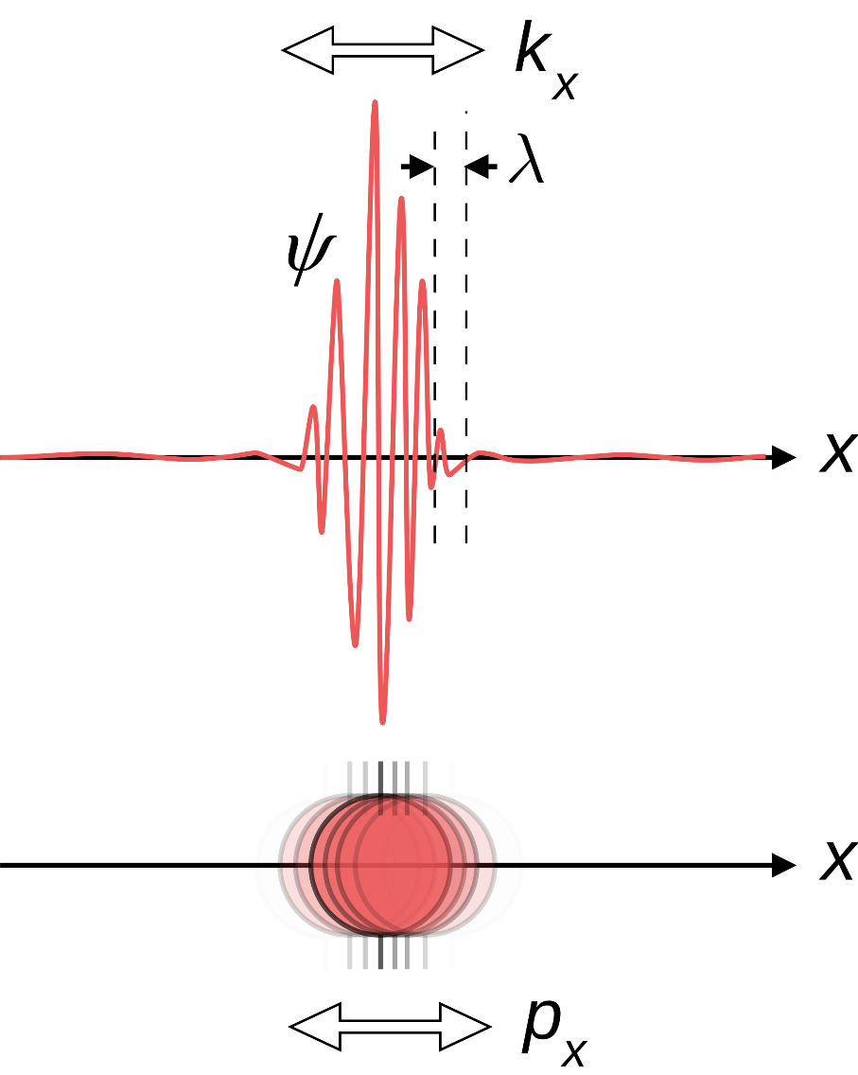
CW | Nuclear Radius | 05/12/2018
Recap:
What happens when electrons travel close to the speed of light?
What is the equation?

Slide 2

Without touching the bag, estimate the number of balls inside the bag

Slide 3
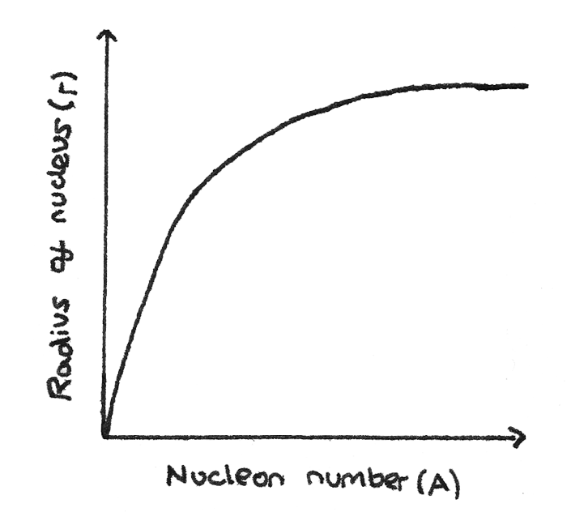

Slide 4
Nuclear radius vs Nucleon number
Experimental data using the electron diffraction technique has that:

Slide 5
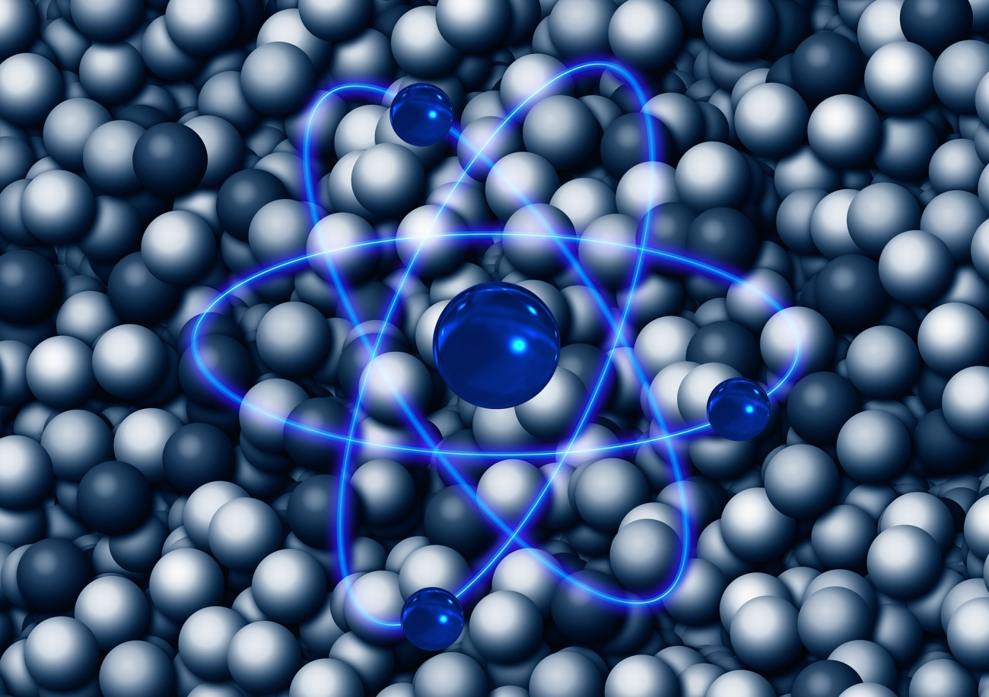
How big is an atomic nucleus?
How can we measure or estimate something we cannot “see”?

Slide 6
Given that an alpha particle accelerates away from a nucleus, if we assume it starts stationary then Coulomb’s law can be used to estimate how close it can get to the centre of the nucleus, i.e. what the diameter of the nucleus is.
NEW EQUATION ALERT:

Slide 7
de Broglie Wavelength and Diffraction
If you accelerate the electrons in a beam to almost the speed of light (this requires 100's of millions of Volts) then this formula simplifies to:

Slide 8
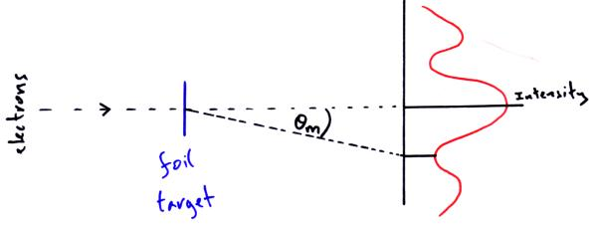

Slide 9
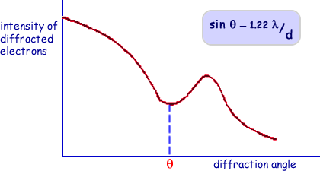

Slide 10
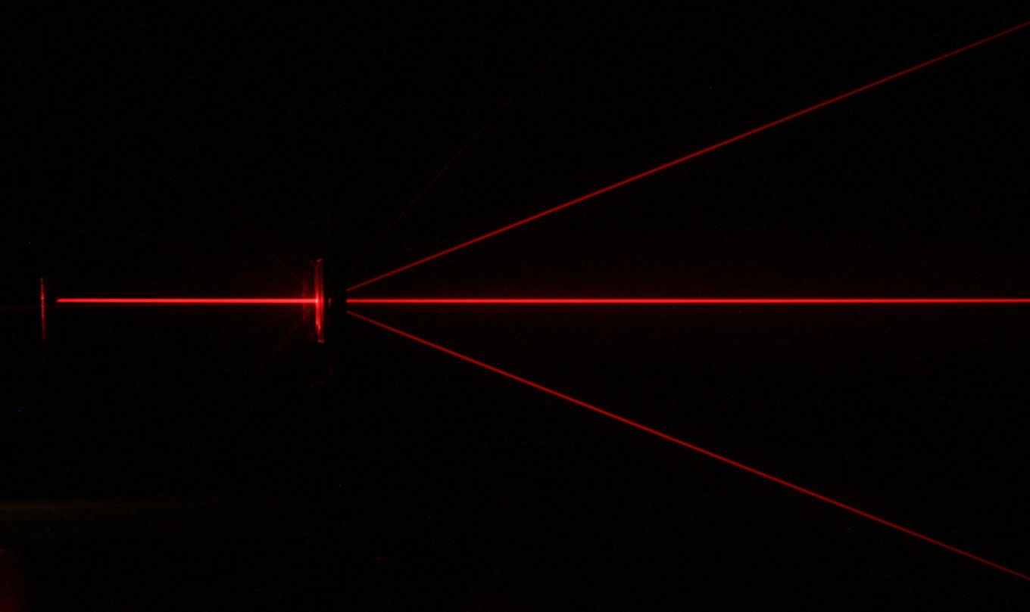
When relativistic electrons pass through a thin sample of a gas then diffraction occurs between the atomic nuclei.
The equation that calculates the minimum angle of diffraction is:
Oxygen gives a value of 44 , use the formula above and the calculated wavelength of a relativistic electron to satisfy yourself that the Oxygen nuclei is about 2.6 fm if the electron has about 420MeV.

Slide 11
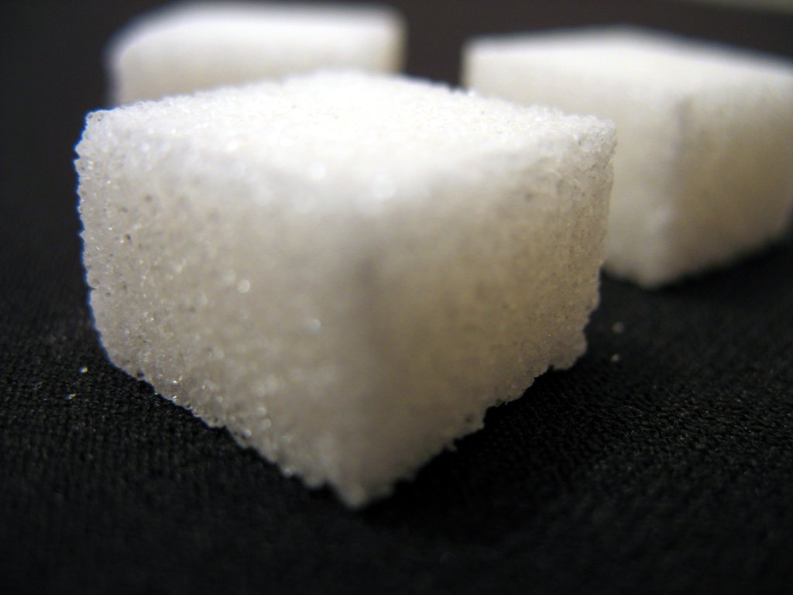
Nuclear Density
Assuming that the nucleus is a sphere then it's volume is:
Density is simply mass / volume and therefore using the mass of a nucleon as u we obtain:
This is the density of a Neutron star. If the population of the world (c.7 Billion) averaging 80kg per person was crushed into a cube of this density, how long would it's sides be?

Slide 12
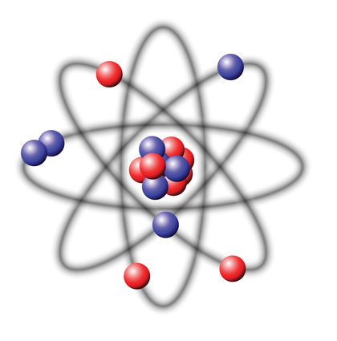

Density of the Nucleus
The radius of a carbon atom is 9x10⁻¹¹ m, while the radius of the nucleus is 33,000 times smaller.
Calculate the density of:
  The Carbon atom
  The Carbon Nucleus
How do these densities compare with the neutron star?
Assuming the average human has a mass of 70kg and assuming they are made of purely carbon, what volume would a human take up if all the empty space of each atom was removed?

Slide 13
Summary
There are several methods to calculate the approximate diameter of a nucleus including:
  Coulomb’s law applied to alpha particles
  Diffraction of relativistic electrons through gases
The several methods concur with each other and support the theory that the nucleus is about 10000th the size of an atom
The density of all nuclei are about the same regardless of atomic number, as they are all made of the same sub-atomic particles

