Slide 1
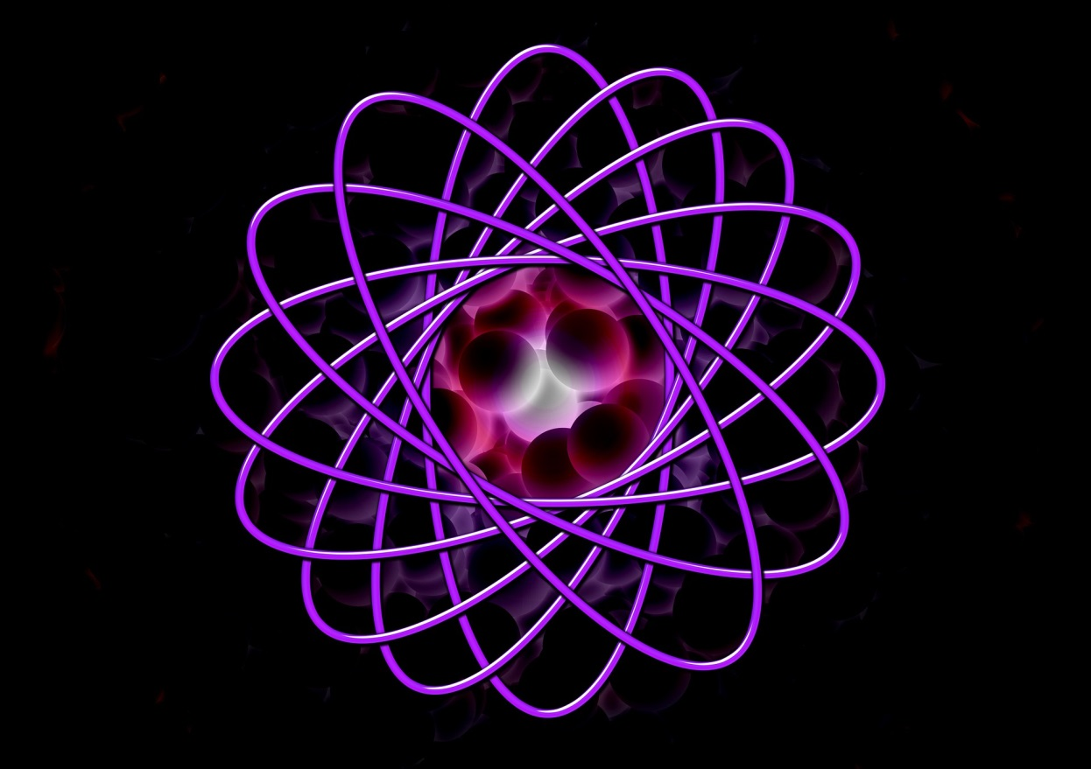
Binding energy
What is the energy change that occurs when constituent particles come together to create a nucleus?

Slide 2
Strong Force- Variation with distance
force
electrostatic force
attract repel
distance from centre / femtometres
1
3
strong force

Slide 3
The Strong Force
The Strong Force acts an attractive force between nucleons at distances of less than 3fm, and repulsive at distances less than 0.5fm
The electrostatic repulsion between protons at 10⁻¹⁵m is about 200N, so the Strong Force needs to be at least 200N
If we wanted to remove a nucleon from the nucleus, the work done to overcome the Strong Force attraction and reach 3fm would be roughly:
Work done = Force x Distance
Work done = 200N x 2.5 x 10⁻¹⁵m
Work done = 5 x 10⁻¹³J or 3.1 MeV

Slide 4
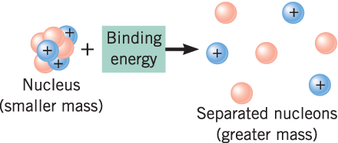
Binding Energy
Binding energy is defined as:
The Binding energy of a nucleus is the amount of work that must be done to separate a nucleus into its constituent parts.
(As we’ve added energy, the mass of the nucleons increases!)

Slide 5
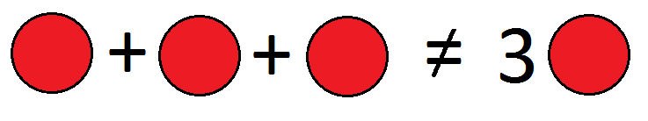
Binding Energy
An atomic nucleus has less mass than its constituent parts
1u = 1.661 x 10⁻²⁷ kg
m_{p}= 1.673 x 10⁻²⁷ kg
m_{n}= 1.675 x 10⁻²⁷ kg

Slide 6
Binding Energy
If we consider the inverse:
We are forming a nucleus from separate nucleons, potential energy decreases, and so we…
Release Energy!
(Because energy is released, the mass decreases!)
?
(released!)

Slide 7
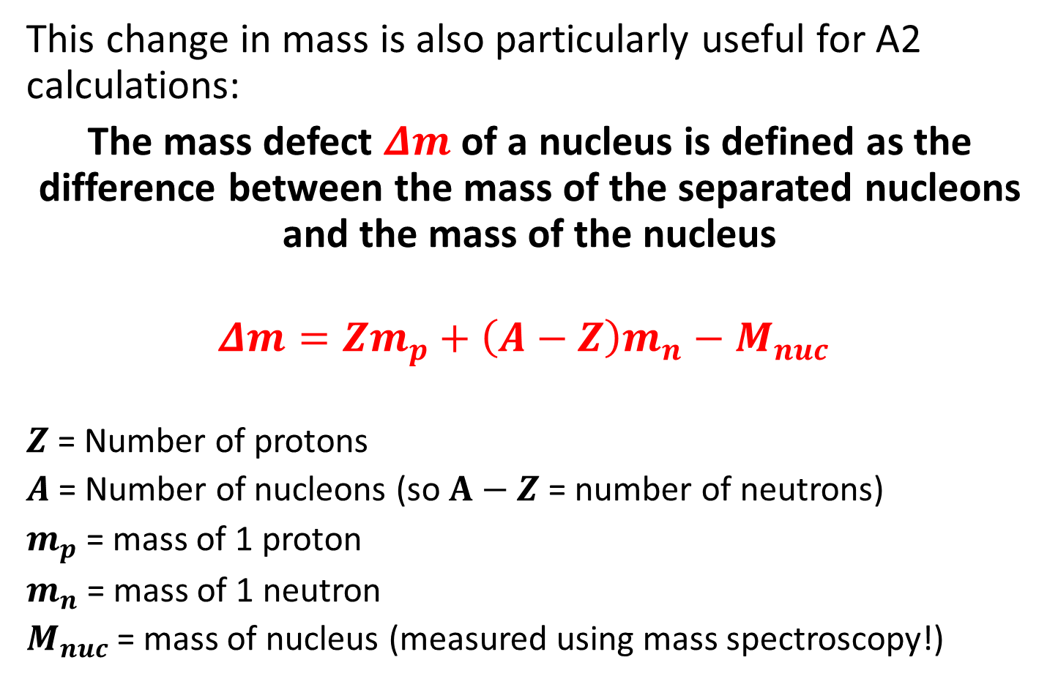
Mass defect
This change in mass is also particularly useful for A2 calculations:
The mass defect $Δm$ of a nucleus is defined as the difference between the mass of the separated nucleons and the mass of the nucleus
$$Δm=Zm_{p}+\left(A−Z\right)m_{n}−M_{nuc}$$
$Z$ = Number of protons
$A$= Number of nucleons (so $A−Z$ = number of neutrons)
$m_{p}$ = mass of 1 proton
$m_{n}$ = mass of 1 neutron
$M_{nuc}$ = mass of nucleus (measured using mass spectroscopy!)

Slide 8

Mass defect
Because we release this Energy when we form a nucleus:
The Binding energy of a nucleus (energy released when it forms, and also the energy required to pull each nucleon apart) is equal to:
$$Binding Energy=Δmc^{2}$$
(released!)

Slide 9
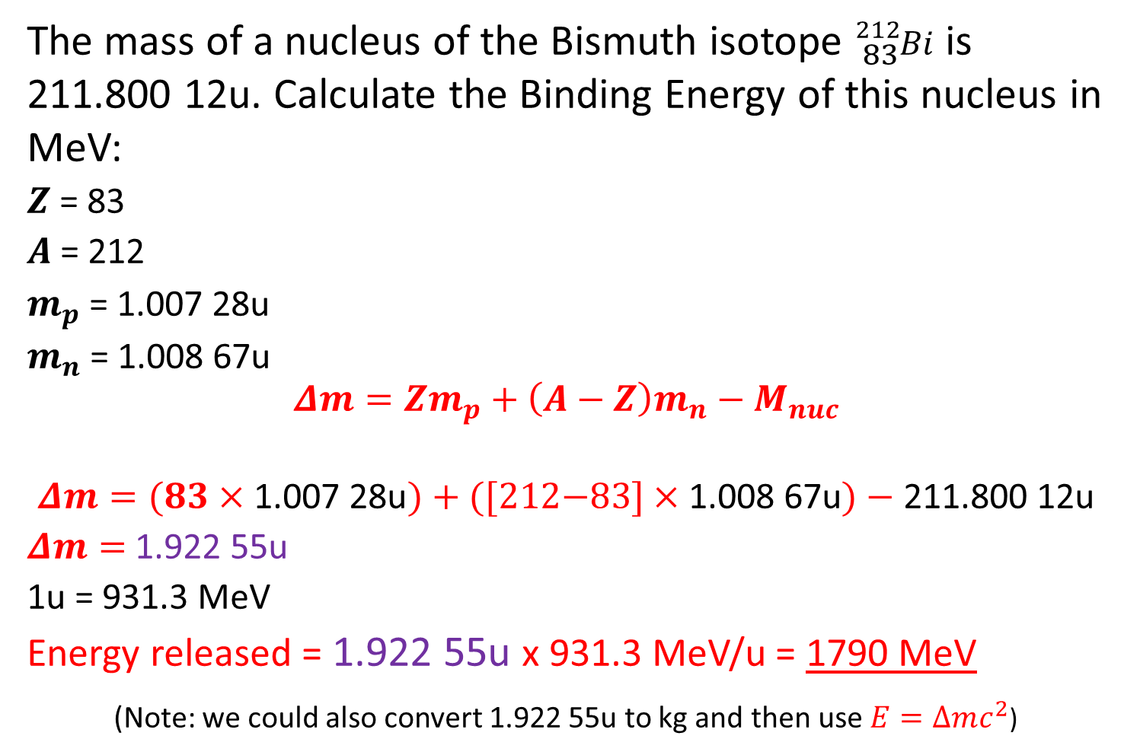
Question 3
The mass of a nucleus of the Bismuth isotope ${}_{83}^{212}{Bi}$ is 211.800 12u. Calculate the Binding Energy of this nucleus in MeV:
$Z$ = 83
$A$ = 212
$m_{p}$ = 1.007 28u
$m_{n}$ = 1.008 67u
  $$Δm=Zm_{p}+\left(A−Z\right)m_{n}−M_{nuc}$$
  $$Δm=(83×\text{1.007 28}\text{u})+\text{([212−83}]×\text{1.008 67}\text{u})−\text{211.800 12}\text{u}$$
  $Δm=$ 1.922 55u
  1u = 931.3 MeV
  Energy released = 1.922 55u x 931.3 MeV/u = 1790 MeV
  (Note: we could also convert 1.922 55u to kg and then use $E=∆mc^{2}$)

Slide 10
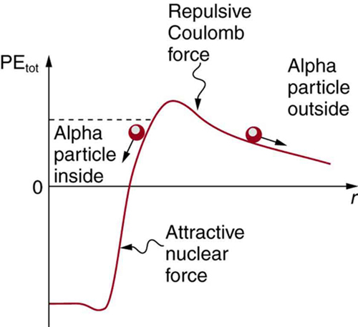
Quantum Tunnelling
Imagine we begin to remove an Alpha particle from a nucleus (from left to right)
It’s potential energy increases as we fight the Strong Force attraction, until it no longer affects our particle (~3fm)
The repulsive Electrostatic Force then repels us away from the nucleus
This point is represented by the top of the “hill”

Slide 11
Quantum Tunnelling
During Polonium-212 alpha decay, the alpha particle might have 8.78 MeV of KE
However it would need 26 MeV to overcome the barrier (due to Strong Force attraction) in the diagram
However, we still observe the decay due to Quantum tunnelling:
There is a small probability that it will “Tunnel” through to the other side
No energy is lost or gained, as it has the same total Potential Energy!
Tunnelling probability depends on the strength of the two Forces and the width of the “barrier” -you will not be tested on this at A2 though!

Slide 12
Summary
The binding energy is the same as the work that would be needed to be done to separate the nucleus into its constituent parts
Einstein’s formula E=mc² can be used to calculate the mass deficit in particles according to the energy changes that occur
The binding energy per nucleon of an isotope is a measure of it’s relative stability

