Slide 1
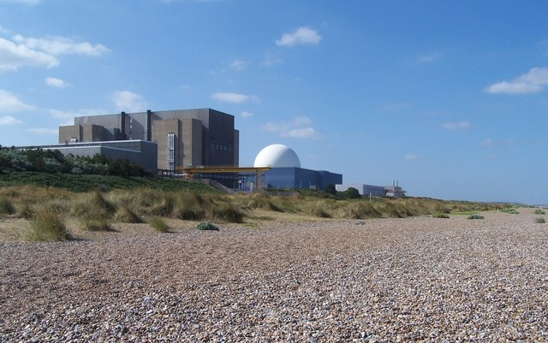
The Thermal nuclear reactor
Just fifteen operational plants across seven sites
Fourteen are AGR’s (Advanced Gas Cooled Reactors) and one is a PWR (Pressurised Water Reactor)
How many reactors are there in the United Kingdom?

Slide 2
The thermal nuclear reactor
Key points:
Uranium²³⁵ is used as it is fissile (2-3%) together with non-fissile U²³⁸
Thermal energy is removed by either hot gases or liquids and run through a heat exchanger to make steam to run a turbine
Fuel rods are housed inside a reactor core that is steel lined and reinforced with concrete to contain radiation
Control rods are vertically implanted into the core and adjusted continuously by computer to keep the rate of fission constant. They are neutron absorbers (Boron)
A moderator is a chemical that slows down the neutrons to kinetic energies that are equivalent to high temperatures (hence the name Thermal Reactor)

Slide 3
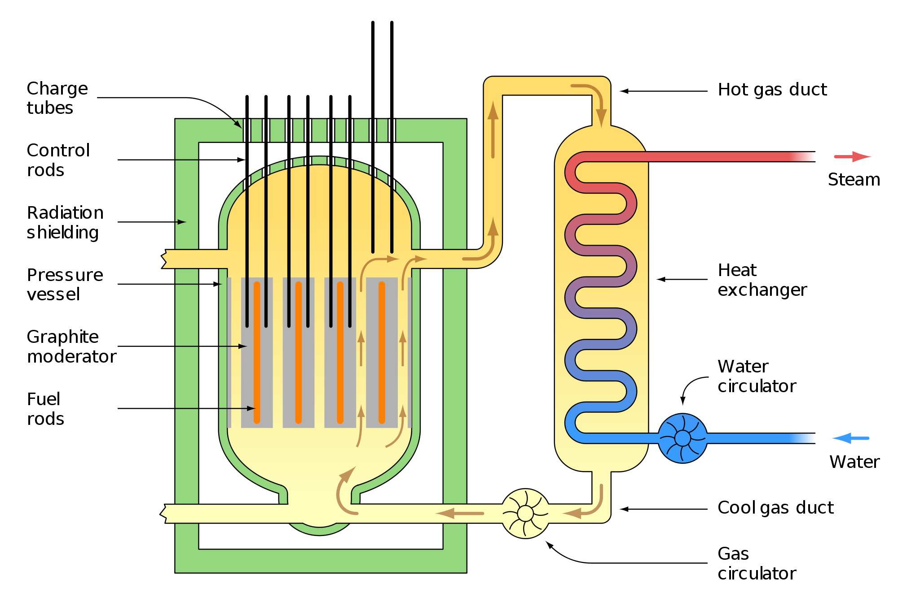

Slide 4
Choice of materials
The controls rods must be made from a robust material that can absorb neutrons and will not produce further reaction in doing so.
  Graphite is used in fission plants and this is what determines the life expectancy of the nuclear plant, when the graphite degrades the plant must close
Moderators must collide elastically with the neutrons and slow them down. This means choosing a relatively small molecule; water is often used

Slide 5
Safety
The United Kingdom has an excellent track record on safety in the nuclear industry
Reactor design was created with safety in mind and with fail safe built in
Reactors are enclosed in steel and concrete several metres thick to keep radiation contained
The fuel rods are fitted and removed by remote robotic systems

Slide 6
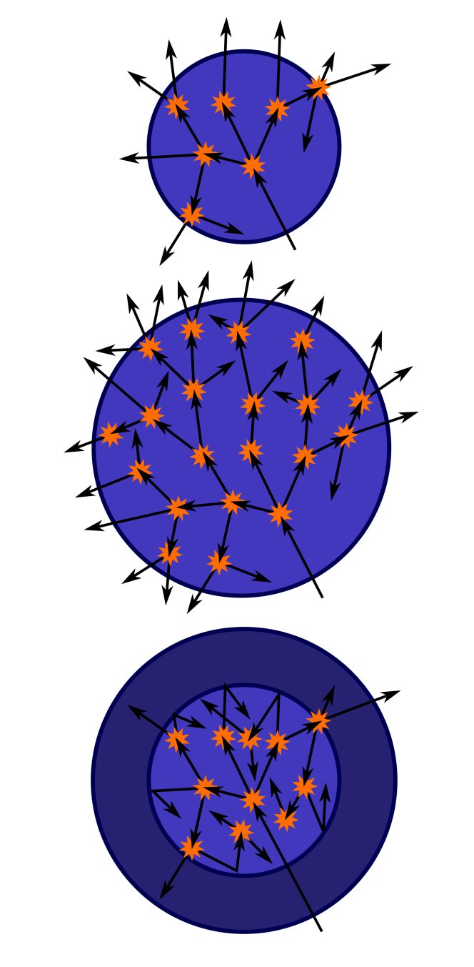
Critical Mass
For sufficient neutrons from the fission reaction to go on to create further reactions then you need a certain mass of material
This is because some neutrons are absorbed by other atoms present and some escape from the material
The minimum mass needed is called the critical mass

Slide 7
Nuclear Waste
Nuclear waste is put into three main categories:
High level – Spent fuel rods and any other fissile products or objects that have come into contact with fissile products
Intermediate level – Low activity materials and containers
Low level – Anything that has been within the vicinity of the reactor, usually not radioactive at all e.g. clothing, gloves and other laboratory equipment

Slide 8
Waste storage and management
Category | Example | Storage
Low | Clothing / Equipment | In drums in trenches
Intermediate | Low activity waste / materials | In drums within concrete reinforced buildings
High | U²³⁵ and Pu²³⁹ and any long-lived highly active fission products | Sealing in deep trenches in Sellafield in Cumbria; prevention of contamination is paramount. Some fission remnants are recovered and re-used at THORP reprocessing plant

Slide 9
Summary
The United Kingdom has fifteen nuclear reactors
The main constituents are fuel, control rods, a moderator and a fluid to take away the heat from the reaction
Safety is paramount in the nuclear industry in both design and operation
Waste is split into three main types and stored according to their hazards

