Slide 1
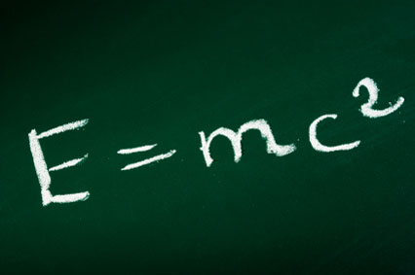
Energy from the Nucleus

Slide 2
Energy-mass equivalence
In 1905, Einstein published the special theory of relativity
The mathematics of the full theory is complex, but the ideas that came out of it were revolutionary:
  Time slows down for an observer moving at a faster speed
  The observed mass of an object increases with speed, as well increasing with total energy
  Measured lengths decrease as an observer’s speed increases

Slide 3
Energy-mass equivalence
The one we study in this module is:
  The observed mass of an object increases with total energy
What familiar law determines the increase in mass?
E = mc² !

Slide 4
Question 1
Calculate the minimum energies of the photons produced by the annihilation of a proton and antiproton:
E = mc² = (1.67 x 10⁻²⁷ ) x (3.0 x 10⁸)²
= 1.50 x 10⁻¹⁰ J
The minimum energies occur when the pair of particles have initially insignificant kinetic energy.
rest energy of a proton = 1.50 x 10⁻¹⁰ J
rest energy of an antiproton also = 1.50 x 10⁻¹⁰ J
Total mass converted into electromagnetic radiation in the form of two photons = 3.0 x 10⁻¹⁰ J
Therefore each photon has an energy of 1.50 x 10⁻¹⁰ J

Slide 5
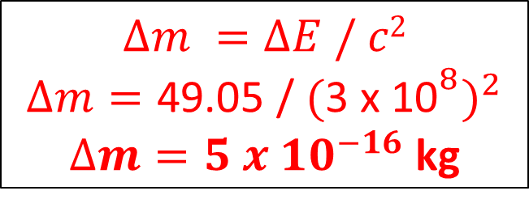
Energy-mass equivalence
“E=mc²” tells us about how much energy we produce when antimatter and matter annihilate.
It also tells us how much mass increases by when we add energy to a system…
Imagine raising a 5kg bowling ball 1m off the ground:
Energy increase = GPE
= m x g x h
= 5 x 9.81 x 1
= 49.05 J
$$∆m =∆E / c2$$
$$∆m=\text{49.05 /} {{\text{(}\text{3 }\text{x}\text{ 10}}^{8})}^{2}$$
$∆m=5 x {10}^{−16}$ kg

Slide 6
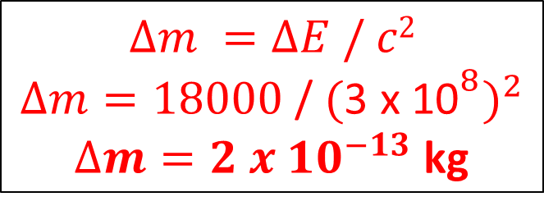
Energy-mass equivalence
It’s a crazy thought, but adding any type of energy actually increases the mass of an object (as you can see though, it is usually a very small and insignificant amount).
Similarly, removing energy decreases the mass of an object.
Imagine a sealed torch emitting 5W of light for an hour:
Energy decrease = P x t
= 5 x 60 x 60
= 18000 J
$$∆m =∆E / c2$$
$$∆m=\text{18000}\text{ /} {{\text{(}\text{3 }\text{x}\text{ 10}}^{8})}^{2}$$
$∆m=2 x {10}^{−13}$ kg

Slide 7
Atomic mass unit “u”
The atomic mass unit is defined as the mass of each nucleon in a Carbon-12 nucleus (basically the measured mass of the nucleus, divided by 12!)
1u = 1.661 x 10⁻²⁷ kg
What is the rest energy of 1u in MeV?
E = mc² = (1.661 x 10⁻²⁷ ) x (3.0 x 10⁸)²
= 1.49 x 10⁻¹⁰ J
1.49 x 10⁻¹⁰ / (10⁶ x 1.6 x 10⁻¹⁹)(convert to eV)
= 931.3MeV

Slide 8
Atomic mass unit “u”
You’ll notice that the mass of each nucleon in Carbon 12 weighs LESS than a proton or neutron individually!!
1u = 1.661 x 10⁻²⁷ kg
m_{p}= 1.673 x 10⁻²⁷ kg
m_{n}= 1.675 x 10⁻²⁷ kg
Where does this difference in mass come from?
It arises due to something called “Binding Energy”, which we will come on to talk about very soon!

Slide 9
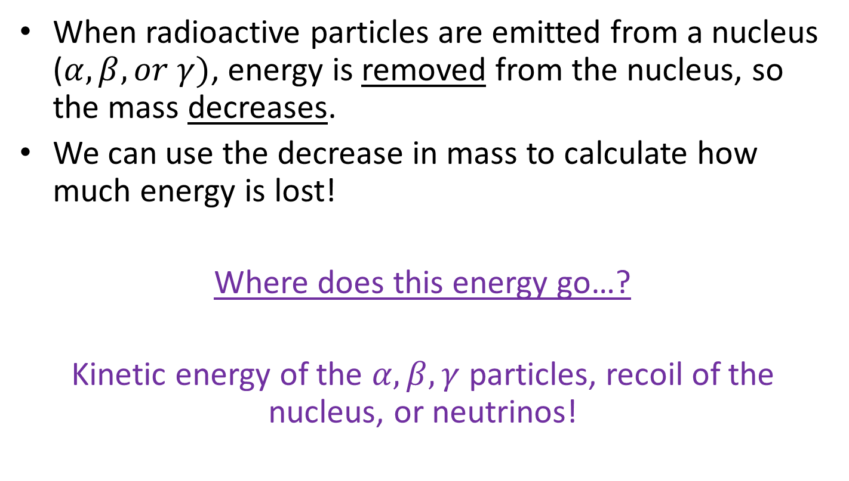
Released energy
When radioactive particles are emitted from a nucleus ($α, β, or γ)$, energy is removed from the nucleus, so the mass decreases.
We can use the decrease in mass to calculate how much energy is lost!
Where does this energy go…?
Kinetic energy of the $α, β, γ$ particles, recoil of the nucleus, or neutrinos!

Slide 10
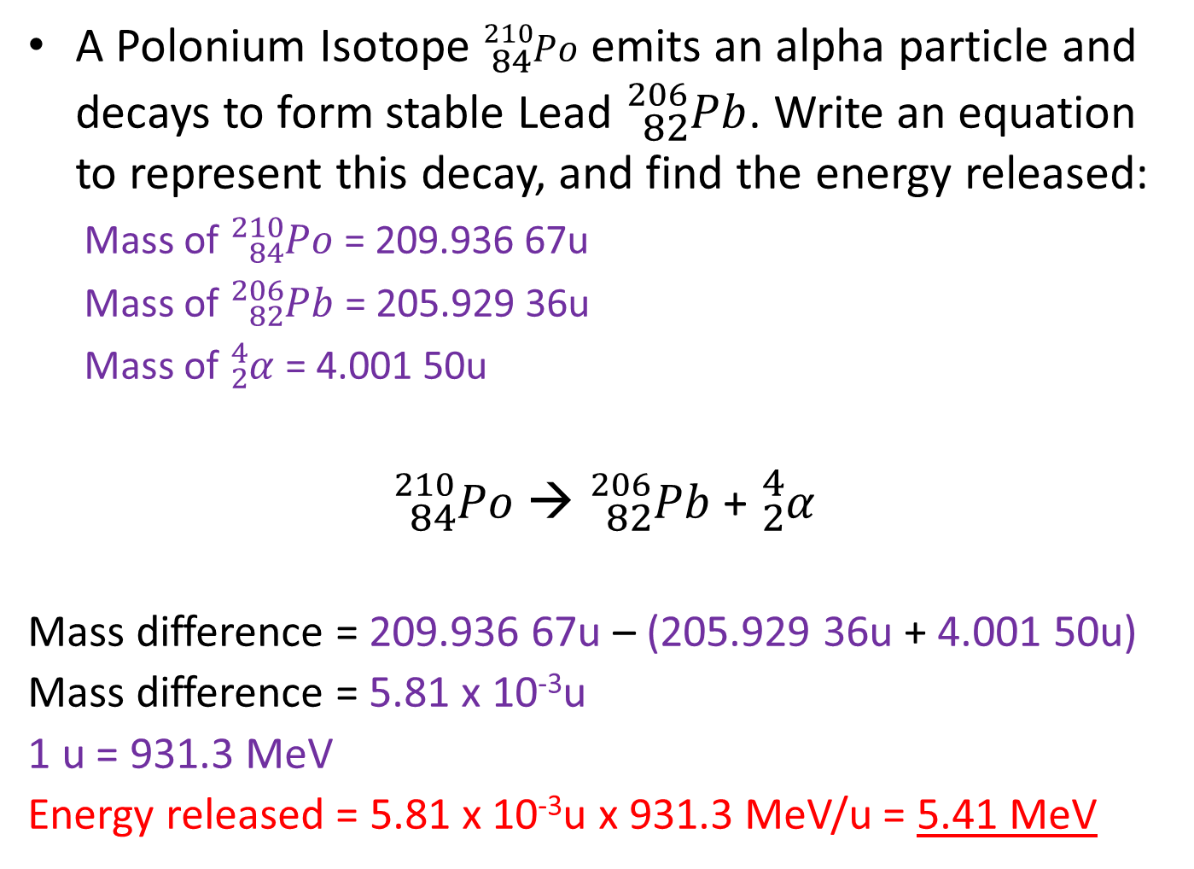
Question 2
A Polonium Isotope ${}_{84}^{210}{Po}$ emits an alpha particle and decays to form stable Lead ${}_{82}^{206}{Pb}$. Write an equation to represent this decay, and find the energy released:
  Mass of ${}_{84}^{210}{Po}$ = 209.936 67u
  Mass of ${}_{82}^{206}{Pb}$ = 205.929 36u
  Mass of ${}_{2}^{4}α$ = 4.001 50u
${}_{84}^{210}{Po}$ → ${}_{82}^{206}{Pb}$ + ${}_{2}^{4}α$
  Mass difference = 209.936 67u – (205.929 36u + 4.001 50u)
  Mass difference = 5.81 x 10⁻³u
  1 u = 931.3 MeV
  Energy released = 5.81 x 10⁻³u x 931.3 MeV/u = 5.41 MeV

Slide 11
Strong Force- Variation with distance
force
electrostatic force
attract repel
distance from centre / femtometres
1
3
strong force

Slide 12
The Strong Force
The Strong Force acts an attractive force between nucleons at distances of less than 3fm, and repulsive at distances less than 0.5fm
The electrostatic repulsion between protons at 10⁻¹⁵m is about 200N, so the Strong Force needs to be at least 200N
If we wanted to remove a nucleon from the nucleus, the work done to overcome the Strong Force attraction and reach 3fm would be roughly:
Work done = Force x Distance
Work done = 200N x 2.5 x 10⁻¹⁵m
Work done = 5 x 10⁻¹³J or 3.1 MeV

Slide 13
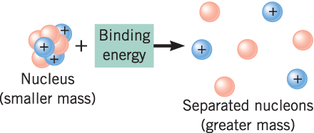
Binding Energy
Binding energy is defined as:
The Binding energy of a nucleus is the amount of work that must be done to separate a nucleus into its constituent parts.
(As we’ve added energy, the mass of the nucleons increases!)

Slide 14
Binding Energy
If we consider the inverse:
We are forming a nucleus from separate nucleons, potential energy decreases, and so we…
Release Energy!
(Because energy is released, the mass decreases!)
?
(released!)

Slide 15
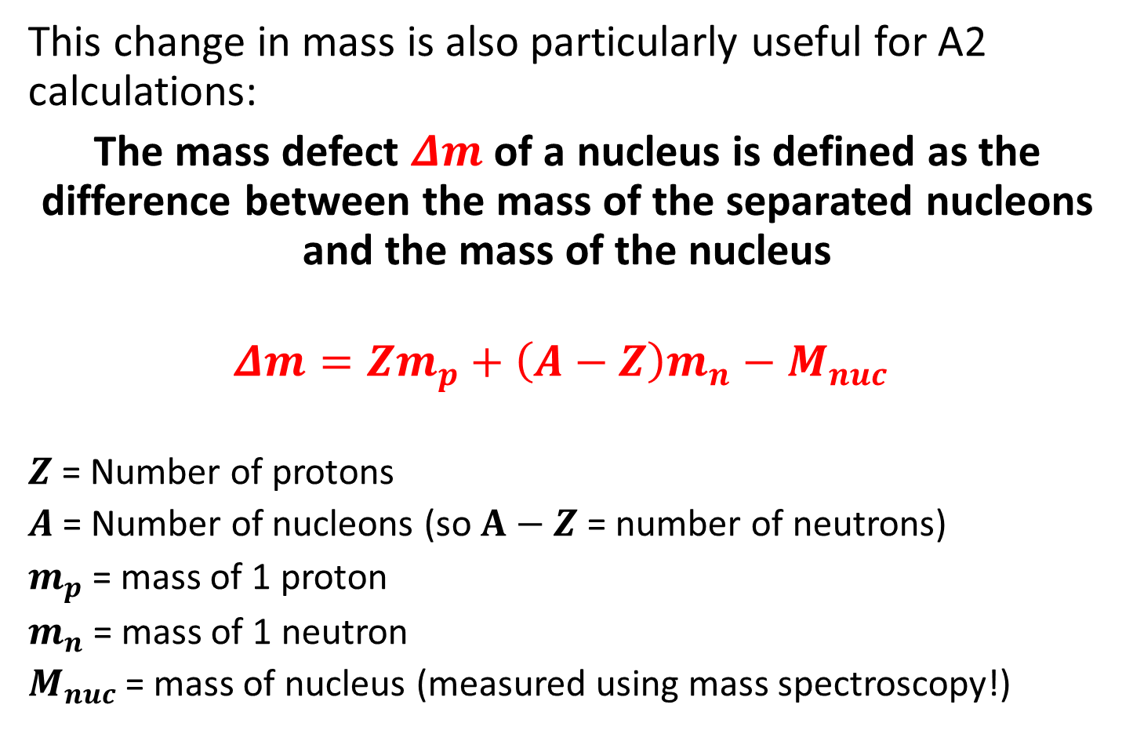
Mass defect
This change in mass is also particularly useful for A2 calculations:
The mass defect $Δm$ of a nucleus is defined as the difference between the mass of the separated nucleons and the mass of the nucleus
$$Δm=Zm_{p}+\left(A−Z\right)m_{n}−M_{nuc}$$
$Z$ = Number of protons
$A$= Number of nucleons (so $A−Z$ = number of neutrons)
$m_{p}$ = mass of 1 proton
$m_{n}$ = mass of 1 neutron
$M_{nuc}$ = mass of nucleus (measured using mass spectroscopy!)

Slide 16

Mass defect
Because we release this Energy when we form a nucleus:
The Binding energy of a nucleus (energy released when it forms, and also the energy required to pull each nucleon apart) is equal to:
$$Binding Energy=Δmc^{2}$$
(released!)

Slide 17
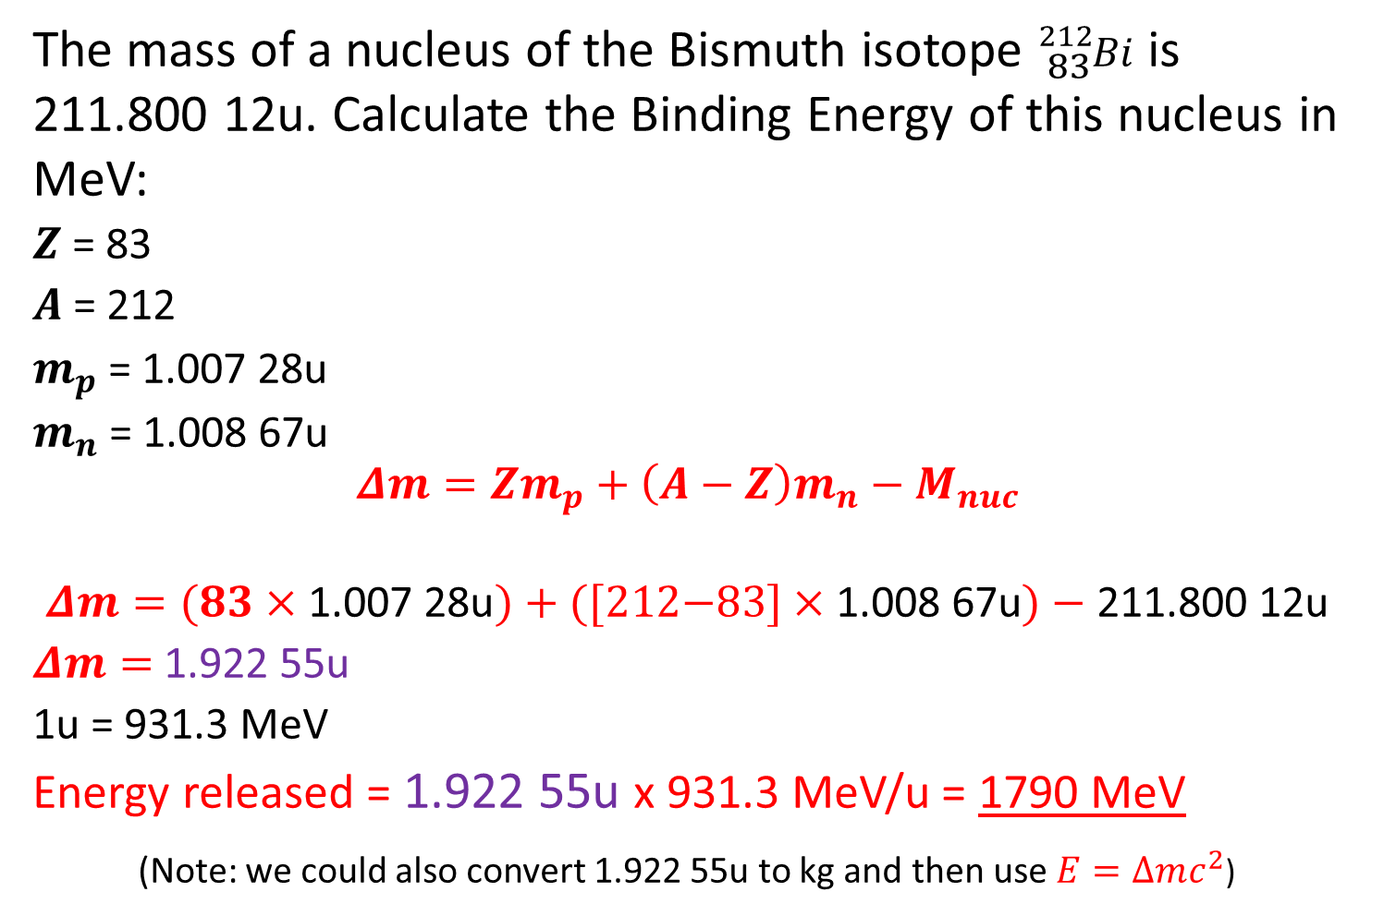
Question 3
The mass of a nucleus of the Bismuth isotope ${}_{83}^{212}{Bi}$ is 211.800 12u. Calculate the Binding Energy of this nucleus in MeV:
$Z$ = 83
$A$ = 212
$m_{p}$ = 1.007 28u
$m_{n}$ = 1.008 67u
  $$Δm=Zm_{p}+\left(A−Z\right)m_{n}−M_{nuc}$$
  $$Δm=(83×\text{1.007 28}\text{u})+\text{([212−83}]×\text{1.008 67}\text{u})−\text{211.800 12}\text{u}$$
  $Δm=$ 1.922 55u
  1u = 931.3 MeV
  Energy released = 1.922 55u x 931.3 MeV/u = 1790 MeV
  (Note: we could also convert 1.922 55u to kg and then use $E=∆mc^{2}$)

Slide 18
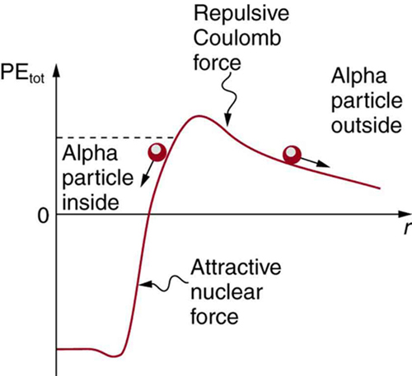
Quantum Tunnelling
Imagine we begin to remove an Alpha particle from a nucleus (from left to right)
It’s potential energy increases as we fight the Strong Force attraction, until it no longer affects our particle (~3fm)
The repulsive Electrostatic Force then repels us away from the nucleus
This point is represented by the top of the “hill”

Slide 19
Quantum Tunnelling
During Polonium-212 alpha decay, the alpha particle might have 8.78 MeV of KE
However it would need 26 MeV to overcome the barrier (due to Strong Force attraction) in the diagram
However, we still observe the decay due to Quantum tunnelling:
There is a small probability that it will “Tunnel” through to the other side
No energy is lost or gained, as it has the same total Potential Energy!
Tunnelling probability depends on the strength of the two Forces and the width of the “barrier” -you will not be tested on this at A2 though!

Slide 20
Nuclear stability
The more nucleons we add to a nucleus, the more energy we release, and the more mass defect we lose.
However, we can also look at the binding energy per nucleon.
For example, forming Uranium-235 from individual protons and neutrons will release more binding energy overall (6.5 MeV x 235 nucleons = 1528MeV) than forming Iron-56 (8.5MeV x 56 nucleons = 476 MeV).
However, Iron-56 is a more tightly-bound nucleus, and has more binding energy per nucleon (8.5MeV > 6.5 MeV).
As we add more nucleons to Iron, the total increase in binding energy each time gets lower and lower).

Slide 21
Nuclear stability
This makes sense- the strong force has a short range and so stays at pretty similar values, but the electrostatic repulsion has a larger range and so increases in strength.
Therefore there is less potential energy when adding new nucleons to large nuclei.
If you want to do further reading on the theory behind the topic, the mathematical solution to this is called the “Semi-Empirical Mass Formula”- interesting additional reading that might help your understanding!)

Slide 22
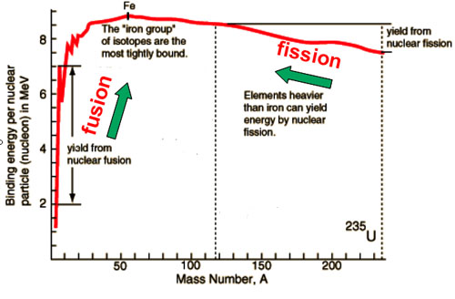
Binding energy per nucleon vs. Mass Number

Slide 23
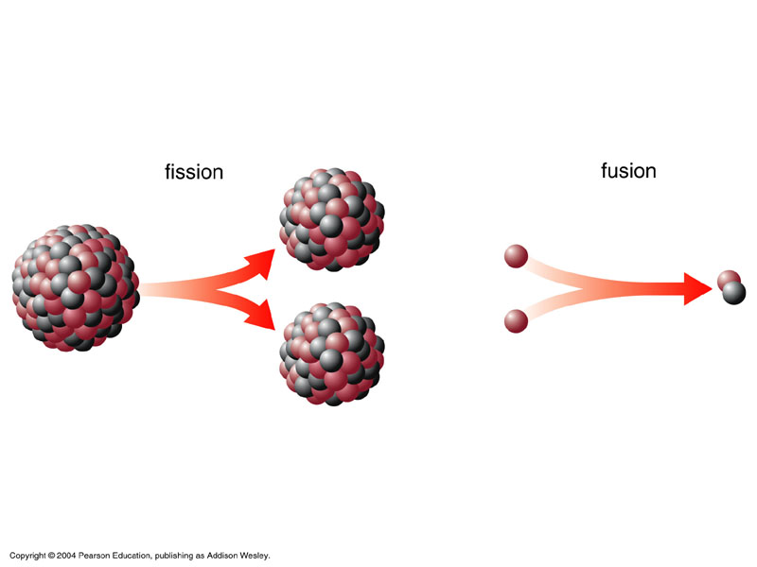
Nuclear Fission and Fusion
Fission
Fusion

Slide 24
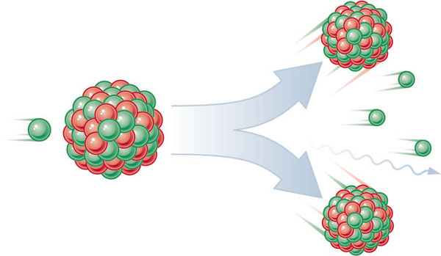
Induced Nuclear Fission
In 1938, Hahn and Strassman discovered that we could force a Uranium-235 atom to split into two fragments, releasing further neutrons (and energy!) in the process

Slide 25
Induced Nuclear Fission
Uranium-235 absorbs one neutron…
It then fragments, into Krypton-89 and Barium-144
What else is produced?
Use your periodic tables to write the equation:
http://hyperphysics.phy-astr.gsu.edu/hbase/nucene/u235chn.html
Phet animation

Slide 26
Induced Nuclear Fission
There are two fissionable substances in common use in nuclear reactors: Uranium-235 and Plutonium-239.
Fission is the splitting of an atomic nucleus.
For fission to occur, Uranium-235 or Plutonium-239 must first absorb a neutron.
The nucleus undergoing fission splits into two smaller nuclei, and this releases two or three neutrons plus a lot of energy.
The neutrons may then go on to hit other atomic nuclei, causing a chain reaction.

Slide 27
Chain Reactions
Daughter Nuclei
Neutron
Parent Nuclei

Slide 28
Chain Reactions
Each fission event releases 2 extra neutrons, so after n generations, we have 2^{n} neutrons
How long would it take for fission of 6 x 10²³ atoms?
$$2n =6×{10}^{23}$$
$$\log_{2}{(6×{10}^{23}})≈79 generations$$
It takes no more than a fraction of a second to reach this number, and each fission event releases 200MeV of energy- how much energy would fission of 235g of Uranium-235 give off?
$E=6×{10}^{23}×200×1.6×{10}^{−19}×{10}^{6}=1.92×{10}^{13}$J
This is about a million times more energy than the same amount of fossil fuel!
For fission to occur, Uranium-235 or Plutonium-239 must first absorb a neutron.
The nucleus undergoing fission splits into two smaller nuclei, and this releases two or three neutrons plus a lot of energy.
The neutrons may then go on to hit other atomic nuclei, causing a chain reaction.

Slide 29
Choose appropriate words to fill in the gaps below:
Nuclear fission is the _________ up of the nucleus of an atom into two smaller nuclei. Energy, neutrons and _________ radiation are also emitted.
Nuclear ________ use Uranium _____ or Plutonium _____to produce energy by nuclear ________. A controlled chain reaction is maintained by the use of _______ rods which absorb some of the _________ produced.
An _______ bomb is the consequence of an uncontrolled chain reaction.
splitting
gamma
reactors
235
239
fission
control
neutrons
atomic
WORD SELECTION:
reactors
gamma
atomic
splitting
239
neutrons
235
fission
control
Notes:
29

Slide 30
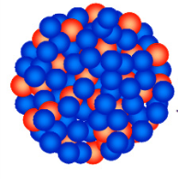
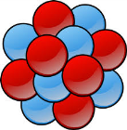
Why does Fission release energy?
Uranium-235 Krypton-90
More binding energy in total (1528 MeV)
Less binding Energy per nucleon (6.5MeV/nucleon)
Less mass difference when nucleons combine
Higher mass per nucleon
Less binding energy in total (720 MeV)
More binding energy per nucleon (8MeV/nucleon)
Higher mass difference when nucleons combine
Lower mass per nucleon
This decrease in mass per nucleon from Uranium to
Krypton (and other fragments) releases the energy!

Slide 31
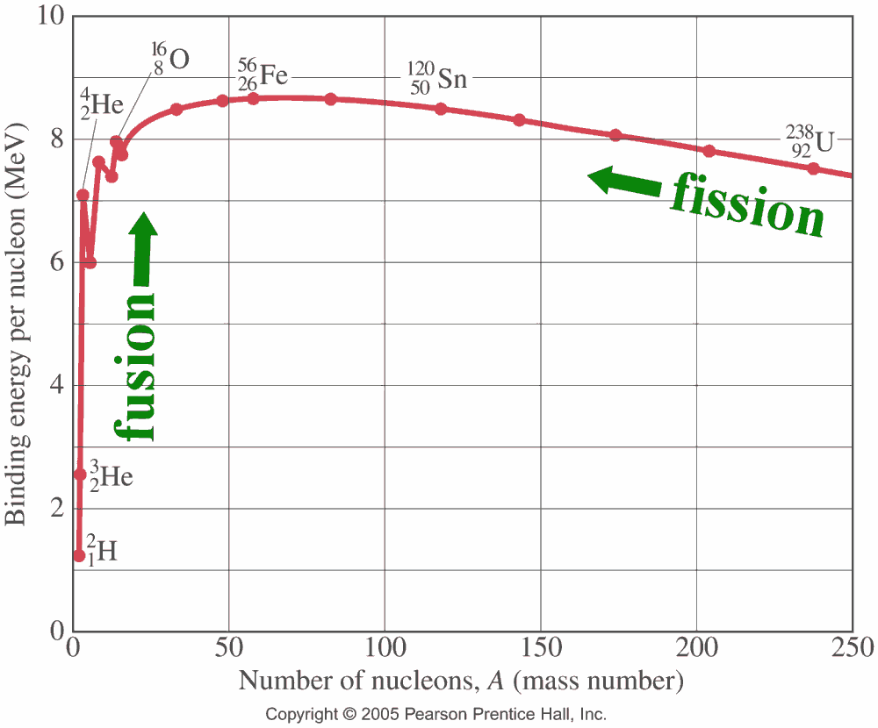
Massively important key statement (!)
Increasing the binding energy per nucleon decreases the mass of each nucleon, therefore releasing energy through E=mc².

Slide 32
Energy from Nuclear Fission
We can write a nuclear fission equation in the following way:
$${}_{92}^{235}U+{}_{0}^{1}n→{}_{56}^{144}{Ba}+{}_{36}^{90}{Kr}+2{}_{0}^{1}n+Q$$
$Q$ = Energy released
The mass difference would be equal to:
$$∆m=M_{U−235}−M_{Ba−144}−M_{Kr−90}−m_{n}$$
The relationship between $Q$ and $∆m$ is:
$$Q=∆mc^{2}$$

Slide 33
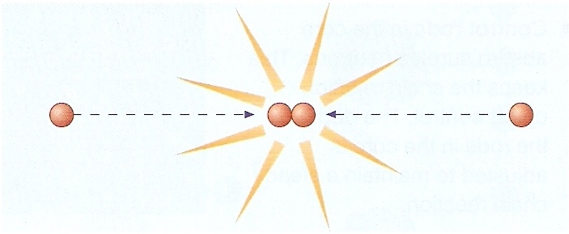
Nuclear Fusion
Nuclear fusion is the joining of two atomic nuclei to form a larger one

Slide 34

Energy from Fusion
Nuclear fusion is the process by which energy is released in the Sun and other stars.
The Sun’s core is around 27,000,000K
Even at this temperature, using the Maxwell-Boltzmann distribution and classical Physics, there’s a 10⁻¹⁵¹ probability of two nuclei having enough energy to fuse together!!
This is clearly not enough to sustain
  a fusion reaction- how is it that the
  Sun has such a high power output?
Quantum tunnelling allows nuclei to
  fuse at lower energies! (We wouldn’t
  be here if it didn’t happen)!

Slide 35
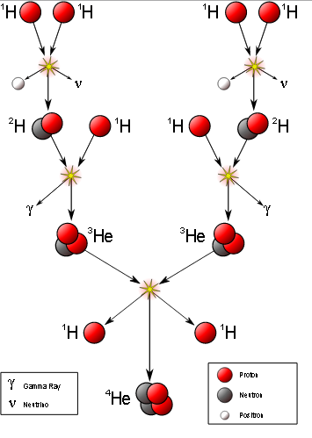
p-p chains
There are several ways that Hydrogen can fuse into Helium (and indeed, other elements, inside the Sun!)
The following is called a “p-p” (proton-proton) chain interaction
Try to write an equation for each step!

Slide 36
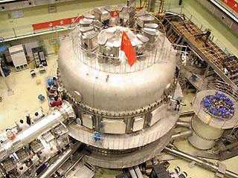
Nuclear Fusion reactors
Scientists are currently working to make nuclear fusion reactors.
The fuel for fusion reactors is the isotope hydrogen-2 (deuterium) which is found in sea water.
The only by-product is Helium, which is harmless and in our atmosphere anyway!
An experimental fusion reactor in Seattle USA

Slide 37
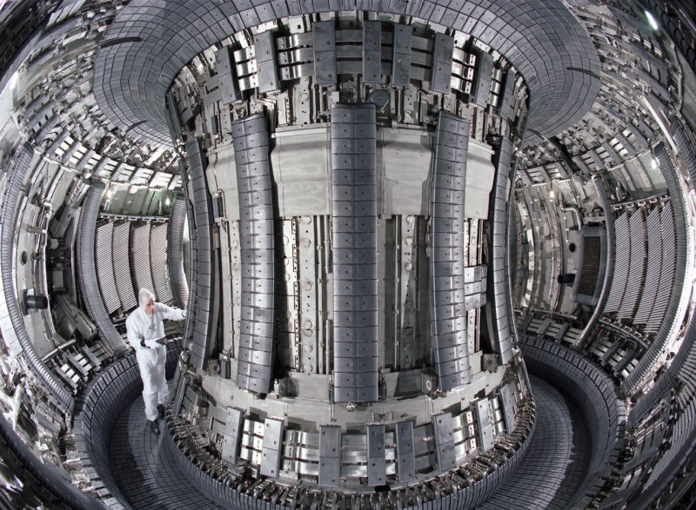
Nuclear Fusion reactors
The plasma of Deuterium is contained within a strong magnetic field
This prevents it from touching the side (and losing energy/melting anything it comes into contact with…!

Slide 38
Why does Fusion release energy?
Increasing the binding energy per nucleon decreases the mass of each nucleon, therefore releasing energy through E=mc².

Slide 39
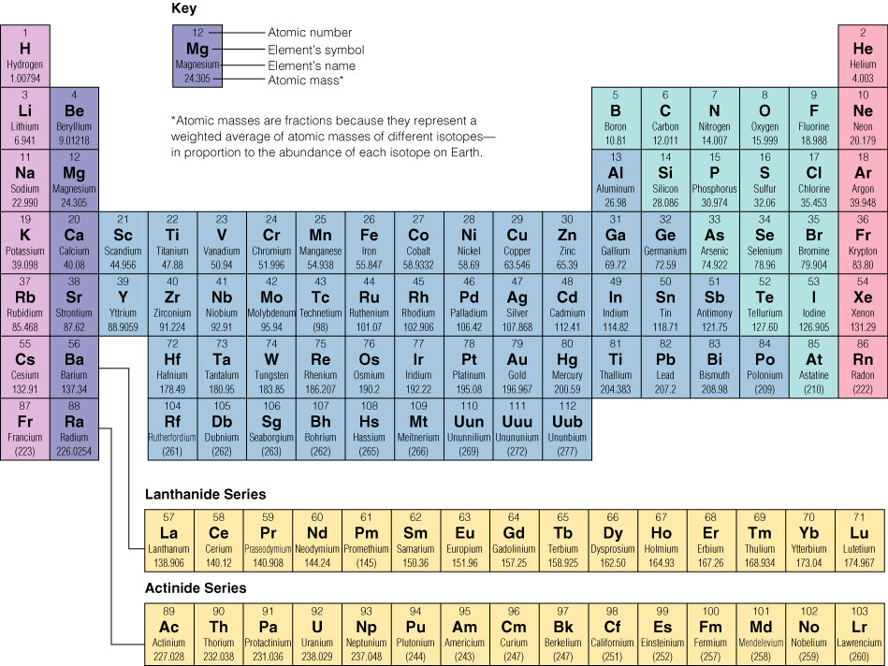
Where do the elements on Earth come from?
After the Big Bang, the Universe was 75% Hydrogen and 25% Helium (very simple arrangements of protons/neutrons!)
Light elements (up to Iron) can be fused inside stars
Heavier elements (eg. Gold, Uranium) are formed using the energy during the massive explosions when a large star “goes supernova”

Slide 40
Nuclear Reactors and Safety Considerations
Produce an A3 poster of a diagram of a reactor, including labelled parts, and descriptions of what each part does
Produce a separate leaflet describing:
  The safety features of the reactor
  How different types of waste are handled and disposed of safely

