Slide 1
Nuclear Decay
And Detection

Slide 2
Aims
Decay Routes
Measuring Radiation
Activity and Decay

Slide 3
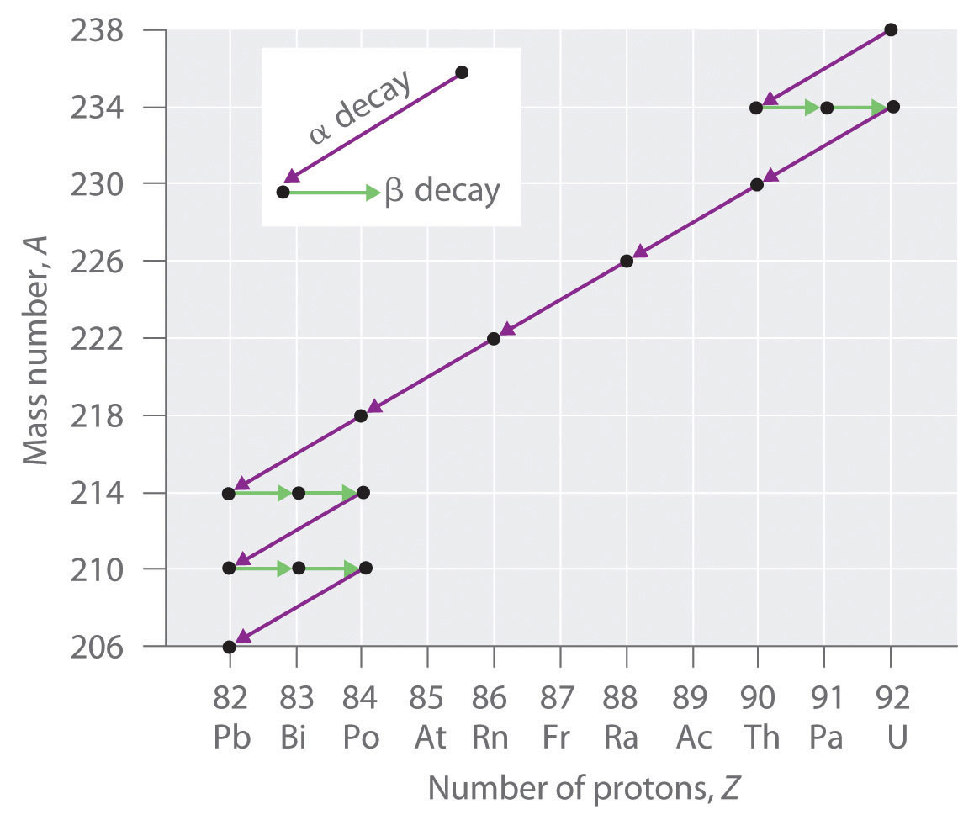
Nuclear Decay Routes

Slide 4
Film Badge Dosimeter

Slide 5
Measuring Radiation
Film Badge Dosimeter
The film holder usually contains a number of filters that attenuate radiation, such that radiation types and energies can be differentiated by their effect when the film is developed.
The filters are metal, usually lead, aluminium, and copper. To monitor beta particle emission, the filters use various densities of plastic or even label material. It is typical for a single badge to contain a series of filters of different thicknesses and of different materials; the precise choice may be determined by the environment to be monitored. The use of several different materials allows an estimation of the energy/wavelength of the incident radiation.
Filters are usually placed on both the back and front of the holder, to ensure operation regardless of orientation.

Slide 6
Cloud Chamber

Slide 7
Cloud Chamber
https://www.youtube.com/watch?v=noP7HT-Uins

Slide 8
Geiger Muller Tube

Slide 9
Scintillation Counter

Slide 10
Activity and Decay
Radioactivity and radioactive emission are very random in nature (induced fission is different to a point!)
A good model to use in the study of radioactive decay is to statistically determine the probabilities that decay will happen and call it activity
Activity is the number of emissions per second
$\frac{∆N}{∆t}=−λN$
Number of nuclei decaying per second = decay constant x number of nuclei
Activity is $A=λN$

Slide 11
Question
What is the unit of activity?
Becquerel (Bq)

Slide 12
Solution to Activity
$\frac{∆N}{∆t}=−λN$
$N=N_{0}e^{−λt}$

Slide 13
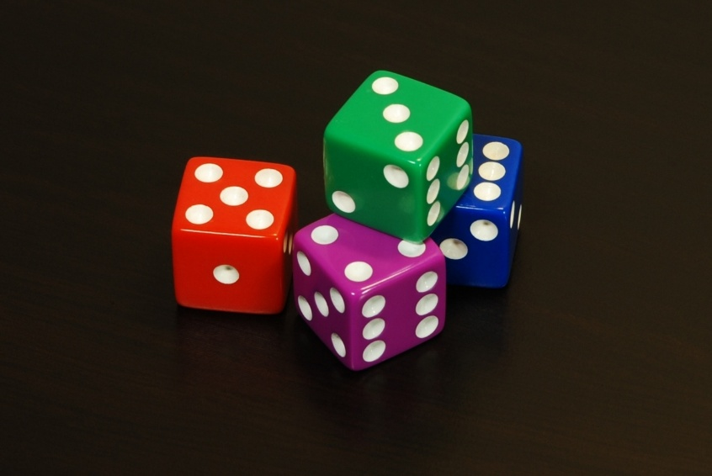
$$T_{\frac{1}{2}}$$
Half Life is the statistical ‘life-time’ of an unstable radioactive source
It is more specifically: the amount of time it takes to reduce something by half

Slide 14
Half Life from Activity
$N=N_{0}e^{−λt}$
$T_{\frac{1}{2}}=\frac{\ln{2}}{λ}$

